Slide 1
Note 4 Assembly Programming (x86)
Reading: https://en.wikibooks.org/wiki/X86_Assembly
Sections:
x86 Basics
x86 Instruction Set
Syntaxes and Assemblers
Useful reference: x86 cheat sheet
CSC 2210 Procedural and Object-Oriented C++
Copyright © 2023-24 Robert W. Hasker

Slide 2
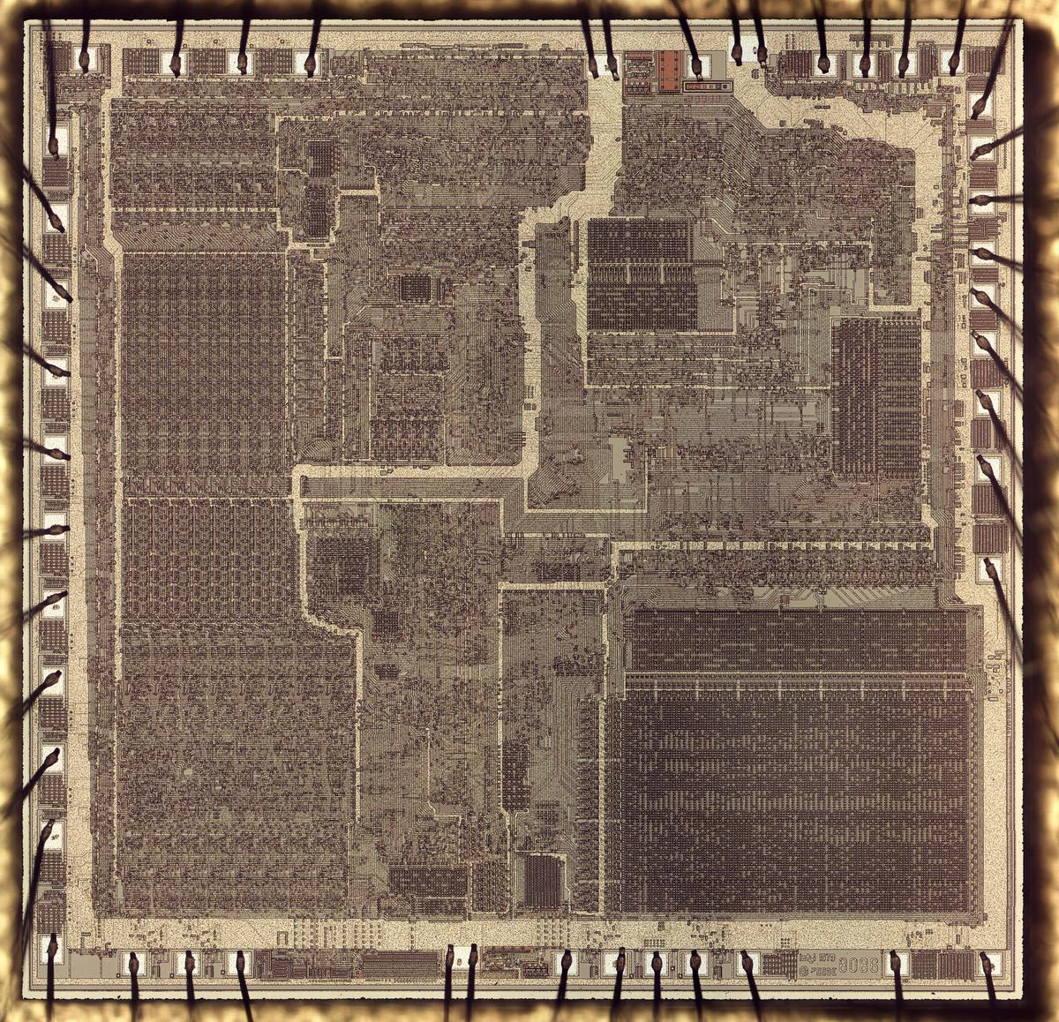
The Intel 8086 Processor
We are looking at the 8086 because it is supported by the school laptops.
Released in 1978, could be considered the model T of microprocessors
relatively simple but got the job done, produced in large quantities
A full computer on a single chip
Image from http://www.righto.com/2020/06/a-look-at-die-of-8086-processor.html

Slide 3
8086 Structure
Note what a register is: a box of bits, connected to the ALU and Control circuits
16 bits, 29,000 transistors
Could address up to 1 MiB – that is, 20-bit addresses
Floating point math done on a separate processor, the 8087
Registers:
AX, BX, CX, DX: general purpose
AX = AH/AL, BX = BH/BL, etc.
SP: stack pointer
BP: stack base pointer
Used for current function
SI, DI: source/destination index
Used for array operations
Complex registers because didn’t have a lot of transistors to work with!!
A definition of a register by ChatGPT (2024):
In assembly language, a register is a small, fast storage location within the CPU (Central Processing Unit) that is used to quickly store and retrieve data. Registers are an essential part of the processor architecture and play a crucial role in executing instructions.
And don’t ask your grandparents about the joys of accessing all of memory!
SS: stack segment register, CS: code segment, DS: data segment, ES: extra segment
Had to add these to AX/BX/etc. to get effective addresses…
Notes:
Image from http://www.righto.com/2020/06/a-look-at-die-of-8086-processor.html
Definition of a register in terms a child would understand:
lright, imagine a register in assembly language is like a tiny notebook that a computer uses to write down and keep track of important information. Just like you might use a notebook to remember your homework or to-do list, a computer uses registers to remember and store small pieces of information that it needs to do its job.
In the computer world, these registers are super fast and can hold small amounts of data, like numbers or special instructions. They help the computer do calculations, remember where things are stored, and keep track of what it's supposed to do next.
So, think of a register as a little helper in the computer's brain, jotting down important notes and helping it carry out tasks quickly and efficiently.

Slide 4
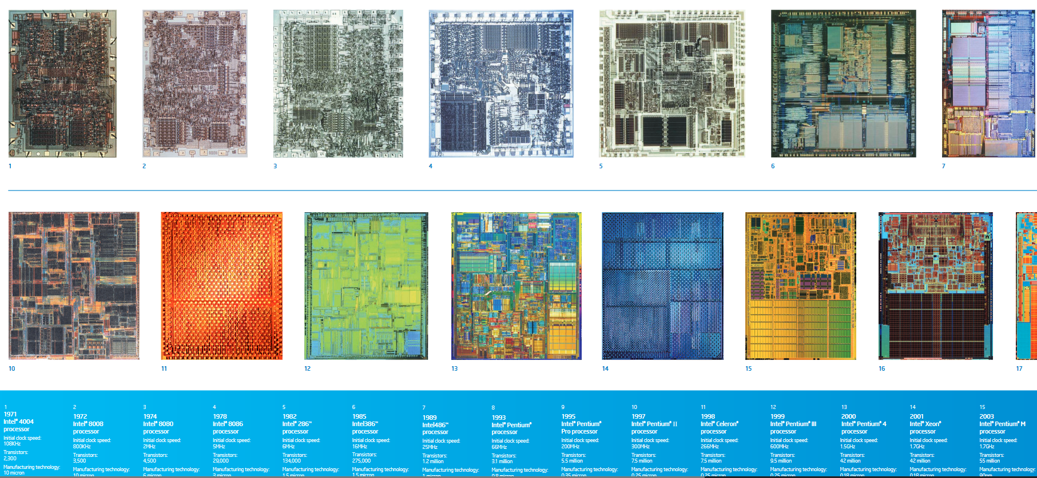
A partial Intel timeline (w/ jumps in word size)
32-bit registers:
EAX, EBX, ECX, EDX
“E” means “extended”
EAX extends AX, EBX extends BX, etc.
ESP, EBP: extended stack, stack base registers
ESI, EDI: array processing
64-bit architecture:
RAX, RBX, RCX, RDX: 64-bit extension of EAX, etc.
Also have new, general purpose registers: R8-R15
8086 in 1978
16 bits, 29k trans.
80386 in 1985
32 bits, 275k trans.
Core 2 Duo in 2006
64 bits, 209m trans.
7000 times as many transistors in 38 years!
Notes:
From https://www.intel.com/content/www/us/en/history/history-intel-chips-timeline-poster.html
“trans.” is short for transistors

Slide 5
Some first assembly code
We will use the online assembler at https://www.onlinegdb.com/online_gcc_assembler
Our apologies for the advertisements!
This uses GAS – the GNU Assembly
It’s used by g++ on Windows
A first program:
main: entry point – corresponds to main in C++
xor %eax, %eax: sets register EAX to 0 – why?
ret: return to the operating system
Setting %eax follows the Intel convention for returning function results
▶ Run this (upper left corner)

Slide 6
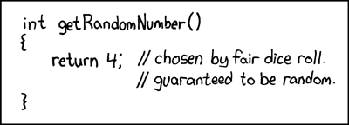
Doing something
Implement the code to the right
mov $4, %eax
mov: copy data
“move” is “traditional”…
%: signals register
$: signals an immediate value – the value is stored in the instruction
General form of instruction:
name source_value, destination
Native Intel assembler: this is written as mov eax, 4 (destination first, no symbols for register or number)
Add 38 to this because we know 42 is the answer: add $38, %eax

Slide 7
Doing something
Change to Debug mode
Set breakpoint at ret
Click start
rax not displayed!
Change code to compute result in %rbx (but don’t store in rax)
Run again, note result is random!
Set %rax to be same as %rbx
Add neg %ebx, note the bits show 2s-complement

Slide 8
More experimentation
See the online binary calculator
Use and, or, xor, not with 01101100 (0x6C) and 01110101 (0x75)
C/C++/Java operators: &, |, ^, ~
These are known as bitwise operators
Example (in C/C++): unsigned int result = 0x6c & 0x75;
What is the truth table for xor?
The xor instruction takes just 2 bytes, mov $0, %eax needs 5
Smaller is faster!
Signed multiplication: imul
If one argument, always multiplying by %eax
The low order bits always written to %eax, the high order bits to %edx
This allows capturing all of the bits in the result
More typical way:
Challenge:
If a is in %rax,
compute a² + 7a – 3 into %rax
without modifying other registers
Will need push, pop
push %rdx
pop %rcx
mov $5, %ebx
mov $6, %ecx
imul %ecx, %ebx # result in %ebx, not %eax/%edx
Notes:
Just “mul” is unsigned multiplication
Note: onlinegdb does not allow push/pop of 32-bit registers – a bug? – so push %rax will result in a build error
ADD: discussion on setting, clearing specific bits using AND, OR

Slide 9
Reviewing the rest of the code
.data: data segment – currently empty, but a place to put constants and computed results
.text: code segment
This name likely comes from it being the text of the program in the same way that the lyrics are the words (text) of a song
.global: signals this code can be used from other mdules
main: a label indicating the start of a routine
In this case, it is the program entry point
ret: return instruction; return to the caller
Here: return to the C run time, often known as crt0

Slide 10
Another example
Suppose %rax, %rbx, %rcx, and %rdx contain the populations of four cities; set %rdx to the total population and %rcx to the (truncated) average
Step one: compute the sum
What would be pseudocode for each instruction in the sequence?
Step two: compute the average
Challenge: Using div, idiv is challenging because there are lots of rules
See https://en.wikibooks.org/wiki/X86_Assembly/Arithmetic
Simple solution for divide by four: shift bits to the right
Example: if %rdx is 183 or 0b10110111, a right shift by one gives 0b01011011 or 91, by two gives 0b00101101 or 45.

Slide 11
Adding assembly code to C/C++ programs
WHY?
Machine control that’s not possible at a high level; eg, communicate with floating point processor
Improved speed for complex operations: example, comparing strings 8 bytes at a time
Method 1: just write the full program in assembly
Lots of detail, very labor intensive
Input and output becomes especially tedious
Alternative: use the __asm__ keyword
This encapsulates assembly code and executes it like regular statements
See samples/simp_asm_fun_call.cpp
We will typically write our assembly code using onlinegdb
No installation
Simple debugging
Works fine for small pieces

Slide 12
A note on sizes and instructions
Many x86 instructions work on multiple types of data
Example: the 32-bit mov instruction can move a byte, a word, a long (32), or a quadword (64 bits)
These are written as movb, movw, movl, movq
Example: movl $5, %eax
But note %eax is 32 bits, so can assume we want to set all 32!
Similar suffixes can be appended to add, imul, xor, and, etc.
GAS uses the register size to determine how much data to “move”
Other assemblers require you to always specify
This was an ill-fated attempt to add types to assembly code
In most cases, this is redundant information – violating “write once”
You will often see this size information in "disassembled" code

Slide 13
Review
A brief history of the Intel (x86) family
x86 registers (8 bit through 64 bit)
16-bit: ax (ah/al), bx (bh/bl), cx (ch/cl), dx (dh/dl), sp, bp
32-bit: eax, ebx, ecx, edx, esp, ebp
64-bit: rax, rbx, rcx, rdx, rsp, rbp
64-bit adds r8, r9, … r15
Basic math: add, neg, imul, etc.
Basic bitwise operations: and, or, xor, not, shr, shl
Straight-line assembly programs
Next: loopy labels

