Slide 1
Note 1 SE 2040: Other Languages
SE2040 Software Development III
Dr. Rob Hasker
Copyright © 2016 Robert W. Hasker

Slide 2
Key notes from the syllabus
~1 wk on Ruby, 7-8 weeks on C++, remainder on C
Late policy: 5% up to 3 days late, 15% 4-7 days late, 100% >1wk late
Not completing labs: evidence of not attending, can lead to being dropped
Assignments: individual unless stated otherwise
See standards document
Common mistake: leaving hard tabs in files – creates grading problems
Use Eclipse for C++
Hand-written notes win, especially in a class like this
Practice your handwriting, scan notes to stay organized

Slide 3
Other languages
What languages have you used on internships?
Languages I’ve used:
How many languages do you think there are?
Paid to write code in |  | Taught or experimented with
Ada | Fortran | Awk | ML
Assembly | Lisp | Caml | Modula-2
C | Pascal | F# | Prolog
C++, C# | Python | Java | Scheme
Cobol | Ruby
csh | SQL

Slide 4
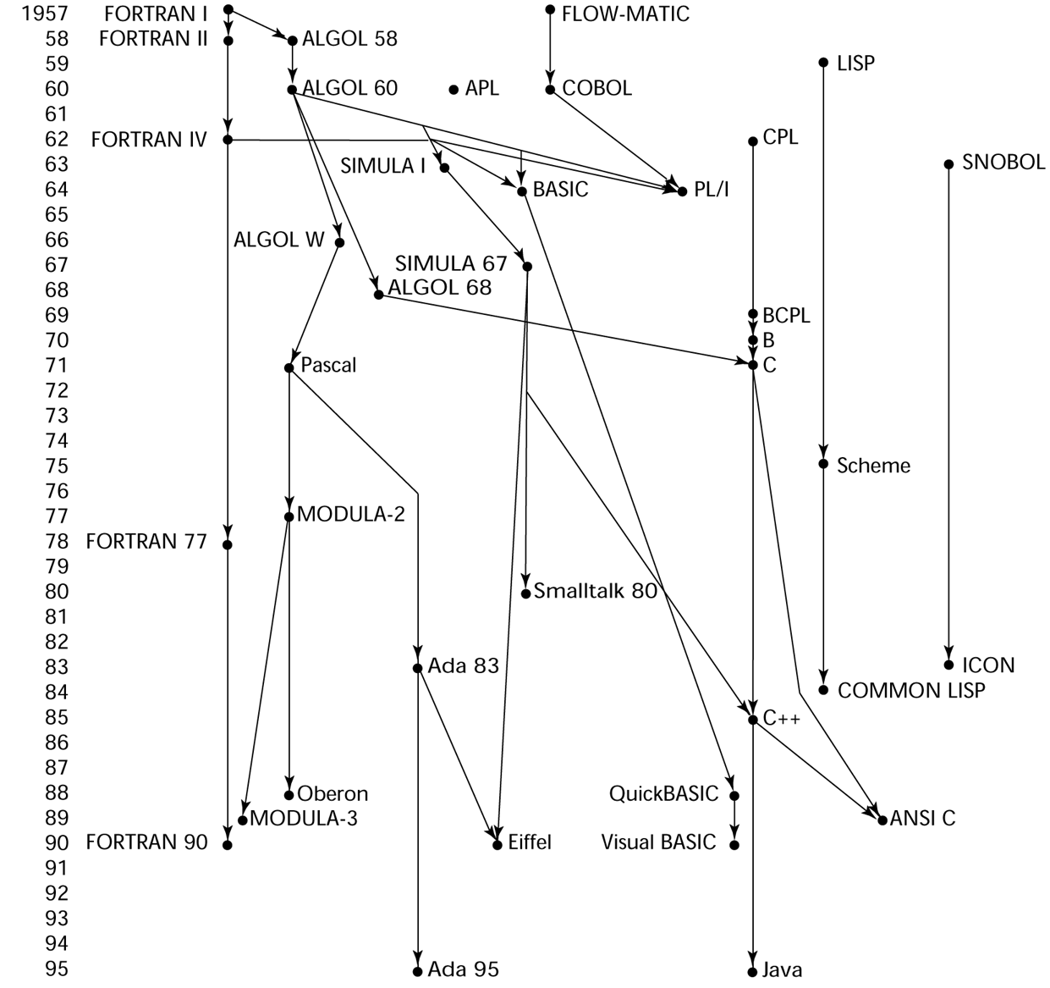
Genealogy of Common Languages
See here for a
history up to the
present

Slide 5
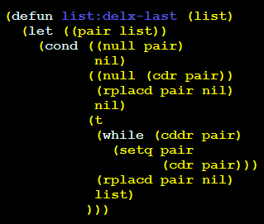
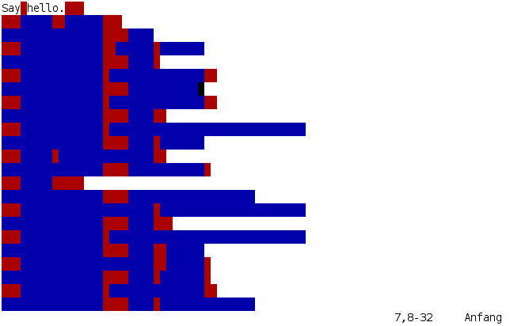
Odd languages
APL:
Whitespace
xkcd.com/224/

Slide 6
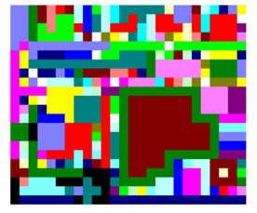
Odd languages
Shakespeare
The Infamous Hello World Program.
Romeo, a young man with a remarkable patience.
Juliet, a likewise young woman of remarkable grace.
Ophelia, a remarkable woman much in dispute with Hamlet.
Hamlet, the flatterer of Andersen Insulting A/S.
Act I: Hamlet's insults and flattery.
Scene I: The insulting of Romeo.
[Enter Hamlet and Romeo]
Hamlet:
You lying stupid fatherless big smelly half-witted coward!
You are as stupid as the difference between a handsome rich brave
hero and thyself! Speak your mind!
You are as brave as the sum of your fat little stuffed misused dusty
old rotten codpiece and a beautiful fair warm peaceful sunny summer's
day. You are as healthy as the difference between the sum of the
sweetest reddest rose and my father and yourself! Speak your mind!
You are as cowardly as the sum of yourself and the difference
between a big mighty proud kingdom and a horse. Speak your mind.
Speak your mind!
[Exit Romeo]
Piet
Notes:
Shakespear: hello world written as a play with scenes.

Slide 7
Informal goals for this course
Introduce some new languages
Discuss other ways to think about programming
Learn how to learn new languages
See syllabus for more detail
Starting point: Ruby

Slide 8
Ruby
Wide-spectrum language:
supports manipulating files/performing OS operations (similar to bash)
simple, powerful tools to process file contents (awk, sed)
great support for network-based communications
sockets, remote procedure calls, servers)
GUI support

Slide 9
Ruby
Draws from
procedural programming is simple: C, Pascal
elements of scripting languages such as Awk, Perl, Python (os support, built-in regular expressions and file processing, associative arrays)
strong support for OO: everything is an object
support for "anonymous functions": Lisp, Scheme
A simple way to get started: Ruby in Twenty Minutes
Running Ruby on computer:
command: irb - "Interactive Ruby"

Slide 10
Why cover Ruby?
Lots of interesting features, very flexible
Used heavily in some domains: web development, testing frameworks
Will appear in SE 3800 (Process II)
A chance to think about how to learn new languages
Watch for…
Syntax: what are the rules? What’s good? What’s unfamiliar?
Types: how different? How similar to other languages?
What is distinctive about the language?
Are there techniques I can use with other languages?

