Slide 1
CS 2400: Introduction to Artificial Intelligence
Note 1: Introduction

Slide 2
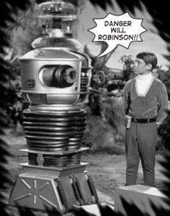
Where to start?
Name systems which use artificial intelligence
Key question: What is AI?
Related: what is intelligence?
Notes:
non-human intelligent behavior: is it intelligent when a cat walks right in front of you on your way to the kitchen?
Open question: is use of tools by a crow reasoned or just accident?
… write the examples of AI systems on the board
Definition of anthropomorphism: The American Heritage® Dictionary of the English Language, 5th Edition.

Slide 3
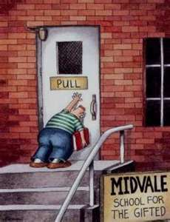
Where to start?
Name systems which use artificial intelligence
Key question: What is AI?
Intelligence: ability to acquire & apply knowledge and skills
What are examples of non-human, intelligent behavior?
What is something that is clearly not intelligent?
Is water intelligent because it seems to always find a way into houses?
What are examples of non-intelligent behavior in computers?
Why do people say things like “the computer decided to not work today”?
Anthropomorphism: attributing human motivation, characteristics, or behavior to inanimate objects, animals, or natural phenomena.
… it might be useful to have a working definition of AI
Notes:
non-human intelligent behavior: is it intelligent when a cat walks right in front of you on your way to the kitchen?
Open question: is use of tools by a crow reasoned or just accident?
… write the examples of AI systems on the board
Definition of anthropomorphism: The American Heritage® Dictionary of the English Language, 5th Edition.

Slide 4
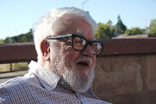
McCarthy on AI
The term "Artificial Intelligence" was first coined by Prof. John McCarthy
for a Conference on the subject held at Dartmouth in 1956
McCarthy defines the subject as
the "science and engineering of making intelligent machines, especially intelligent computer programs”
“Making intelligent machines”: building robots?
Largely motors, levers, pressure sensors, switches...
John McCarthy

Slide 5
Textbook:
synthesis: combining parts into a whole
analysis: understanding the whole by examining parts
agent: acts in an environment
What are simple agents at work in this building?
Agents are judged by their actions (or behavior!)
AI = the field that studies the synthesis and analysis of computational agents that act intelligently.
Notes:
agents at work: include flies laying eggs on discarded food, dust mites doing whatever dust mites do, thermostats, lights, fans
would a door be an agent?

Slide 6
AI = the field that studies the synthesis and analysis of computational agents that act intelligently.
computational agents: decisions are explainable by computation
Are humans computational agents?
Probably depends on religious, philosophical views!
Challenge: no examples of non-humans with comparable intelligence
Assumption: all physical agents are limited
none are omniscient, omnipotent
can only act on observation within a finite domain
all have limited time to act
Notes:
agents at work: include flies laying eggs on discarded food, dust mites doing whatever dust mites do, thermostats, lights, fans
would a door be an agent?

Slide 7
Scientific Goal of AI
Understand the principles that make intelligent behavior possible in natural or artificial systems.
This includes:
Analyzing natural, artificial agents
Constructing, evaluating hypotheses about constructing intelligent agents
Building computational systems performing tasks requiring intelligence
Engineering goal: design, construct agents that act intelligently
Question: what should a course on this cover?
Review syllabus

Slide 8
Intelligence
Review our definition:
AI = the field that studies the synthesis and analysis of computational agents that act intelligently.
Defined: synthesis, analysis, computational agent
What about intelligence?

Slide 9
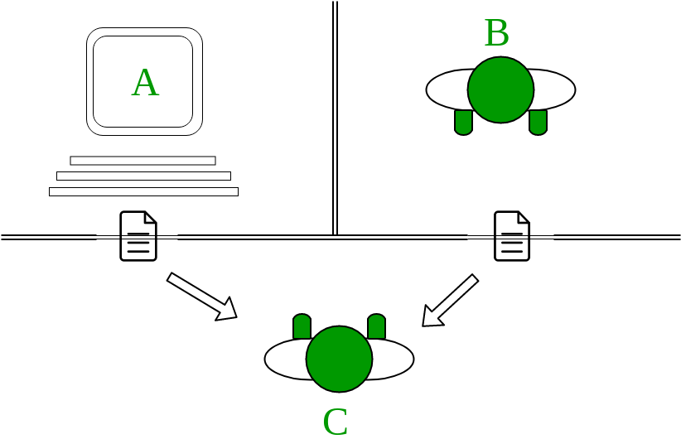
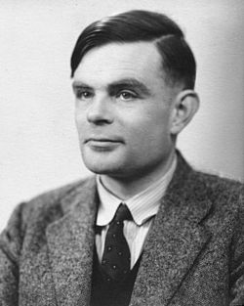
The Turing Test
Issue: how to know if machines think?
What would you ask an unknown entity to determine if it was a computer or human?
1950
https://en.wikipedia.org/wiki/Turing_test
What flaws do you see in this?
How would you make this a valid experiment?
What would qualify as “success”?
Who should be the testers?

Slide 10
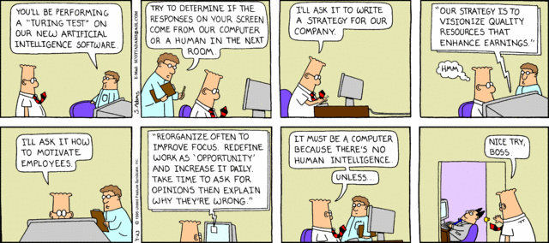
The Turing Test
Issue: how to know if machines think?
What would you ask an unknown entity to determine if it was a computer or human?
1950
What flaws do you see in this?
https://en.wikipedia.org/wiki/Turing_test

Slide 11
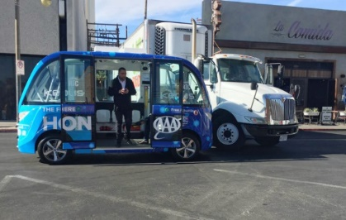
Domain-specific intelligence failures
Tesla Autopilot can be tricked into driving into oncoming traffic with stickers
https://arstechnica.com/information-technology/2019/04/researchers-trick-tesla-autopilot-into-steering-into-oncoming-traffic/
Microsoft’s Chatbot became sexist, racist
https://www.techrepublic.com/article/why-microsofts-tay-ai-bot-went-wrong/
Pokemon Go kept users out of some areas with a racial bias
https://www.usatoday.com/story/tech/news/2016/08/09/pokemon-go-racist-app-redlining-communities-color-racist-pokestops-gyms/87732734/
British police use AI to detect pornography
False positives on dune pictures
https://gizmodo.com/british-cops-want-to-use-ai-to-spot-porn-but-it-keeps-m-1821384511
Machine Translation Bias

Slide 12
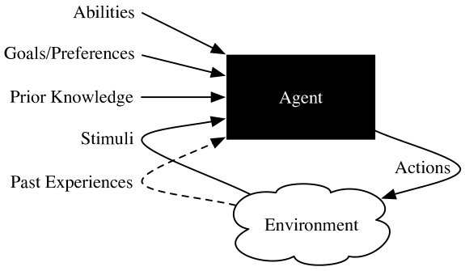
Software agents in more detail
AI = the field that studies the synthesis and analysis of computational agents that act intelligently.
Inputs:
prior knowledge
history of interaction: stimuli, past experiences
goals: what it is trying to achieve
abilities: actions agent capable of taking
Output: specific actions
Inside the box: belief state
Set of known truths, including history

Slide 13
Acting rationally: rational agent
Rational behavior: doing the right thing
The right thing: that which is expected to maximize goal achievement
given the available information
Doesn't necessarily involve thinking
– e.g., blinking reflex
but thinking should be in the service of rational action

Slide 14
Rational agents
An agent is an entity that perceives and acts
Perception: through sensors
Actions: through actuators
This course: designing rational agents
Abstractly, an agent is a function mapping percept histories to actions
[f: P* → A]
For any given class of environments and tasks, we seek the agent (or class of agents) with the best performance
Caveat: computational limitations make perfect rationality unachievable!
design best program for given machine resources
… and what is best?

Slide 15
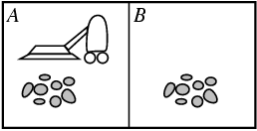
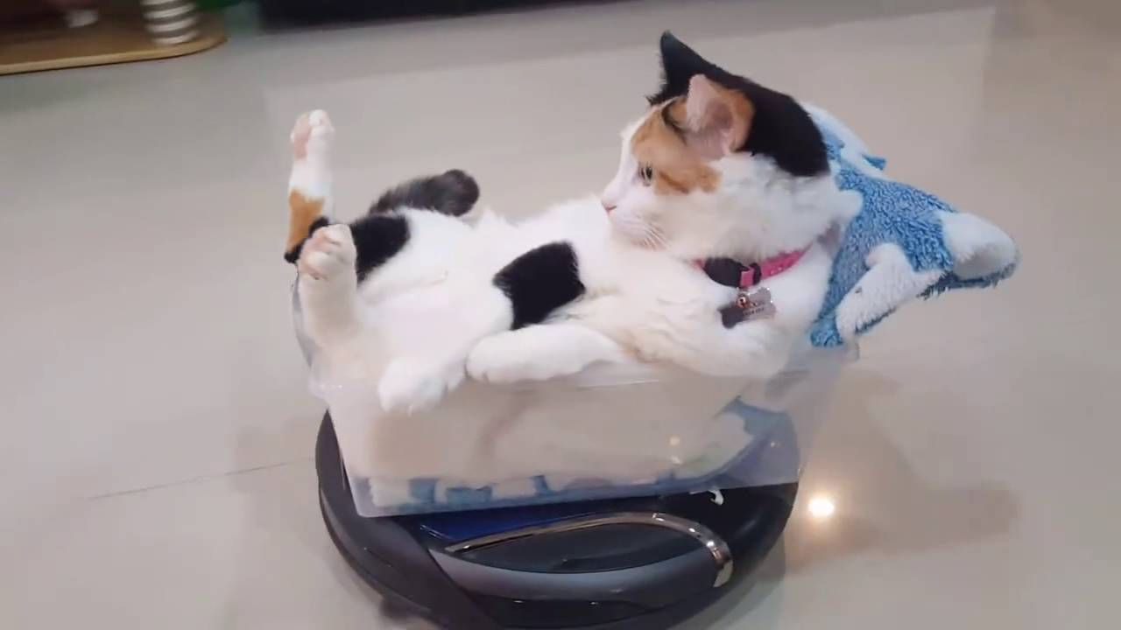
Vacuum-cleaner world – Roomba!
Percepts: location and contents, e.g., [A,Dirty]
Actions: Left, Right, Suck, NoOp

Slide 16
A vacuum-cleaner agent
Percept Sequence | Action
[A, Clean] | Right
[A, Dirty] | Suck
[B, Clean] | Left
[B, Dirty] | Suck
[A, Clean] [A, Clean] | Right
[A, Clean] [B, Dirty] | Suck
…

Slide 17
Describing, Designing Agents
Basic elements:
Environment: where the agent works
Sensors: how the agent detects the state of the environment
Actuators: how the agent affects the environment
Performance measure: evaluating progress, effectiveness
Memory device: PEAS
Performance measure, Environment, Actuators, Sensors
But the ESAP order is a better order to consider!
This week’s lab: identifying these elements

Slide 18
ESAP: “Intelligent” Light Switch
Turn on when person enters room, off when everyone has left
How do they work?
Is this a sign of intelligence?
Apply ESAP:
Environment?
Sensors?
Actuators?
Performance measure?
What might a “more intelligent” system do?
Notes:
Env: room
Sensor: motion detector
Actuator: lights turning on/off
Perf measure: times lights on when they shouldn’t be, off when they shouldn’t be

Slide 19
ESAP: Netflix
What are the goals of Netflix?
Where might the “intelligence” be said to reside?
Apply ESAP:
Environment?
Note: focus on the environment from the software’s point of view!
Sensors?
Actuators?
Performance measure?
Note: The more restricted the environment, the easier the design problem!
Notes:
Env: predicting what movies someone might want to view at a particular time
Sensor: user (with history of likes and views), likes/dislikes of other users, collection of tagged movies & shows
Actuator: suggested movies/shows to present
Performance measure: how often a user adds a suggested movie to their list or watches that movie right then
possibly better: #times user leaves netflix without watching, number of users who cancel account

Slide 20
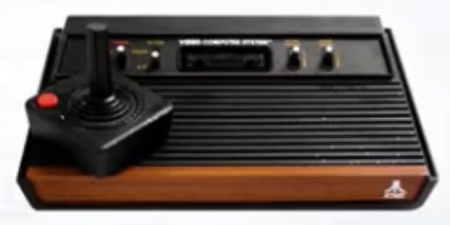
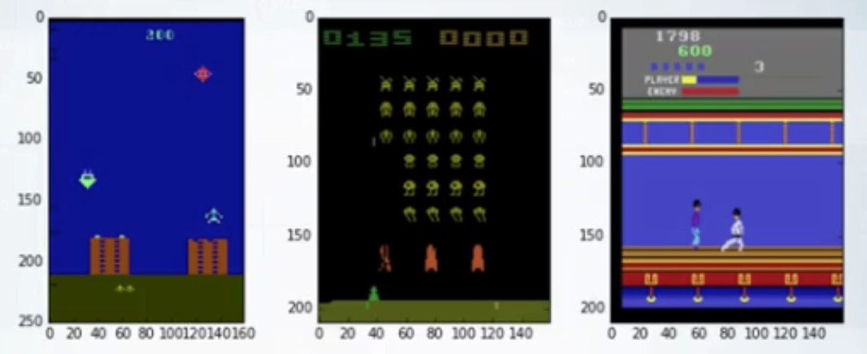
PEAS – Game play
Agent: Atari Game Player
Environment:
Sensors:
Actuators:
Performance measure:

Slide 21
Review
AI = the field that studies the synthesis and analysis of computational agents that act intelligently
Discussions about recognizing intelligence
Turing Test: necessary, but probably not sufficient
Describing computational/software agents
ESAP: Environment, Sensors, Actuators, Performance measure
Examining the intelligent agents from the point of view of the software
We aren’t electrical, mechanical engineers!

