Slide 1
CS 2400:
Introduction to Artificial Intelligence
Reading: Sections 3.1-3.5
Note 2: Search
Credit for selected slides to authors of Berkeley CS188 Introduction to Artificial Intelligence
https://inst.eecs.berkeley.edu/~cs188/sp20/

Slide 2
CHANGE NOTES TO REVIEW BFS IN book (and do BFS before DFS)
This is Fig. 3.4. Next time I'll talk through this algorithm, but I'll do it here and folks can ask more questions here or in lab.
Frontier: a set of paths; the <...> notation is another way to show a sequence (that is, a list), so <n_0,..,n_k> is a path from node n_0 through other nodes to node n_k. That path is k+1 nodes in length. Setting frontier to {<s>} means you initialize the set with a single path that consists of starting at the start node and going nowhere. This gets extended later.
If Frontier is {}, then that means there are no candidate paths, meaning you've searched the full space and not found a solution.
The select and remove <...> from the Frontier means "remove some path using some algorithm". For DFS, you'd remove the last path added (a stack); for BFS, you'd remove the oldest path added (a queue).
goal(n_k): captures that node n_k is a goal node; note this is just checking the last node in the path
The Frontier U {...} step adds a new path to the frontier. For DFS, you'd add it at the front, for BFS at the end, etc. The set {<n_0,...,n_k,n> : <n_k,n> in A} means extending the path <n_0,...,n_k> by one more node, n, where n is reachable from n_k (that is, there's an edge from n_k to n in the graph A). For labs 2 and 3, this means that n is a neighbor of n_k.
The return _|_ means return some symbol indicating that there was no valid path from the start to a goal. That is, the algorithm failed to find a path.

Slide 3
How to get from MSOE to Wrigley Field?
…to either root for or against the Cubs…
Suggestions?

Slide 4
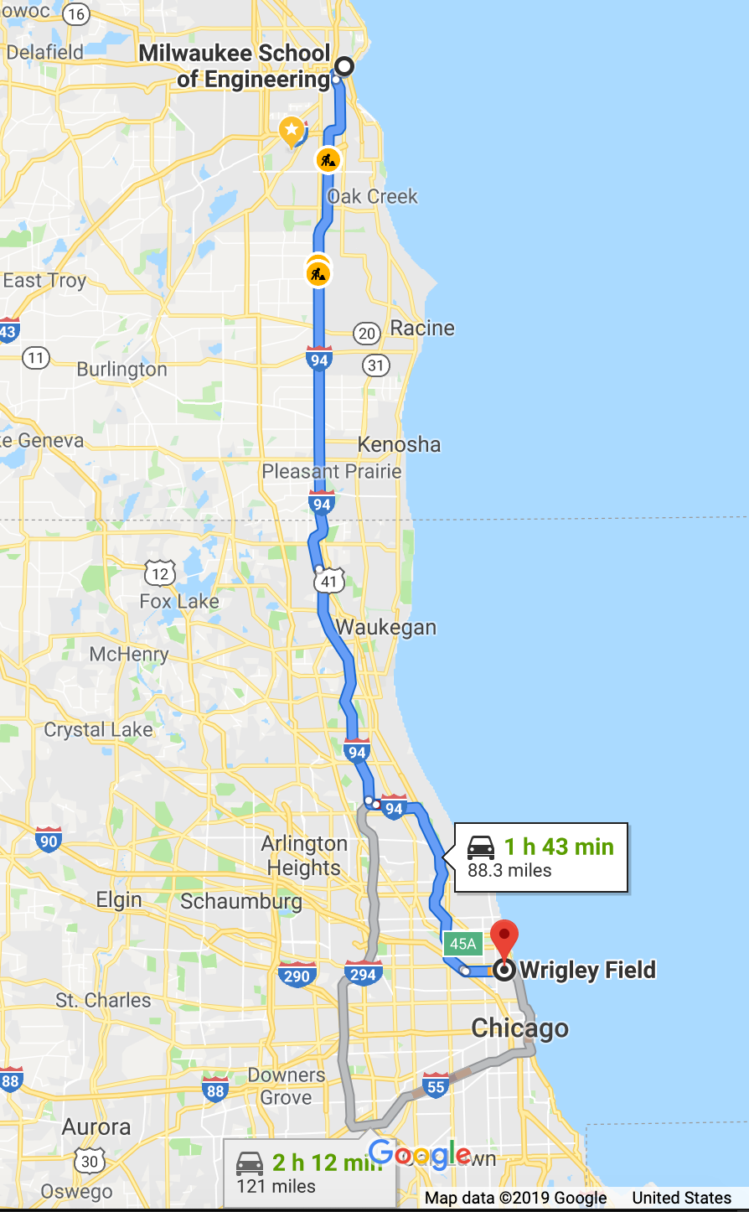
How to get from MSOE to Wrigley Field?
…to either root for or against the Cubs…
Google Map solution: drive there
  But are they optimizing for time? Cost? Stress?
Other options:
  Walking
  Cycling
  Train
  Bus
  Rideshare
  Fly to Midway, take a cab to the stadium
  Sail
  Bribe a roommate to take you

Slide 5
The challenge
If you decide to take the train, then have other questions:
  Which departure time?
  How to get to the station?
  How to purchase a ticket?
  Can you return on the train on the same day?
Generally: need a way to organize alternatives

Slide 6
Trees to the rescue
Go to Wrigley Field
Drive your car
Take I-94E
Non-interstate route
Take train
Hop to Intermodal
Clybourne to I-94
I-94 to W. Addison
W. Addison to Clark
Hiawatha to Union Station
Red Line bus
Transport to Intermodal
Bicycle
Depart 1:05 pm
Depart 3 pm
Union Station to Wrigley
Taxi
Ride share
Sail
Rent boat w/ lessons
Sail to Belmont Harbor
Walk to Wrigley
Likely to have many more steps in this tree alone – deeper tree
We’re ignoring the possibility of travelling to Green Bay or Minneapolis first – no back-tracking
Can add costs (money, gas, time, stress)

Slide 7
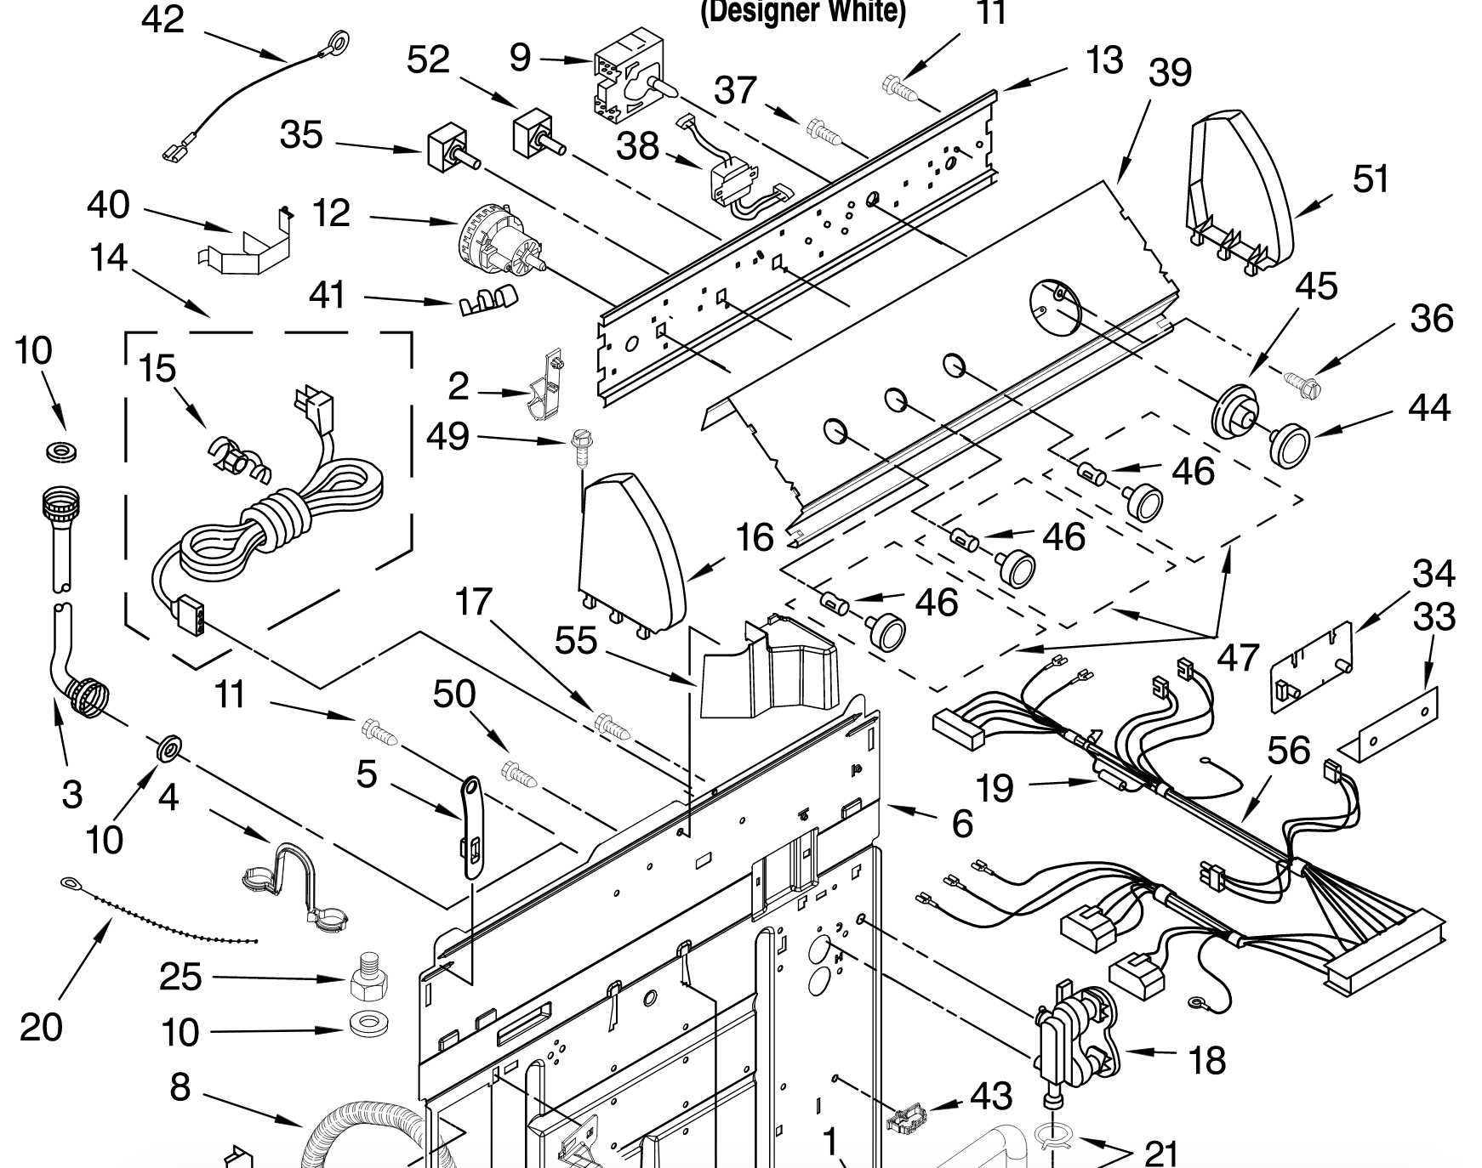
Another application: clothes washer assembly
Build tree of parts
Each set of branches: parts touching another part
Search: most efficient way to combine parts

Slide 8
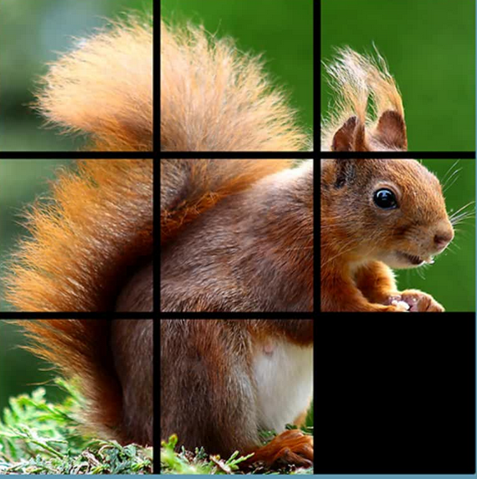
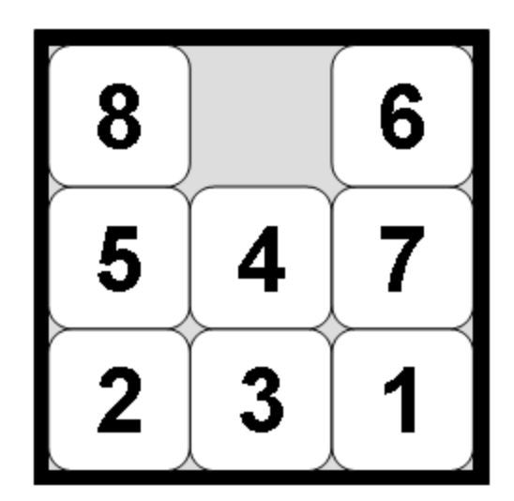
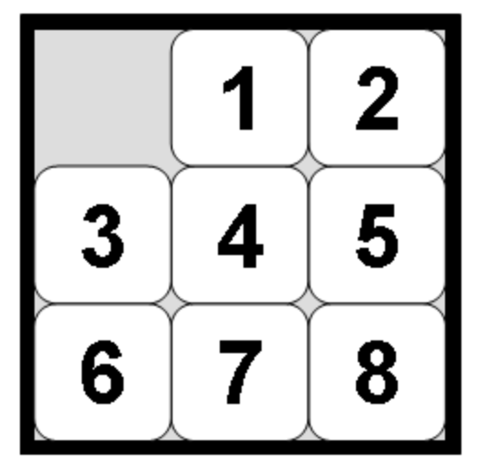
Classic problem: 8-tile puzzle
Goal: convert to
Notes:
Slide tiles to the empty spaces
Image from Amazon from a free app by Pegolandia

Slide 9
8-puzzle state space
Initial State
move 8
move 5
move 2
move 6
move 7
move 4
move 4
move 4
move 1
move 3
move 5
move 7
move 1
move 2
move 2
move 8
move 1
move 6
move 3
move 3
move 7
… etc.
Notes:
Note there would be moves for all of the 4th layer

Slide 10
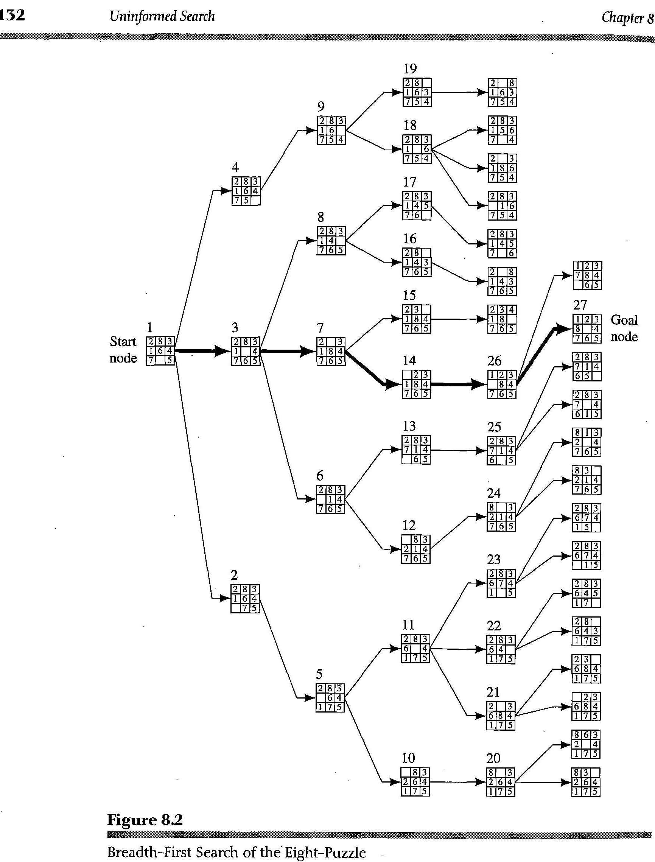
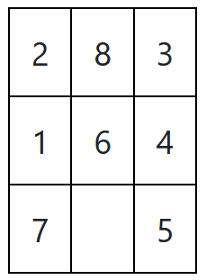
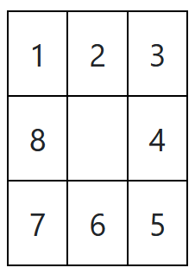
Representing the state space
Each state: 3 by 3 array
Initial state: unsolved puzzle
Goal: solved
A graph represents the moves of the “blank” space

Slide 11







Search
Search problems consist of
  State space
  Successor function
  Start State
  Goal State(s)
Solution
  Sequence of actions taking the start state to a goal state
“N”, 1.0
“E”, 1.0

Slide 12
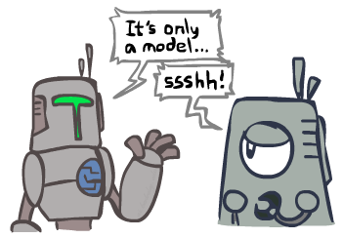
Search and Models
Search operates over models of the world
  The agent doesn’t actually try all the plans out in the real world!
  Planning is all “in simulation”
  Your search is only as good as your models…

Slide 13
Example: Traveling in Romania
State space:
  Cities
Successor function:
  Roads: Go to adjacent city with cost = distance
Start state:
  Arad
Goal test:
  Is state == Bucharest?
Solution?

Slide 14
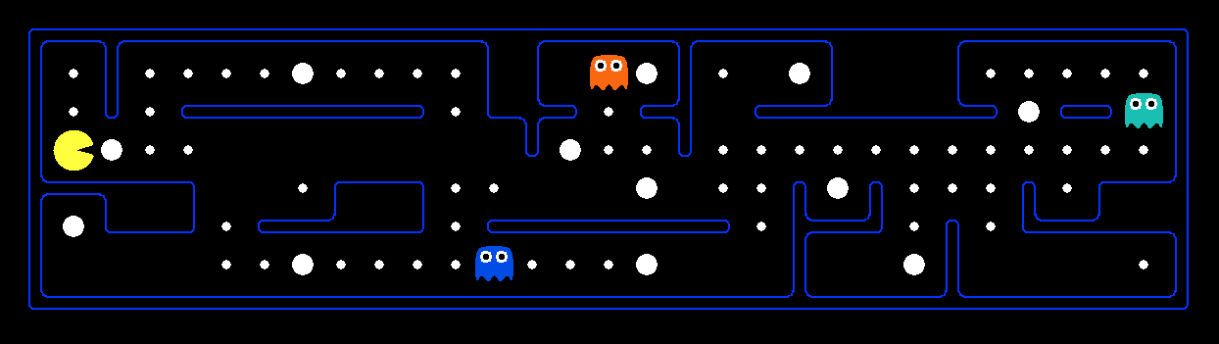
What’s in a State Space?
The world state includes all details about the environment
A search state keeps only the details needed for planning (abstraction)
Problem: Finding paths
  States: (x,y) location
  Actions: NSEW
  Successor: update location only
  Goal test: is (x,y)=END
Problem: Eat-All-Dots
  States: {(x,y), dot booleans}
  Actions: NSEW
  Successor: update location and possibly a dot boolean
  Goal test: dots all false
Notes:
Wrong example for “eat-all-dots”: (x, y, dot count)

Slide 15
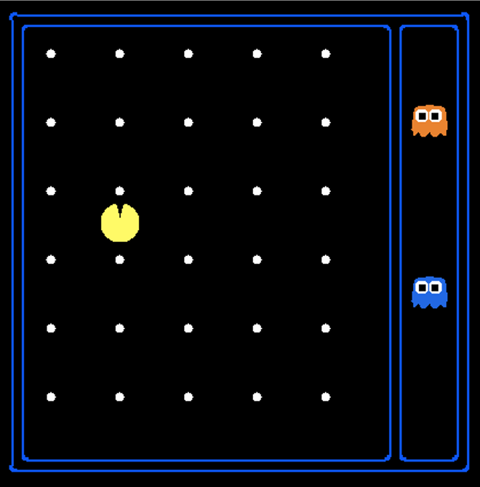
State Space Sizes?
Consider this simplified version:
  Food items: up to 30
  Agent (Pac-Man) positions: 25 by 25
    (providing smooth movement)
  Agent can face north, south, east, west
  Two ghosts, also 25 by 25 positions

Slide 16
CS 2400:
Introduction to Artificial Intelligence
Reading: Sections 3.4-3.5
note 2b: Search
Credit for selected slides to authors of Berkeley CS188 Introduction to Artificial Intelligence
https://inst.eecs.berkeley.edu/~cs188/sp20/

Slide 17
How to get from MSOE to Wrigley Field?
Review
…to either root for or against the Cubs…
Google Map solution: drive there
  But are they optimizing for time? Cost? Stress?
Other options:
  Walking
  Cycling
  Train
  Bus
  Rideshare
  Fly to Midway, take a cab to the stadium
  Sail
  Bribe a roommate to take you

Slide 18
Defining state space
Review
The world state includes all details about the environment
A search state keeps only the details needed for planning (abstraction)
Problem: Finding paths
  States: (x,y) location
  Actions: NSEW
  Successor: update location only
  Goal test: is (x,y)=END
Problem: Eat-All-Dots
  States: {(x,y), dot booleans}
  Actions: NSEW
  Successor: update location and possibly a dot boolean
  Goal test: dots all false
Notes:
Wrong example for “eat-all-dots”: (x, y, dot count)

Slide 19
State Space Sizes?
Consider this simplified version:
  Food items: up to 30
  Agent (Pac-Man) positions: 25 by 25
    (providing smooth movement)
  Agent can face north, south, east, west
  Two ghosts, also 25 by 25 positions + fenced
Size:
  2³⁰ * 25² * 4 * (25² + 1) * (25² + 1)
  about 1.051934e18
    Note: max 64-bit value: approx.18e18

Slide 20
State Space Graphs
State space graph: A mathematical representation of a search problem
  Nodes are (abstracted) world configurations
  Arcs represent successors (action results)
  The goal test is a set of goal nodes (maybe only one)
In a state space graph, each state occurs only once!
We can rarely build this full graph in memory (it’s too big), but it’s a useful idea

Slide 21
Search Trees
This is now / start
“N”, 1.0
“E”, 1.0
Possible futures
A search tree:
  A “what if” tree of plans and their outcomes
  The start state is the root node
  Children correspond to successors
  Nodes show states, but correspond to PLANS that achieve those states
  For most problems, we can never actually build the whole tree
Notes:
Different plans that achieve the same state, will be different nodes in the tree.

Slide 22
State Space Graphs vs. Search Trees
State Space Graph
Each NODE in in the search tree: PATH from start to that node
Search Tree
S
a
G
d
e
p
b
c
q
b
c
e
h
r
d
e
f
a
a
h
r
p
q
f
S
h
Both constructed on demand – building out as little as possible
p
q
f
q
c
G
p
q
r
q
c
G
a
a

Slide 23
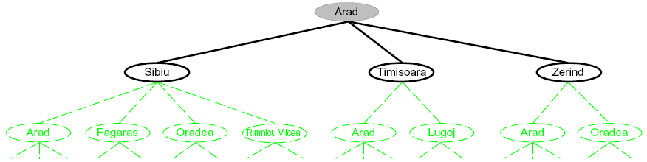
Searching with a Search Tree
Search:
  Expand out potential plans (tree nodes)
  Maintain a fringe of partial plans under consideration
  Attempt to expand as few tree nodes as possible

Slide 24
General Tree Search
Important ideas:
  Fringe
  Expansion
  Exploration strategy
Main question: which fringe nodes to explore?

Slide 25
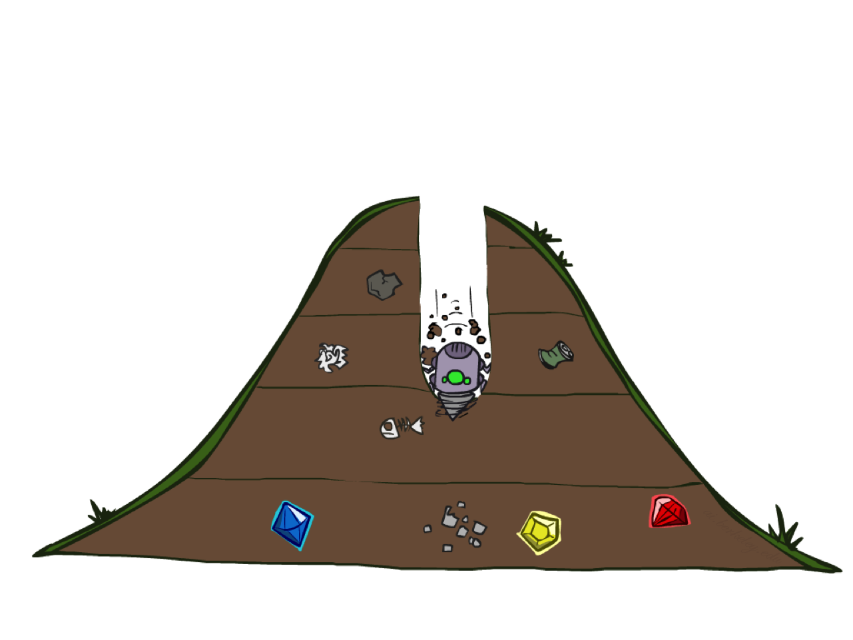
Depth-First Search

Slide 26
Depth-First Search
a
G
b
c
e
d
f
…applied to simplified city map:
S
h
p
q
r

Slide 27
Depth-First Search
Strategy: expand a deepest node first
Implementation: Fringe is a (LIFO) stack
a
G
a
c
b
c
b
e
d
e
d
f
f
S
h
h
p
p
r
q
r
q
S
d
e
p
b
c
e
h
r
q
a
a
h
r
p
q
f
p
q
f
q
c
G
q
c
G
a
a

Slide 28
Search Algorithm Properties
Time complexity?
Space complexity?
Cartoon of search tree:
  b is the branching factor
  m is the maximum depth
  solutions at various depths
Number of nodes in entire tree?
  1 + b + b² + …. b^{m} = O(b^{m})
1 node
b
…
b nodes
b² nodes
m tiers
b^{m} nodes

Slide 29
Depth-First Search (DFS) Properties
What nodes DFS expand?
  Some left prefix of the tree.
  Could process the whole tree!
  If m is finite, takes time O(b^{m})
How much space does the fringe take?
  Only has siblings on path to root, so O(bm)
Is it complete?
  Complete: Guaranteed to find a solution if one exists?
  m could be infinite, so yes if we prevent cycles (more later)
Is it optimal?
  Optimal: Guaranteed to find the least cost path?
  No, it finds the “leftmost” solution, regardless of depth or cost
  Example assuming children of S are [d, e, p]
    Visiting d before e means missing the shorter path
1 node
b
…
b nodes
b² nodes
m tiers
b^{m} nodes
a
G
b
c
d
e
f
S
h
p
q
r

Slide 30
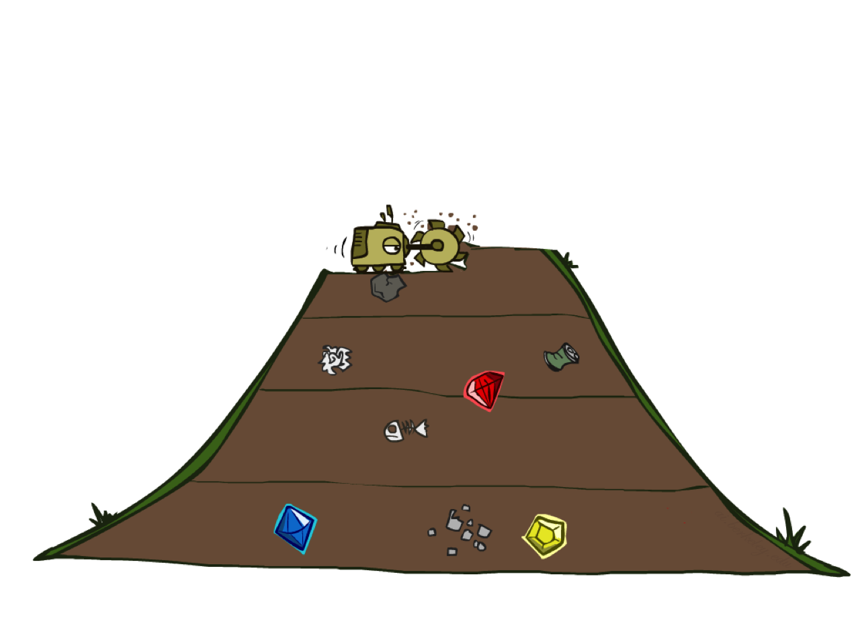
Breadth-First Search

Slide 31
Breadth-First Search
Strategy: expand a shallowest node first
Implementation: Fringe is a FIFO queue
a
G
b
c
d
e
f
S
h
p
q
r
S
d
e
p
Search
Tiers
b
c
e
h
r
q
a
a
h
r
p
q
f
p
q
f
q
c
G
q
c
G
a
a

Slide 32
Breadth-first vs. depth-first search
i.e., BFS vs DFS
BFS: follow numbered sequence
Notes:
BFS: breadth-first search; DFS: depth-first sear

Slide 33
Breadth-first vs. depth-first search
i.e., BFS vs DFS
BFS: follow numbered sequence
  (rotated to see left-to-right)
DFS, assuming left-to-right:
  1, 2, 5, 10, 20, …
  What would happen if can visit a node twice with DFS?
  Even with recording visits, many nodes searched before finding goal
Notes:
BFS: breadth-first search; DFS: depth-first sear

Slide 34
Breadth-First Search (BFS) Properties
What nodes does BFS expand?
  Processes all nodes above shallowest solution
  Let depth of shallowest solution be s
  Search takes time O(b^{s})
How much space does the fringe take?
  Has roughly the last tier, so O(b^{s})
Is it complete?
  s must be finite if a solution exists, so yes!
Is it optimal?
  Yes, if costs are all 1 (more on costs later)
1 node
b
…
b nodes
s tiers
b² nodes
b^{s} nodes
b^{m} nodes

Slide 35
BFS vs DFS
Depth-First Search (DFS):
  Unvisited nodes stored on stack
  Explore all children before siblings
  If there are two ways to get to a state (state-space has loops), naïve version will loop forever
  Typically must track visited nodes, making this as expensive as BFS!
  Not guaranteed to find shortest path
Breadth-First Search (BFS):
  Visit nodes in layers
  That is, explore all children before any grandchildren
  Guaranteed to find shortest path to (first) goal node
  Unvisited nodes stored in a queue
  Length of queue can get very large: O(b^{s}) where b is branching factor, s is shallowest solution layer
  Eg: b = 20, s = 30: O(20³⁰)
  Not practical for most problems!

Slide 36
Iterative Deepening
Goal: DFS’s space advantage with BFS’s time / shallow-solution advantages
  Run a DFS with depth limit 1. If no solution…
  Run a DFS with depth limit 2. If no solution…
  Run a DFS with depth limit 3. …..
b
…

Slide 37
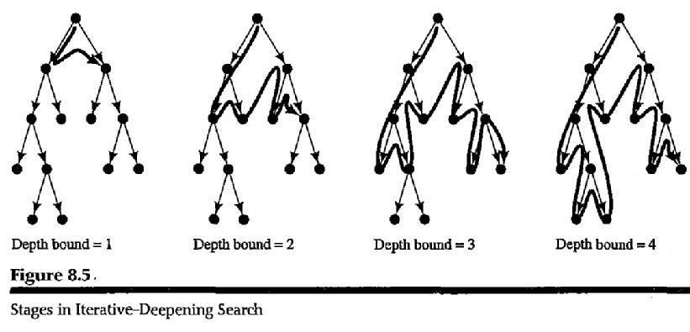
Iterative Deepening in pictures…
Basic idea: cap depth
  Do depth-first search at most 1 level deep, then 2, then 3, etc.

Slide 38
Iterative Deepening
Goal: DFS’s space advantage with BFS’s time / shallow-solution advantages
  Run a DFS with depth limit 1. If no solution…
  Run a DFS with depth limit 2. If no solution…
  Run a DFS with depth limit 3. …..
Isn’t that wastefully redundant?
  Generally most work happens in the lowest level searched, so not so bad!
  Textbook analysis: b = 2: double the work, b = 3: 1.5 times; even less overhead when b is large
b
…
Notes:
textboo

Slide 39
Review
State-space search: organizing searches in trees or graphs
  Will generally assume a graph since most real-world problems have more than one way to reach a goal
Depth-first search: expand grandchildren before other children
Breadth-first search: expand children before grandchildren
DFS fails on loops, BFS uses too much memory
Iterative deepening: works when there’s no other information
But do we try all possibilities? Often there are many short cuts!
Next: formalizing shortcuts

Slide 40
Exercises
See Blackboard for a short quiz on state spaces

