Slide 1
CS 2400: Introduction to Artificial Intelligence
Reading: Section 3.6
Probably read after lecture
note 3: Informed Search
Credit for selected slides to authors of Berkeley CS188 Introduction to Artificial Intelligence
https://inst.eecs.berkeley.edu/~cs188/sp20/
Note: Contains References to Artificial Intelligence: A New Synthesis (Nilsson, 1998)

Slide 2
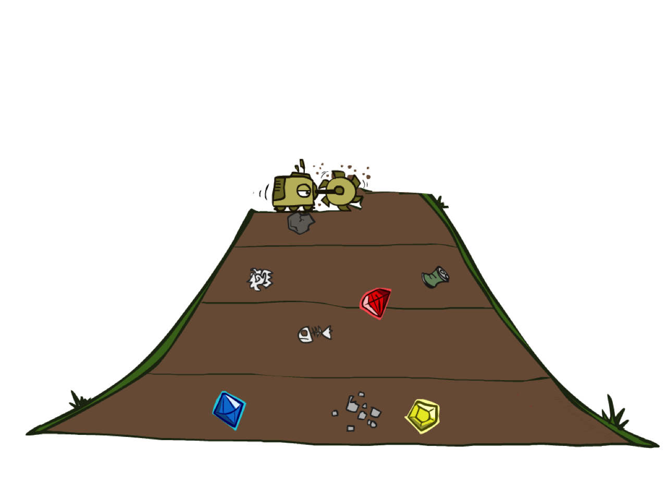
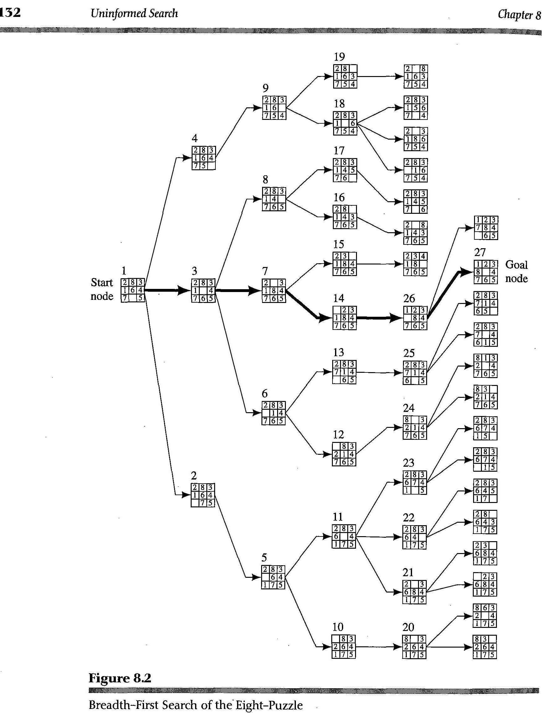
Breadth-first search
Psuedocode:
breadth_first_search: StartState → Path or FAILURE
create a queue of paths with one member, [StartState]
while the queue is not empty
remove the next path to explore from the queue
if the end state on this path is a goal state,
return path from start to goal
otherwise,
for each of the neighbors of the path end state,
extend (a copy of) the path with the neighbor
add the extended path to the queue
end-if
end-while
signal FAILURE (no more states to explore)
Notes:
Figure: figure 8.2 from Nilsson text

Slide 3
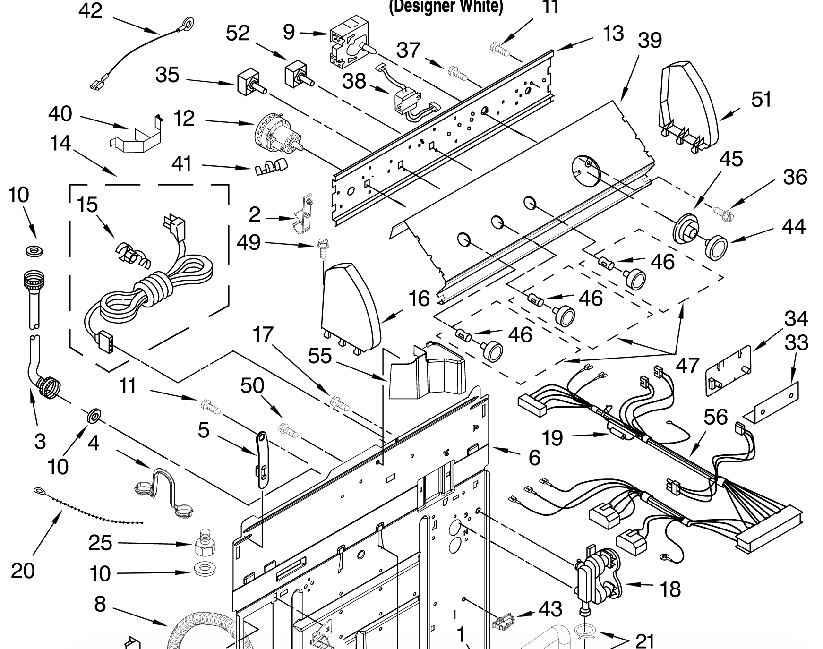
Why BFS is not useful
40+ parts on this partial diagram
At least 80 pairs of items that can be connected
Next level: at least 40 choices
10 levels down: approx. 40¹⁰ choices
This is the size of the fringe with BFS!
Will start to cut down options, but could always disconnect parts…
Full solution: ~40⁴⁰, or ~10⁶⁵ steps
Number of atoms in solar system: around 10⁵⁷!
Notes:
number of atoms in the solar system (counting plasma-forms of hydrogen and helium as atoms): 10^57
conclusion: BFS is a really bad idea in this domain…

Slide 4
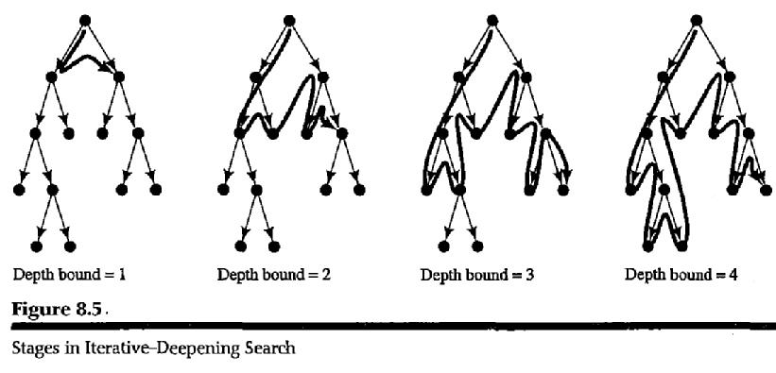
Iterative Deepening
Guaranteed to find solution if it exists
Memory usage of DFS: fringe = nodes between node being visited and start
Notes:
Figure: Figure 8.5 from Nilsson text

Slide 5
Will iterative deepening solve the problem?
Spending significant time trying alternatives
This domain: lots of solutions
Iterative deepening: works, but not practical on most real problems
Issue: there are obvious improvements to the search
assemble pieces, combine assemblies
Notes:
It’s worse: there are no solutions in less than 40 steps, so depths < 40 are meaningless…

Slide 6
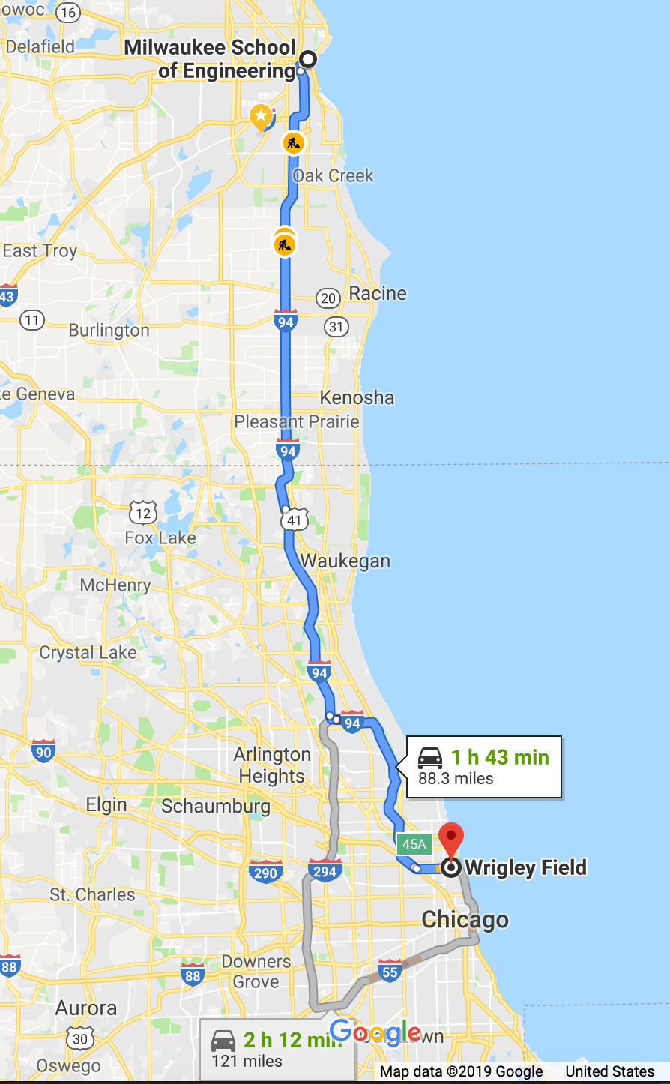
Will iterative deepening solve the problem?
Consider MSOE to Wrigley Field
Sailboat: clearly a bad idea if time, money matters
Little need to search going north, west
Many pruning opportunities
Solution: introduce heuristics
Rule-of-thumb that can be used to evaluate alternatives
In search: heuristic attempts to measure how close each state is to a goal state
Search high score states before others

Slide 7
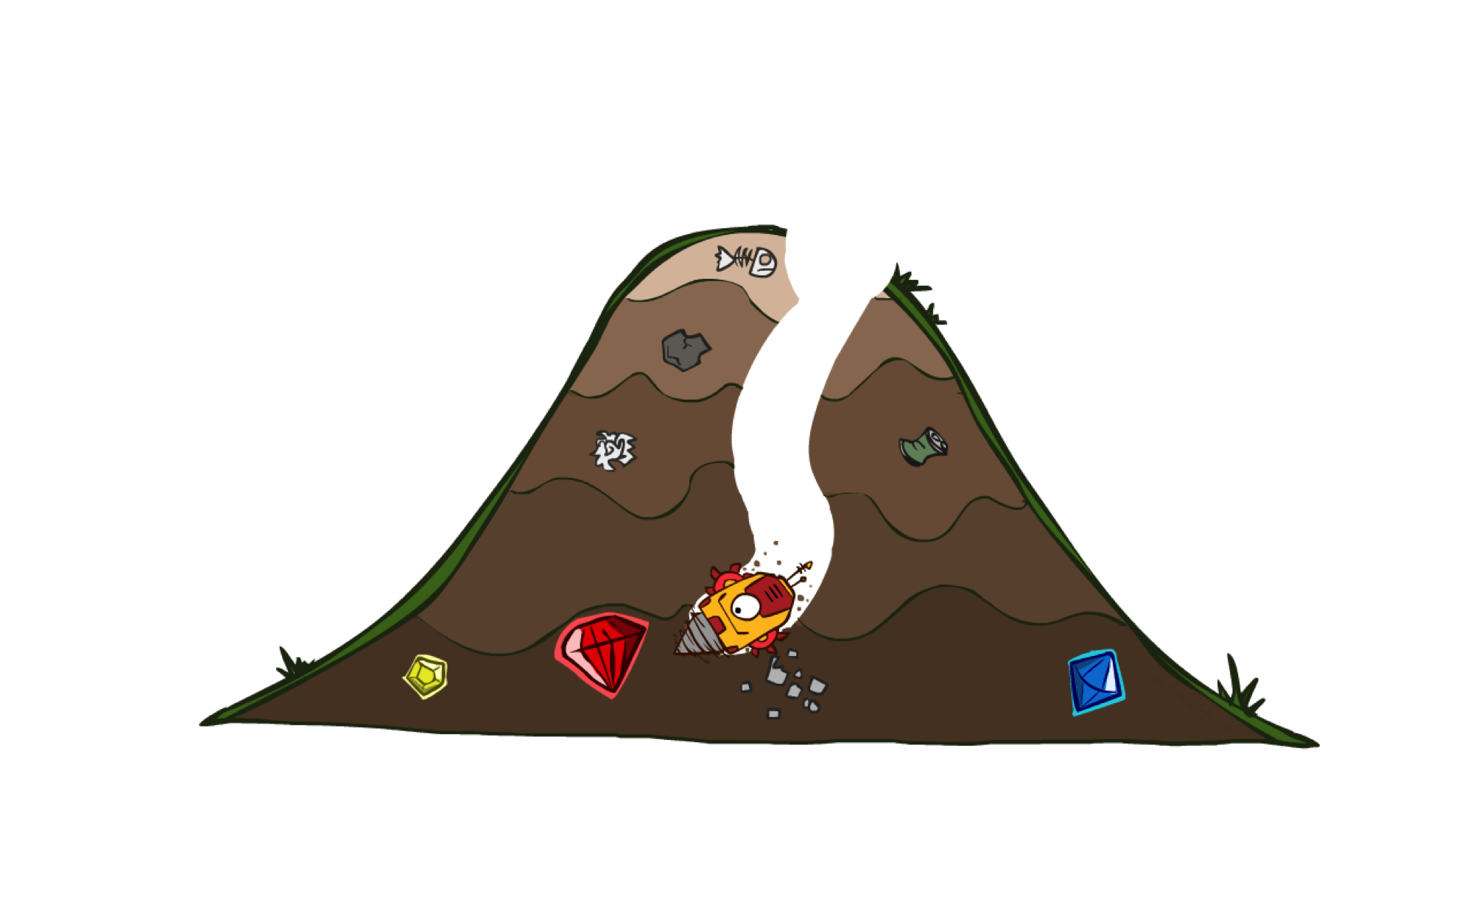
Best-first search
Pseudocode:
best_first_search: StartState → Path or FAILURE
create a queue set of states with one member, StartState
while the queue set is not empty
remove the next highest value state to visit from the set
if this state is a goal state,
return path from start to goal
otherwise,
for each of the high value state neighbors,
add the neighboring state to the queue set
end-if
end-while
signal FAILURE (no more states to explore)

Slide 8
Best-first search
Example heuristics:
Number of pieces in correct position
Number of pieces within one position of correct
Distance each piece to goal location
Moves needed to solve puzzle
Pseudocode:
best_first_search: StartState → Path or FAILURE
create a queue set of states with one member, StartState
while the queue set is not empty
remove the next highest value state to visit from the queue
if this state is a goal state,
return path from start to goal
otherwise,
for each of the high value state neighbors,
add the neighboring state to the queue set
end-if
end-while
signal FAILURE (no more states to explore)

Slide 9
Heuristics
Generally: estimating how many steps needed
Compare the following two:
Number of tiles out of place
Total number of positions each tile must move to get in place
How to decide which is best?
Possible criteria: Time/space complexity.
Likelihood of not finding a goal when one exists.
Length of solution path found.
Observation: if heuristic h(n) is always less than the lowest-cost path from node n to a goal, then combining that information with number of moves to reach n can mean we get a solution with minimal cost
Such a heuristic is admissible – reasonable to consider
“admissible” in the sense that someone is capable of being admitted (to a college)

Slide 10
Admissibility
Let
s(n) = the minimal cost of getting from start node to n
g(n) = the actual cost of minimal path from node n to goal
Then
c(n) = s(n) + g(n) is the cost of a minimal cost path from the start to a goal going through node n

Slide 11
Admissibility
Let
s(n) = the minimal cost of getting from start node to n
g(n) = the actual cost of minimal path from node n to goal
Then
c(n) = s(n) + g(n) is the cost of a minimal cost path from the start to a goal going through node n
Note: don’t have g(n)
If we knew g(n), wouldn’t need search!

Slide 12
Admissibility
Let
s(n) = the minimal cost of getting from start node to n
g(n) = the actual cost of minimal path from node n to goal
Then
c(n) = s(n) + g(n) is the cost of a minimal cost path from the start to a goal going through node n
Let h(n) be such that 0 ≤ h(n) ≤ g(n)
that is, h(n) is admissible
Note: don’t have g(n)
If we knew g(n), wouldn’t need search!
can show: if
a solution is reachable from the initial state
each node has a finite number of children
the cost of each move is greater than 0
then guaranteed to find a minimal-cost path from the start to a goal

Slide 13
Admissibility
Algorithm A*:
Best-first search using c(n) = s(n) + h(n)
Guaranteed to find minimal cost path
Let
s(n) = the minimal cost of getting from start node to n
g(n) = the actual cost of minimal path from node n to goal
Then
c(n) = s(n) + g(n) is the cost of a minimal cost path from the start to a goal going through node n
Let h(n) be such that 0 ≤ h(n) ≤ g(n)
That is, let h(n) be admissible

Slide 14
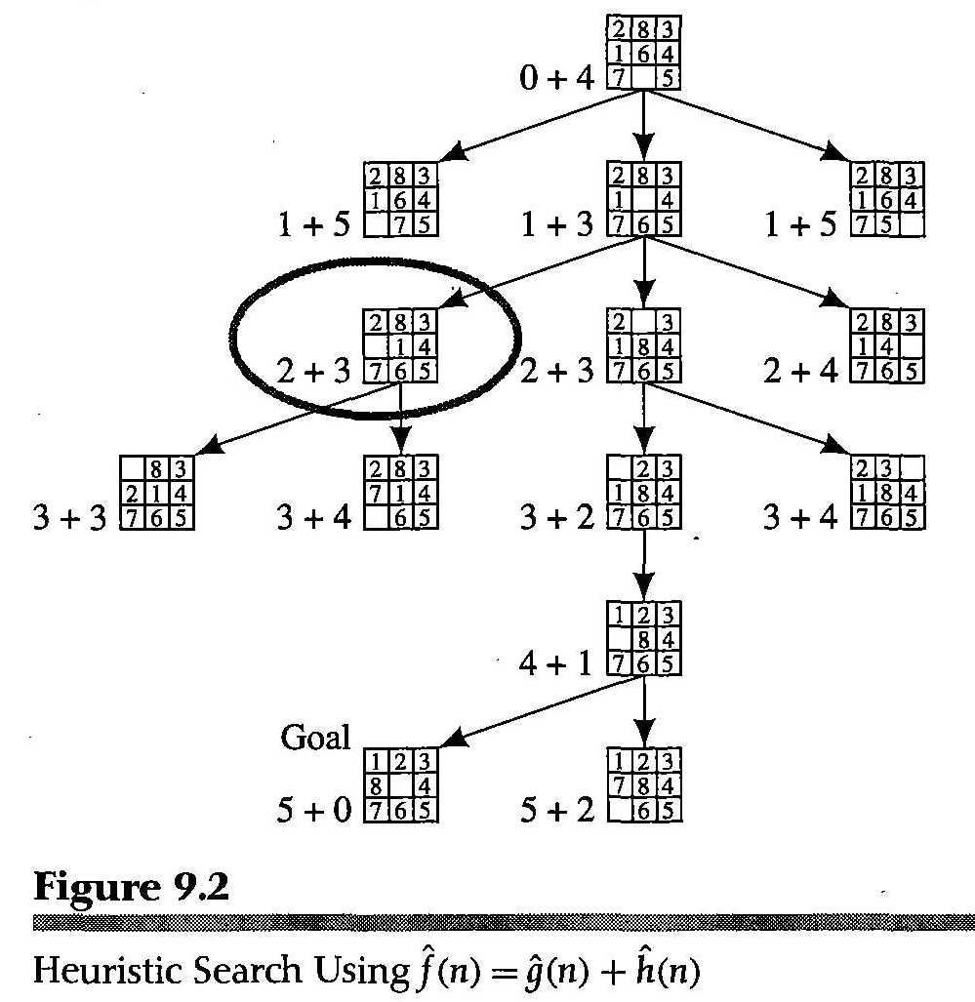
Applying A*
Example: 8-tile: h(n) = count pieces out of place
Shown: c(n) = s(n) + h(n)
Note: if h(n) is always 1 (unless at the node), then get breadth-first search
For example, s(root) = 0, h(root) = 4, so f(root) = 0 + 4 = 4.
Circled node: s(n) = 2, h(n) = 3

Slide 15
Consider the following example
S
/ \
A B
|
C
|
X
|
Y
|
Z
|
G
Start: S, Goal: G
Assume h() is given by the admissible heuristic
h(S) = 4
h(A) = 2
h(B) = 3
h(C) = 1
h(X) = h(Y) = h(Z) = 0.1
h(G) = 0
(Note this never overestimates the number of steps to G; for example, true cost to get from S to G is 5)
Apply best-first search starting at G
Will visit X through A and C
After reaching Y, f(B) is the lowest; if don’t adjust, will then move forward with Z, ignoring the path through B
However, this is not the shortest solution
Solution: track s(n) for each visited node (rather than just whether or not the node has been visited)
cost_to_visit[S] = 0
cost_to_visit[X] = 3
When find better path to X, update to:
cost_to_visit[x] = 2
... and revisit neighbors

Slide 16
A* search
priority queue: queue where items are ordered by some value
eg: a line of people grouped by age – young people first
Pseudocode:
A*_search: StartState → Path or FAILURE
create a priority queue of paths with one member, [StartState]
while the priority queue is not empty
remove the first (lowest c(n)) path from the queue
if have already visited the end state (with higher cost),
discard this path
if this end state in path is a goal state,
return path from start to goal
otherwise,
for each of the end state’s neighbors,
add the path with that neighboring state to the priorty queue
end-if
end-while
signal FAILURE (no more states to explore)
Note: typically store s(n), h(n) along with states in the priority queue to avoid recomputing every step

Slide 17
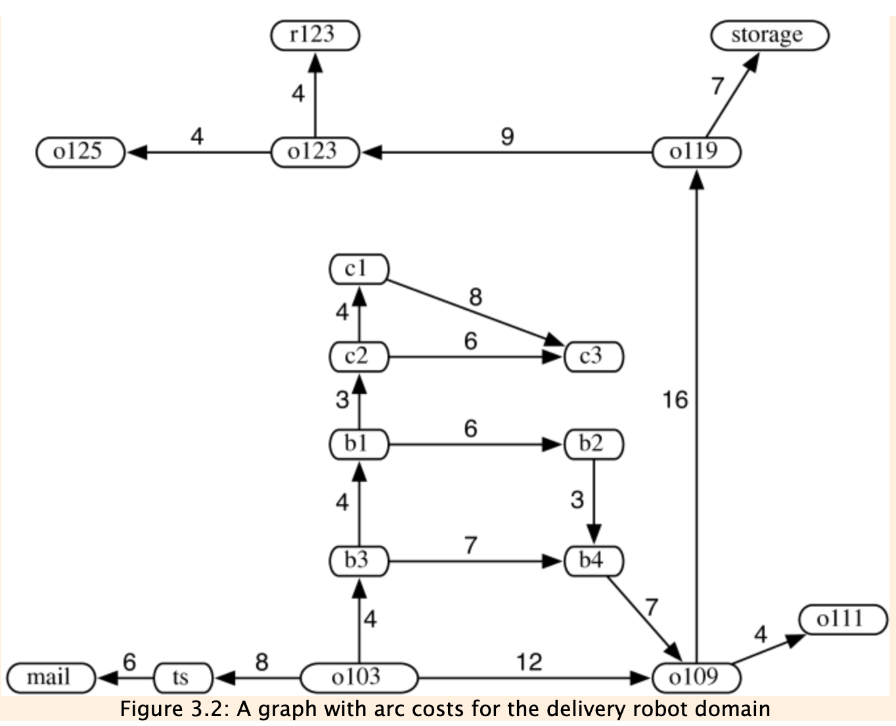
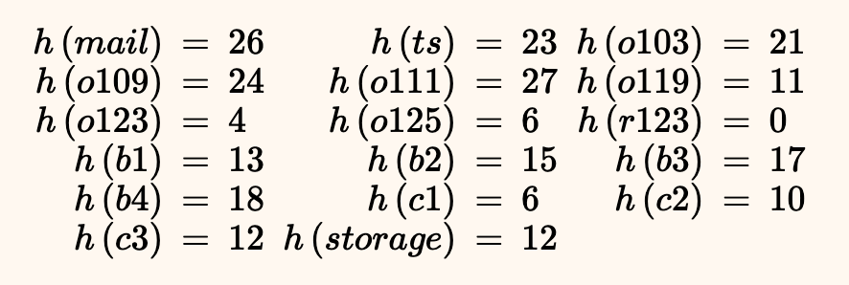
Applying A*
Find path from o103 to r123
Assume following (admissible) heuristic:

Slide 18
Informed Search
Why isn’t BFS a good solution in most cases?
Why isn’t DFS a good solution in most cases?
How is A* informed? That is, what do we mean by informed search?
How can we always find the best node to visit next?
What is the difference between best-first search and A*?
If the true cost to get from a node n to the finish is best_case(n), what do we know about the estimated cost h(n) (for A*)?
Why would we want h(n) to be as close to best_case(n) as possible?
How would we use A* to implement BFS?

Slide 19
Review
Showed BFS, DFS, Iterative deepening all inadequate for real domains
Best-first search: using a heuristic to determine which node is the most likely to be useful
That is, closest to the goal from the current location
Admissible heuristics: never over-estimate distance to goal from a given node
A*: best-first search using cost(n) = distance_from_start(n) + h(n)

Slide 20
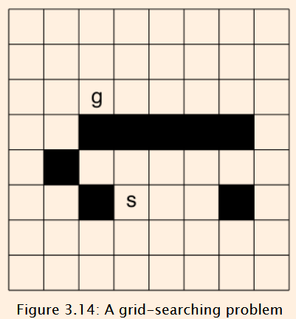
In-class exercise
The exercises at the end of chapter 3 contains the problem shown at the right
The goal is to find a path from s to g
Moves can be up/left/right/down, one square at a time, not moving into black squares
Number the nodes for a depth-first search from s to g, assuming neighbors are visited in up/left/right/down order
Assume each room visited just once
Identify three or four heuristics you could use
Are any of them admissible? Explain.

