Slide 1
CS 2400: Introduction to Artificial Intelligence
Reading: Section 11.2.2, 11.3
note 5: Playing games
Note: Contains References to Artificial Intelligence: A New Synthesis (Nilsson, 1998)

Slide 2
Search & Playing Games
Why is game playing an AI topic?
Certainly, a challenging task!
Obvious version of the Turing Test
What is a limitation of the game playing as a measure of intelligence?
The challenge for most games: large numbers of alternative paths
People: limit paths that you must examine
Computers: examining many paths is easy, harder to evaluate each “like a person”
Playing games is certainly easier than “real life”!
Are there intelligent people who aren’t good at playing games?
But useful: many problems come down to weighing alternative actions when there is some agent working against you
This is “adversarial search”
Notes:
Limitations: game playing is easier than real life; many games come down to reviewing many alternatives and finding the best move; examining multiple alternatives is easy for a computer, hard for a person, but evaluating best moves may be easier for people than computers; much progress in game playing, but mostly due to increases in hardware allowing more alternatives to be searched

Slide 3
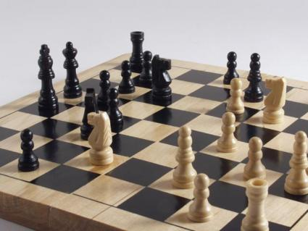
Modeling games
Core model: locations of pieces
Static evaluation function: def e(b: Board) -> score
High score: more likely to win
Winning state: +infinity
Losing state: -infinity
Core game play: make moves that maximize your chance of winning/maximize e()
Opponent’s strategy: make moves which minimize your chance of winning/minimize e()

Slide 4
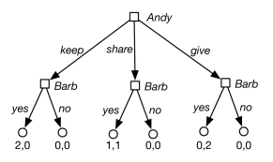
Playing Games
Sample graph to left: Andy goes first, Barb responds
Andy’s move: maximal e()
Barb’s move: minimal e()
MiniMax search: finding a move that maximizes likelihood that Andy wins
Andy: referred to as MAX player
Barb: MIN player

Slide 5
Tic-tac-toe
 | O
 | X
Possible e(b): (number of rows, columns, diagonals open to MAX) minus (number of rows, columns, diagonals open to MIN)
In this case (MAX placing Xs): 6 – 4 = 2
Give the scores for each of the following:
 | X
 | X
X
Notes:
It’s important to do these by hand – helps give you a feel for how they work
8 - 4 = 4. 8 – 6 = 2, 8 – 5 = 3

Slide 6
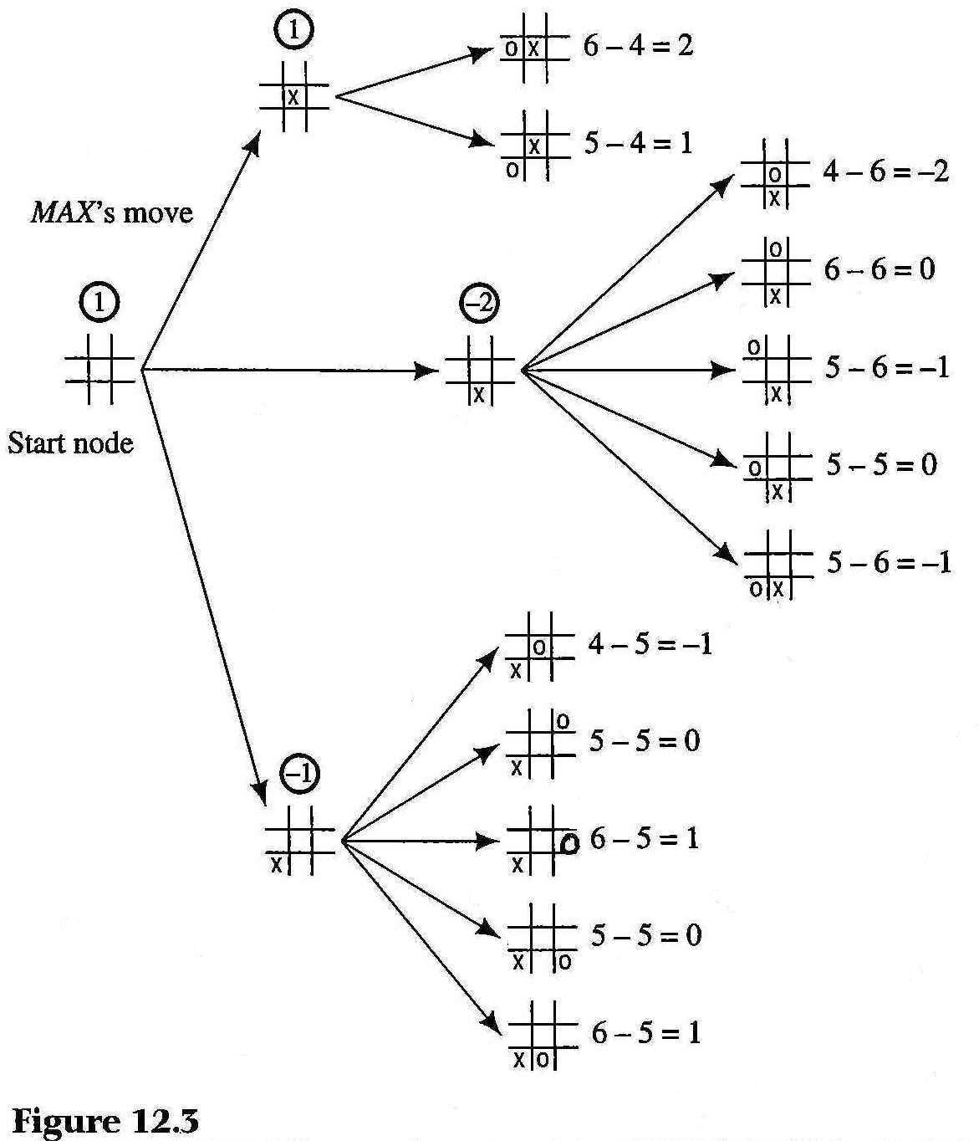
Tic-tac-toe
Better information: look at what MIN would do
Score for MAX at level 1: minimum of MIN’s possibilities
No need to eval board at MAX’s move since it’s MIN’s response that matters (unless win)
Best score for MAX: place in center
MIN: place O in left corner – IF O’s analysis is the same!
Notes:
Image from Nilsson, Figure 12-3.

Slide 7
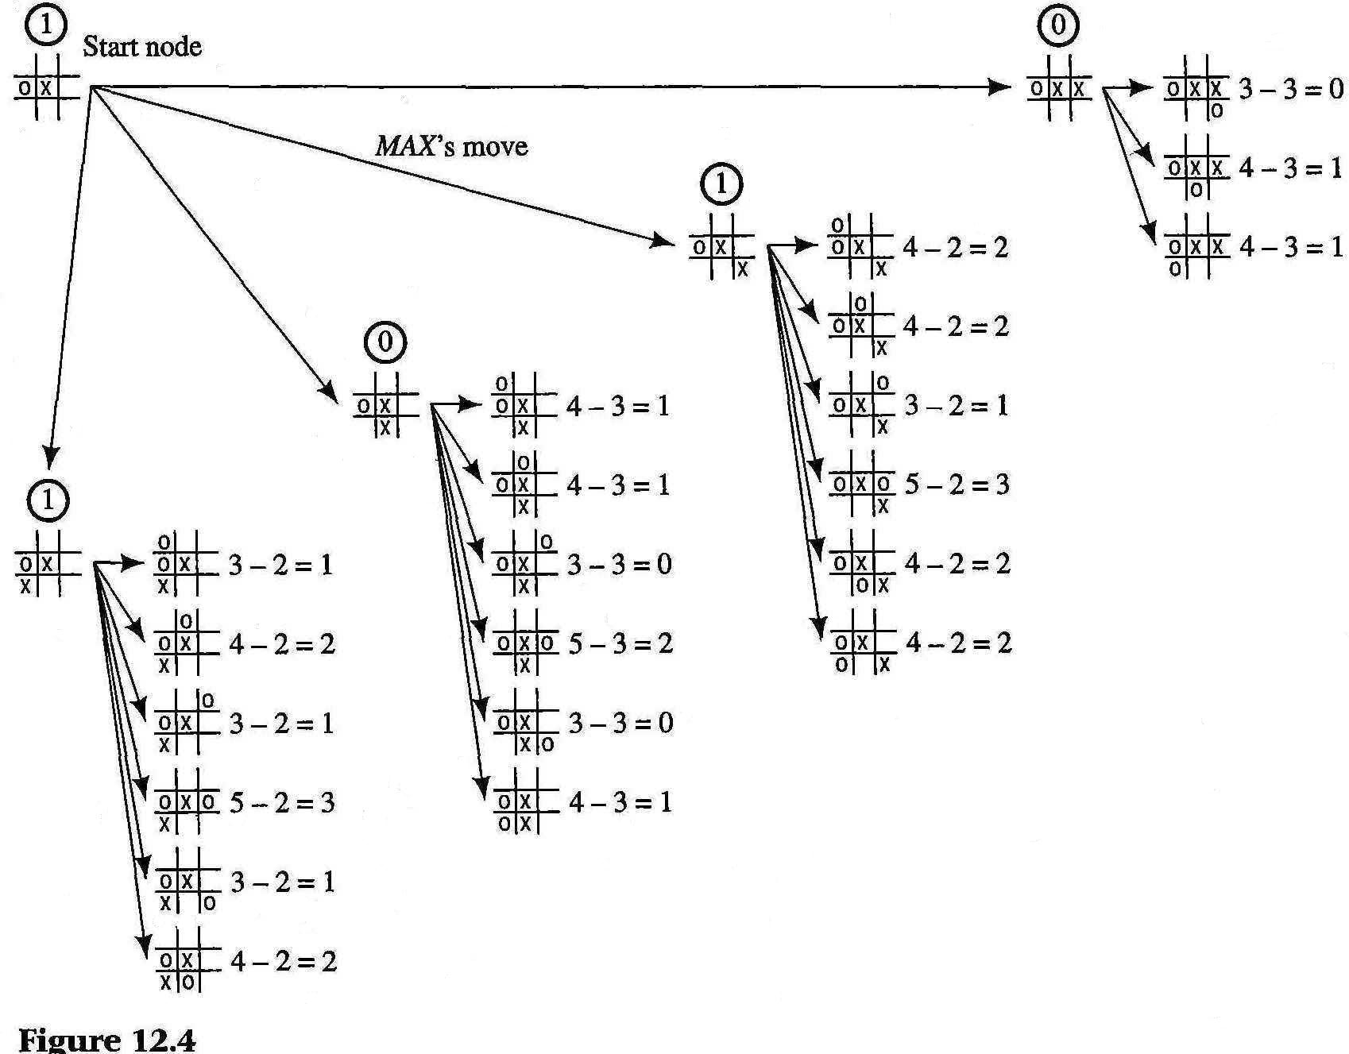
Tic-tac-toe
MAX’s alternatives from this point
MAX can play bottom left or bottom right for a score of 1
Assume MAX randomly selects bottom right
MIN must respond with O in upper left
Notes:
Image from Nilsson, Figure 12-3.

Slide 8
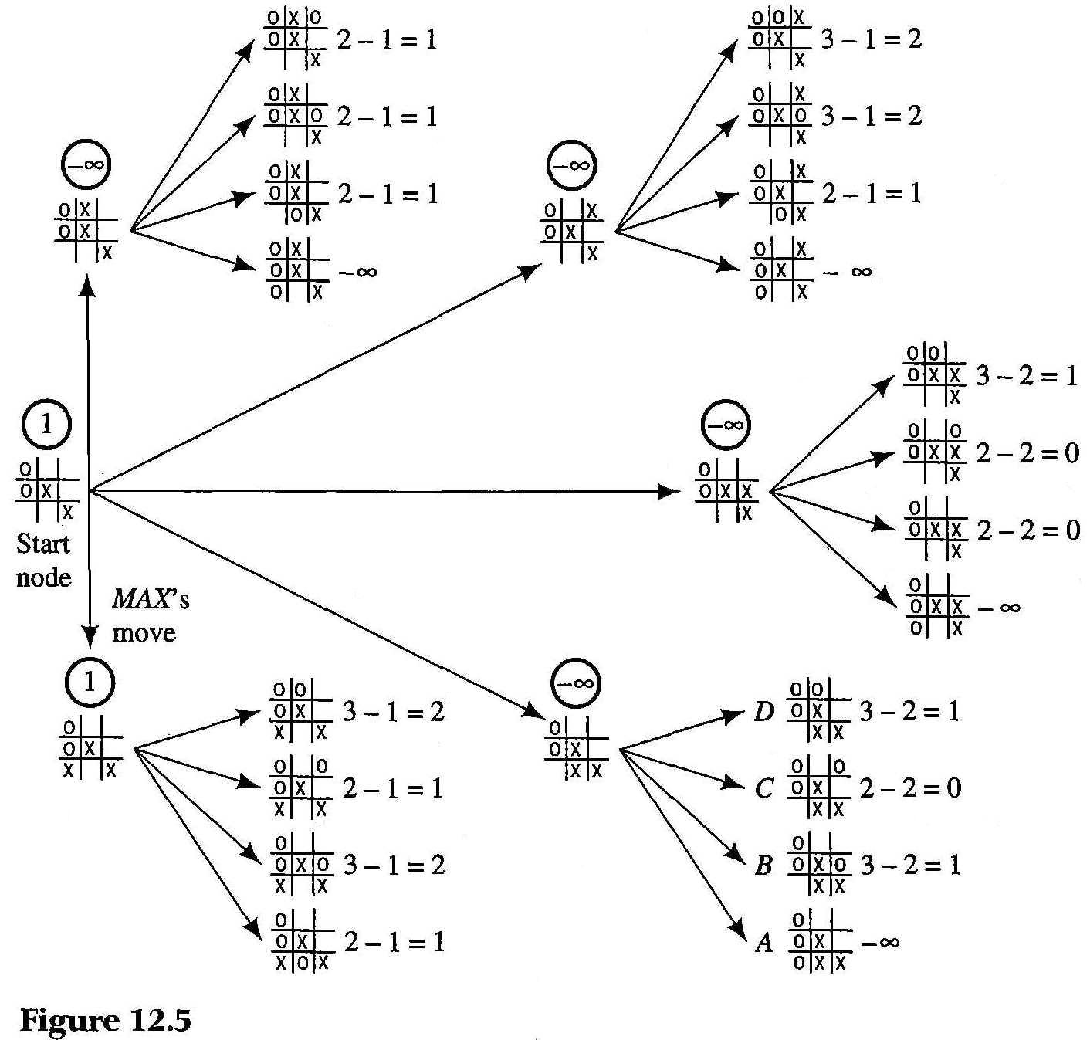
Tic-tac-toe
New state: MAX (X’s) and MIN (O’s) have both made two moves
MAX: will move
Only non-defeat move for MAX: lower left
Notes:
Image from Nilsson, Figure 12-3.

Slide 9
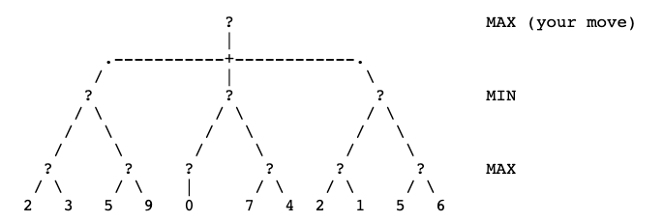
Minimax Search with Look-ahead
Ply: one set of moves by either player
Minimax procedure:
Expand n plys
Evaluate bottom-most ply
Propagate results towards decision point
If a node represents MAX’s move: pick maximum
If a node represents MIN’s move, pick minimum
Value: 3
Notes:
Have students work out values at each question mark

Slide 10
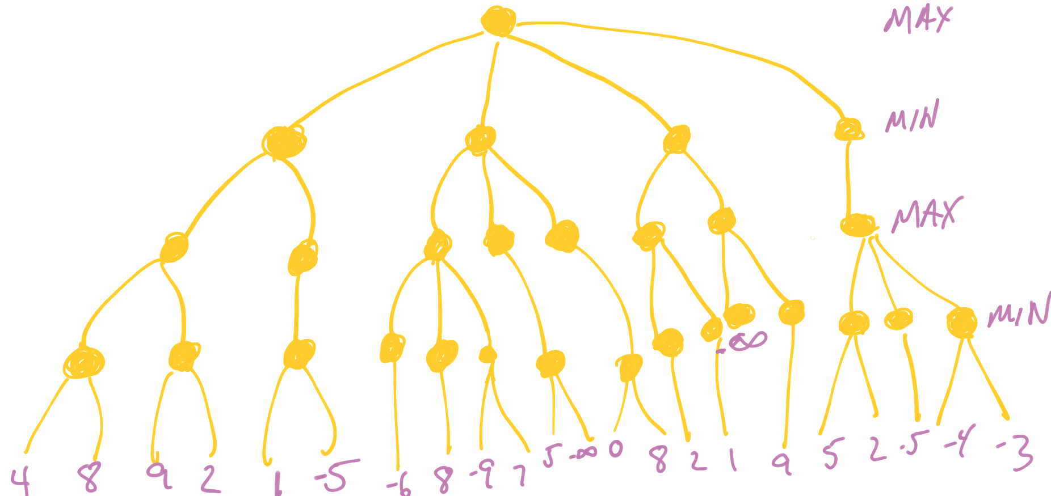
A four-ply mini-max example
Perform mini-max
What is MAX’s move?
What is MIN’s response?
Notes:
Warning: the last question is a trick question!
Answer to first question below:
The topmost MIN nodes, left to right: -5, -infinity, 2, 2; max’s move: either of the right two branches

Slide 11
Minimax Search with Look-ahead
Minimax Weakness
Sometimes a bad move reaps benefits down the road
Example: giving up a queen in chess
In general: looking one or two moves further might reveal a position is much better than thought
Horizon effect: when looking just a few more plys would reveal a move as very bad or very good
Issue: minimax doesn't allow for deeper search in "interesting" situations.
Ply: one set of moves by either player
Minimax procedure:
Expand n plys
Evaluate bottom-most ply
Propagate results towards decision point
If a node represents MAX’s move: pick maximum
If a node represents MIN’s move, pick minimum
Value: 3
Notes:
Have students work out values at each question mark

Slide 12
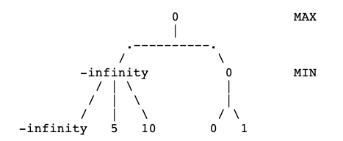
Alpha-beta Pruning
Minimax: suffers from horizon effect
Fix: don’t evaluate subtrees that have low value
For example, consider game-playing tree to right
Alpha-beta pruning
Whenever determine value of a node, propagate its result up the tree right away
Only explore children that could improve the accuracy
If value of MAX node is x, ignore any MIN child with value <= x
If value of MIN node is no more than y, can ignore any MAX child with value >= y

Slide 13
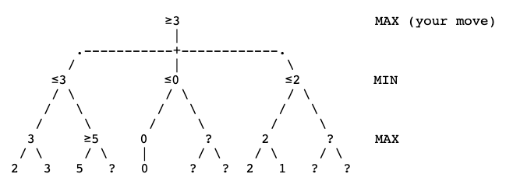
Alpha-beta Pruning
Evaluates just 6 leaves
Note must have one leaf for each topmost move
Consider what happens if that move is an automatic win or loss
Algorithm: complex logic with alpha, beta layers
Hand-execution: simply ask what would happen if a particular node was –infinity or +infinity
Claim: alpha-beta pruning doubles the number of useful nodes evaluated
less of a threat of suffering from horizon effect
Improvement: allows evaluating more plys (since less work to evaluate bottom-most states)

Slide 14
Alpha-Beta Pruning
Which leaves MUST be evaluated?
What is MAX’s move?
Notes:
Pruned nodes (not evaluated):

Slide 15
Review
Minimax search: look-ahead search for games
Alpha-beta pruning: optimizing search.
Next: using logic to represent problems, planning

