Slide 1
CS 2400: Introduction to Artificial Intelligence
Readings: Ch. 5 through 5.1.2; Ch. 6 through 6.2
Note 5: Propositional and First-Order Logic

Slide 2
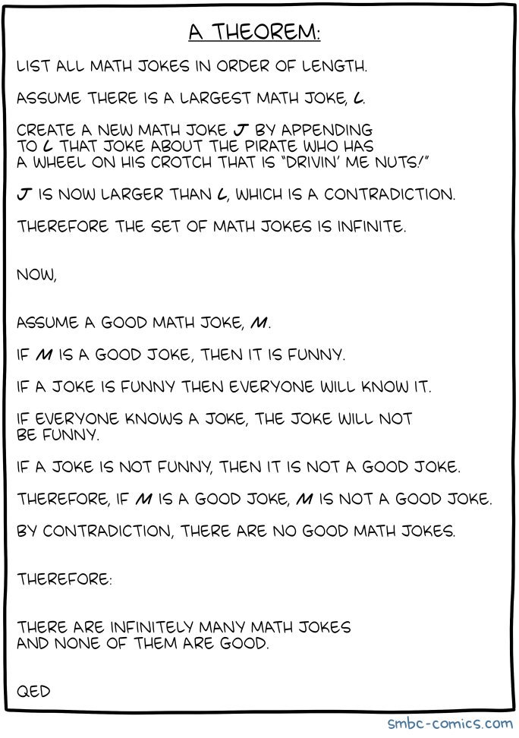

Slide 3
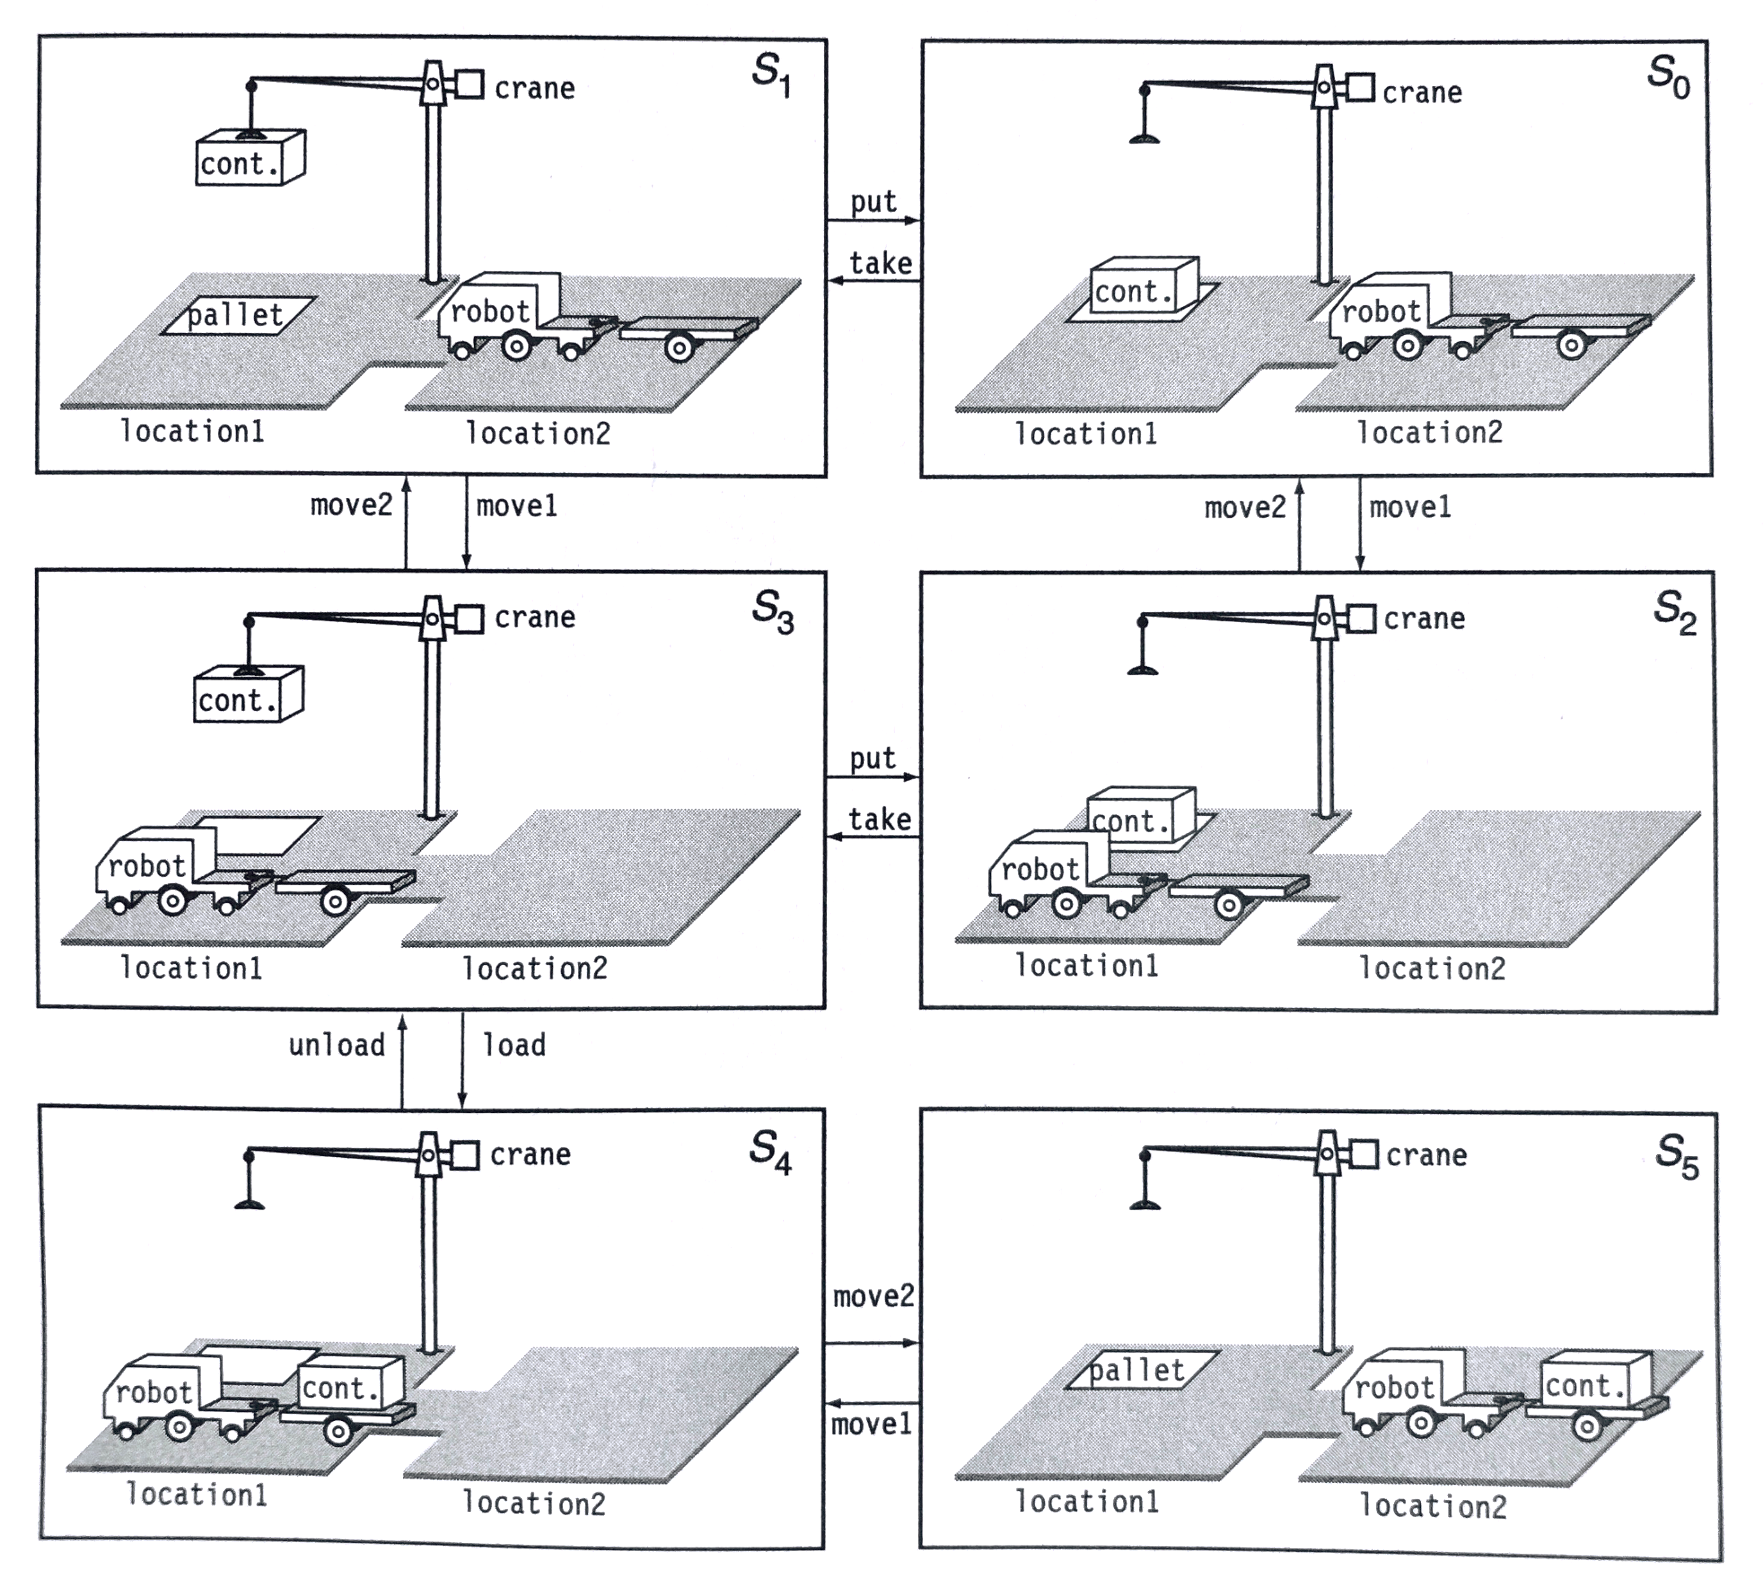
If only I had a plan…
Goal: transport the container from location 1 to location 2
… to be unloaded by the recipient
Transitions:
put: put container down
take: lift container
load: container on truck
move1: location2 → location1
move2: location1 → location2
Seems automatable!
Notes:
Image from M. Ghallab, D. Nau, P. Traverso, Automated Planning: Theory and Practice, Elsevier, 2004

Slide 4
Representing the problem
Question: how to describe the various world states?
Images: hard to process
3-D (physical) model: expensive, hard to process, unnecessary detail
Free text: every problem has new notation
Our solution: first-order logic (FOL)
Will start by reviewing propositional logic
Will then introduce variables
Notes:
Unnecessary detail: what if the container shifts a half inch during transportation?

Slide 5
Propositional logic
Logical constants: true, false
Propositional symbols: p, q, s, ... (atoms)
Atomic proposition: single symbol (starting with lower case letter)
Proposition or logical formula:
an atomic proposition or
a compound proposition of the form
¬ p not p [negation]
p ∧ q p and q [conjunction]
p ∨ q p or q [disjunction]
p → q p implies q [implication / conditional]
p ← q p if q [reverse implication]
p ↔ q p if and only if q [biconditional]
Can also wrap propositions in parentheses: ( … )
When parentheses are omitted, precedence follows this table
highest precedence at top

Slide 6
Examples of Propositions
Suppose hot means “It is hot”
Suppose humid means “It is humid”
Let rain mean “It is likely to rain”
(hot ∧ humid) → rain
“If it is hot and humid, then it is likely to rain”
humid → hot
“If it is humid, then it is hot”
What if I use French: “chaud”, “humide”, “pluie”
We can still reason even if the symbols change
The meanings of atoms are completely determined by us
Could use p, q, and it has the same meaning to the machine
Would need a truly intelligent system to assign meanings to symbols
Our only concern is what we can infer: is it raining?
Notes:
Note: humid implies hot is not actually true – it can be humid in cold weather.

Slide 7
Propositions for docks
h: crane holding container
p: container on pallet
c: robot on crane side (left)
d: robot on delivery side (right)
u: lift container up
l (ell): lower container
Write statements for:
lifting container
lowering container on robot
moving container to delivery side
danger situations: dropping container on ground, lifting a container when one already in the air
This gives us a way to represent the information
But is it useful? Need a way to reason with them
That is, we need to be able to identify which conclusions are justified
This means having a formal definition of the operations
That is, defining their semantics

Slide 8
Truth tables: semantics for propositions
The five logical connectives:
p | q | ¬ p | p ∧ q | p ∨ q | p → q | p ↔ q
true | true | false | true | true | true | true
true | false | false | false | true | false | false
false | true | true | false | true | true | false
false | false | true | false | false | true | true
A complex sentence:
p | h | p ∨ h | ¬ h | (p ∨ h) ∧ ¬ h | ((p ∨ h) ∧ ¬ h) → p
true | true | true | false | false | true
true | false | true | true | true | true
false | true | true | false | false | true
false | false | false | true | false | true

Slide 9
Rules of Inference: more concise semantics
Truth tables: work, but too expensive
Given N propositions, have 2^{N} cases to consider
Not a problem for small N (say, up to 20 or so propositions)
Consider planning to assemble a washer from hundreds of parts…
Improvement: use rules of inference
how new sentences are derived from existing sentences
RULE PREMISE CONCLUSION
Modus Ponens p, p → q q
And Introduction p, q p ∧ q
And Elimination p ∧ q p
Double Negation ¬ ¬ p p
Distribution Over And ¬(p ∧ q) ¬ p ∨ ¬ q
Implication Elimination p → q ¬ p ∨ q
Unit Resolution p ∨ q, ¬ p q
Notes:
Unit resolution: provable by truth tables

Slide 10
How do we know unit resolution is a valid rule?
Truth tables to show {p ∨ q, ¬p} is equivalent to {¬p, q}
p | q | p ∨ q | ¬p | (p ∨ q) ∧ ¬p | ¬p ∧ q | OK?
True | True | True | False | False | False | ✓
True | False | True | False | False | False | ✓
False | True | True | True | True | True | ✓
False | False | False | True | False | False | ✓

Slide 11
Application: starting a car
Let
batt: battery is charged
gas: engine receiving gasoline
ig: ignition is engaged
run: engine is running
Then we can say an engine is running when the battery is charged, the engine is receiving gasoline, and the ignition is engaged:
bat ∧ gas ∧ ig → run
Suppose the engine is not running; can we explain why?
What can we deduce from gas, ig, and ¬run?

Slide 12
Proof: battery not charged
RULE PREMISE CONCLUSION
Modus Ponens p, p → q q
And Introduction p, q p ∧ q
And Elimination p ∧ q p
Double Negation ¬¬p p
Distribution Over And ¬(p ∧ q) ¬p ∨ ¬q
Implication Elimination p → q ¬p ∨ q
Unit Resolution p ∨ q, ¬p q
Known:
batt ∧ gas ∧ ig → run
gas
ig
¬run
Steps:
¬(batt ∧ gas ∧ ig) ∨ run
by implication elimination
(¬batt ∨ ¬(gas ∧ ig)) ∨ run
by distribution over and
(¬batt ∨ ¬gas ∨ ¬ig) ∨ run
by distribution over and
¬batt ∨ ¬gas ∨ ¬ig
by unit resolution between 4, 5
¬batt ∨ ¬gas
by unit resolution between 3, 8
¬batt
by unit resolution between 2, 9

Slide 13
Proving things
A proof is a sequence of propositions, where each proposition is either a premise or a proposition derived from earlier propositions in the proof by one of the rules of inference.
The last proposition is the theorem (also called goal or query) that we want to prove.
Previous proof
Premise: {batt ∧ gas ∧ ig → run, gas, ig, ¬run}
Conclusion: ¬batt
But will this work for planning?

Slide 14
Propositional logic is a weak language
Hard to identify “individuals” (e.g., Mary, 3)
Can’t directly talk about properties of individuals or relations between individuals (e.g., “Bill is tall”)
Generalizations, patterns, regularities can’t easily be represented (e.g., “all triangles have 3 sides”)
First-Order Logic (abbreviated FOL or FOPC): a way to concisely represent this kind of information
Adds:
Variables: x, y
Quantifiers: ∀ x, ∃ y
Relations: elephant(x), fears(x, y)
Sentences:
“Every elephant is gray”: ∀ x (elephant(x) → gray(x))
“There is a white alligator”: ∃ x (alligator(x) ^ white(x))
“Elephants are afraid of mice”: ∀ x ∀ y (elephant(x) ∧ mouse(y) → fears(x, y))

Slide 15
Quantifiers
Universal quantifiers are often used with “implies” to form “rules”:
(∀x) student(x) → smart(x) means “All students are smart”
Universal quantification is rarely used to make blanket statements about every individual in the world:
(∀x)student(x)∧smart(x) means “Everyone in the world is a student and is smart”
Existential quantifiers are usually used with “and” to specify a list of properties about an individual:
(∃x) student(x) ∧ smart(x) means “There is a student who is smart”
A common mistake is to represent this English sentence as the FOL sentence:
(∃x) student(x) → smart(x)
But what happens when there is a person who is not a student?

Slide 16
Connections between All and Exists
We can relate sentences involving ∀ and ∃ using De Morgan’s laws:
(∀x) ¬p(x) ↔ ¬(∃x) p(x)
¬(∀x) p ↔ (∃x) ¬p(x)
(∀x) p(x) ↔ ¬ (∃x) ¬p(x)
(∃x) p(x) ↔ ¬(∀x) ¬p(x)

Slide 17
Applying FOL to planning
Suppose a robot is stacking blocks, each the same size
A smaller version of the problem of stacking boxes in a room…
Each block has a name: a, b, c, etc.
Typical problem: create a stack c on b, b on a
Relations:
holding(a) - robot is holding block a in its gripper
empty - robots gripper is empty
on(a, b) - block a is directly on top of block b
ontable(c) - block c is on the table
clear(d) - block d has nothing on top of it
How would you write the following?
If the robot is holding a block, that block is not on the table
If the robot is holding a block, that block is not on another block
Clear blocks have nothing on them – a definition of clear

Slide 18
Planning
Planning in the blocks world: finding a sequence of actions that rearrange the blocks appropriately
Actions:
lift(x): lift block x
drop(y): drop block y on table
place(x, y): place block x on top of block y
Each action has a precondition and effect
lift(x):
Precondition: empty, clear(x)
Effect: holding(x)

Slide 19
STRIPS operators
Can represent the world as a set of facts:
{ on(a, b), ontable(b), ontable(c), empty }
STRIPS: a planning system capturing events achieving a goal
Stanford Research Institute Problem Solver
Developed in 1971, the basis for much research on planning
STRIPS operators: planning steps
Each has a name; lift_from_table(x)
Each has a delete list: facts to remove when executing the step
If any element not present, cannot apply the step – these are preconditions
Example: empty, ontable(x), clear(x)
Each has an add list: facts to add as a result of executing the step
Example: holding(x), clear(x)

Slide 20
Blocks world STRIPS operators
lift_from_table(x)
Delete list/precondition: empty, ontable(x), clear(x)
Add list: holding(x), clear(x)
lift_from_block(x)
Delete list/precondition: empty, on(x, y), clear(x)
Add list: holding(x), clear(y), clear(y)
drop(x) – drop a block on the table
Delete list/precondition: holding(x)
Add list: ontable(x), clear(x)
place(x, y) – place block x on top of block y
Delete list/precondition: holding(x), clear(x), clear(y)
Add list: on(x, y), clear(x)

Slide 21
Strips operators and FOL
lift_from_table(x)
Delete list: empty, ontable(x), clear(x)
Add list: holding(x), clear(x)
This operator corresponds to the sentences
∀x ∀t1 ∃t2 ontable(x, t1) ∧ clear(x, t1) ∧ empty(t1) ∧ lift_from_table(x, t1) ∧ successor(t1, t2) → ¬ontable(x, t2) ∧ ¬empty(t2) ∧ holding(x, t2) ^ clear(x, t2)
t1, t2: the moment in time when a fact is true
successor(t1, t2): t2 is the time just after t1
Could further simplify with facts such as
∀t ∀x holding(x, t) → ¬ontable(x, t) ∧ ¬empty(t)
That is: if the gripper is holding a block, it’s not on the table and the gripper isn’t empty

Slide 22
Logic with strips operators
Adding FOL simplifies certain goals
Example: define above(x, y) to mean x is on y or x is on a block that is above y:
∀x ∀y (above(x, y) ↔ on(x, y) ∨ ∃z (on(x, z) ∧ above(z, y)))
Can then say I want block a above b and c; we don’t care how b and c are arranged:
Goal: above(a, b) ∧ above(a, c)

Slide 23
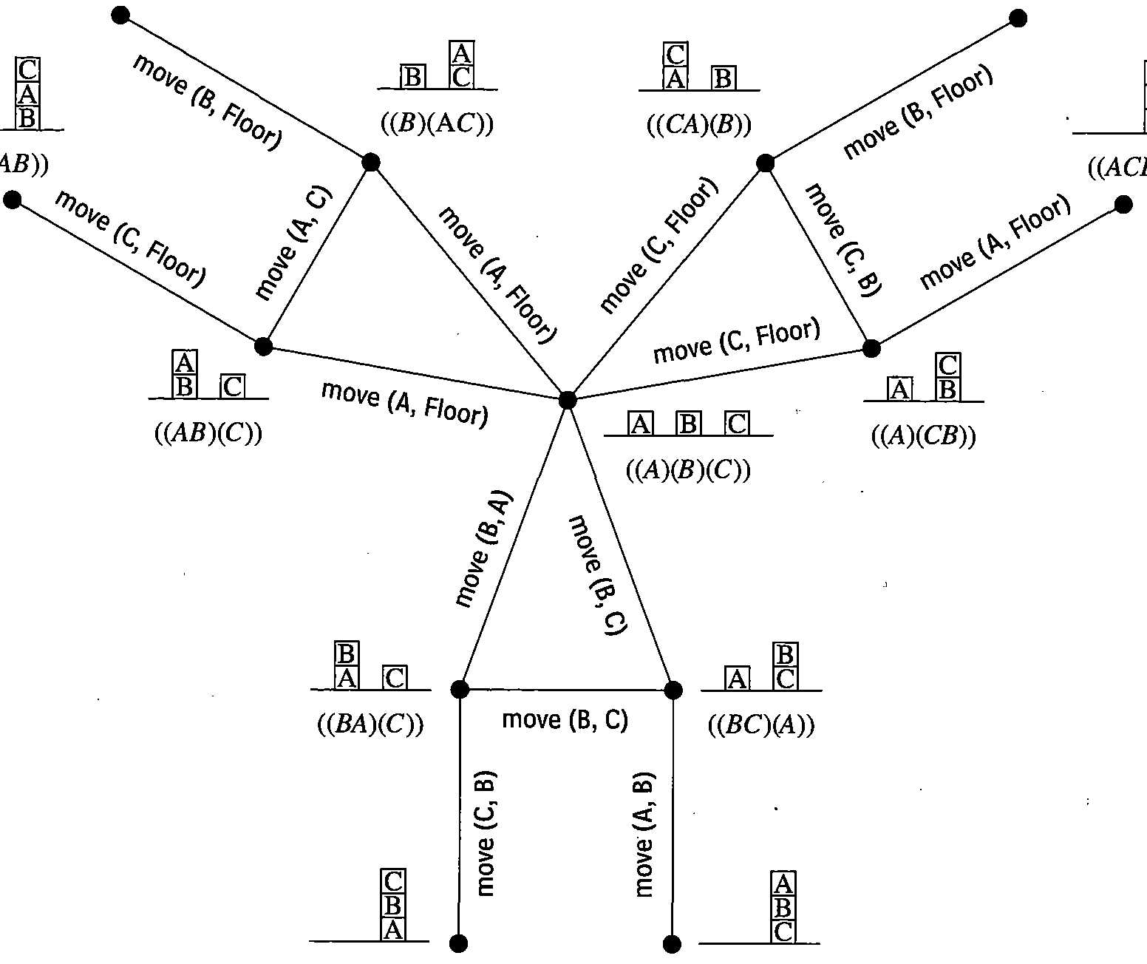
Finding plans
move(x, y):
shorthand: pick up x and place on y
“Floor” = “table”
Finding a plan: state space search
Consider A* heuristics that might work in this domain…
Notes:
Graph: from Nilsson, Ch. 2, Figure 7

Slide 24
Review
Planning: finding a sequence of steps to accomplish a goal
Propositional logic: a powerful way to capture knowledge about the domain
Predicate logic: adds general rules
Introduces forall (∀), exists (∃)
STRIPS: a planning system based on delete, add lists
Planning as state space search

