Slide 1

CS 2400 Introduction to Artificial Intelligence
Readings: 7.1, 7.5
Neural Networks

Slide 2
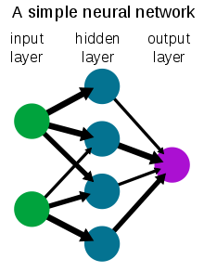
Neural Networks
Origins: Algorithms that try to mimic the brain
Very widely used in 80s and early 90s
Recent resurgence:
  State-of-the-art technique for many applications
Artiﬁcial neural networks are not nearly as complex or intricate as the actual brain structure
8

Slide 3
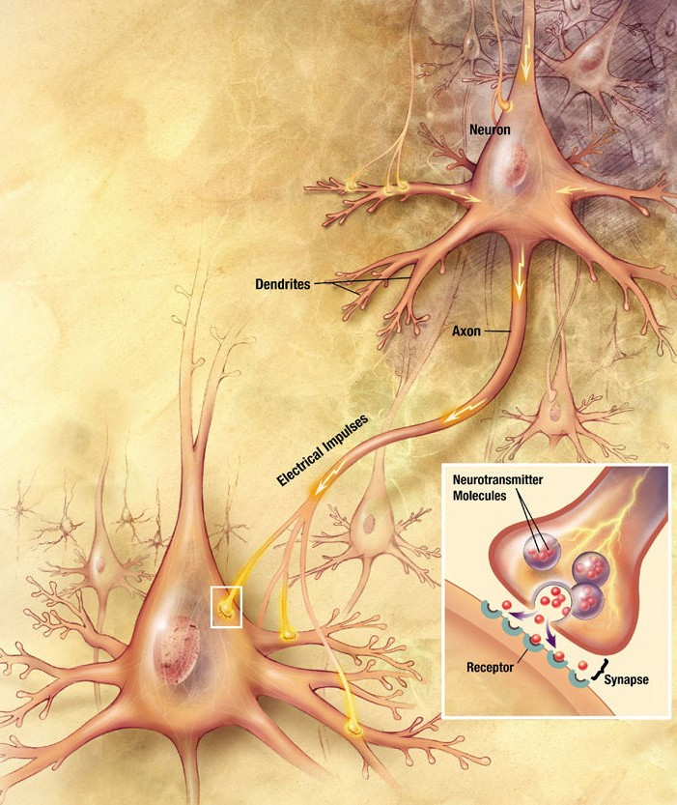
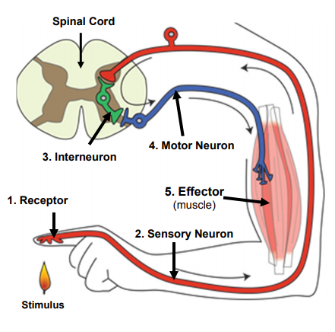
Biology of a Neuron
3

Slide 4
Brain Structure
Diﬀerent areas of the brain have diﬀerent functions
  Some areas seem to have the same function in all humans
    e.g. Broca’s region for motor speech
  The overall layout is generally consistent
  Some areas are more flexible, and vary in their function
    low-­‐level structure and function can vary greatly
We don’t know how diﬀerent functions are “assigned” or acquired
  Partly the result of the physical layout / connection to inputs (sensors) and outputs (actuators)
  Partly the result of experience (learning)
We really don’t understand how this neural structure leads to what we perceive as “consciousness” or “thought”
  We therefore have no idea how to recreate it☺
Based on slide by T. Finin, M. desJardins, L Getoor, R. Par
4

Slide 5

Building a Neural Net
h
Output
x₁
x₂
…
x_{M}
Features
Each Neuron “holds” a number (really it is a function) between 0 and 1
This corresponds to an “activation”
Why does it make sense to limit the numbers to 0..1?
Notes:
This is regular perceptron

Slide 6
Building a Neural Net
Hidden layers are added to enable more complex learning
_{h}
Output
a₁
a₂
…
a_{D}
Hidden Layer
D = M
x₁
x₂
…
x_{M}
Input
Notes:
What if we connect all the X to all the Z?

Slide 7
Building a Neural Net
Tuning tip #1: Try different numbers of neurons!
_{h}
Output
a₁
a₂
…
a_{D}
Hidden Layer
D < M
x₁
x₂
x₃
…
x_{M}
Input
Notes:
What if we connect all the X to all the Z?

Slide 8
Multi-Class Output (Classification)
Activation here corresponds to
the “percentage” likelihood
for this output
The max value of the neurons
in the output layer is the “choice”
What happens if 2 outputs are equivalent?
h₁
…
h_{K}
Output
a₁
a₂
…
a_{D}
Hidden Layer
x₁
x₂
x₃
…
x_{M}
Input
Notes:
Why called feed forward?

Slide 9



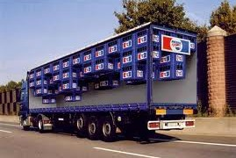
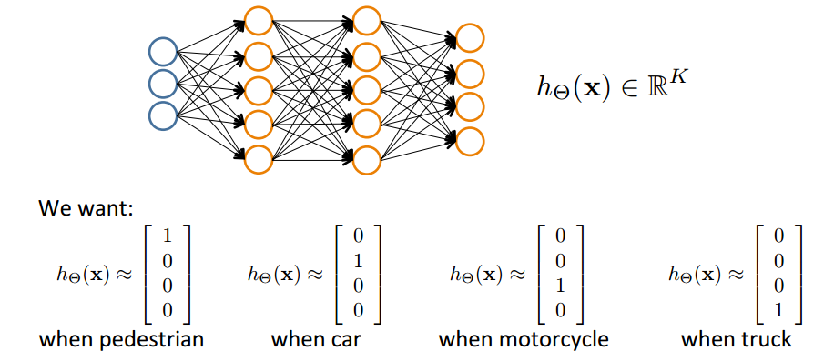
Classification Example
Pedestrian
Car
Motorcycle
Truck
Slide by Andrew Ng
17

Slide 10
Basic Neural Network: Perceptron
_{0.95}
0.5
0.65
0.3333
0.1*0.5 + 0.75*0.3333 + 0.65 = 0.95
_{0.01}
_{.75}
Bias
Bias: a way to shift the activation
a.k.a. putting your finger on the scale
  Sometimes needed, sometimes not
Learning Process:
Start: Randomly assign weights (between 0-1)
Iterate:
Present inputs from training data
Get output h, nudge weights to gives results toward our desired output
Stop when enough epochs have completed

Slide 11
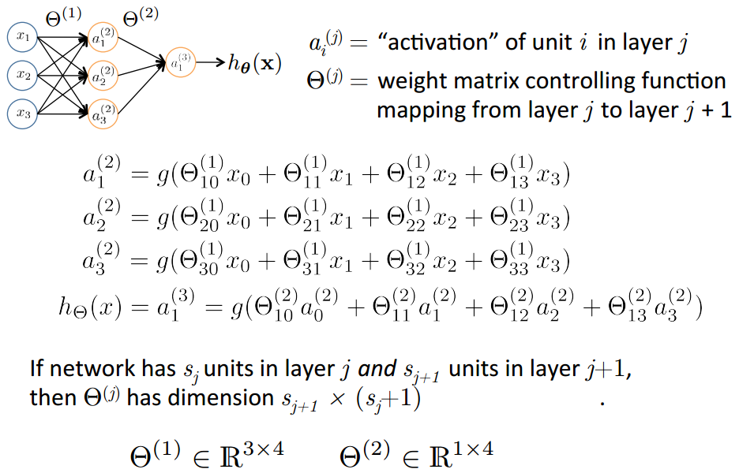
Neural Network
Each output will need to be
between 0 and 1
A Sigmoid function will
“compress” outputs to 0..1
This is an “Activation Function”
Slide by Andrew Ng
14

Slide 12
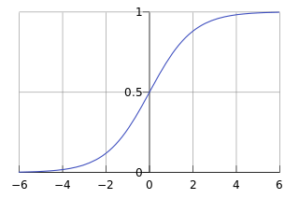
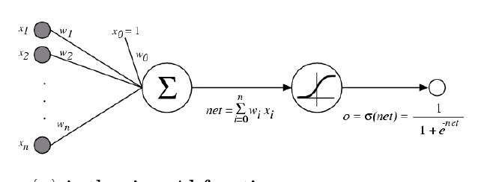
Activation Functions
Sigmoid / Logistic Function
Sigmoid is not the only game in town…

Slide 13
NN In class exercise
1
2
We are going to build a Neural Network with you!
  Tic-tac-toe classifier
  Who wins? X or O
14 volunteers needed!
Step 1 map board to input neurons…
Step 2
  Math
  See Excel sheets for your neuron
3
10
4
11
14
5
12
Output
6
13
7
Hidden
8
9
Input

Slide 14
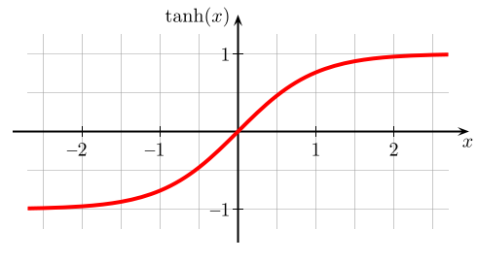
Activation Functions
Sigmoids are not widely used for a variety of reasons
  Mostly their limitations for training NN with lots of layers
    Vanishing Gradient caused by limited activation range and lots of hidden layers
    https://en.wikipedia.org/wiki/Vanishing_gradient_problem
Alternate 1: tanh
Like logistic function but shifted to range [-1, +1]
Slide from William Cohen

Slide 15
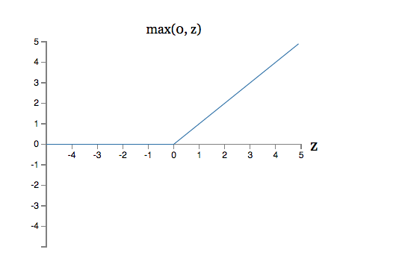

Activation Functions
reLU often used in vision tasks (for hidden layers)
Alternate 2: rectified linear unit
Linear with a cutoff at zero
Some gradients are fragile during training and cause the neuron to stop activating
Wait, this isn’t 0..1 anymore
Slide from William Cohen

Slide 16
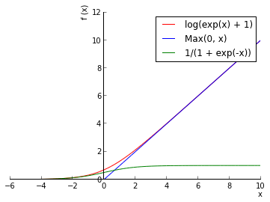
Activation Functions
Soft reLU also often used in vision tasks
Alternate 2: rectified linear unit
Soft version: log(exp(x)+1)
Doesn’t saturate (at one end)
Sparsifies outputs
Helps with vanishing gradient
Slide from William Cohen

Slide 17
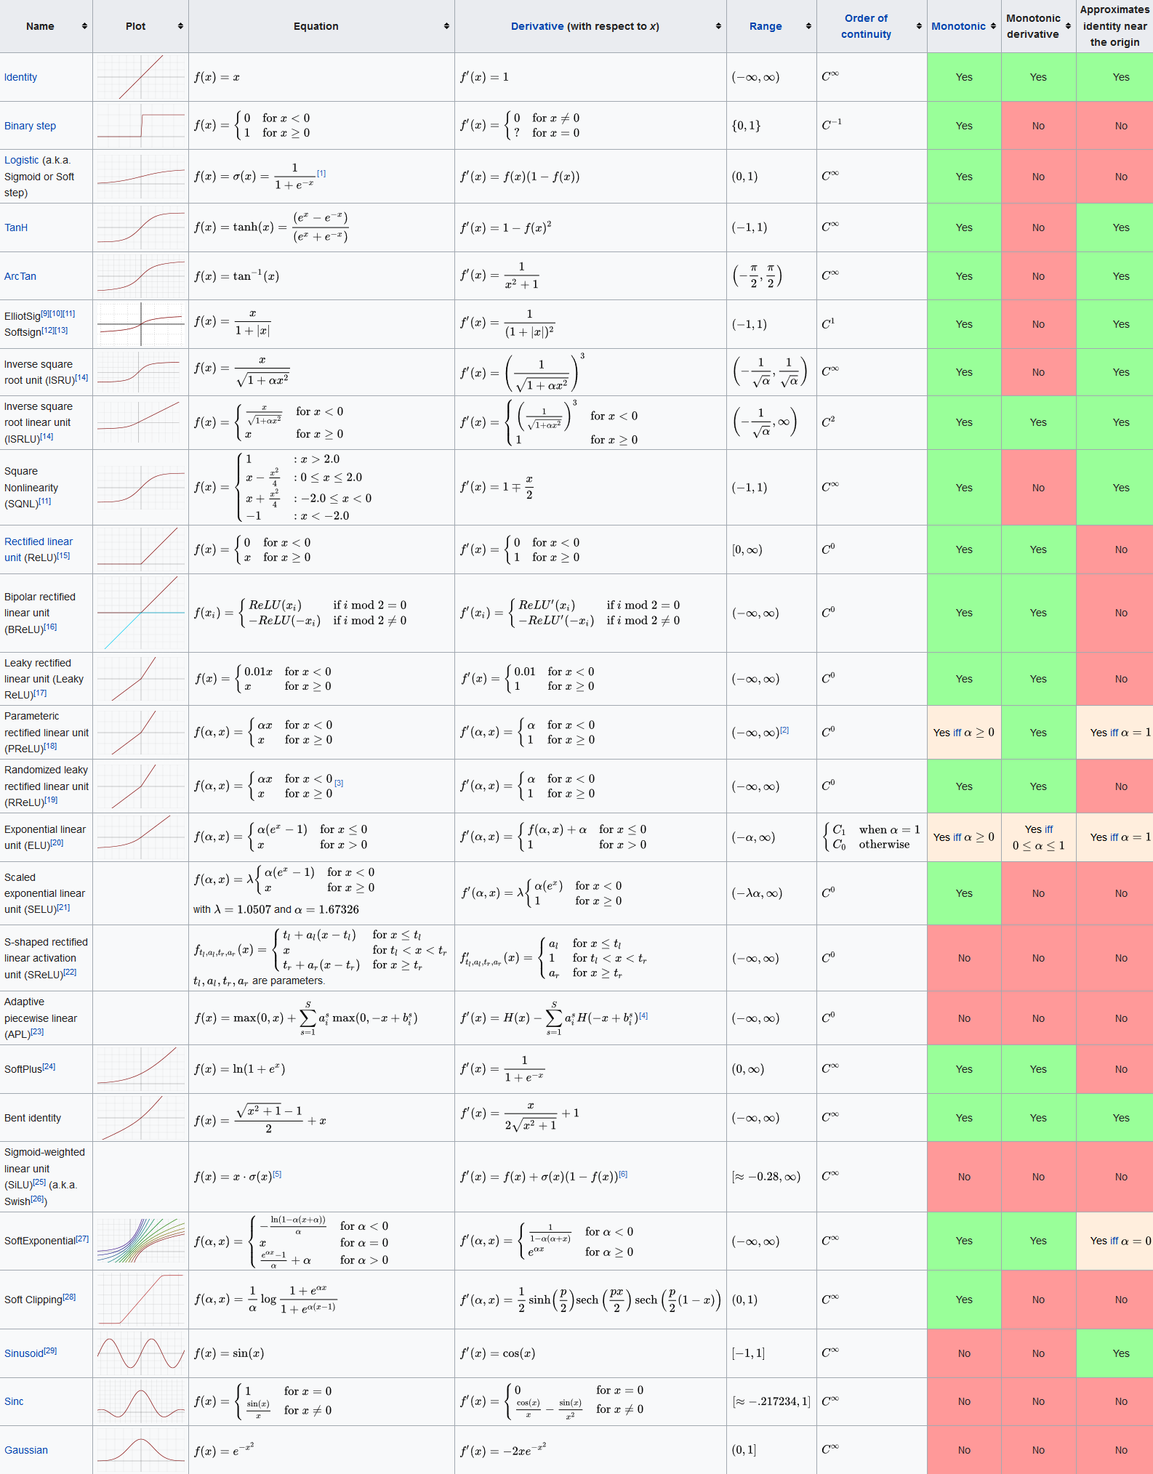
Activation Function Summary
There are several activation functions
  Tradeoffs exist
  Conventions exist
There are more not presented here, but the concepts are similar
New activation functions will be invented
https://en.wikipedia.org/wiki/Activation_function

Slide 18
Tracing NN Inference

Slide 19
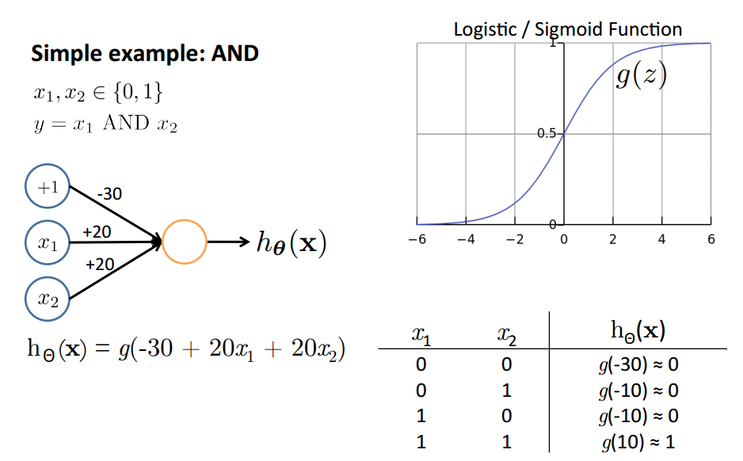
Representing Boolean Functions
Bias
Based on slide and example by Andrew Ng
21

Slide 20
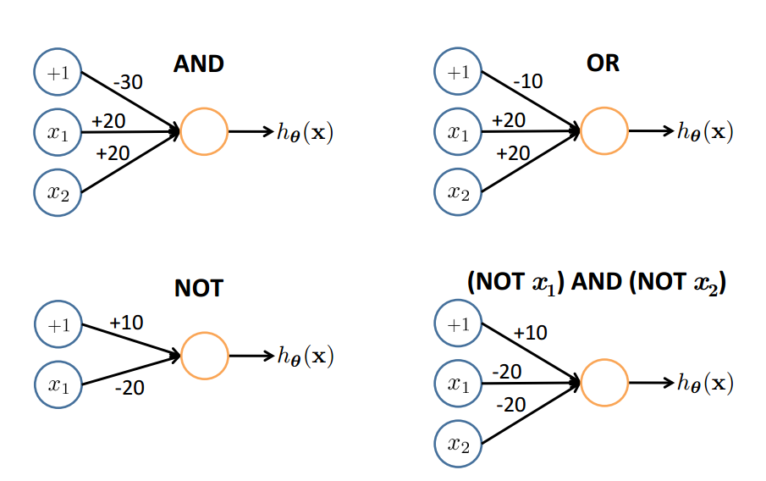
Let’s try some weights and biases for OR
0
1
1
1

Slide 21
Let’s try some weights and biases for AND
AND
0
0
0
1

Slide 22
Let’s try some weights and biases for NOR
NOR
1
1
1
0

Slide 23
Representing Boolean Functions
22

Slide 24
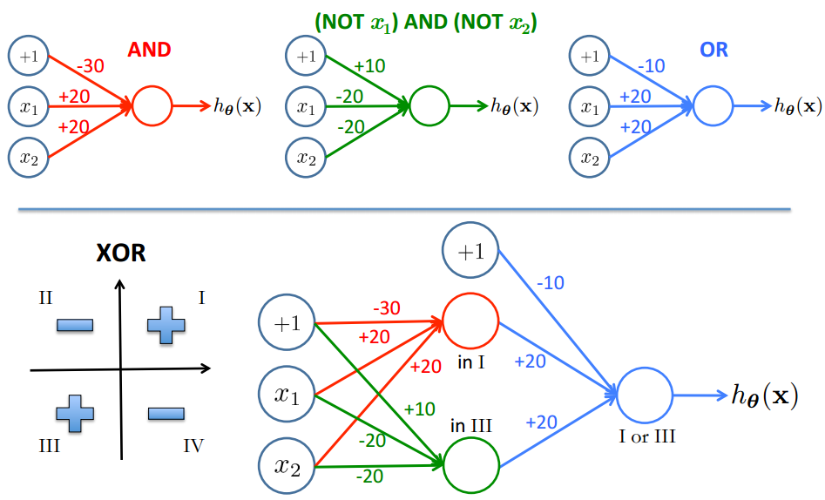
Combining Representations to Create Non-­Linear Functions
Based on example by Andrew Ng
23

Slide 25

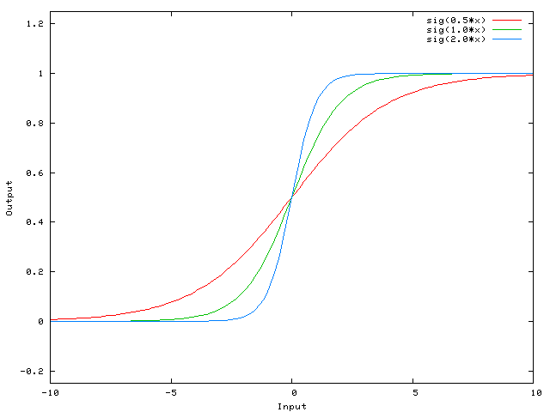
Role of Bias
The Activation function is limited in what it can detect (activate)
Consider this 1-input, 1-output network that has no bias:
Reminder: The output of the network is computed by
  multiplying the input (x)
  by the weight (w₀)
  and passing the result through some kind of activation function
Weight changes will only change the “Steepness” of the curve
  Limitations?

Slide 26
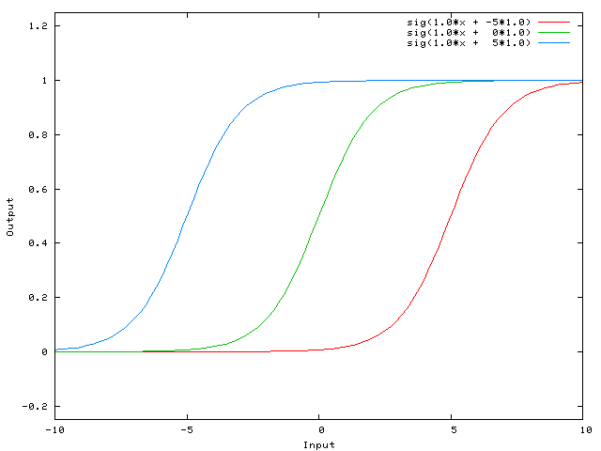
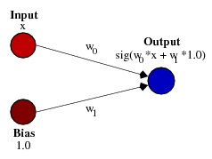
Role of Bias
What if you wanted the network to output 0 when x is 2?
Just changing the steepness of the sigmoid won't really work
  you want to be able to shift the entire curve to the right.
That's exactly what the bias allows you to do.
We add a bias to that network, like:
  Note that only one bias is needed per neuron
Having a weight of -5 for w₁ shifts the curve to the right
This allows us to have a network that outputs 0 when x is 2

Slide 27
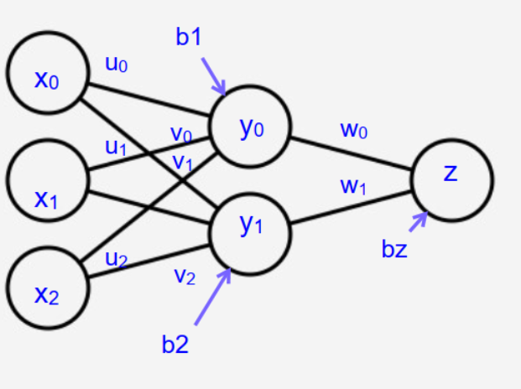
Computing the result
Inputs: x₀, x₁, x₂
Weights: u₀, u₁, u₂, v₀, v₁, v₂, w₀, w₁
Biases: b₁, b₂, b_{z}
Activation functions: h for hidden units, f for output
Computing y₀, y₁:
[x₀ x₁ x₂] + [b₁ b₂] = [y₀ y₁]
Computing output:
[h(y₀) h(y₁)] + b_{z} = z, so output is f(z)
u₀ | v₀
u₁ | v₁
u₂ | v₂
W₀
W₁

Slide 28
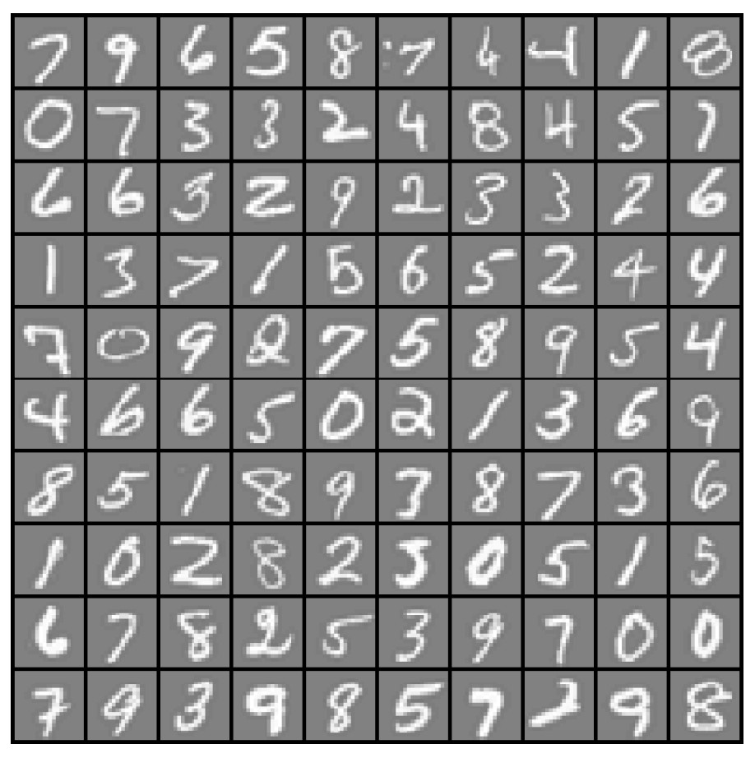

Example: Computer Vision Input
x₁ ... x₂₀
x₂₁ ... x₄₀
x₄₁ ... x₆₀
...
^{x}381 ^{... x}400
20 × 20 pixel images
d = 400 10 classes
Each image is “unrolled” into a vector x of pixel intensities

Slide 29
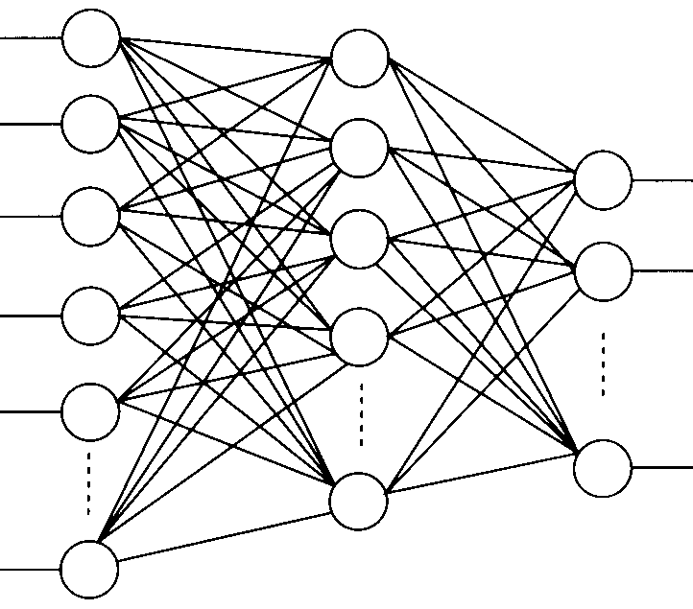
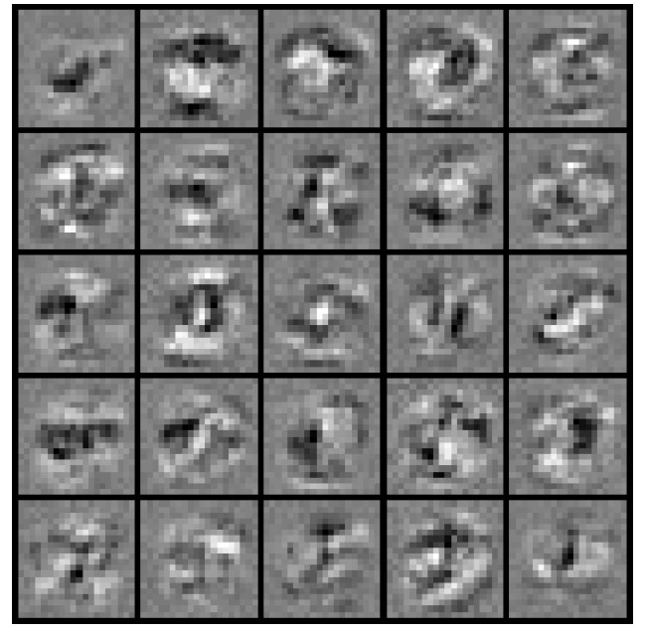
Layering Representations
x₁
x₂
x₃
x₄ x₅
Output Layer
“0”
“1”
“9”
x_{d}
Hidden Layer
Input Layer
Visualization of Hidden Layer

Slide 30
Different Levels of Abstraction
We don’t know the “right” levels of abstraction
So let the model figure it out!
Notes:
TODO: Make pixels greyscle
TODO: Increase size of 1st hidden layer

Slide 31
Different Levels of Abstraction
Face Recognition:
  Deep Network can build up increasingly higher levels of abstraction
  Lines, parts, regions
Notes:
TODO: Make pixels greyscle
TODO: Increase size of 1st hidden layer

Slide 32
Neural Network Video
https://www.youtube.com/watch?v=aircAruvnKk

Slide 33
Architectures

Slide 34
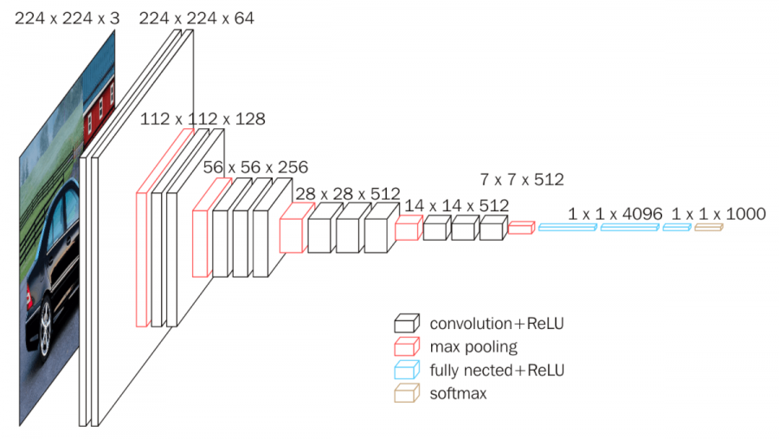
Neural Network Architectures
Even for a basic Neural Network, there are many design decisions to make:
  Structure of input data
  # of hidden layers (depth)
  # of neurons per hidden layer (width)
  Type of activation function
    at each neuron
  Structure of output data

Slide 35
Decision Boundary
0 hidden layers: linear classifier
  Hyperplanes

Slide 36
Decision Boundary
1 hidden layer
  Boundary of convex region (open or closed)
Notes:
We saw with XOR

Slide 37
Decision Boundary
2 hidden layers
  Combinations of convex regions

Slide 38
Decision Boundary
Many hidden layers
  Complex combinations of convex regions
Lots of layers and neurons have a lot of capacity for “intelligence”
  Structure and training dictate their capability
Nature vs. nurture

