Slide 1
CS 2400 Introduction to Artificial Intelligence
Reading: 7.5
Training Neural Networks

Slide 2
Training a Neural Network
Run an example from the training set
attribute values are input
normalized of course!
Feed-forward process
Summation of weights and activation functions are applied at each node of hidden and output layers
Back-propagation process
Measure error, go back from the output layer to each hidden layer, (layer by layer)
Modify the weights and biases
Eventually the weights will (should) converge and training stops

Slide 3
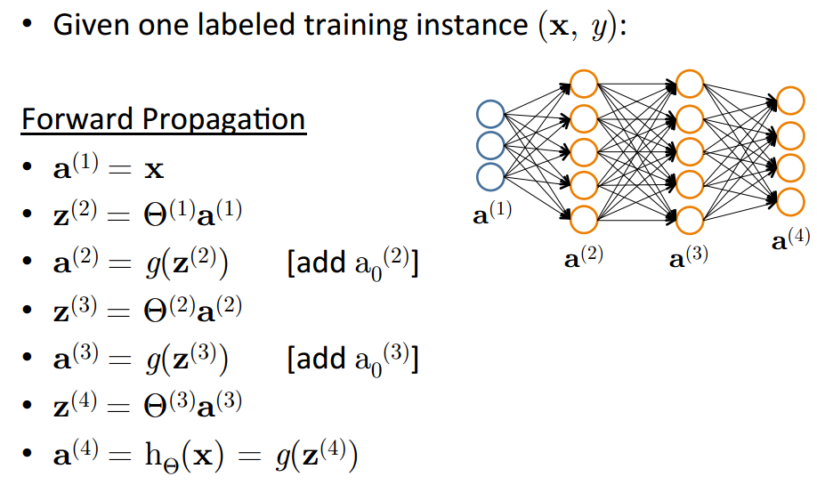
Forward Propagation
Remember, g(x) is our activation function
Based on slide by Andrew Ng

Slide 4
Perceptron Learning Rule
Equivalent to the intuitive rules:
If output is correct, don’t change the weights
If output is low (h(x) = 0, y = 1), increment weights for all the inputs which are 1
If output is high (h(x) = 1, y = 0), decrement weights for all inputs which are 1
Perceptron Convergence Theorem:
If there is a set of weights that is consistent with the training data (i.e., the data is linearly separable), the perceptron learning algorithm will converge [Minicksy & Papert, 1969]
29

Slide 5
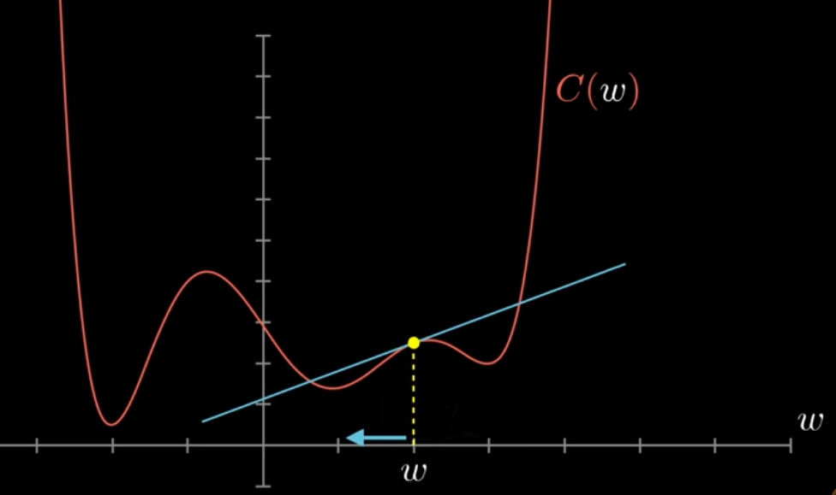
Backpropagation
Technique for calculating the Gradient (derivative) of a function
Used for Neural Networks to calculate the gradient of the cost function
The gradient of the cost function defines the “adjustments” necessary to all weights, biases to reduce the error
Not “learning” by itself
What if the cost function is discontinuous?

Slide 6
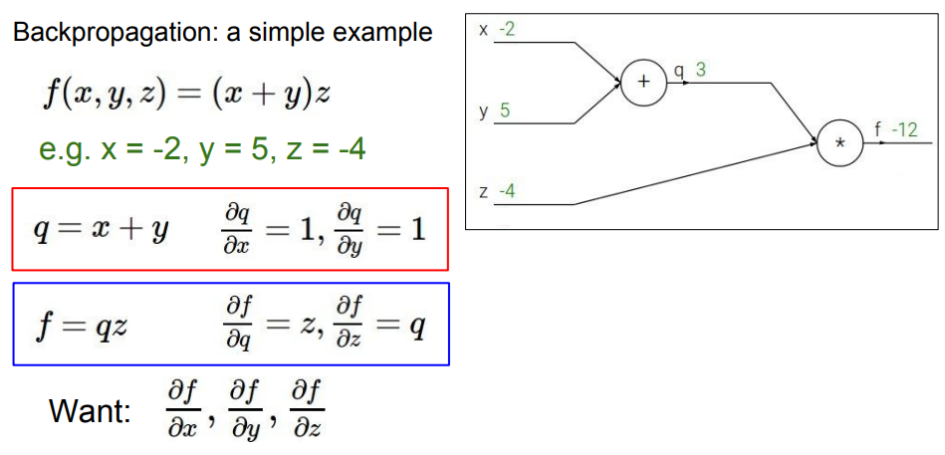
Backpropagation Example- Computational Graph
Goal: Find gradient of f
w.r.t each of the variables
In other words, what is the affect of each of these variables on f ?
How much does f change w.r.t x
Credit: http://cs231n.stanford.edu/slides/2017/cs231n_2017_lecture4.pdf

Slide 7
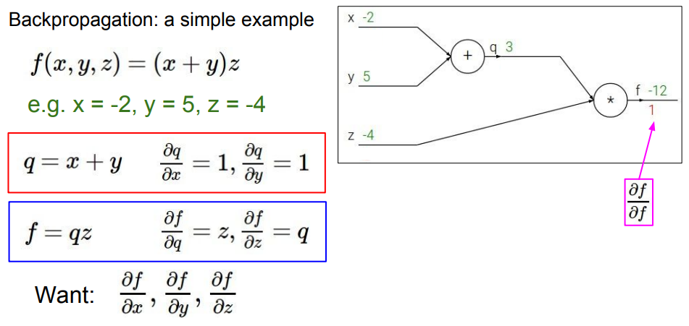
Start at the “back”
Credit: http://cs231n.stanford.edu/slides/2017/cs231n_2017_lecture4.pdf

Slide 8
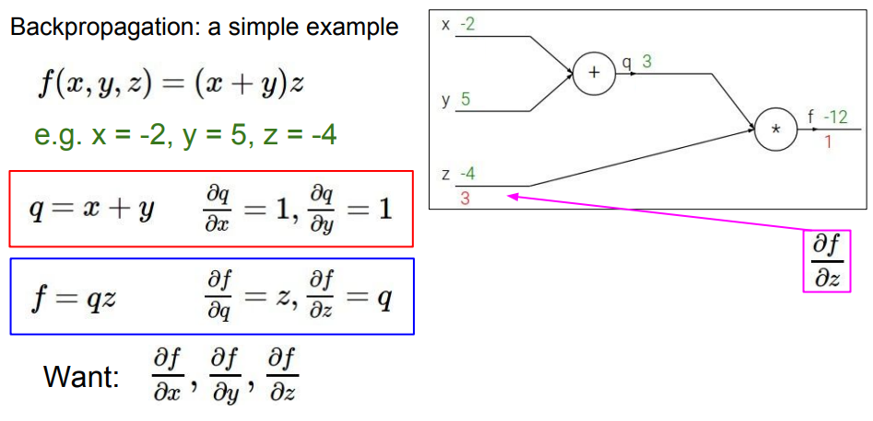
Credit: http://cs231n.stanford.edu/slides/2017/cs231n_2017_lecture4.pdf

Slide 9
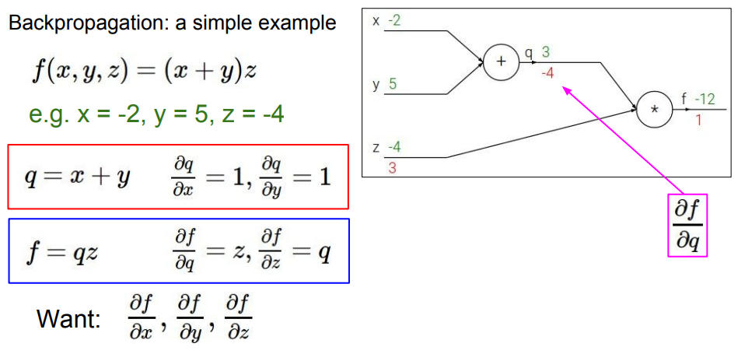
Credit: http://cs231n.stanford.edu/slides/2017/cs231n_2017_lecture4.pdf

Slide 10
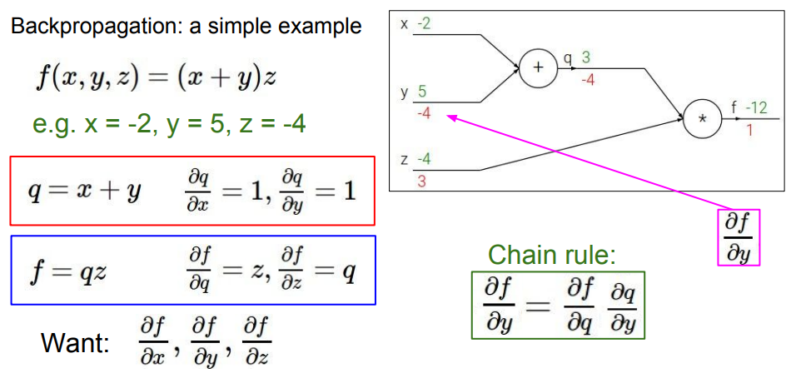
Credit: http://cs231n.stanford.edu/slides/2017/cs231n_2017_lecture4.pdf

Slide 11
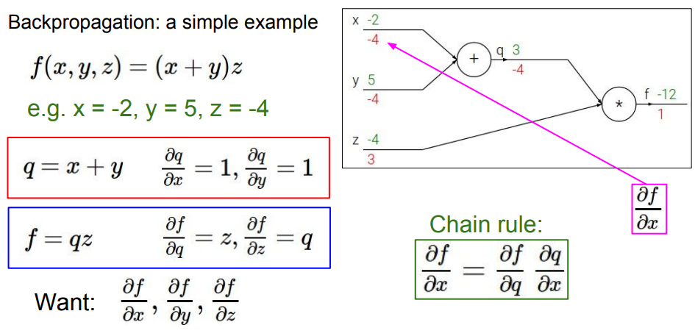
Backpropagation Example
We can use calculus to find the closed-form expressions for computational graphs, but not when we use backprop for neural networks…
Credit: http://cs231n.stanford.edu/slides/2017/cs231n_2017_lecture4.pdf

Slide 12
Backpropagation for Neural Networks
Computes the gradient w.r.t. a loss function for a single training example
Find the adjustments to the weights to rapidly decrease the cost (optimization)
Learning Goal: Minimize Cost function over ALL training data
For multiple variables
Calculate the gradient for each example
Average them and this is your averaged gradient
Step the weights/biases in the direction to reduce the cost
This is “gradient descent”

Slide 13
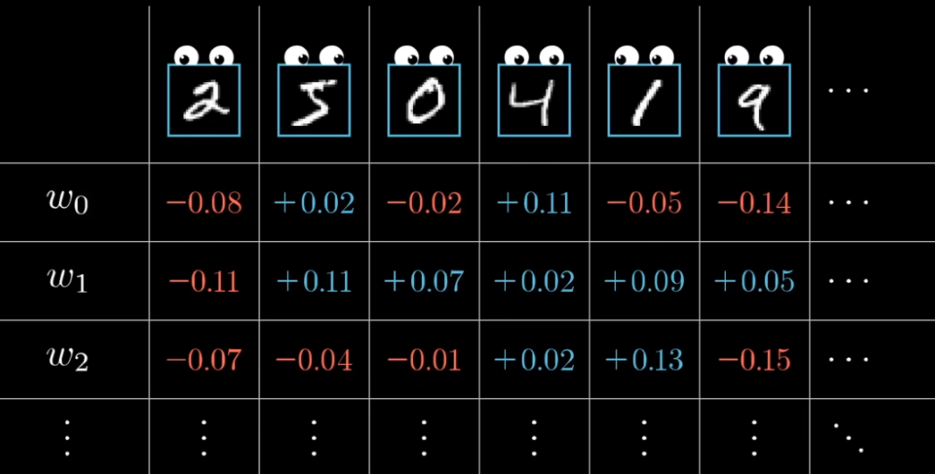
Backpropagation intuition
Gradient is the “average” of all the desired adjustments to the weights and biases in the NN
For all training data
https://www.youtube.com/watch?v=Ilg3gGewQ5U

Slide 14
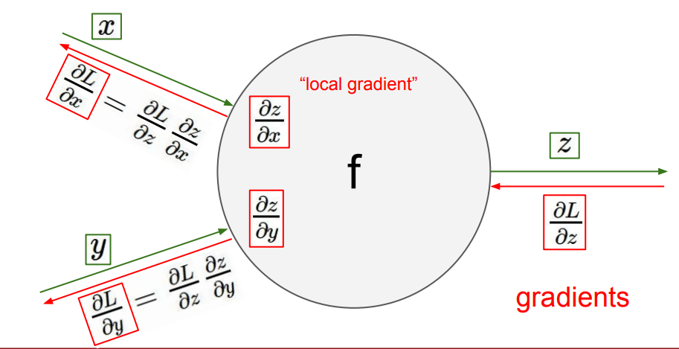
Backpropagation for NN
Gradient of the loss function L
w.r.t. z

Slide 15
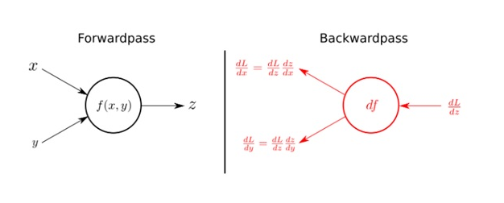
Backpropagation Calculus
We use the Chain Rule from multivariable calculus
Calculate the derivative of the loss function (L)
We want dL/dx, dL/dy, etc. to adjust the weights appropriately
We will do this for every sample!
We can calculate these partial derivatives using the chain rule

Slide 16
Chain Rule
Formula for calculating derivatives of composite functions
Given a composite function f(x) = h(g(x)),
This concept can be extended to any number of nestings in a composite function
Backpropagation recursively applies the chain rule

Slide 17
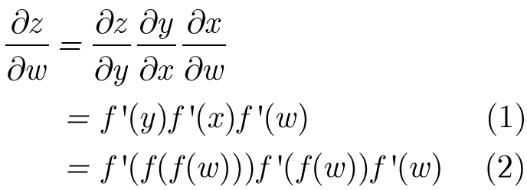
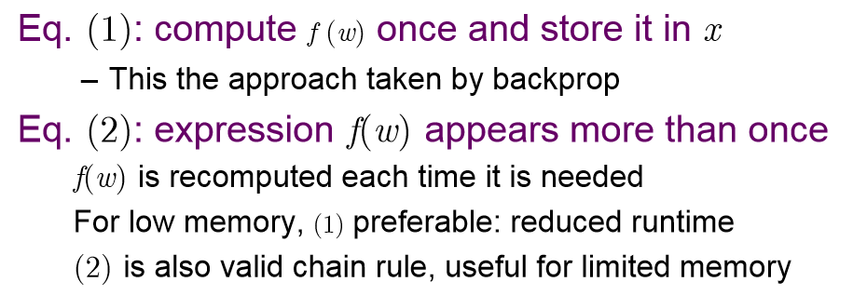
Chain Rule Options
We want to calculate the gradient for the network here->
Computing the Gradient

Slide 18
Backpropagation
Backpropagation is not the learning algorithm
It is a technique for calculating the gradient
Backpropagation + weight updates = learning
It is also not only for machine learning
It can be used to compute derivatives of any function
Or identify that the derivative is undefined
For more information
https://www.youtube.com/watch?v=tIeHLnjs5U8
https://www.youtube.com/watch?v=d14TUNcbn1k

Slide 19
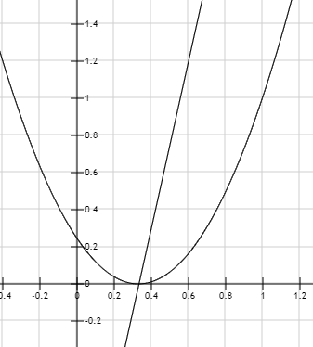
Backpropagation for NN Example (regression)
dC/dw
w = 0.8
Input: x
Output: f(x)=xw
C
Target: y
Mean Squared Error Cost: C=(f(x)-y)²
dC/df = 2 * (f(x)-y)
dC/dw = df/dw * dC/df
dC/dw = x * 2(f(x)-y)
w

Slide 20
Backpropagation for NN Example (regression)
dC/dw
w = 0.8
Input: x
Output: f(x)=xw
C
Mean Squared Error Cost: C=(f(x)-y)²
dC/df = 2 * (f(x)-y)
dC/dw = df/dw * dC/df
dC/dw = x * 2(f(x)-y)
Target: y
w
Epoch | x | w | f(x) | y | C | dC/dw | lr
1 | 1.5 | 0.8 | 1.2 | 0.5 | 0.49 | 2.1 | 0.1
Reduce the weight by
the learning rate (lr) * dC/dw

Slide 21
Backpropagation for NN Example (regression)
dC/dw
w = 0.8
Input: x
Output: f(x)=xw
C
Mean Squared Error Cost: C=(f(x)-y)²
dC/df = 2 * (f(x)-y)
dC/dw = df/dw * dC/df
dC/dw = x * 2(f(x)-y)
Target: y
w
Epoch | x | w | f(x) | y | C | dC/dw | lr
1 | 1.5 | 0.8 | 1.2 | 0.5 | 0.49 | 2.1 | 0.1
2 | 1.5 | 0.59 | 0.885 | 0.5 | 0.148 | 1.155 | 0.1
Reduce the weight by
the learning rate (lr) * dC/dw

Slide 22
Backpropagation for NN Example (regression)
dC/dw
w = 0.8
Input: x
Output: f(x)=xw
C
Mean Squared Error Cost: C=(f(x)-y)²
dC/df = 2 * (f(x)-y)
dC/dw = df/dw * dC/df
dC/dw = x * 2(f(x)-y)
Target: y
w
Epoch | x | w | f(x) | y | C | dC/dw | lr
1 | 1.5 | 0.8 | 1.2 | 0.5 | 0.49 | 2.1 | 0.1
2 | 1.5 | 0.59 | 0.885 | 0.5 | 0.148 | 1.155 | 0.1
3 | 1.5 | 0.47 | 0.7 | 0.5 | 0.04 | 0.6 | 0.1
4 | 1.5 | 0.41 | 0.615 | 0.5 | 0.013 | 0.345 | 0.1
5 | 1.5 | 0.37 | 0.555 | 0.5 | 0.003 | 0.165 | 0.1
100 | 1.5 | 0.34 | 0.51 | 0.5 | 0.0001 | 0.03
Reduce the weight by
the learning rate (lr) * dC/dw

Slide 23
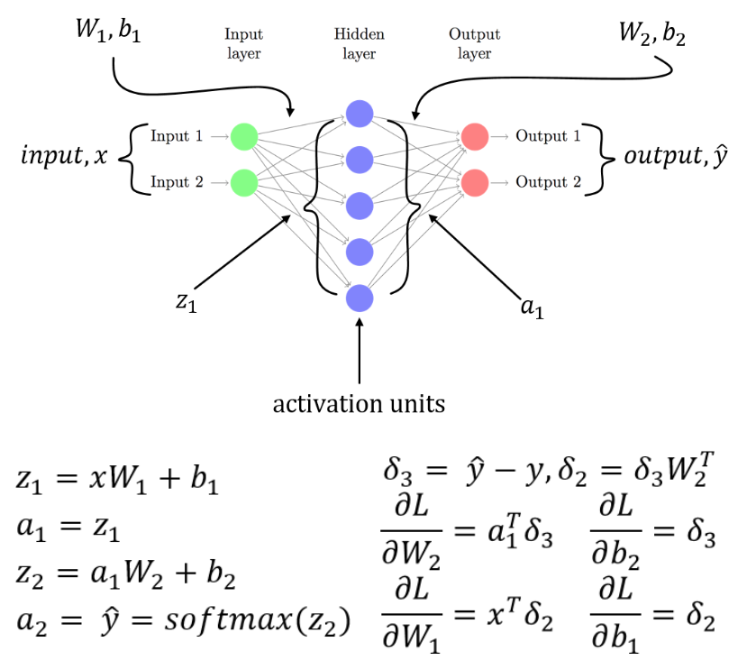
Putting it all together with biases…
activation(z₂)

Slide 24
Computational Cost
Computational cost is proportional to the number of connections in the network
Same as forward propagation
The constant for backprop is MUCH larger, so performance is slower
Storage of derivatives avoids exponential computational explosion
https://kasperfred.com/series/introduction-to-neural-networks/computational-complexity-of-neural-networks

Slide 25
Stochastic Gradient Descent
Calculating the gradient for all training data is computationally expensive
For very large training sets
The gradient for every sample must be calculated before determining each weight adjustment
Millions of training samples
Billions of weights
Ouch.
Alternative: Use a smaller, randomized set (minibatch) instead of the whole training set
This gives an indication
Not precise, but usually accurate
Much faster

Slide 26
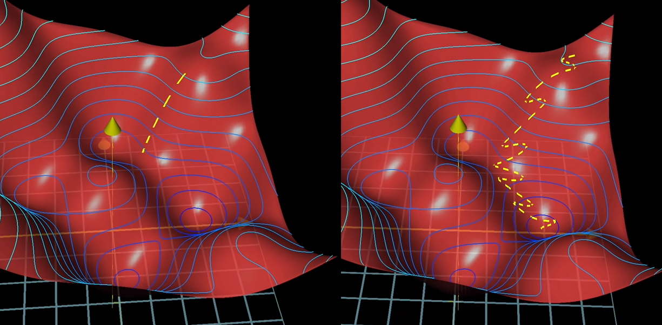
Minibatch
Your minibatch size should be large enough to capture an unbiased set of the classes
Training data must be shuffled!
Compute gradient of the cost function based only on the training samples from the minibatch
Not the actual cost function
But a good approximation
The “walk” to the minimum is faster
But less precise
Gradient Descent SGD

Slide 27
Backpropagation Issues
“Backprop is the cockroach of machine learning. It’s ugly, and annoying, but you just can’t get rid of it.”
- Geoﬀ Hinton

Slide 28
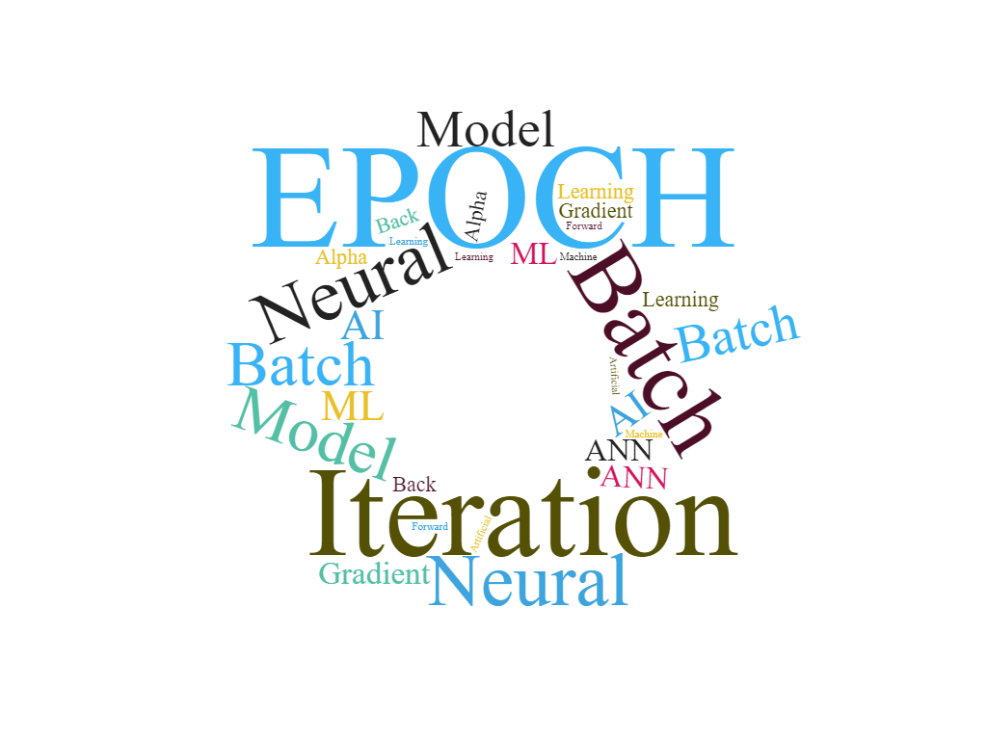
Epochs
Iterations of forward and backward propagation continue until “convergence”
These iterations are referred to as training “epochs”
Too many epochs can contribute to over fitting
Too many hidden layer nodes can also lead to over fitting
Experimentation is key

Slide 29
Training a Neural Network
Randomly initialize weights
Implement forward propagation
Implement code to compute cost function
Implement backprop to compute partial derivatives
Use gradient descent with backprop to ﬁt the network

Slide 30
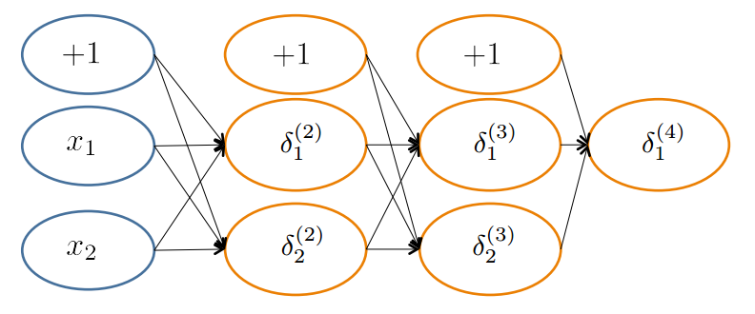
Random Initialization
Important to randomize initial weight matrices
Can’t have uniform initial weights
– Otherwise, all gradients will be identical & the NN won’t learn

Slide 31
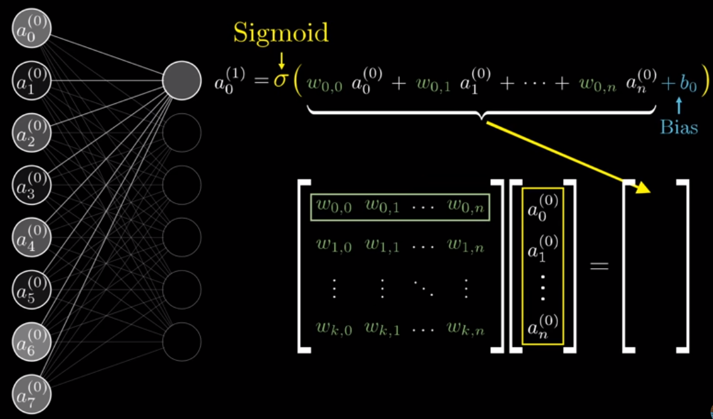
Implementation Details
Matrices represent these operations more efficiently
Easier to parallelize!

Slide 32
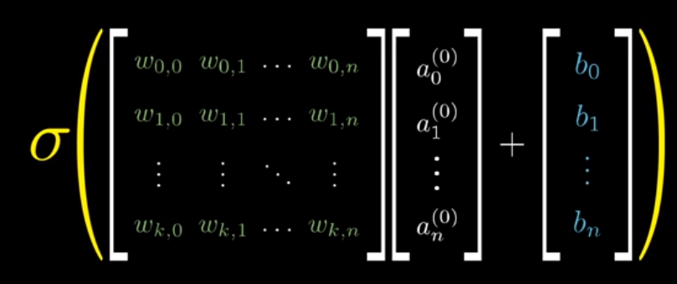
Efficient Calculations
Bias values are vectorized and added after the matrix multiply
Sigmoid is applied to the entire result
Technically it is applied to each row individually
One expression
For entire layer!
Libraries optimize
Matrix math

Slide 33
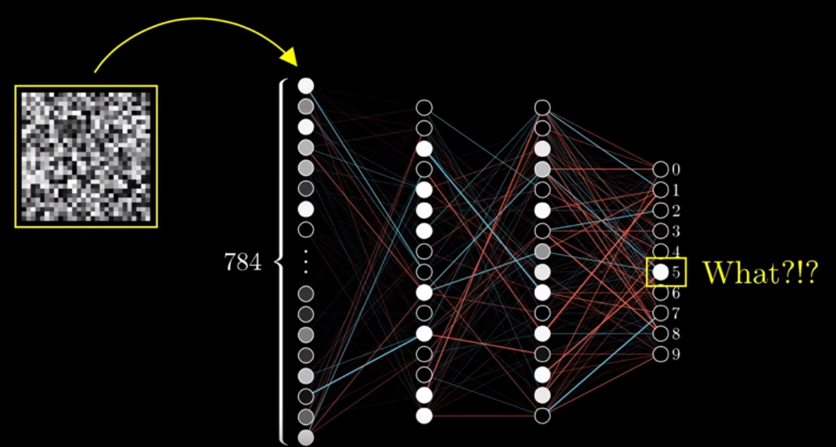
Be careful with accuracy!
A NN can be 95+% accurate, but still not intelligent
What should this network be doing?

