Slide 1
CS 2400 Introduction to Artificial Intelligence
Readings: 12.1, 12.3, 12.4
Reinforcement Learning

Slide 2
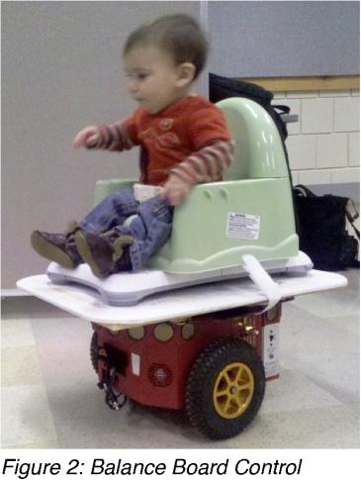
Reinforcement Learning (RL)
RL is concerned with how an agent ought to take actions in an environment
so as to maximize some notion of cumulative reward
Learning by interacting with the environment
Underlies nearly all theories of learning and intelligence
Babies Take the Wheel of Driving Robots
Giving disabled babies the power of movement could improve their development.
http://www.technologyreview.com/blog/mimssbits/25667/

Slide 3
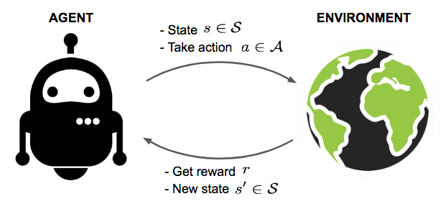
RL – Basic Idea
Learn by interacting with our environment
Cause and effect
Goals and rewards (or punishment)
What is the learning environment in this class?
What are the interactions you have with the material in this class?
How does diversity of interactions help you learn?

Slide 4
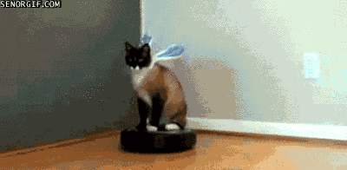
RL Examples – Roomba
A mobile robot decides
Whether it should enter a new room in search of more area to vacuum
Start trying to find its way back to its battery recharging station
Try to knock the cat off
Notes:
(Older roombas didn’t really search, but newer models do.)

Slide 5
RL Examples - Chess
A master chess player makes a move
The choice is informed both by planning:
anticipating possible replies and counter replies
and by immediate, intuitive judgments of the desirability of particular positions and moves
Deep Blue versus Garry Kasparov

Slide 6
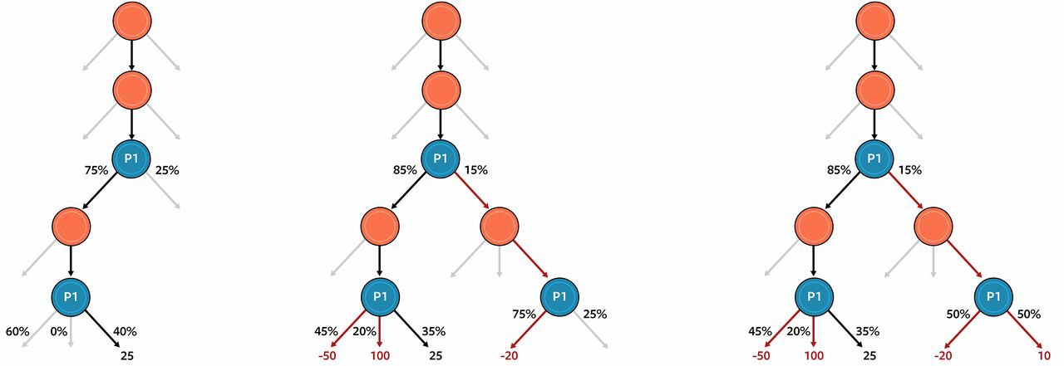
Case Study: Pluribus
Texas Hold-em is a poker game
Randomization, betting, bluffing
Why is this more challenging than Chess or other games?
Pluribus uses RL developed by Facebook and CMU
Plays copies of itself (randomly at first)
Can also play humans to learn, but we are slow☺
Analyzes actions and probabilities of outcomes to make decisions
Abstracts actions and information into “groups” to reduce the state space
What are the implications of this breakthrough?
https://www.kdnuggets.com/2019/08/inside-pluribus-facebooks-new-ai-poker.html

Slide 7
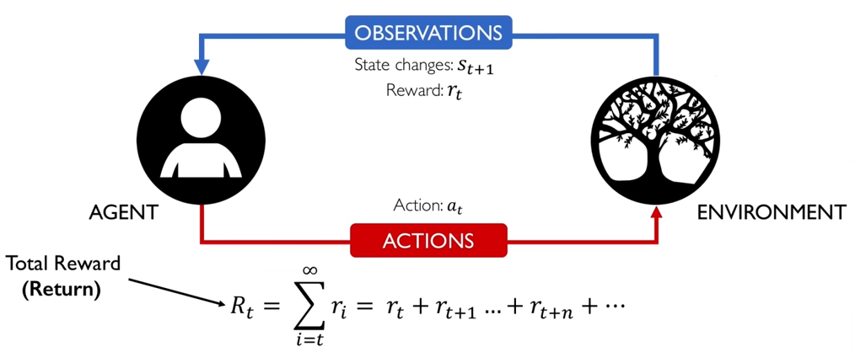
RL Interaction
Interaction
active decision-making agent
Environment (real or simulated)
The agent seeks to achieve a goal
despite uncertainty about its environment
The agent's actions are permitted to affect the future state of the environment
Correct choice requires taking into account delayed consequences of actions
thus may require foresight or planning
Effects of actions cannot be fully predicted
For non-trivial systems
The agent can use its experience to improve its performance over time

Slide 8
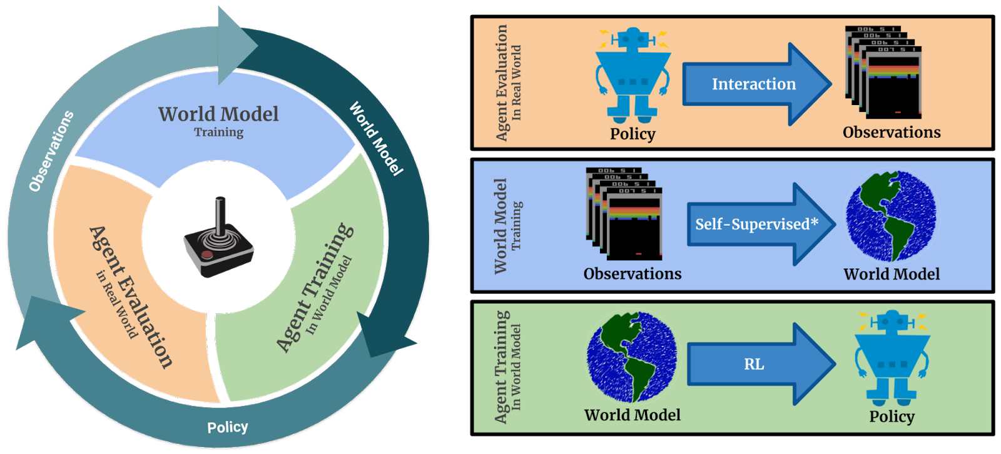
Elements of RL
Reinforcement learning system:
policy
reward function
value function – total reward
optionally, a model of the environment

Slide 9
RL - Policy
Policy
What the agent learns
How decisions are made given the current state
A mapping
from perceived states of the environment
to actions to be taken when in those states

Slide 10
RL – Reward and Value Functions
Reward function indicates what is good
in an immediate sense
Value of a state is the total amount of reward an agent can expect to accumulate over the future
Starting from that state

Slide 11
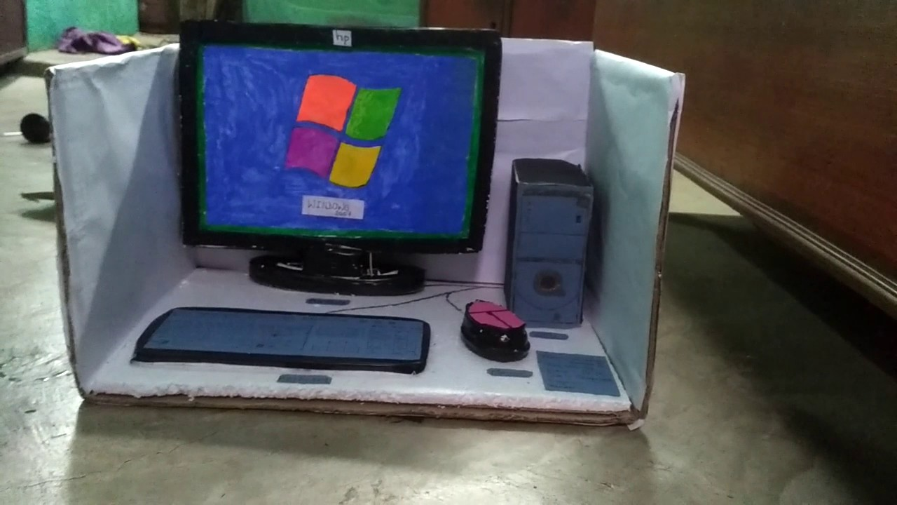
RL – Model of the environment
Models provide a framework of the environment to be explored
Models are used for planning
Any way of deciding on a course of action
Considering possible future situations before they are actually experienced
What models do you currently use in your learning?

Slide 12
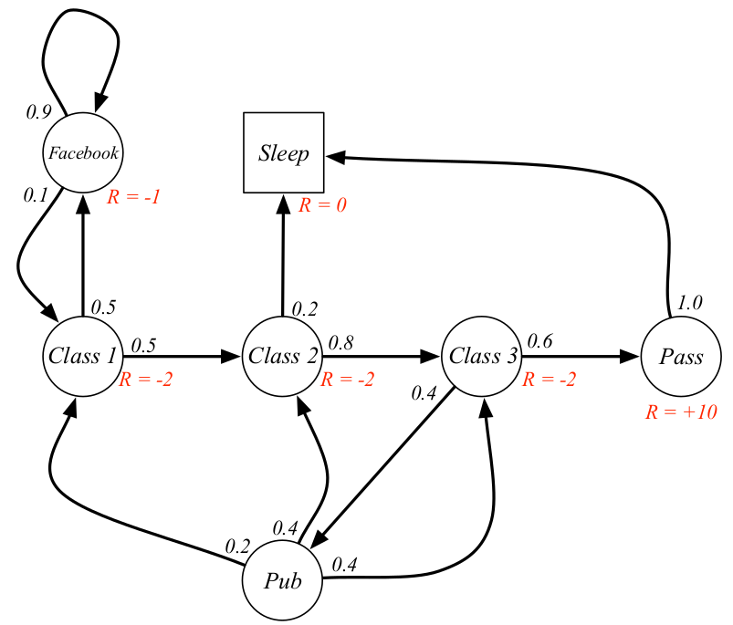
Markov Decision Process
Assume
Finite set of states S
Set of actions A
At each discrete time t,
agent observes state s_{t} Є S
chooses action a_{t} Є A
Then receives reward R_{t} and state changes to s_{t+1}
Purpose
Find a policy that specifies an action based on a given state
https://towardsdatascience.com/reinforcement-learning-demystified-markov-decision-processes-part-1-bf00dda41690

Slide 13
Agent’s Learning Task
Execute actions in the environment
Observe results
Learn action policy π : S -> A that maximizes the discounted value of future rewards:
Where is the discount factor/utility for future rewards
Problem:
Target function to learn is the action policy
but we have no training examples of form <s,a>
Training examples are of the form of
taking action a
from a given state s
observing rewards:<<s,a>,r>

Slide 14
Discount Factor/Utility
Desirability of some future event
Perceived at the present time
Not at the time of occurrence
Inherently, utility is lower if the event is farther ahead in time
Why?
Concept
Degree of an agent’s patience
Assuming rationality ☺
Experiments with human agents
People who choose 1 candy bar today over 2 tomorrow will likely choose 2 candy bars 101 days from now over 1 candy bar 100 days from now
Marshmallow test
https://www.youtube.com/watch?v=QX_oy9614HQ

Slide 15
Summary
Reinforcement learning: learning to take actions in an environment
Elements:
policy – what’s learned
reward function: reward for particular actions
value function: total reward that can be earned
(optional) model of the environment
Markov decision process: a mathematical formulation of RL
Discount factor: accounts for lowered value of delayed rewards
RL goal: learn action policy π : S -> A that maximizes the discounted value of future rewards:
Where gamma is the discount factor/utility for future rewards

Slide 16
Q-learning
RL goal: learn an optimal policy from history of interaction with the environment
History:
states
actions
rewards
Goal: find Q*(s, a): expected (maximal) reward of doing a in state s using an optimal policy
Q-learning: using temporal differences (sect. 12.3) to estimate Q*(s, a)
That is, the difference between the currently known reward and the previously computed reward, adjusted by a learning factor.
Notes:
Reminder: policy describes what action to take from each state
Goal: learn this policy where we don’t have a clear model of rewards
* Dog learning to sit: they don’t know reward is for an action, but slowly learn from trial and error which action results in reward
Value function: defines value of a policy within the context of a set of rewards
argmax: find the arguments to a function maximizing some result

Slide 17
Value Function
Goal: compute Q*, that is, Q*(S, A)
S: set states
A: set actions
Will keep a table Q[S, A], of current estimates of Q*
Note the brackets!
Basic formula:
alpha: learning rate
gamma: discount factor
r: reward for doing action a
s’: state reached after doing a in state s
max over a’: maximum over the actions from state s’
Algorithm to compute Q[], where Q[s, a] = 0 initially.

Slide 18
Q Function
Notes:
Update this notation to match the previous notation

Slide 19
Training Rule to Learn Q
Note: textbook uses Q[s, a] rather than
Q-circumflex

Slide 20
Q Learning from Deterministic Worlds

Slide 21
Example: updating Q approximation

Slide 22
Initially: all of Q[s, a] = 0
Upper box: one iteration across all states
Reward for moving to goal G
Middle left: Q[S, A] after multiple iterations
Lower: extracting a policy from the Q[S, A]

Slide 23
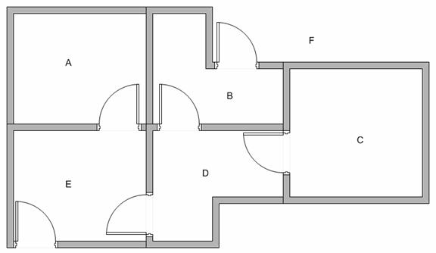
Q-Learning – Modeling the environment
5 rooms in a building connected by doors. Goal state is F (leave building).

Slide 24
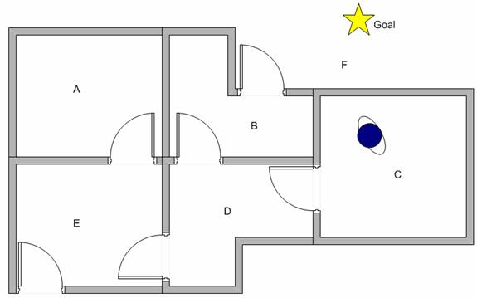
Learn through experience
Robot can learn through experience
It does not know which sequence of doors the agent must pass
for example, to go outside the building or anywhere else

Slide 25
Q Learning Algorithm
Set learning rate parameter 𝛾 and environment reward matrix R
Initialize matrix Q as zero matrix
For each episode:
Select random initial state
Do while we have not reached the goal state
Select one among all possible actions for the current state
Using this possible action, consider to go to the next state
Get maximum Q value of this next state based on all possible actions
Compute
Set the next state as the current state

Slide 26
Q Learning
Initial Q matrix; where –’s indicate impossible moves
Can always “move” from a room back to itself
Reward for going to state F (that is, in room F): 100; elsewhere the reward is 0
Q | Action
State | A | B | C | D | E | F
A | 0 | - | - | - | 0 | -
B | - | 0 | - | 0 | - | 0
C | - | - | 0 | 0 | - | -
D | - | 0 | 0 | 0 | 0 | -
E | 0 | - | - | 0 | 0 | 0
F | - | 0 | - | - | 0 | 0

Slide 27
Q Learning
Set the value of discount 𝛾 = 0.8, alpha is 0.3
Consider updates for moving from B to D, F
B to D: 0 + 0.3 * (0 + 0.8 * max[0, 0] - 0) = 0 – not interesting yet
B to F: 0 + 0.3 * (100 + 0.8 * max[0, 0] – 0) = 30
Likewise for E to F, F to F
Next slide: consider what happens if in room D
Q | Action
State | A | B | C | D | E | F
A | 0 | - | - | - | 0 | -
B | - | 0 | - | 0 | - | 30
C | - | - | 0 | 0 | - | -
D | - | 0 | 0 | 0 | 0 | -
E | 0 | - | - | 0 | 0 | 30
F | - | 0 | - | - | 0 | 30

Slide 28
Q Learning
Initial state: room D, alpha is 0.3
There are four possible actions for the current state D
go to state B
go to state E
go to state C
stay in state D
Going to C, D results in no change at this point
Consider going to B:
Q[D,B] = Q[D, B] + 0.3 * (r_{DB} + 0.8 * max[0, 30] – Q[D, B])
Q[D,B] = 0 + 0.3 * (0 + 0.8 * max[0, 30] – 0)
= (rounded) 7
Q[D, E]: same as Q[D, B]
Reward | Action
State | A | B | C | D | E | F
A | 0 | - | - | - | 0 | -
B | - | 0 | - | 0 | - | 30
C | - | - | 0 | 0 | - | -
D | - | 0 7 | 0 | 0 | 0 7 | -
E | 0 | - | - | 0 | 0 | 30
F | - | 0 | - | - | 0 | 30

Slide 29
Q Learning
Further updates: moving from B to D or F:
Q[B, D] = Q[B, D] + 0.3 * (r_{BD} + 0.8 * max[7, 0, 0] – Q[B, D])
= 0 + 0.3 * (0 + 0.8 * 24 – 0) ⋍ 2
Q[B, F] = Q[B, F] + 0.3 * (r_{BF} + 0.8 * max[0, 0, 30] – Q[B, F])
= 30 + 0.3 * (100 + 0.8 * max[0, 0, 30] - 30) ⋍ 58
Reward | Action
State | A | B | C | D | E | F
A | 0 | - | - | - | 0 | -
B | - | 0 | - | 2 | - | 58
C | - | - | 0 | 0 | - | -
D | - | 7 | 0 | 0 | 7 | -
E | 0 | - | - | 0 | 0 | 30
F | - | 0 | - | - | 0 | 30

Slide 30
Q Learning - multiple episodes
When finished? When matrix converges on values
Compare normalized matrix (dividing each number by largest value)
See CS 2040 sample code website: qlearn.rb
Normalized values after 100 (random) steps:
Q (n) | Action
State | A | B | C | D | E | F
A | .3 | - | - | - | .119 | -
B | - | .507 | - | .112 | - | 1.0
C | - | - | .007 | .127 | - | -
D | - | .216 | .030 | .075 | .254 | -
E | 0 | - | - | .090 | .157 | .664
F | - | .276 | - | - | .194 | .634

Slide 31
Q Learning - multiple episodes
Normalized values after 1000 random steps:
Every run produces slightly different results at this point
Q (n) | Action
State | A | B | C | D | E | F
A | .578 | - | - | - | .746 | -
B | - | .748 | - | .597 | - | .976
C | - | - | .441 | .590 | - | -
D | - | .772 | .453 | .571 | .746 | -
E | .559 | - | - | .580 | .683 | .993
F | - | .767 | - | - | .775 | 1.0

Slide 32
Q Learning - multiple episodes
Convergence after 3000 random steps
Consistent across multiple runs:
Q (n) | Action
State | A | B | C | D | E | F
A | .634 | - | - | - | .797 | -
B | - | .797 | - | .634 | - | 1.0
C | - | - | .504 | .634 | - | -
D | - | .797 | .504 | .634 | .797 | -
E | .634 | - | - | .634 | .797 | 1.0
F | - | .797 | - | - | .797 | 1.0

Slide 33
Applications of Reinforcement Learning
Intelligent Trading Agents for Massively Multi-player Game Economies
John Reeder, Gita Sukthankar, M. Georgiopoulos, G. Anagnostopoulos
Learning to be a Bot: Reinforcement Learning in Shooter Games,
Michelle McPartland, Marcus Gallagher
Agent Learning using Action-Dependent Learning Rates in Computer Role-Playing Games
Maria Cutumisu, Duane Szafron, Michael Bowling, Richard S. Sutton
Combining Model-Based Meta-Reasoning and Reinforcement Learning for Adapting Game-Playing Agents
Patrick Ulam, Joshua Jones, Ashok Goel

Slide 34
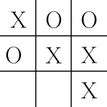
RL Example – Tic Tac Toe
How could we construct a player that will learn to maximize its chances of winning?
Reward winning
+10
Penalize losing
-10
Ignore draws
+0

Slide 35
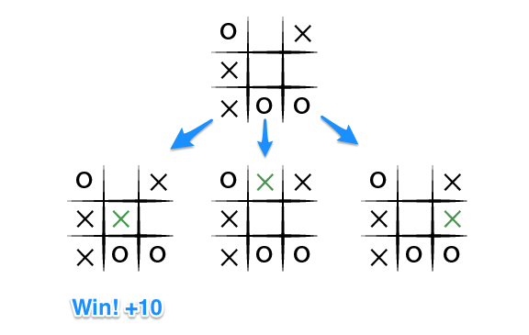
Tic Tac Toe – Minimax
Minimax algorithm assumes a particular way of playing by the opponent
an infallible opponent
The player would never reach a game state from which it could lose
Note: This algorithm will not scale to complex environments with large state spaces
Consider:
Where should X move next?

Slide 36
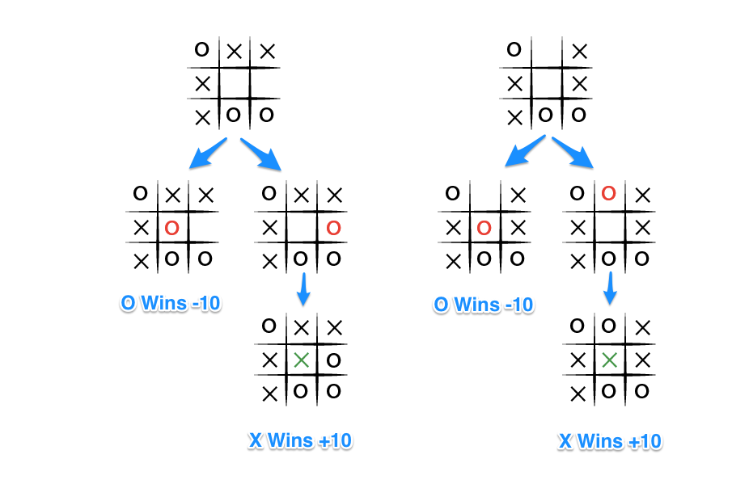

Slide 37
Minimax
https://www.neverstopbuilding.com/blog/minimax

Slide 38
Tic Tac Toe – Learning a Model
Assume that information is not available a priori for this problem
as it is not for the vast majority of problems of practical interest
Such information can be estimated from experience playing many games against the opponent!
Heuristic?
Learn a model of the opponent's behavior up to some level of confidence
Then apply dynamic programming to compute an optimal solution
given the approximate opponent model

Slide 39
Reinforcement Learning for Tic-Tac-Toe
Trying random moves, observing the outcomes
an agent can eventually build a predictive model of its environment
Given enough experience playing a game an agent will know
what the board will look like after it makes a given move
how the opponent is likely to reply in a given situation

Slide 40
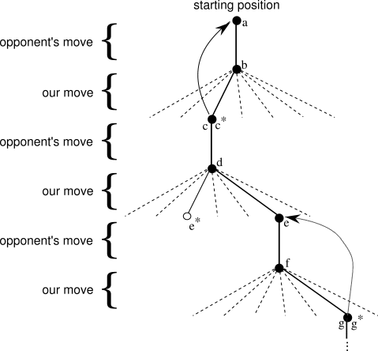

Slide 41
RL Tic-tac-toe – Key features
Emphasis on learning while interacting with an environment
There is a clear goal, and correct behavior requires planning or foresight that takes into account delayed effects of one's choices
The simple reinforcement learning player would learn to set up multi-move traps for a shortsighted opponent.
Striking feature of the reinforcement learning solution that it can achieve the effects of planning

Slide 42
More information- Deep Q Learning
https://www.youtube.com/watch?v=nZfaHIxDD5w

