Slide 1
CS 2400 Introduction to Artificial Intelligence
Sections 4.8, 4.9
Genetic Algorithms
“Genetic Algorithms are good at taking large, potentially huge search spaces and navigating them, looking for optimal combinations of things, solutions you might not otherwise find in a lifetime.”
- Salvatore Mangano
Computer Design, May 1995

Slide 2
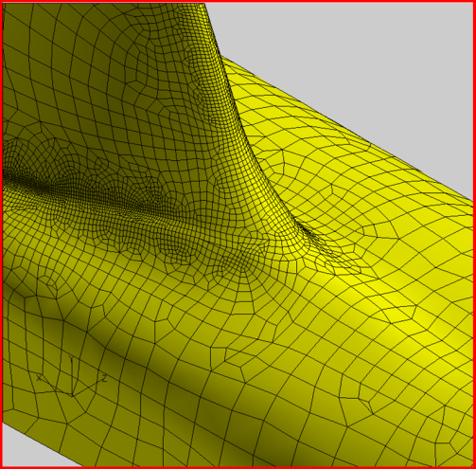
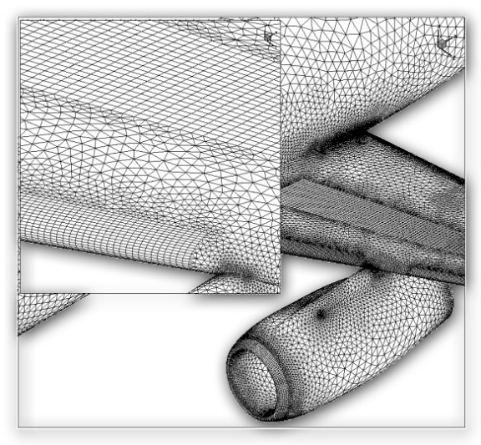
The Genetic Algorithm
Directed search algorithms based on the mechanics of biological evolution
Developed by John Holland, University of Michigan (1970’s)
To understand the adaptive processes of natural systems
To design artificial systems software that retains the robustness of natural systems
Example: Find optimal surface design for an aircraft

Slide 3
Applicable situations
Often used for optimization (scheduling, design, etc.) problems, though can be used for many other things as well, as we’ll see a bit later.
Good problem for GA: Scheduling air traffic
Bad problems for GA:
Finding large primes (not a continuous problem)
2D pathfinding (search space is small, other algorithms like A* would be better)
Notes:
Finding large primes is a bad problem for GA because the fitness landscape is not continuous – hard to differentiate between something 1 bit away from a prime, and something that is the complement of a prime.
2D pathfinding bad because the search space is small, so better off with A*.

Slide 4
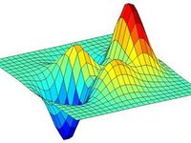
Applicable situations
Genetic algorithms work best when the “fitness landscape” is continuous (in some dimensions)
This is also true of standard search, e.g. A*
Intuitively, this just means that we can find a “good” heuristic
Image source: scholarpedia.org

Slide 5
So what is a genetic algorithm?
Genetic algorithms are a randomized heuristic search strategy
Basic idea:
Simulate natural selection
The population is composed of candidate solutions
Focus is on evolving a population from which strong and diverse candidates can emerge
via mutation and crossover (mating)

Slide 6
Components of a GA
A problem to solve, and ...
Encoding technique (gene, chromosome)
Initialization procedure (creation)
Evaluation function (environment)
Selection of parents (reproduction)
Genetic operators (mutation, recombination)
Parameter settings (practice and art)

Slide 7
Simple Genetic Algorithm
initialize population;
evaluate population;
while TerminationCriteriaNotSatisfied
{
select parents for reproduction;
perform recombination and mutation;
evaluate population;
}
return best candidate

Slide 8
The GA Cycle of Reproduction
children
reproduction
modification
modified
children
parents
population
evaluation
evaluated children
deleted
members
discard

Slide 9
Population
population
Chromosomes could be:
Bit strings (0101 ... 1100)
Real numbers (43.2 -33.1 ... 0.0 89.2)
Permutations of element (E11 E3 E7 ... E1 E15)
Lists of rules (R1 R2 R3 ... R22 R23)
Program elements (genetic programming)
... any data structure ...

Slide 10
Reproduction
children
reproduction
parents
population
Parents are selected at random with selection chances biased in relation to chromosome evaluations

Slide 11
Chromosome Modification
children
Modifications are stochastically triggered
Operator types are:
Mutation
Crossover (recombination)
modification
modified children

Slide 12
Mutation: Local Modification
Before: (1 0 1 1 0 1 1 0)
After: (0 1 1 0 0 1 1 0)
Before: (1.38 -69.4 326.44 0.1)
After: (1.38 -67.5 326.44 0.1)
Causes movement in the search space (local or global)
Restores lost information to the population

Slide 13
Crossover: Recombination
P1 (0 1 1 0 0 0 0 0) (0 1 0 1 1 0 0 0) C1
P2 (1 1 0 1 1 0 1 0) (1 1 1 0 0 0 1 0) C2
Crossover is a critical feature of genetic
algorithms:
It greatly accelerates search early in evolution of a population
It leads to effective combination of schemata (subsolutions on different chromosomes)
*

Slide 14
Evaluation
modified
children
The evaluator decodes a chromosome and assigns it a fitness measure
The evaluator is the only link between a classical GA and the problem it is solving
evaluated
children
evaluation

Slide 15
Deletion
population
Generational GA: entire populations replaced with each iteration
Steady-state GA: a few members replaced each generation
discarded members
discard

Slide 16
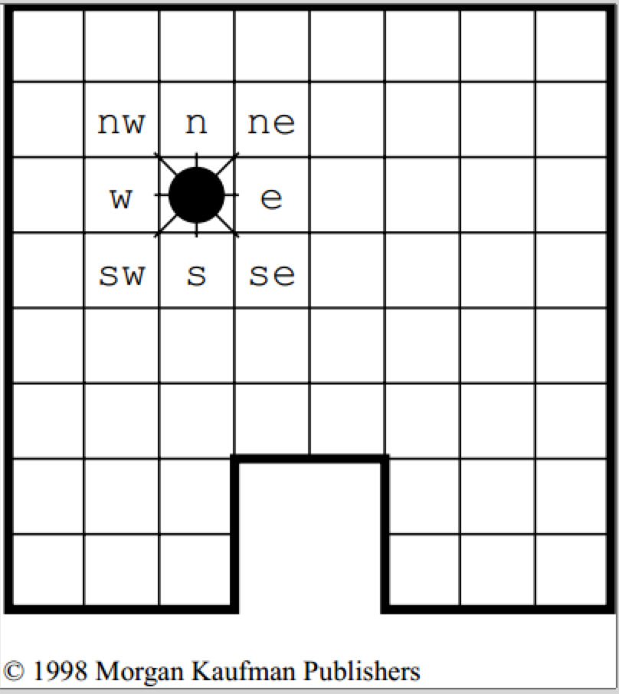
Example: Program to explore a room
From Artificial Intelligence: A New Synthesis (Nilsson, 1998)
Specific type of genetic algorithm: genetic programming
Goal: generate a program to accomplish a task
Here: circle the edge of a room
Programming language used: Lisp
All code written as a list between parens (, )
Example, maximum of two values:
(if (> a b)
a
b)
Advantage of this form: easy to manipulate

Slide 17
Example: Program to explore a room
basic instructions: move a direction
(north), (east), (west), (south), (northeast), (northwest), etc.
tests: is there a wall in a specified direction?
written as (n), (e), (w), (s), (ne), (nw), etc.
return 0 or 1
Assumption:
move operations such as (north) return 0 if fail, 1 if successful
primitive functions:
(AND x y): if x = 0 then 0 else y
(OR x y): if x = 1 then 1 else y
(IF x y z): if x = 1 then y else z
Sample program:
(IF (ne) (south) (north))

Slide 18
Learning Algorithm
Generate 5000 random programs
Evaluation
Run program 60 steps
Count number of times visit cell next to a wall
Goal: 32
Fitness: sum of next-to-wall cells visited across 10 runs
Start at random spot in room each time
Perfect score would be 320
unlikely to reach unless all start points are at wall!
Creating next generation:
Tournament selection to pick 500 (10%) of programs to carry to the next generation
Pick seven at random, compare, select the best
Note all could be low performers!
Use crossover to create 4500 new programs
chose two subexpressions and replace one by another
Mutation: randomly replacing subexpressions by new programs
Not done here; initial randomness apparently enough

Slide 19
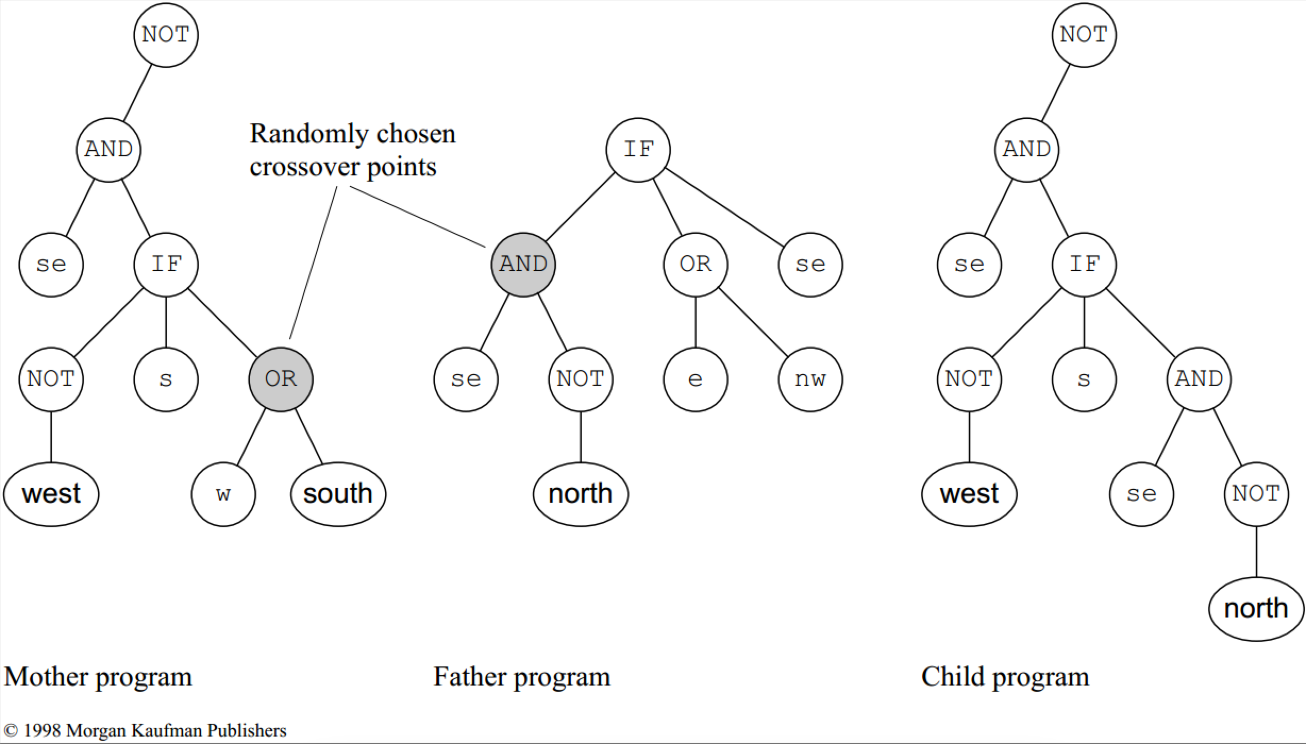
Crossover Example
Showing code as a tree
First program:
(NOT
(AND (se)
(IF (NOT (west))
(s)
(OR (w)
(south))))
Basic operation: list manipulation
Aside: should “mother” and “father” be used when there’s no reason to assign genders?

Slide 20
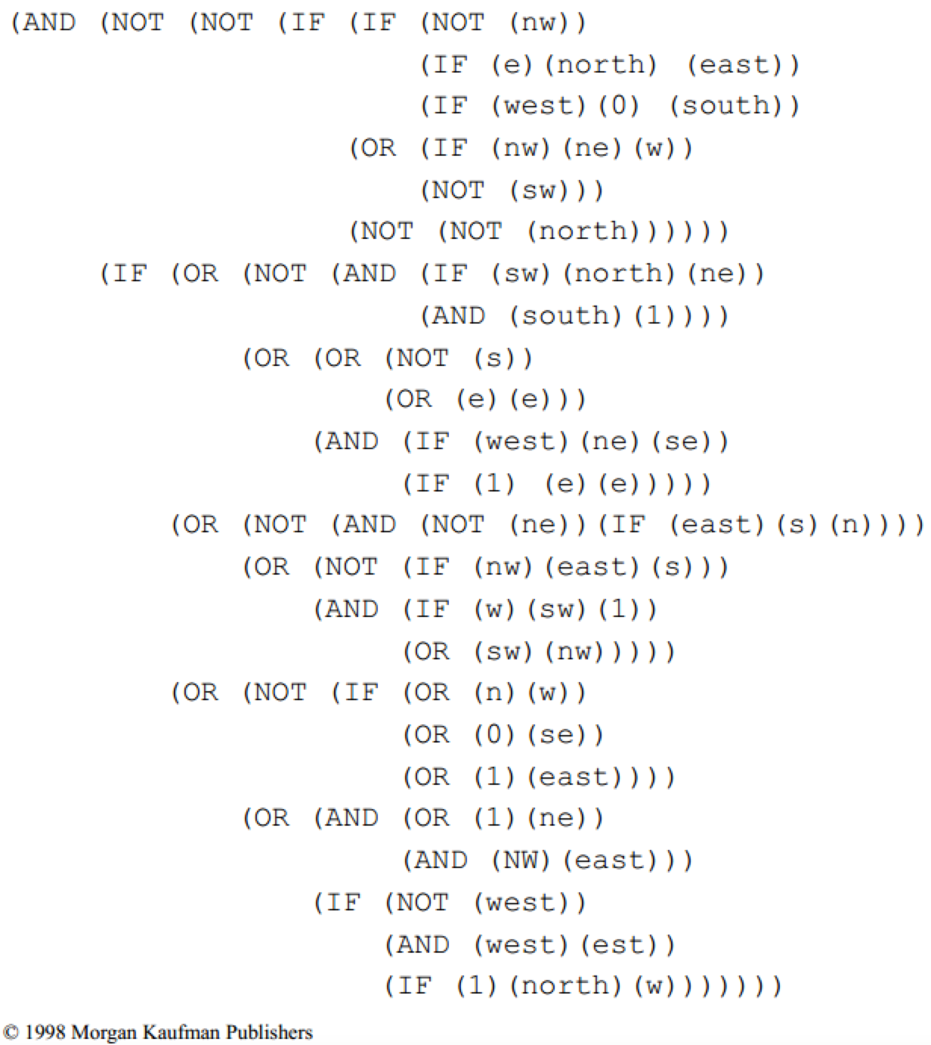
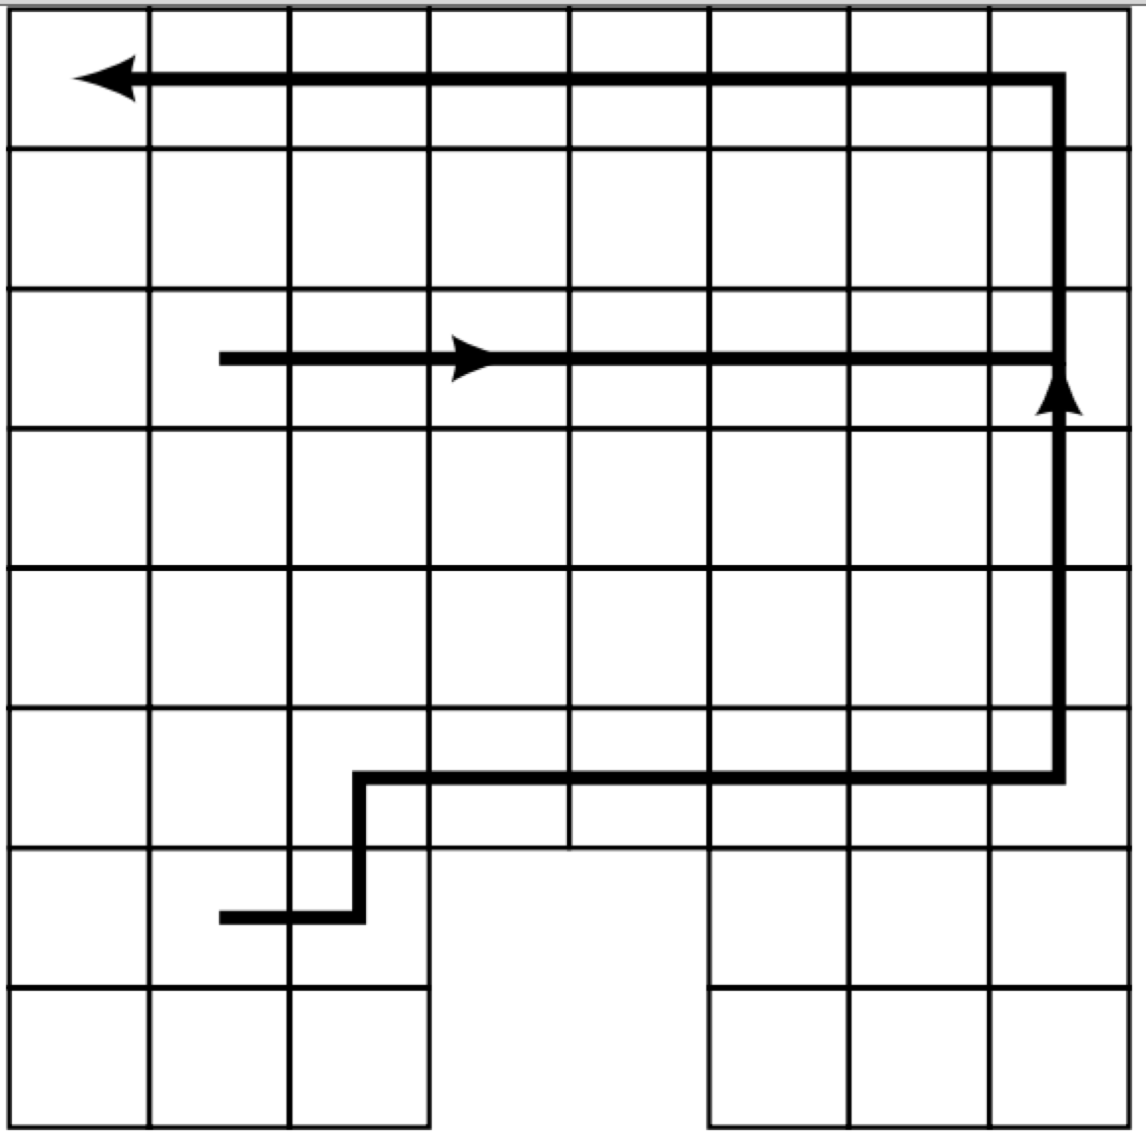
Results: best fit in generation 0:
Difficult to read, lots of redundant pieces
Starting at any cell, moves east until wall; when reaches wall, moves north until either gets trapped in corner or can move east again
Fitness: 92

Slide 21
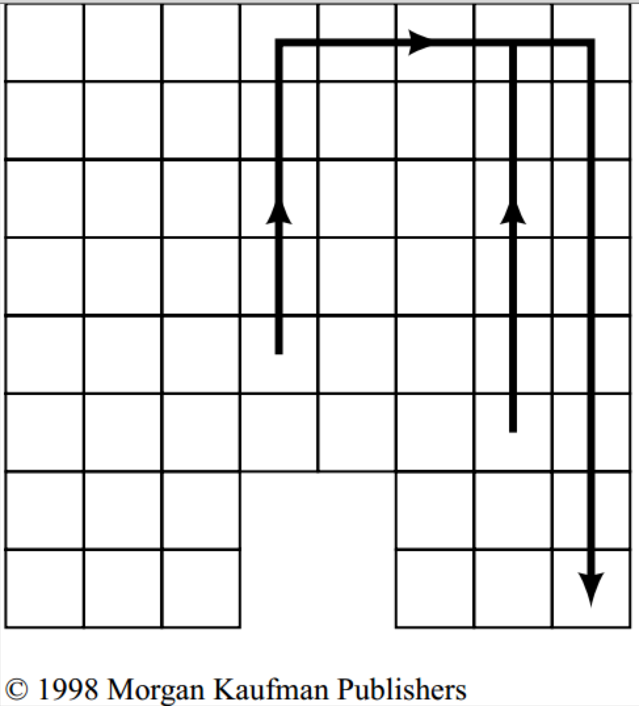
Results: best fit in generation 2:
Robot moves north until wall, follows wall to right, moves south, gets stuck
fitness: 117

Slide 22
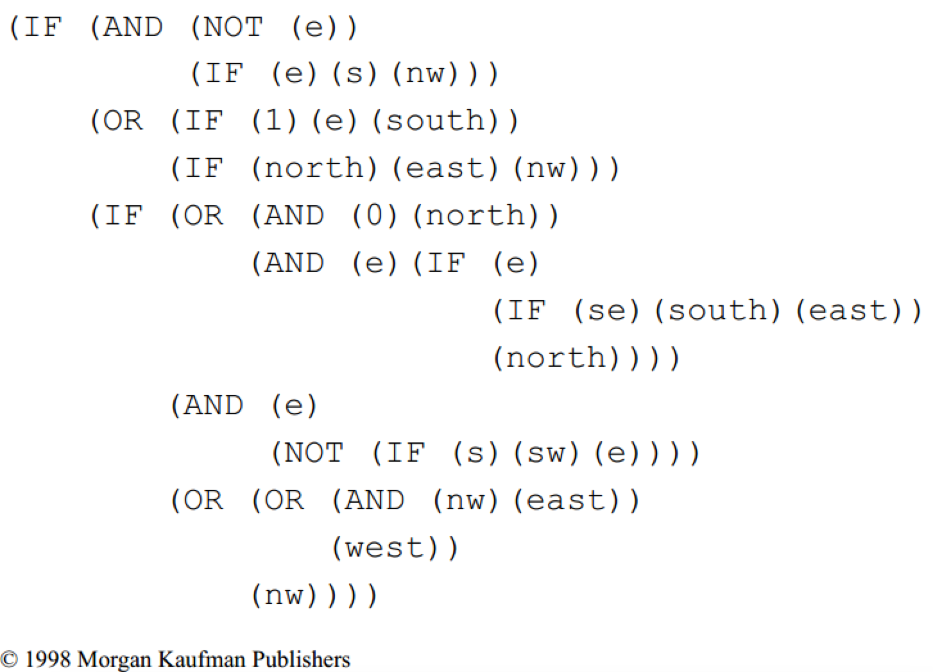
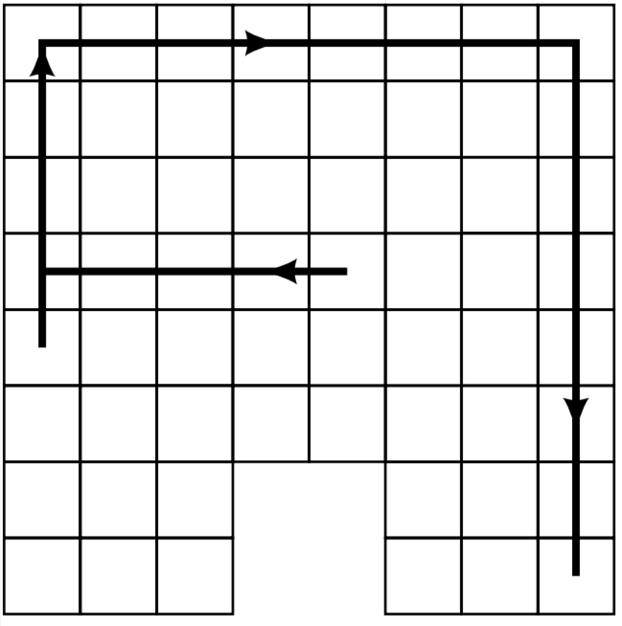
Results: best fit in generation 6:
Moves west; follows west/north/east walls but gets stuck in SE corner
fitness: 163

Slide 23
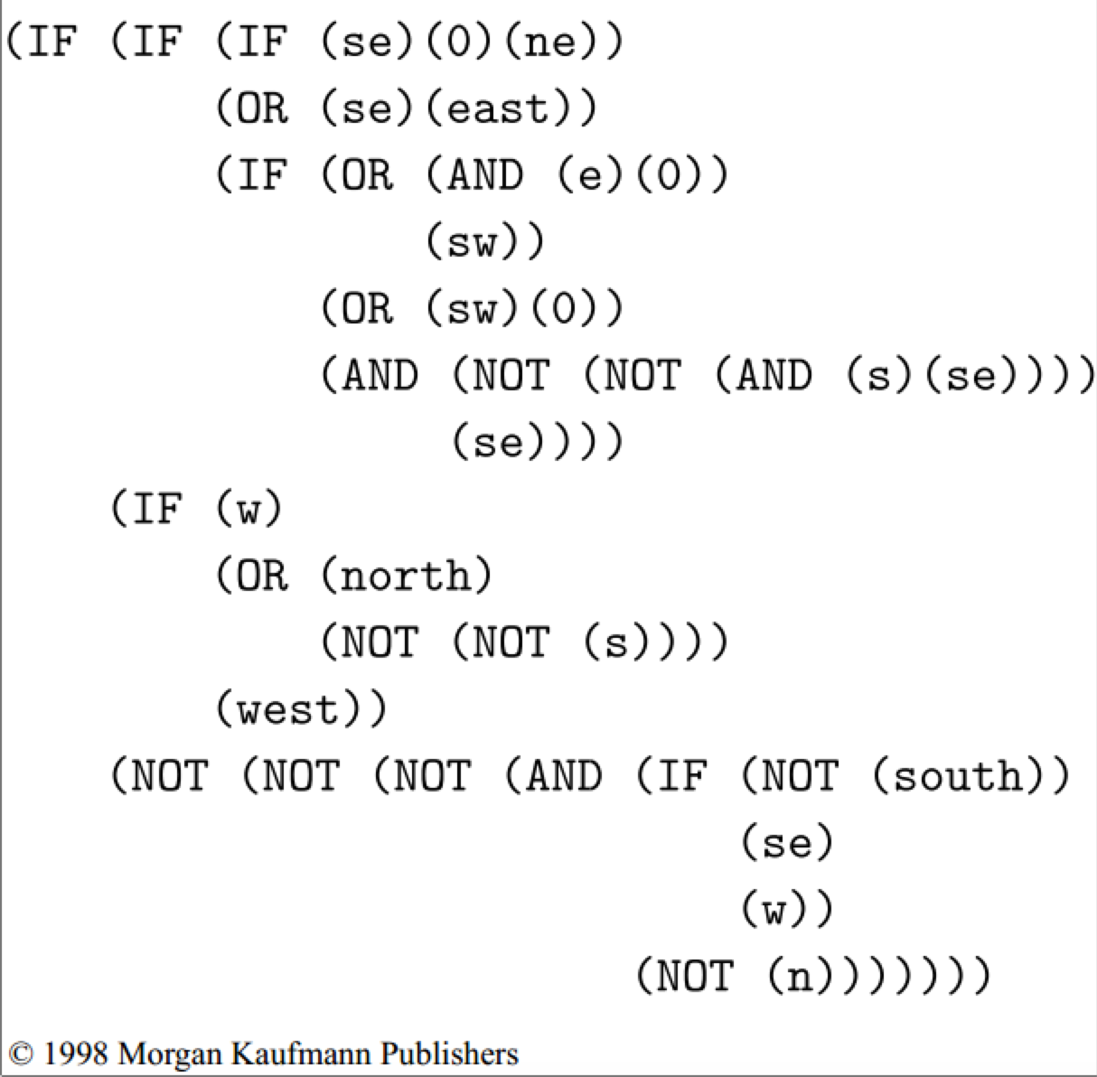
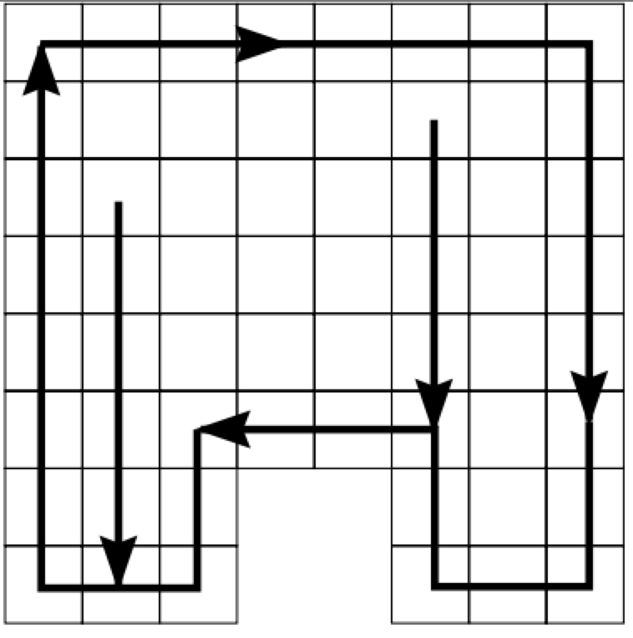
Results: best fit in generation 10:
Follows wall perfectly: south to wall, then moves clockwise
fitness: close to 320

Slide 24
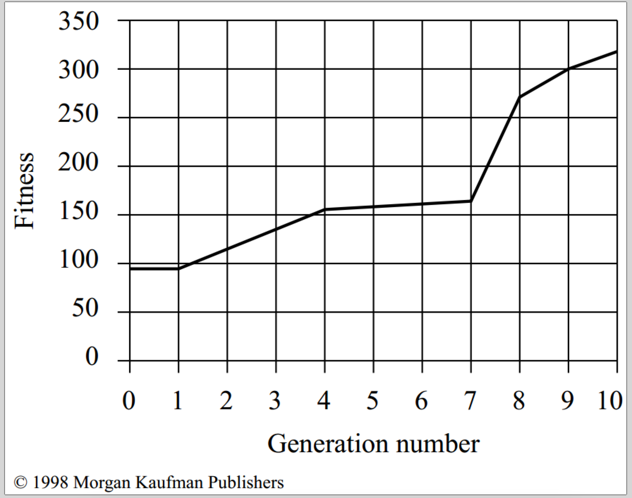
Fitness by generation
Graphing best by generation
Keys:
Crossover found a good solution
Sufficient randomness at start so didn’t need mutation
General experience:
crossover needs to play a much stronger role than mutation
(typically, mutate in just 1% of cases)

Slide 25
An Abstract Example
Distribution of Individuals in Generation 0
Distribution of Individuals in Generation N

Slide 26
A Simple Example
“The Gene is by far the most sophisticated program around.”
- Bill Gates, Business Week, June 27, 1994

Slide 27
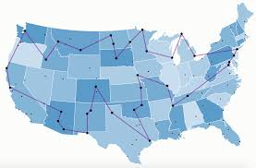
A Simple Example
The Traveling Salesman Problem:
Find a tour of a given set of cities so that
each city is visited only once
the total distance traveled is minimized

Slide 28
Representation
Representation is an ordered list of city numbers
1) London 3) Dunedin 5) Beijing 7) Tokyo
2) Venice 4) Singapore 6) Phoenix 8) Victoria
CityList1 (3 5 7 2 1 6 4 8)
CityList2 (2 5 7 6 8 1 3 4)

Slide 29
Crossover
Crossover combines inversion and
recombination:
Parent1 (3 5 7 2 1 6 4 8)
Parent2 (2 5 7 6 8 1 3 4)
Child (2 5 7 2 1 6 3 4)
This operator is called the Order1 crossover

Slide 30
Mutation
Mutation involves reordering of the list:
Before: (5 8 7 2 1 6 3 4)
After: (5 8 6 2 1 7 3 4)

Slide 31
TSP Example: 30 Cities

Slide 32
Solution _{i} (Distance = 941)

Slide 33
Solution _{j}(Distance = 800)

Slide 34
Solution _{k}(Distance = 652)

Slide 35
Best Solution (Distance = 421)

Slide 36
Overview of Performance

Slide 37
Some GA Application Types

Slide 38
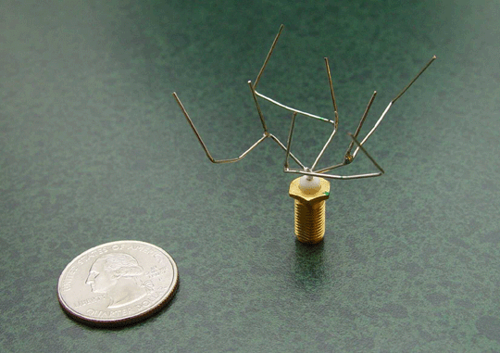
Examples - GA in the wild
ST5 Antenna – NASA Evolvable Systems Group
http://ti.arc.nasa.gov/projects/esg/research/antenna.htm

Slide 39
ST5 Antenna
Needs less power than standard antennae.
Doesn’t require a matching network nor a phasing circuit – two less steps in design and fabrication.
More uniform coverage than standard antennae, yielding more reliable performance.
Short design cycle – 3 person-months to prototype fabrication, vs. 5-person months on average for conventionally designed antennae.
Notes:
First, there is the potential of needing less power. Antenna ST5-3-10 achieves high gain (2-4dB) across a wider range of elevation angles. This allows a broader range of angles over which maximum data throughput can be achieved. Also, less power from the solar array and batteries may be required.
Second, the evolved antenna does not require a matching network nor a phasing circuit, removing two steps in design and fabrication of the antenna. A trivial transmission line may be used for the match on the flight antenna, but simulation results suggest that one is not required.
Third, the evolved antenna has more uniform coverage in that it has a uniform pattern with small ripples in the elevations of greatest interest (between 40 and 80 degrees). This allows for reliable performance as elevation angle relative to the ground changes.
Finally, the evolved antenna had a shorter design cycle. It was estimated that antenna ST5-3-10 took 3 person-months to design and fabricate the first prototype as compared to 5 person-months for the conventionally designed antenna.

Slide 40
Issues for Genetic Algorithms Practitioners
Choosing basic implementation issues:
representation
population size, mutation rate, ...
selection, deletion policies
crossover, mutation operators
Termination Criteria
Performance, scalability
Solution is only as good as the evaluation function (often hardest part)

Slide 41
Benefits of Genetic Algorithms
Concept is easy to understand
Supports multi-objective optimization
Good for “noisy” environments
Always an answer; answer gets better with time
Inherently parallel; easily distributed
Genetic programs can be examined

Slide 42
Benefits of Genetic Algorithms (cont.)
Many ways to speed up and improve a GA-based application as knowledge about problem domain is gained
Easy to exploit previous or alternate solutions
Flexible building blocks for hybrid applications
Substantial history and range of use

Slide 43
When to Use a GA
Alternate solutions are too slow or overly complicated
Need an exploratory tool to examine new approaches
Problem is similar to one that has already been successfully solved by using a GA
Want to hybridize with an existing solution
Benefits of the GA technology meet key problem requirements

Slide 44
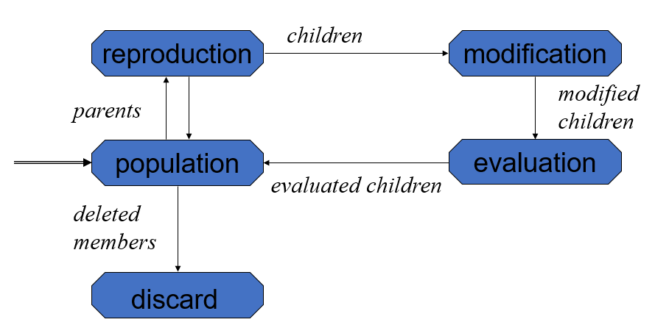
Review
Genetic algorithms
build population, select items as parents, perform crossover, mutate, evaluate & discard some, repeat with new population
represent as bit vectors, weights, programs, etc
Genetic programming: GAs based on code
mutation: applied to small percentage
Observable, robust to noise, easily parallelized
Though parallelizable (here) might just means we did a lot of wasted work!
Not suitable if have a more direct solution

Slide 45
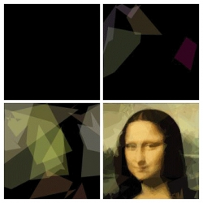
Examples - GA in the wild
Image compression – evolving the Mona Lisa
Generation 1
Generation 301
Generation 2716
Generation 904314
http://rogeralsing.com/2008/12/07/genetic-programming-evolution-of-mona-lisa/
Notes:
This weekend I decided to play around a bit with genetic programming and put evolution to the test, the test of fine art :-)
I created a small program that keeps a string of DNA for polygon rendering. The procedure of the program is quite simple:
0) Setup a random DNA string (application start)
Copy the current DNA sequence and mutate it slightly
Use the new DNA to render polygons onto a canvas
Compare the canvas to the source image
If the new painting looks more like the source image than the previous painting did, then overwrite the current DNA with the new DNA
repeat from 1
Now to the interesting part :-)
Could you paint a replica of the Mona Lisa using only 50 semi transparent polygons?
Took 904314 generations, though began to be recognizable as the Mona Lisa after 10,000 or so. Images above are generation 1, 301, 2716, and 904314.

Slide 46
Evolving the Mona Lisa
Uses only 50 polygons of 6 vertices each.
Population size of 1, no crossover – parent compared with child, and superior image kept.
Assuming each polygon has 4 bytes for color (RGBA) and 2 bytes for each of 6 vertices, this image only requires 800 bytes.
However, compression time is prohibitive and storage is cheaper than processing time. ☹

