Slide 1
1. Where to start
SE2811 Software Component Design
Dr. Rob Hasker
Notes:
Reading: Java Design Pattern Essentials, Chapter 1

Slide 2
Why OO?
What is the goal of an object-oriented design?
Why do we prefer OO designs?
What is the alternative?
Sample procedural design: suppose next class room is DH 240
Leave classroom, turn left
Walk to Milwaukee Street entrance
Go up steps
At first landing, look for the classroom door to your left
But not all students will go to the same room!
Notes:
Note: I don’t expect answers for the first two questions!
DH 240: the room next to Rosie; my assumption is that the current classroom is DH 129, so one might revise around that…

Slide 3
Why OO?
Extending to full class:
Find schedules of all students
For each,
determine location of next room
plan route to room
give route to student
review route with student to make sure no questions
Is this how you would solve the problem?
Better:
List of rooms at back of class, directions for each
Campus map, possibly highlighted with target locations
Tell students to snap a picture of the map with their phones...
This makes the student responsible for finding the route!
Notes:
Note: I don’t expect answers for the first two questions!

Slide 4
Procedural vs OO
Procedural solution:
List of steps to take
Any modification means modifying appropriate steps
OO solution:
Set of classes with responsibilities
No “God” classes that take care of everything!
Modifications: find class to change or add a new class
How is this a win?
Procedural: limited structure, changes can have unintended side effects
OO: classes provide structure, framework for change; side effects easier to identify/address, especially when the class behaves like a real world object!

Slide 5
Solution: No changes!!
A simple solution (not involving OO): don’t allow change
Issue: requirements are VERY difficult to identify
Customer does not understand full need at start of project
Using a system changes the environment, and then we realize the system could work better with additional changes
Libraries, security constantly changing, meaning code that worked yesterday may not work today
The world changes!
We MUST develop systems with the assumption that they will change
We could just always rewrite everything, but this tosses good work!
How to support change?
This is the question this course addresses!

Slide 6
SE 2811: Software Component Design
Algorithms CS 2852
Requirements
SE 3821
Design: SE 2811
Systems
SE 2811: Designing for change and reuse
Classic reuse models: requirements, algorithms
This class: reusing designs
But this is the story for SEs
What about CS students?
Notes:
Print

Slide 7
SE 2811: Software Component Design
Algorithms CS 2852
New technologies - most CS courses
Design: SE 2811
Libraries
It’s wasteful to build all systems from scratch!
Few projects consist of one team building a full system...
Libraries: collections of useful tools
Computer science: building tools used in full system design?
A working thesis!
These tools are useful for implementing libraries
They are also useful for ensuring libraries are flexible!
Notes:
Print

Slide 8
SE 2811: Software Component Design
Algorithms CS 2852
Requirements
SE 3821/CS courses
Design: SE 2811
Systems/Libraries
Design for reuse, models
Classic reuse models: requirements, algorithms
2811: reusing designs
1994: Gang of 4
Gamma, Helm, Johnson, Vlissides
Design pattern: general, reusable solution to a commonly occurring problem in software design
Notes:
Print

Slide 9
A real-life example
How to get lunch?
Identify at least four methods
What are common elements?
What can differ?
How do we compare them?
Are these algorithms?
Algorithm: sequence of steps to be followed to calculate a result

Slide 10
Example #2
Problem:
Workplace, home traffic pattern: travel to frequently accessed objects
If objects scattered, flow of life is awkward
Items forgotten, misplaced

Slide 11
Example #2
Problem:
Workplace, home traffic pattern: travel to frequently accessed objects
If objects scattered, flow of life is awkward
Items forgotten, misplaced
Solution:
Waist-high shelves around at least part of main rooms in which people live & work
They should be long, 22-40 cm deep
Shelves or cupboard underneath
Interrupt shelf for seats, windows, doors

Slide 12
Example #2
Note features:
Shelf color, material not important to the structure
Not an algorithm/not blueprints
Architectural design pattern
Are there times when the pattern is a poor choice?
Each pattern:
Solves a recurring problem
Tradeoffs: advantages, disadvantages to applying

Slide 13
Software example
public class StereoController {
private Volume volume;
private Equalizer equalizer;
public StereoController(Volume volume,
Equalizer equalizer) {
this.volume = volume;
this.equalizer = equalizer;
}
public changeVolume(int ticks) {
volume.adjust(ticks);
}
public changeChannel(int channel,
int ticks) {
if ( equalizer != null )
equalizer.getChannel(channel).adjust(ticks);
}
}
Notes:
Based on Null Object Pattern from a previous textbook; see https://www.oodesign.com/null-object-pattern.html for a discussion

Slide 14
Software example
Models core elements of stereo: volume control, equalizer
public class StereoController {
private Volume volume;
private Equalizer equalizer;
public StereoController(Volume volume,
Equalizer equalizer) {
this.volume = volume;
this.equalizer = equalizer;
}
public changeVolume(int ticks) {
volume.adjust(ticks);
}
public changeChannel(int channel,
int ticks) {
if ( equalizer != null )
equalizer.getChannel(channel).adjust(ticks);
}
}

Slide 15
Software example
Models core elements of stereo: volume control, equalizer
If statement: allows stereo without equalizer
Problem: will need to check every use
Violates a basic design principle: don’t repeat yourself
Why is repetition a problem?
How can we remove it?
public class StereoController {
private Volume volume;
private Equalizer equalizer;
public StereoController(Volume volume,
Equalizer equalizer) {
this.volume = volume;
this.equalizer = equalizer;
}
public changeVolume(int ticks) {
volume.adjust(ticks);
}
public changeChannel(int channel,
int ticks) {
if ( equalizer != null )
equalizer.getChannel(channel).adjust(ticks);
}
}

Slide 16
Solution: create “do nothing” classes
interface EqualizerInterface {
Level getChannel(int i);
}
public class Equalizer implements EqualizerInterface {
public final int MAX_CHANNEL = 6;
private Level[] channels =
new Level[MAX_CHANNEL];
public Equalizer() { }
public Level getChannel(int i) {
return channels[i];
}
}
public class NullLevelObject
extends Level {
public adjust(int value) { }
}
public class NullEqualizerObject
implements EqualizerInterface {
private NullLevelObject nullLevel =
new NullLevelObject();
public Level getChannel(int i) {
return nullLevel;
}
}
NullEqualizerObject: returned channel does nothing on adjust

Slide 17
Removing the `if’
public class StereoController {
private Volume volume;
private EqualizerInterface equalizer;
public StereoController(Volume volume,
EqualizerInterface equalizer) {
this.volume = volume;
this.equalizer = equalizer;
}
public changeVolume(int ticks) {
volume.adjust(ticks);
}
public changeChannel(int channel,
int ticks) {
equalizer.getChannel(channel).adjust(ticks);
}
}
new StereoController(new Volume(),
new NullEqualizerObject());
Stereo without equalizer:

Slide 18
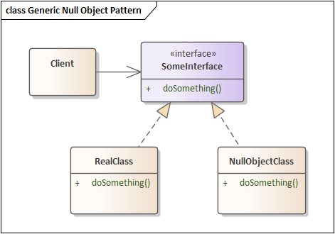
Null Object Pattern
Create a class that mirrors another
Each operation “does nothing”
Value returning operations: return something reasonable
Use this class wherever might have a check for null
Advantage: avoid lots of “if ( x != null )…”
Disadvantage: more classes to write
Clearly a bad idea in this case!
Possibly useful for full Stereo
Also: may delay raising an error: fail fast!
Important details:
Base class must be an interface – Null should have no unnecessary information
Original class is listed as “RealClass” – don’t change this class because much of the system depends on it
Do not be tempted to write messages or other side effects in the null
Full description: see
https://www.oodesign.com/null-object-pattern.html
(but note this suggests an abstract class as the
base, which is generally not recommended.)
Notes:
A significant part of the course: identify problems and solve those problems using (design) patterns

Slide 19
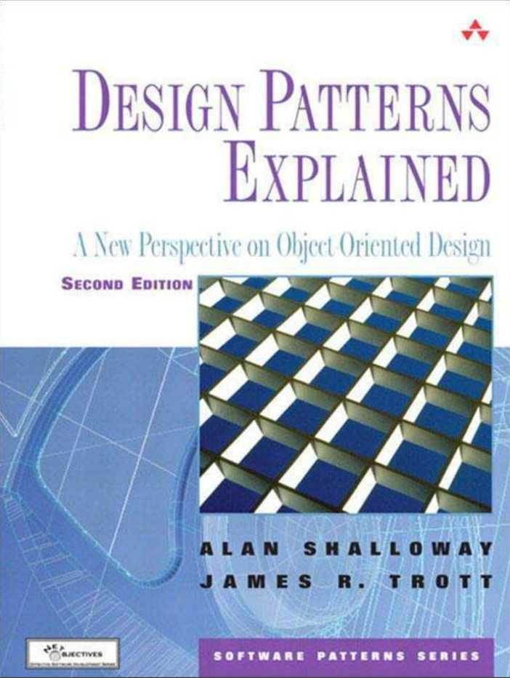
SE-2811 Software Component Design
See syllabus at https://faculty-web.msoe.edu/hasker/se2811
Required
text:

Slide 20
Review
Design patterns: capturing frequent design solutions
Reusing designs in addition to requirements, algorithms
Null Object Pattern: avoiding
if ( x == null )…
through “do nothing” classes
Next: Adapter Pattern

