Slide 1
2. Adapter
SE2811 Software Component Design
Dr. Rob Hasker
Textbook Ch. 7
Notes:
OLD READINGS:
Reading: Java Design Pattern Essentials, Ch. 7
Optional: Software Design Principles, Ch. 2 on DRY, Ch. 5 on LSP

Slide 2
Null Object Pattern, revisited
Recall UML notation:
0..1: StereoController has 0 or 1 Equalizers
Equalizer: has multiple Level objects
StereoController has reference to a Volume object
Implied multiplicity: 1
Drop role name if obvious
Not documenting constructors; little additional information
Don’t list attribute if have association
Minimal clutter!
Notes:
A significant part of the course: identify problems and solve those problems using (design) patterns

Slide 3
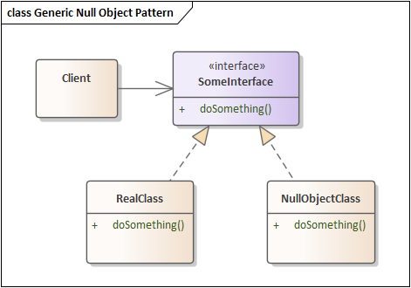
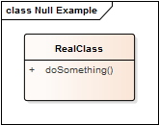
Null Object Pattern, revisited
What problem was being solved?
How to apply to RealClass?
Solution
Define interface
Create null object version with do-nothing operations
Benefits?
Drawbacks?
Notes:
A significant part of the course: identify problems and solve those problems using (design) patterns

Slide 4
Design Patterns
Generally: solving maintenance problems
Course goal: make maintenance easier
Why?
Each pattern:
Problem statement: what problem is being solved
How maintenance improved
Name: allows communication
Solution: class design
Advantages – what is improved in the design
Shortcomings – negatives of using the pattern
Reusing approaches, not specific code or algorithms
Notes:
Why? Successful systems get used, used systems result in requests for changes.

Slide 5
Pattern #2
Scenario:
System built around a class by Vendor1
Purchased when build application
Vendor1 goes out of business, and you need an update
Will replace by Vendor2’s library
Existing System
Vendor1 Class
Vendor1 interface

Slide 6
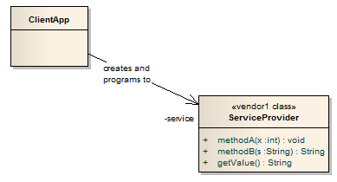
Original Configuration
Vendor2: similar class, but new interface
Change all the calls to methodA, etc?
Assumption: ClientApp is heavily dependent on ServiceProvider
many calls to various ServiceProvider methods.
Commonly, ServiceProvider implements numerous methods (more than shown here)
Notes:
Issue: it’s often not just the method names, but rules on the order they were applied

Slide 7
Solution: Adapter (Wrapper) Pattern
Adapter
Implements the interface your classes expect
Uses the vendor interface to service your requests.
Existing System
Vendor2 Class
Existing System
Vendor2 Class
Adapter

Slide 8
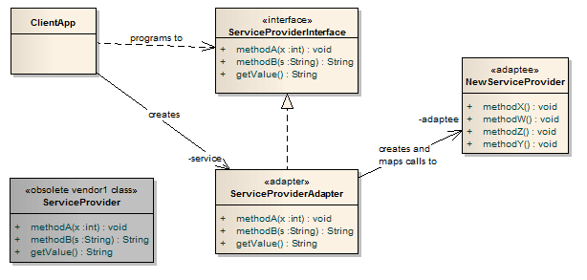
Applying Adapter
4. An adapter class is written which maps calls from the original methods to the new methods
2. An interface declaring
the same methods as
the original
ServiceProvider
is created.
Client MUST use this interface!
1. The original ServiceProvider class is obsolete and discarded
3. A replacement class for the original
ServiceProvider is found that provides similar functionality but with a
Different set of methods – the adaptee

Slide 9
The Adapter Pattern features
Note client calls original method
That method delegates to the new service provider
Typically: the implementation of methodA will be short
simply call one or two methods in NewServiceProvider
However, may have a complex interface
may need to construct additional information
Example: making a 3-D character move on a screen
Result from adaptee: must translate back to the results expected by the client
Only changes to the clients:
Declare variables using the interface type
Create instance(s) of the adapter instead of the original vendor

Slide 10
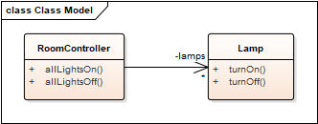
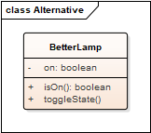
Example: lighting a room
Delivered system:
What to do if replace Lamp by BetterLamp?

Slide 11
When to use Adapter
Legacy code which interfaces to a class library that has changed
Changes might include versions, vendors, new requirements
New application
Interfaces with known third-party library
That library not yet defined
Isolate the problem!
Define an interface, write the adapter later

Slide 12
Adapter: a structural design pattern
Captures relationships between classes
Reduces the dependencies between classes
Traditional solution: rewrite existing code to meet new need
What if we need the original code for another system?
Clone the code?
When copy/paste is your design strategy, you’ve lost
Don’t repeat yourself (DRY), again!

Slide 13
Adapter as a design pattern
What is an alternative name?
Wrapper
When to apply?
That is, what problem is being solved?
Describe the application to a neighbor (in generic terms)
Draw a class diagram!
What are the advantages?
What are the shortcomings?
Not: more classes – we’ve only introduced a couple; lost in the noise
All patterns introduce new classes; only significant if create large numbers
Overhead for delegation calls
It’s less obvious what an adapter method call does
Notes:
The “more classes” is always true and uninteresting unless it is a LOT more classes or very high performance requirements

Slide 14
What we’ve accomplished
The Adapter pattern has solved a big issue: how to disassociate two pieces of code that are likely to change
Our goal: isolate components that change
Question: should we always use an interface class?
Why might we want an abstract class instead?
Notes:
abstract classes: allow non-final fields, concrete methods

Slide 15
Application
Working in teams of two, apply the adapter pattern to a queue:
Download se2811/samples/SimpleLinkedList.java
Download se2811/samples/SimpleQueue.java
Use IntelliJ to build, run both
Download se2811/samples/GenericQueue.java
Create LinkedQueue.java with the same test main as SimpleQueue.java but using SimpleLinkedList instead of ArrayList.
If instructed, upload LinkedQueue.java to Canvas.

Slide 16
Review
Design patterns
Null Object Pattern, revisited
Adapter: adapt existing software to new classes
Provide flexibility if don’t have details for a critical class early in the project

