Slide 1
5: Object-oriented Analysis & Design
SE2811 Software Component Design
Dr. Rob Hasker

Slide 2
Building an OO system
What is the process we have so far for building a system?
Interview customers, collect stories/scenarios
Identify nouns, verbs
Remove duplicates, unnecessary classes (applying RIBS)
Result: identified domain classes with attributes, operations
High level/domain level class diagram:
Meal wheel – see next page
Notes:
We will define “unnecessary” later!

Slide 3
Domain:
Meal Wheel user stories
As a hungry student, I want my phone to randomly select from different restaurants so I know where to eat.
As a picky student, I want my phone to suggest close restaurants that serve sashimi so I can choose a place to eat within a 10-minute walk.
As a restaurant owner, I want to distribute menus to potential customers so customers can be attracted by my food selections.
As a restaurant owner, I want potential customers to know of dietary restrictions that I support so I can attract customers who do not eat particular foods.

Slide 4
Identified nouns, verbs
Nouns:
Student
Phone
Restaurant
Where to eat
Sashimi Menu item
Place Location
10-minute walk Distance
Owner
Menu
Food selection Menu Item
Customer
Dietary Restriction
Verbs
Select [restaurant]
Eat [at restaurant]
Serve [sashimi]
Choose [a place to eat]
Distribute [menus]
Know [of dietary restrictions]
Support [dietary restrictions]
Attract [customers]
Notes:
Other objects: clear responsibilities – have students pick those out
* Student: user; Restaurant: capture location; Place: a type of restaurant; owner: sets menu; Customer: user – better than student

Slide 5
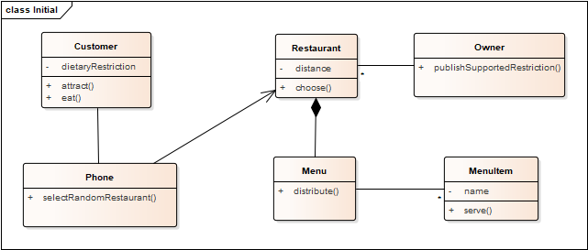
As a hungry student, I want my phone to randomly select from different restaurants so I know where to eat.
As a picky student, I want my phone to suggest close restaurants that serve sashimi so I can choose a place to eat within 10 minutes walk.
As a restaurant owner, I want to distribute menus to potential customers so customers can be attracted by my food selections.
As a restaurant owner, I want potential customers to know of dietary restrictions that I support so I can attract customers who do not eat particular foods.

Slide 6
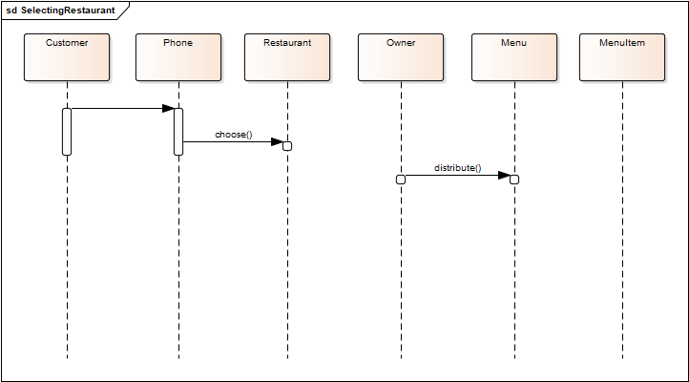
Selecting a restaurant
Notes:
Customer does something with phone, chooses a restaurant. Owner distributes menu. None of this makes sense

Slide 7
Refinements
eating: out of scope
menus may be distributed, but not by a direct act of the owner
serving menu items is out of scope
MealWheel knows about the customer; user just runs the app
How they run it is an Android/iOS issue, out of scope for MealWheel

Slide 8
Selecting a restaurant
Sequence has no scenario; what is a realistic
one for selecting a restaurant?
Build super-menu of all food items
Present super-menu to customer
Customer selects food item
Present list of restaurants serving that item
Select restaurant

Slide 9
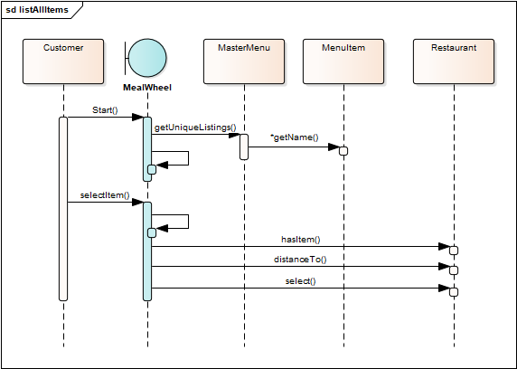
Supporting refined scenario:
Build super-menu of all food items
Present super-menu to customer
Customer selects food item
Present list of restaurants serving that item
Select restaurant

Slide 10
Changes:
Added MealWheel App
System is not a domain object, but useful
MasterMenu: list all items
Restaurant: does it have an item? How far away?
But why notify the restaurant?
No state change with operation
Notes:
Note: there are problems still – where do menu items come from? how do we create the master menu? These are issues that get refined a few slides from now

Slide 11
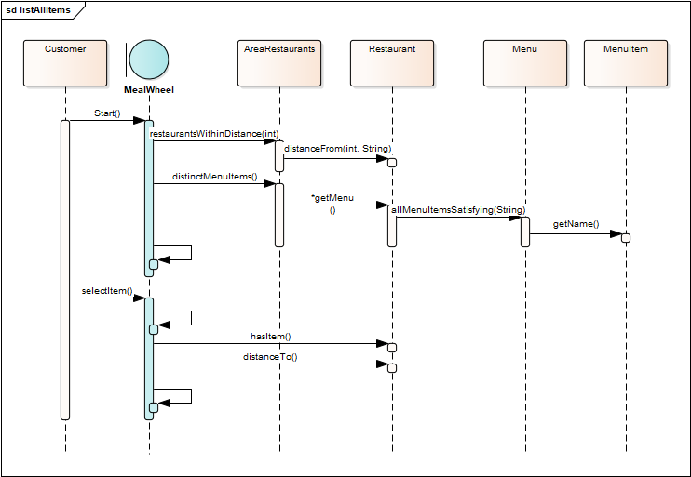
Further Refinements
displayMenuItems
displayRestaurantsWithItem
displayRestaurantLocation
Note many new operations
AreaRestaurants class: opportunity to restrict list by “close” restaurants
Notes:
This fixes some of the problems from the earlier slide (using the same scenario, but answering the question of finding close restaurants before identifying the menu items.

Slide 12
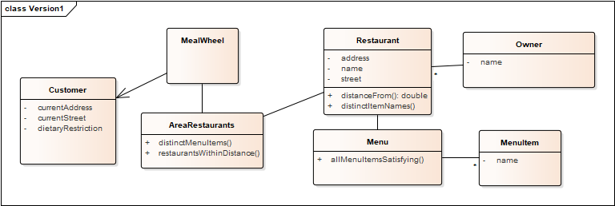
Updated Class Diagram
Notes:
Note added restaurantsWithinDistance, etc.; didn’t list operations on MealWheel, though could have.
Note that each operation is in the TARGET class
> this is much closer to an implementable system, which is the goal! Refine class diagram until can build the system

Slide 13
General notes
No dynamic relationships - capture things that don’t change during run
Dynamic relationships rarely change interfaces
Minimal directionality, few attribute/operation types; only where known
No association labels – these clutter diagram and add little value beyond “x has y”
Capture multiplicities!
generally 1 or *
1..* usually not true at start, and 1..n (or i..n) is generally unnecessary detail.
Don’t list getters, they are assumed, but could list setters
Don’t list constructors; they can also be assumed at this point
Type returned by distinctMenuItems is a bit vague; ok at high level

Slide 14
Domain-driven inheritance
Suppose we have the story
As a budget-conscious student, I want the application to pick a fast-food restaurant because I like to avoid places where tips are expected.
Implication: different types of restaurants are important to the domain
Introducing fast-food restaurants implies other types are needed
Let’s assume conversations with client introduce “cafe” (eg, coffee-shop) and “sit-down” as other types.
Capture these! If they are in stories/requirements, then there will be implementation details specific to each

Slide 15
Domain-driven inheritance
Added classes for types of restaurants
No distinct responsibilities, methods, attributes yet, but they are likely!
An if statement could be used to capture these differences in the base class, but..
A goal of OO designs is to remove if statements – they create more work in testing, maintenance
If there are no distinctions in implementation, remove the inheritance
Note associations are with the base classes unless they are specific to the subclasses
If inheritance is important in the domain, it’s important in the design!
Notes:
If statements are to be avoided when the domain drives separating the cases into distinct classes!

Slide 16
Next steps
Refine, refine
Important aspect of UML: can carry diagrams through whole project
Each step: add more information
Questions to answer
What are the responsibilities for each class?
Containers to use?
Do any objects have complex states? If so, capture these!
Capture additional scenarios as sequence diagrams
Menu updates
Setting dietary restriction; likely to discover need to support > 1
Are there opportunities for patterns?
What maintenance problems can we anticipate?
Are there classes with too many associations or operations?

Slide 17
Additional refinements
Capture all setters, constructors; getters can be assumed
Capture return, attribute, parameter types
Generally: do not list private methods – those are particular to a developer’s implementation
If specify enough detail, can auto-generate all code
UML has sophisticated notation; can capture things like “object A is associated with only one of B or C”
This can be more work than just writing the code…
The win: can maintain the diagram, clients can provide more help
In this case, probably will include private methods

Slide 18
Review
Process:
Collect user stories, requirements, identify nouns and verbs
Use RIBS to eliminate irrelevant classes, identify attributes
Create initial class diagram
Collect scenarios for use cases
Draw high level sequence diagrams
Construct domain-level class diagram(s)
Refine class diagram, capturing containers and state diagrams
Identify maintenance issues, apply patterns
Create detailed diagram (“contract diagram”) with all types, etc.
Key in UML: can carry diagram through full process:
analysis to design to implementation
OOA&D:
Object-oriented Analysis and Design
Notes:
I often don’t draw the detailed diagram – I can see this in the class diagram

Slide 19
Optional Exercise
Campus door lock system with phone interface
Can use app to provide user id information
Alternatively: unlock with domain username, password
Need mechanism to give/remove access for sections of students, individuals
Auto lock, unlock at specified times of the day

