Slide 1
CS 3040
Programming Languages & Translators
NOTE 1 CH 2
Robert Hasker, 2019-2022

Slide 3
Course Mechanics
Syllabus
Textbooks
Software Languages
Real World Haskell
Haskell concepts: in many programming languages and web development environments such as AngularJS
Structure: in-class exercises, out-of-class homework
Exercise:
How do programming languages differ from spoken languages?
What is the same?
My background in programming languages

Slide 4
Course Mechanics
Syllabus
Textbooks
Software Languages
Real World Haskell
Haskell concepts: in many programming languages and web development environments such as AngularJS
Structure: in-class exercises, out-of-class homework
Exercise:
What do you want to learn from this course?
Given the name of the course, what would you expect to learn in it?
My background in programming languages

Slide 5
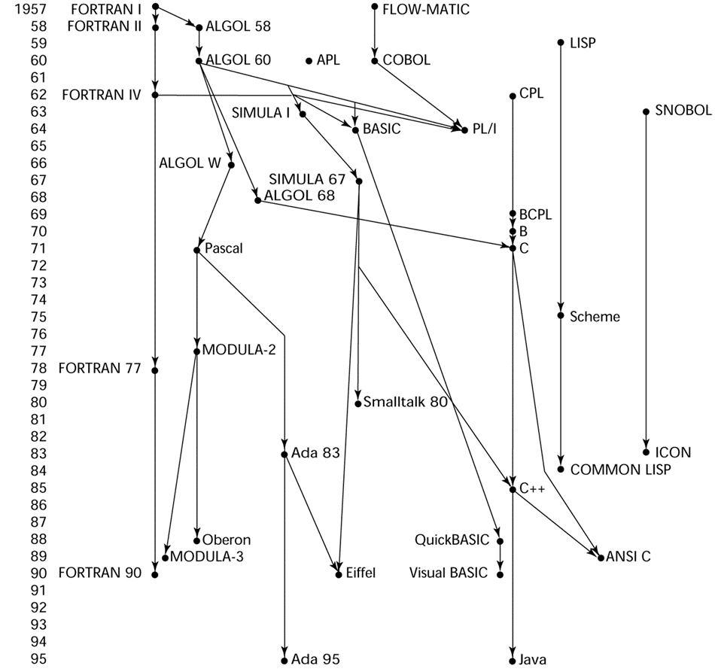
Can we learn all the languages?
See https://www.levenez.com/lang/ for a list of the languages
Common structure to PLS: introduce lots of styles of languages
Issue: there are too many out there to cover even representative samples
Languages borrow heavily from each other
Notes:
Image copyright 2004 Pearson Addison-Wesley

Slide 6
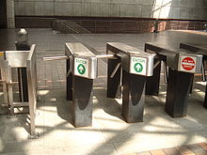
Why Programming Languages & Translators
My goals:
Know the language of language specification: grammars, semantics
Know how to build a simple parser for a language
Become familiar with a table-driven language recognizer
Know how languages are implemented, including memory management
Build your own interpreter for a small language
How useful:
Build quick interpreters to test domains
Have a deeper appreciation for different language constructs
Design specification languages to meet customer, problem needs
Starting point: a domain-specific language for turnstiles

Slide 7
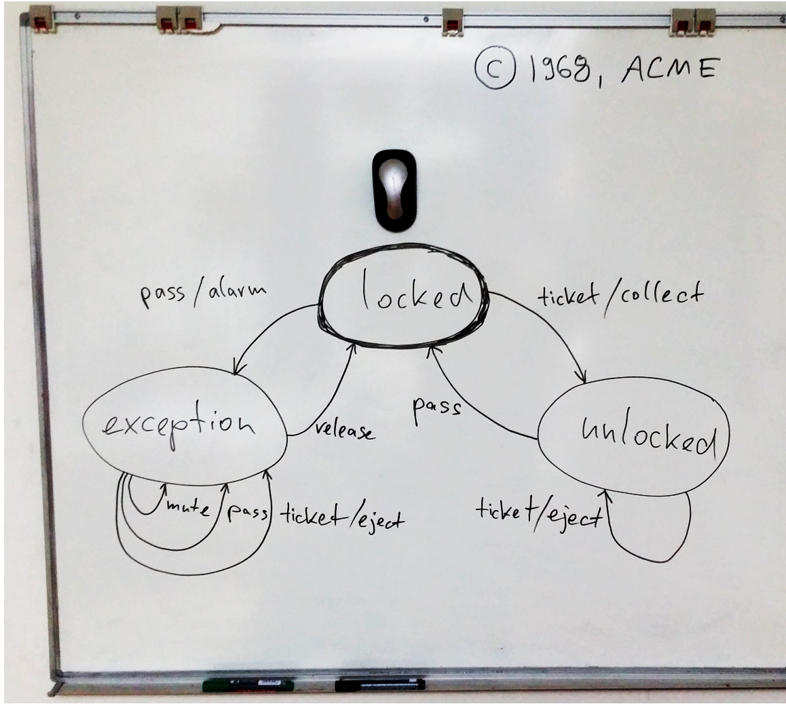
A Turnstile
Locked: passenger cannot pass
Unlocked: allow passenger through
Exception: error state, metro personnel need to intervene
Ticket: passenger inserts ticket
Pass: passenger passes turnstile
Mute: employee turns off alarm
Release: return to normal mode
Collect: take ticket
Eject: ticket ejected
Alarm: signal to metro personnel

Slide 8
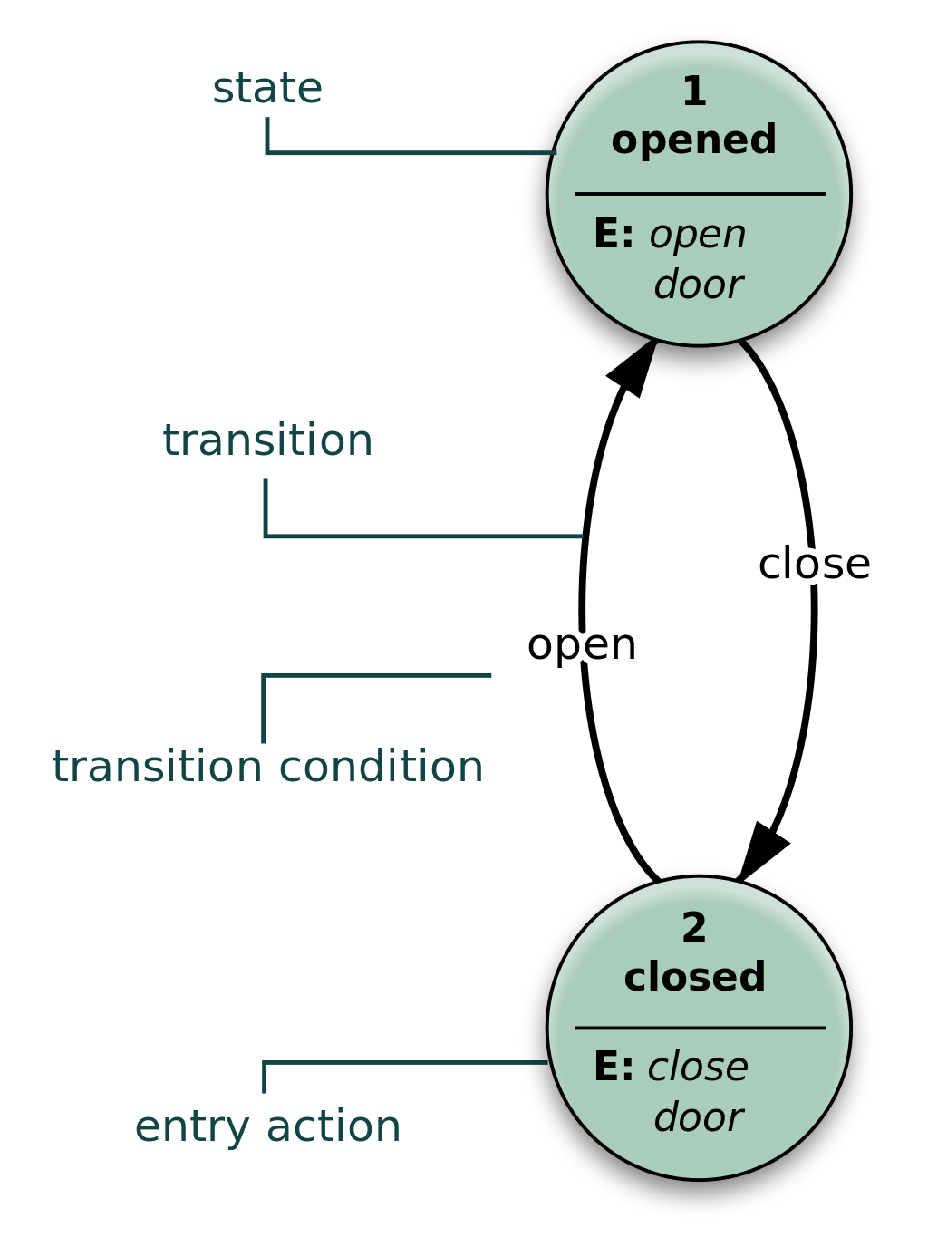
Finite State Machines
Set of states
Free arrow marks start state
States have transitions from one to the next
Events/inputs control which transitions are taken
State names help understand the machine, but have no meaning
If no transition out, then machine crashes in an error state and the input is rejected
If in final state at end of input, the input is accepted
Recognizing “nice”
Notes:
Note that “nice” has an error state – can’t leave, and done when reach success and no more letters

Slide 9
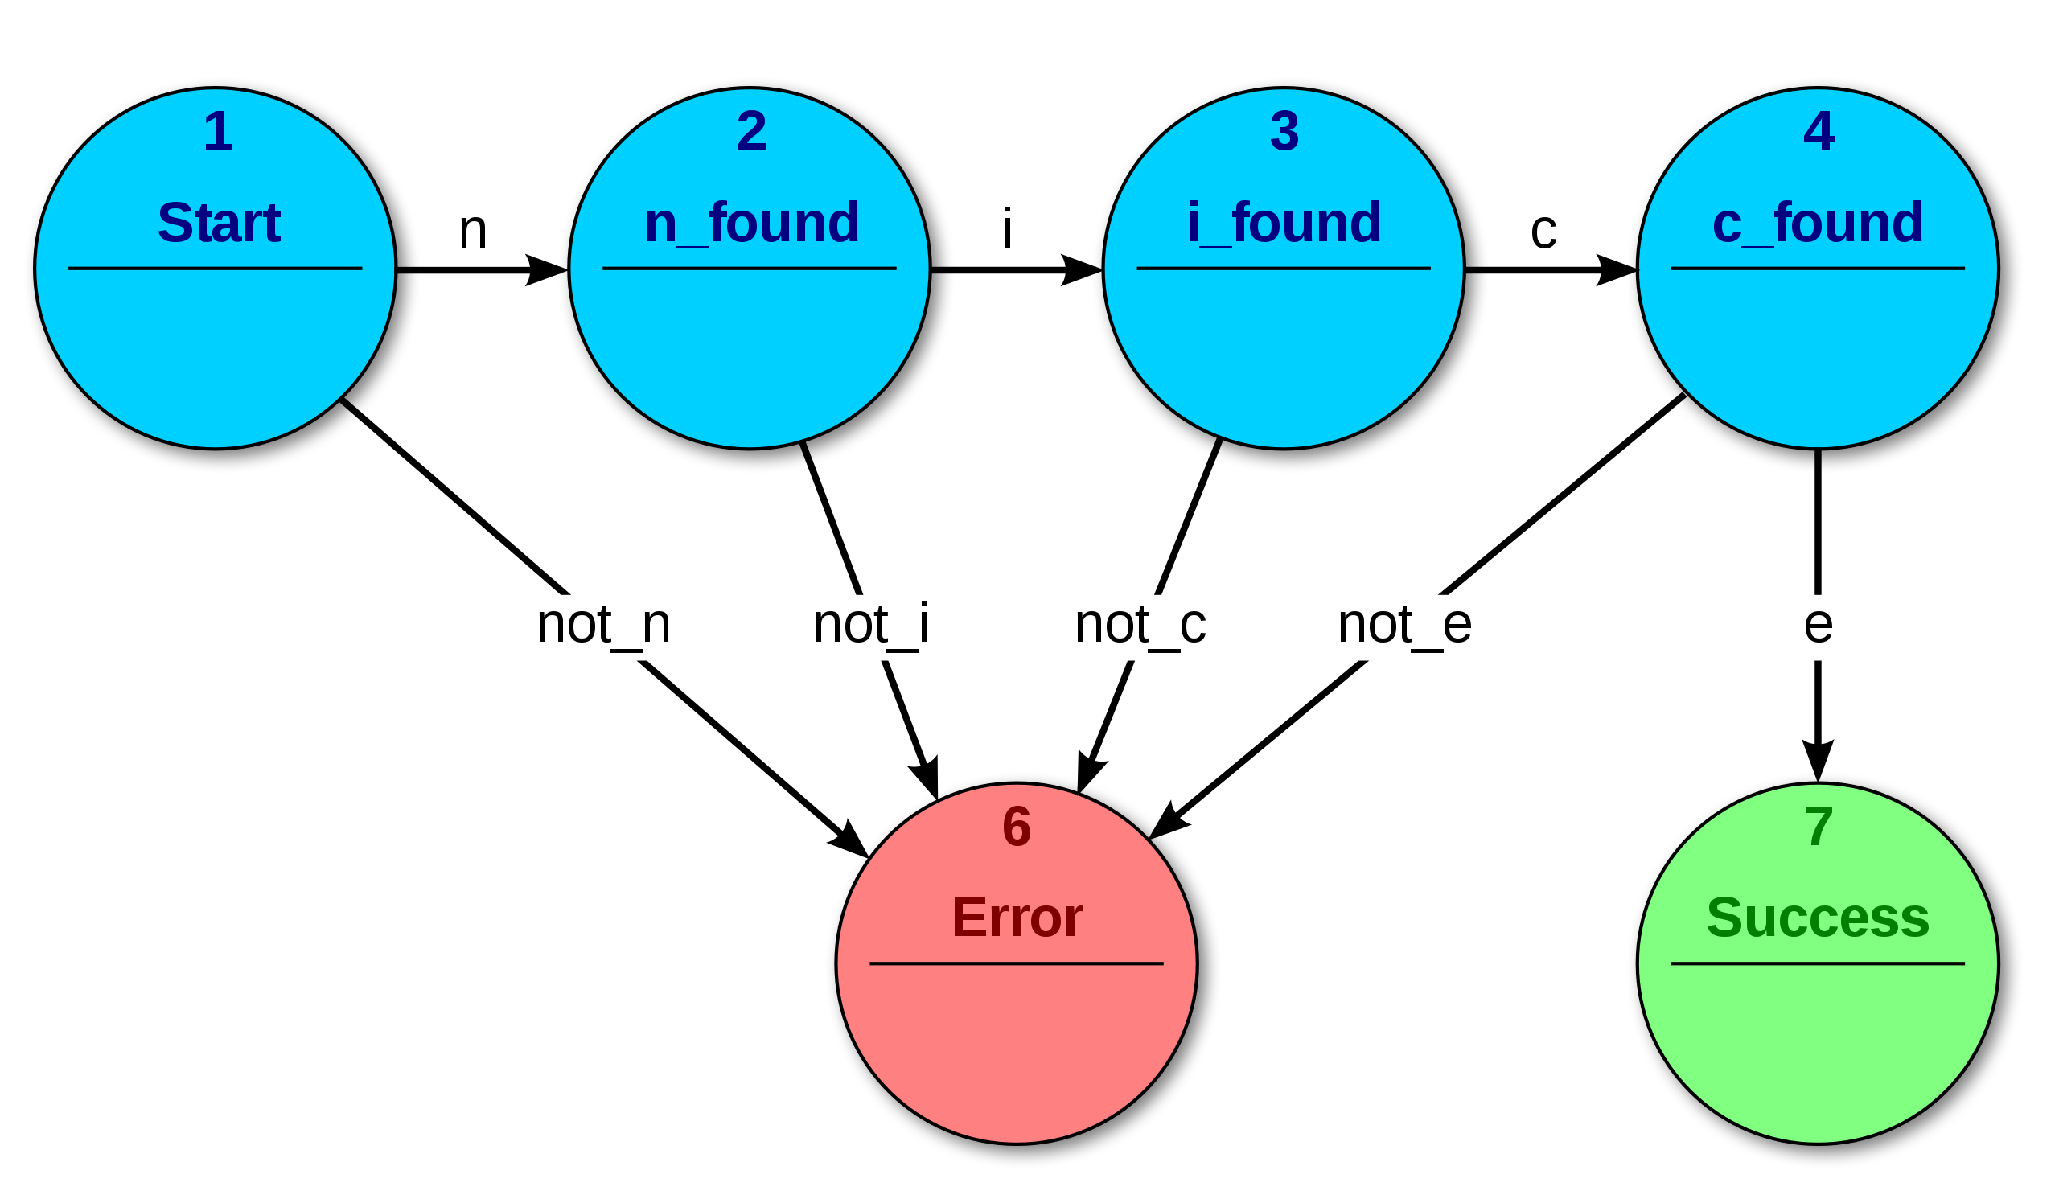
Finite State Machines
Set of states
Free arrow marks start state
States have transitions from one to the next
Events/inputs control which transitions are taken
State names help understand the machine, but have no meaning
If no transition out, then machine crashes in an error state and the input is rejected
If in final state at end of input, the input is accepted
Recognizing “nice”
Notes:
Note that “nice” has an error state – can’t leave, and done when reach success and no more letters

Slide 10
Formalizing machines
some
state
State: a labeled circle
Transition: switching states on event/input:
Start state: - always one start state, always w/ arrow!
Final state: - can have multiple or even zero!
x
1
2
one
bye

Slide 11
01 or 10
0
extra
zero
balanced
Language of machine: {01, 10}
1
1
0
both
odd
extra
one

Slide 12
01 or 10 Odd number 0’s & 1’s
0
0
extra
zero
extra
zero
balanced
balanced
0
1
1
1
1
1
1
0
0
both
odd
extra
one
both
odd
extra
one
0
Language: {01, 10, 0111, 1011, 1101, 1110, 1000, 0100, 0010, 0001, 000111, etc. }
Can’t list all strings!
“etc” is too vague!
Note the names have nothing to do with the inputs; they are just documentation
(Students sometimes mix the name of the state with the transition)

Slide 13
01 or 10 Odd number 0’s & 1’s
0
0
extra
zero
extra
zero
balanced
balanced
0
1
1
1
1
1
1
0
0
both
odd
extra
one
both
odd
extra
one
0
These machines are deterministic
No two transitions out of a state have the same label
Nondeterministic: having a transition from balanced to extra zero on a 1
Epsilon transitions also make a machine nondeterministic
Nondeterministic machines are interesting, but harder to implement...

Slide 14
a’s followed by optional b’s followed by c’s: a^{i}b^{j}c^{k} where i, k > 0
Notes:
j has to be an natural number, so j ≥ 0 can be assumed
Only one event or character per transition
No “ab” type transitions
MUST mark start state with arrow; name of state is not enough
No transition on this arrow; it just points to the first state
Names of states do not matter; they are essentially like the name of an identifier in code
For example: does sum contain a sum just because it’s named that?

Slide 15
Two a’s, a string of b’s, then two more a’s

Slide 16
An even number of letters, divisible by 3

Slide 17
A stop light (red, green, yellow states)

Slide 18
a^{i}b^{j}c^{k} where i, j, k ≥ 0 - note it is useful for greater than 0

Slide 19
Accepting 50 cents in nickels, dimes, quarters

Slide 20
Attempt: a^{n}b^{n}

Slide 21
Implementing an FSM
State
----------------------------
id: str
is_initial: bool
is_final: bool
----------------------------
transition_on(input)
A state: an identifier + a collection of transitions
Each transition:
has a source state
has a destination state
transition_on:
take input or event
change the current state to the transition destination
Success: last reached state is final
1
destination
out_transitions
*
Transition
----------------------------
event: str
----------------------------

Slide 22
Sequences
Inserting ticket: releases gate so person can pass
Inserting second ticket before passing: ticket is ejected
Attempting to pass in locked state: triggers alarm
Resetting after alarm:
Mute alarm
Eject any ticket
Release (really, reset) alarm so back in locked state

Slide 23
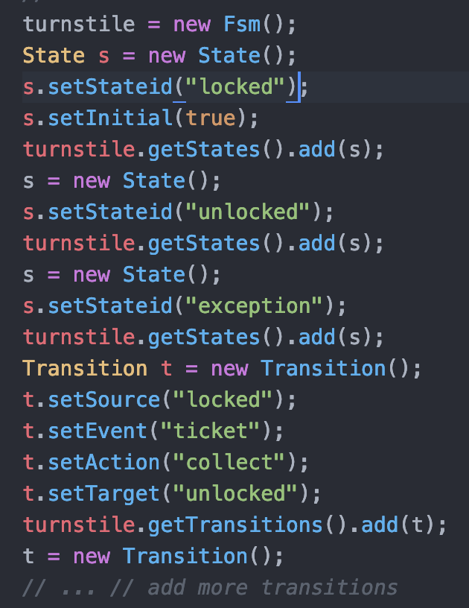
Classic Java solution
Configuring states,
Defining transitions
Notes:
How to implement? This solution has a lot of detail, easy to forget a transition
A lot of code for a simple collection of information!

Slide 24
Classic Java solution
State
----------------------------
id: str
is_initial: bool
is_final: bool
----------------------------
transition_on(input)
1
destination
out_transitions
*
Transition
----------------------------
event: str
----------------------------
Configuring states,
Defining transitions
Notes:
How to implement? This solution has a lot of detail, easy to forget a transition
A lot of code for a simple collection of information!

Slide 25
A more functional solution
Fluent API definition:
Using factory methods rather than constructors to build objects
Method chaining: each step returns object that can be applied
Application of Builder pattern!
Implicit parameters: in this case, a “current state” so no need to repeat
Provide useful conventions to eliminate boilerplate code
Improved: less focus on sequencing
Still has problems:
Lots of object construction
Heavy container manipulation
Repetitive
Solution: a fluent API
Notes:
This solution has a lot of detail, easy to forget a transition
A lot of code for a simple collection of information!

Slide 26
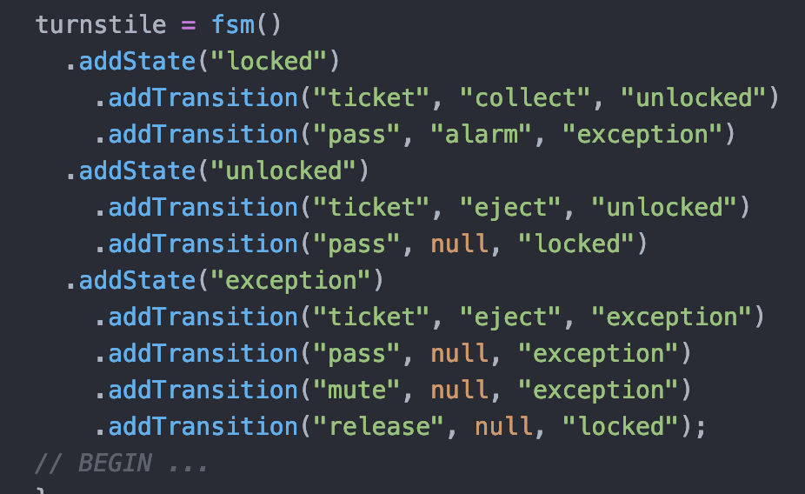
A fluent API solution
Using factory methods rather than constructors to build objects
addState, addTransition
Method chaining: each step returns object that can be applied
fsm(), addState, etc.
Implicit parameters: in this case, a “current state” so no need to repeat
addTransition applied to last state added
Provide useful conventions to eliminate boilerplate code
Assume first state is initial

Slide 27
Developing a fluent API for a language
Write/select sample programs in the target language
Design objects with factory methods constructing domain objects
Add methods matching target language actions
Most operations will be applied to a current object, possibly updating it
Most methods will return the current object
Identify initial states, implicit information from one to next

Slide 28
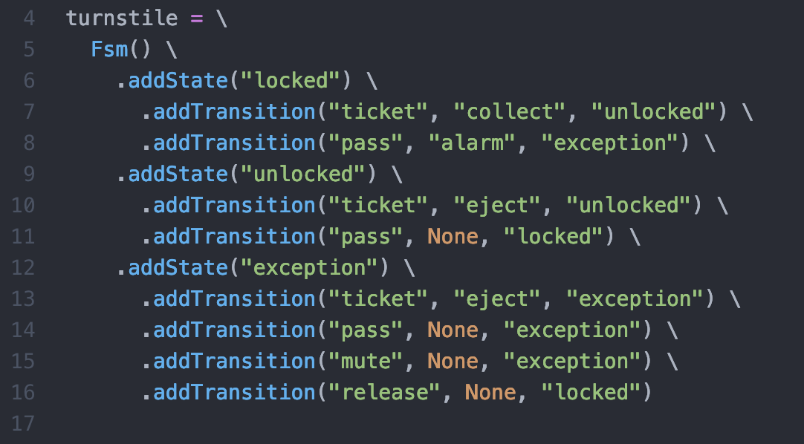
Python version
Building the Python version is very similar:
Textbook discusses this as an “internal DSL” – solution just using existing programming tools
Alternative: external DSL: building a new language for the domain
Allows non-developers to build, verify models
This is a characteristic of Fluent APIs

Slide 29
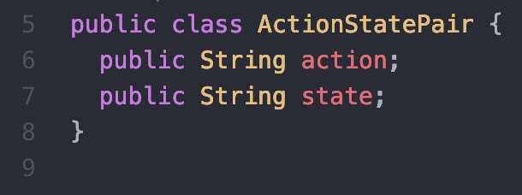
Java classes supporting fluent API
Interface: build machine
ActionStatePair: specifies next state based on an action:

Slide 30
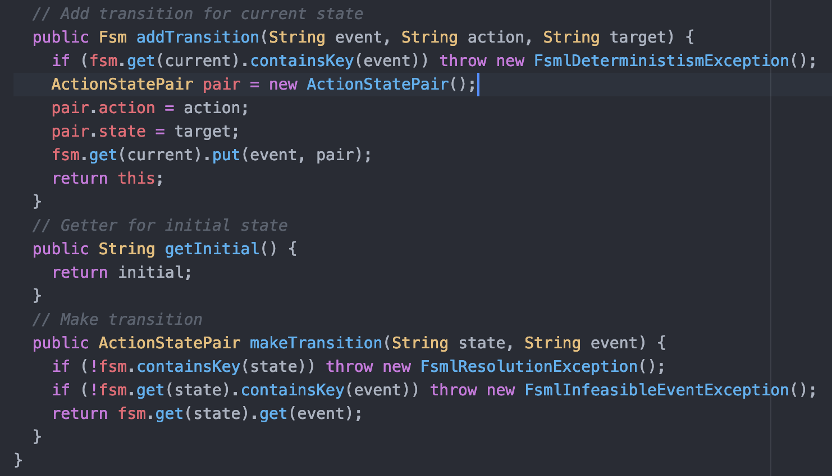
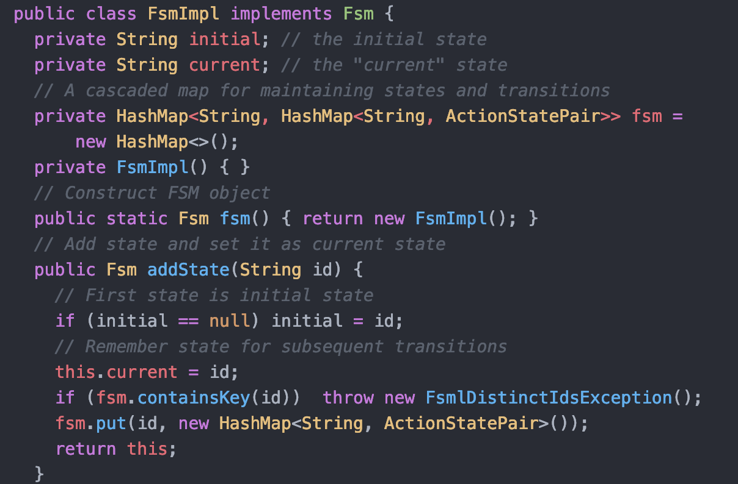
Implementing fluent API in Java

Slide 31
Implementing fluent API in Java

Slide 32
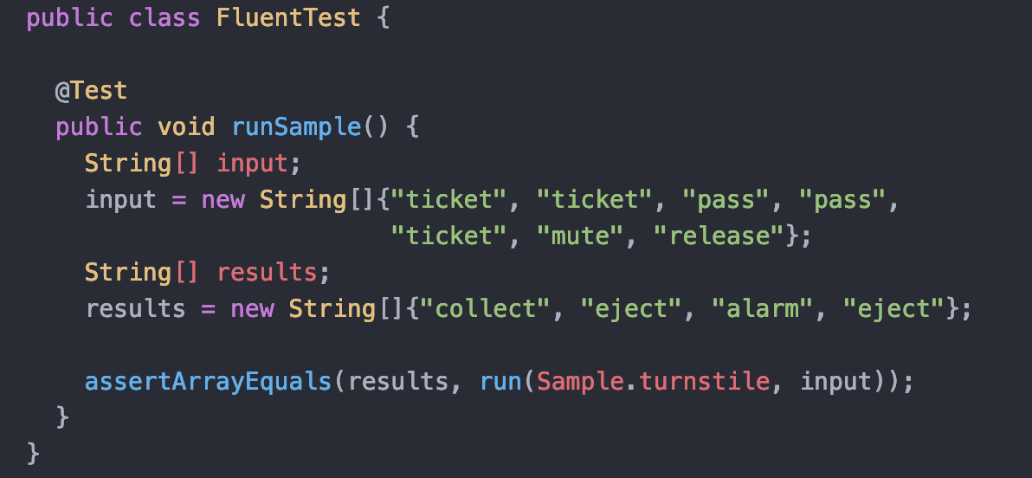
JUnit Test Case
run(): runs the interpreter
These tests also document the API!

Slide 33
Run method: interpreter
All languages need these three elements - the basic goal of the course
This provides…
Syntax: fluent API for internal DSL
Semantics: interpreter describes what happens when executing syntax
Well-formedness: checking this is reasonable
No two states have the same ID
One initial state
Each state pair has at most one transition
Each transition goes to a declared state
No state not reachable from the initial state

Slide 34
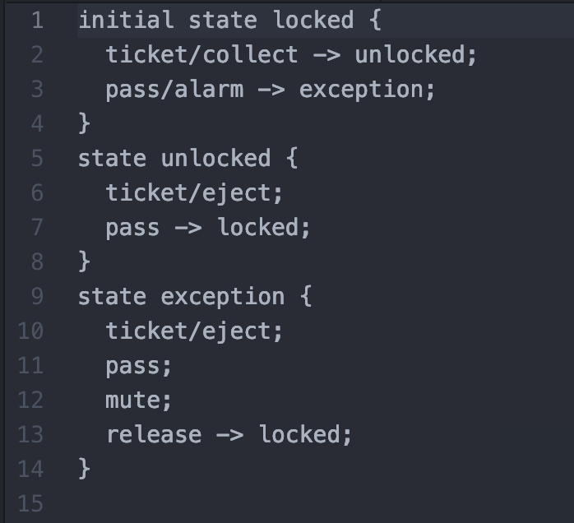
External DSL
Domain specific languages in general
Computer language targeted at a specific domain
In contrast to general purpose languages like Python, C
Examples
HTML, YAML, other markup languages
JSON
SQL
Build scripts (make, Docker, ANT)
Command prompt software
MATLAB, Mathematica, Maple – symbolic math
Csound: sound and music synthesis
Terraform: manage cloud servers, network appliances
Level specifiers for computer games
Security, process tools
Basic tool: develop a language around the problem
Language specification
Sample construction
A FSM is a sequence of states, one marked initial
Each state has an action, result, and transition to new state
States, events, actions: text
No transition: stay in same state
Draw FSM for this:

Slide 35
Implementing the External DSL
ANTLR: https://www.antlr.org/
Another Tool for Language Recognition
Basic goal: support compiler generation
Essentially, a domain-specific language for compiler writers!
Compiler
Program
Libraries
Executable
ANTLR spec
Semantics
Tests
Executable compiler

Slide 36
ANTLR specification
Gives the grammar for our language
That is, rules defining what’s legal and what is not
Incorporates both Backus-Naur Formalism, Regular Expressions to specify the grammar
This motivates introducing these two formalisms...

Slide 37
Summary
Finite state machines as a specification tool
Implementing FSMs as Java code
Building a fluent API
Building an interpreter
External DSL: using tools to define, implement the language
Motivates looking at regular expressions & grammars
Next: regular expressions

Slide 38
ANTLR specification
Grammar: specifying grammar name
Used to generate class names
@header: destination package
fsm, state, transition event, action: same as before
NAME: specification for identifiers using “regular expressions”
More on these in a bit
WS: specification for whitespace; automatically skipped

Slide 39
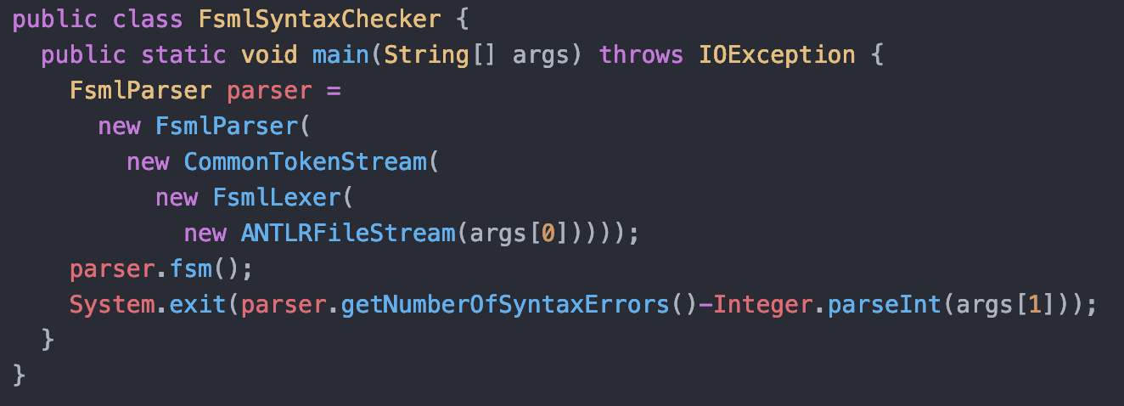
Java Driver for checking syntax
Boilerplate code
ANTLRFileStream: reading ANTLR source
FsmlLexer: break code into tokens, wrapped into a CommonTokenStream
FSMLParser: checks the token stream is valid
Notes:
Run on two test files, one with errors and one without

Slide 40
Parsing
Syntax checking: verifying well-formed input
More generally, “acceptance”
Parsing: creating a parse tree or concrete syntax tree (CST)
Captures structure of program
Execution: bottom up, left to right
Concrete: captures actual syntax
Abstract will come later
Sequence
assignment
x
product
statement
x
a
b
statement
print

Slide 41
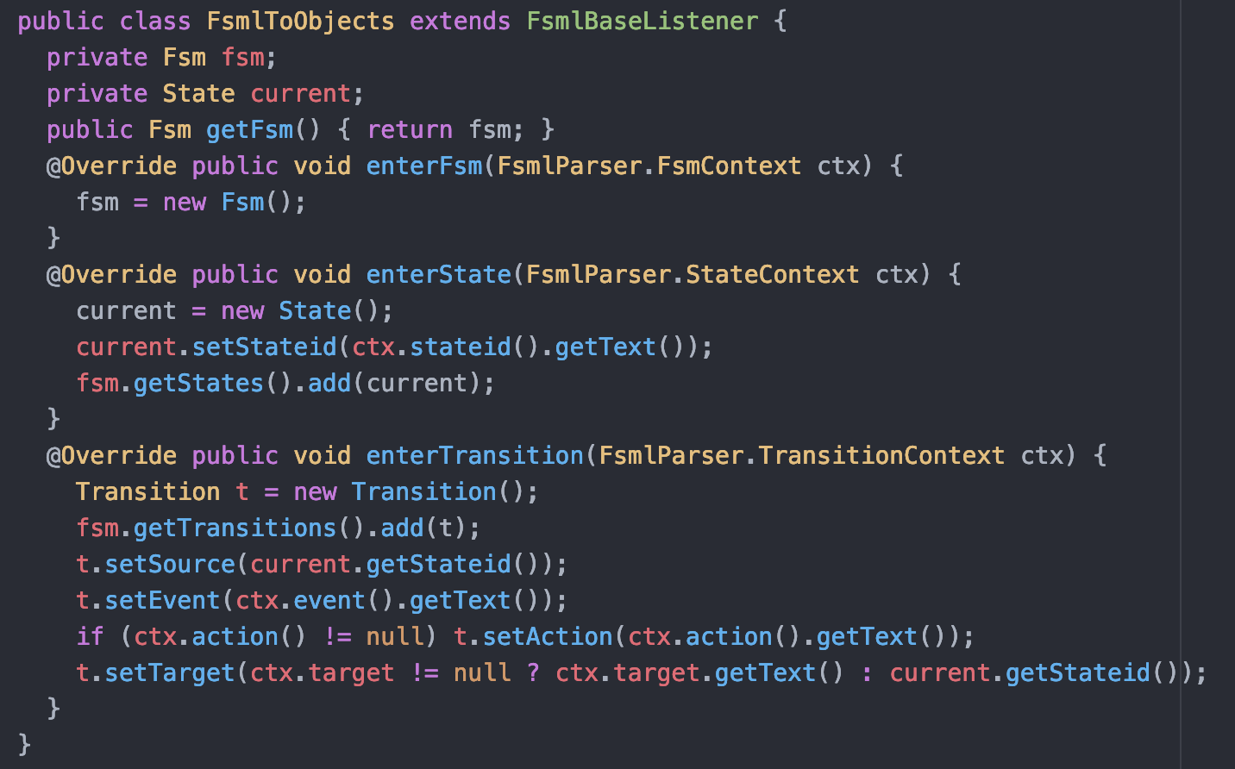
Parse tree listener
enterTransition: executed when have parsed a transition
Result: adds a transition to the machine
enterState: have processed a state; record the name
enterFsm: constructing the finite state machine

Slide 42
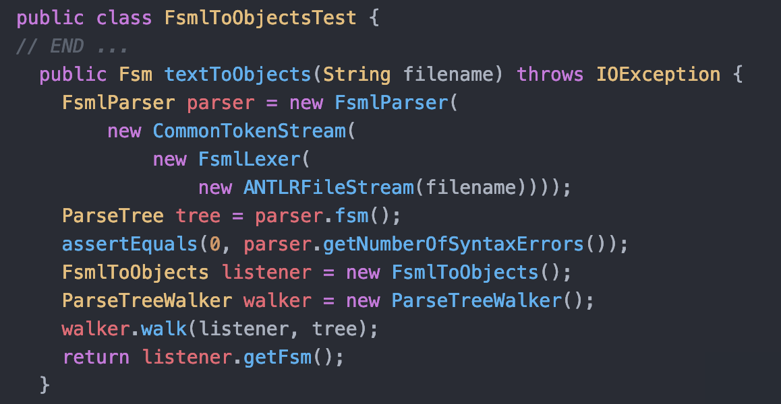
Test driver
Construct parser as before
Get tree from parser
Check no syntax errors
Build listener, call walker to apply it at each node
Returns the Fsm object

Slide 43
Compilation
With a bit more work, can add a runtime environment to the full ANTLR specification; can execute sequences entered by the user
Could then tie inputs to sensors in physical system
Problems:
Would be difficult to interface to C, and most sensors would interface to C (or C++) most easily
Must have full Java interpreter to run the system; expensive on memory, computational power
Ideal: compile to native processor
Solution: generate C code, use C compiler to generate final executable
That is, C as an assembly language…

Slide 44
Compilation: target C code
Enum values to track state
Initial state: LOCKED
Alarm, eject, collect: stubs for routines to interact with hardware

Slide 45
Target C code
Implementing the machine in C
Compilation: generating this code from a specification
Basic model: construct syntax tree, then process that tree to “emit” code for each subtree
See textbook for the full solution

Slide 46
Summary
First portion: a finite state machine (FSM) as a specification tool
Implementing an FSM in imperative, functional Java code
Implementing an FSM using fluent API concepts
Building an interpreter
Specifying the problem using a context free grammar
Executing this grammar in ANTLR
Generating syntax trees, compiled results
Next: Regular expressions and their implementation

Slide 47
In-Class Exercise: building a DSL for code reviews
Identify actions, objects
In groups, pick an aspect of the system and identify commands users would type for those actions
Build a script to run a review, recording action items
Build a script to resolve action items

Slide 48
In-Class Exercise: Zork commands
Spend about 15 minutes exploring Zork 1 (available at http://zorkonline.net/)
Identify as many language constructs as you can
What is the longest sentence you can type that results in a desirable action?
Identify at least one change you would recommend in the language recognized by Zork

