Slide 1
CS 3040
Programming Languages & Translators
Note 3: Grammars Ch 6 through 6.5
Robert Hasker, 2020

Slide 2
How to “understand” 3 + 4 * 5?
Expression
3
+
5
Expression
4
*
More precisely: interpret
First step: capture the structure

Slide 3
Another example: if x then 3 + y else z
if
predicate
true_part
false_part
z
3
+
y
Expression
Expression
Expression
x
Known as a parse tree

Slide 4
Solution: grammars
Broadly speaking, a grammar describes how programs or “sentences” are structured
A sentence is a piece of text to be “parsed”
Parsing:
Checking to see if a sentence is legal by a grammar
Capturing the structure of the sentence
Programs: sentences that capture computer instructions
Utterances in domain-specific languages (DSLs):
Sentences which can be interpreted in the domain
Grammars give us parse trees, parse trees can be interpreted

Slide 5
BTL definition
Example sentence:
if(iszero(zero)), succ(succ(zero)), succ(zero))
Grammar:
Expr → true
Expr → false
Expr → zero
Expr → succ( Expr )
Expr → pred( Expr )
Expr → iszero( Expr )
Expr → if(Expr, Expr, Expr)
Textbook version:
Notes:
Note: pred is used for predecessor - effectively subtracting one; pred(0) is not legal if dealing with natural numbers
Note: we won’t use the textbook way of writing grammars (for the most part) – theirs is a precursor into ANTLR, and we’re not covering that for now

Slide 6
Another grammar: capturing statements in English
A simple grammar for sentences:
SimpleSentence → Noun Verb Object
Noun → zoe | sam
Verb → climb | push | throw
Object → car | ladder | ball
More realistic:
SimpleSentence → NounPhrase VerbPhrase Object
NounPhrase -> Noun
NounPhrase -> Determiner Noun
NounPhrase -> Determiner Adjectives Noun
Adjectives -> Adjective
Adjectives -> Adjective Adjectives
Adjective -> big | small | red | blue | old | new
VerbPhrase → climb | push | throw
Object → NounPhrase

Slide 7
BTL definition
Example sentence:
if(iszero(zero)), succ(succ(zero)), succ(zero))
Grammar:
Expr → true
Expr → false
Expr → zero
Expr → succ( Expr )
Expr → pred( Expr )
Expr → iszero( Expr )
Expr → if(Expr, Expr, Expr)
Textbook version:
Notes:
Note: pred is used for predecessor - effectively subtracting one; pred(0) is not legal if dealing with natural numbers
Note: we won’t use the textbook way of writing grammars (for the most part) – theirs is a precursor into ANTLR, and we’re not covering that for now

Slide 8
In class exercise: adding variables
Extend BTL with x = Expr, sequence
Simplifying: make both into expressions, adding:
Expr → Variable
Expr → Variable = Expr
Expr → Expr ; Expr
Allow one-letter variables
Last case: return second Expression
Need to add a store to track values of variables
Accessing unknown variable: throw exception

Slide 9
Supporting functions
Syntax:
Expr → def name(Variable) Expr
Expr → name(Expr)
Semantics:
Def: define function with given name
Call: temporarily store Expr for variable
Need to restore value of variable after execution
Store: associate a variable with a stack of values
All non-parameter variables: global

Slide 10
Grammars
How should we specify a programming language syntax?
Solution 1: examples – what can go wrong?
Solution 2: English – what can go wrong with this?
Classic notation: Backus-Naur Form (BNF), dating to 1959
Developed by John Backus to describe Algol 58
A way to describe context-free grammars
A metalanguage
a language used to describe another language.
In BNF, abstractions are used to represent classes of syntactic structures
acting like syntactic variables, generally called nonterminal symbols

Slide 11
Example grammars
Revisiting BTL:
Expr → true
Expr → false
Expr → zero
Expr → succ( Expr )
Expr → pred( Expr )
Expr → iszero( Expr )
Expr → if(Expr, Expr, Expr)
productions
- rules for
replacing
one bit of
text by
another

Slide 12
Example grammars
BNF: every production of the form
X → 𝛂
where
X is a nonterminal
𝛂 is a sequence of terminals & nonterminals
No special meaning: |, (), *, +, etc.
That is, they are also terminals
Definitions:
Sentence: a string in (N U T)*
Ground sentence: a sentence in T*
Revisiting BTL:
Expr → true
Expr → false
Expr → zero
Expr → succ( Expr )
Expr → pred( Expr )
Expr → iszero( Expr )
Expr → if(Expr, Expr, Expr)
Draw parse trees for succ(pred(zero)) and if(false, succ(zero), zero)
A classic grammar for expressions:
Expression → Term + Expression Constant → Digit Constant
Expression → Term Constant → Digit
Term → Factor * Term Digit → 0
Term → Factor …
Factor → Constant Digit → 9
Factor → Variable Variable → letter
Factor → ( Expression ) letter → a …
Draw a parse tree for a * 5 + b
terminals – text that appears in the programs
In this grammar: { ‘true’, ‘false’, ‘zero’, ‘succ’, ‘(‘, ‘)’,
‘pred’, ‘iszero’, ‘if’, ‘, ’ }
Nonterminals (first letter capitalized) – symbols that
get replaced by other symbols
productions
- rules for
replacing
one bit of
text by
another
Notes:
Might show that addition and multiplication are right-associative with this grammar
Consider extending to include exponentiation with **, make addition and multiplication left-associative

Slide 13
Example grammars
Revisiting BTL:
Expr → true
Expr → false
Expr → zero
Expr → succ( Expr )
Expr → pred( Expr )
Expr → iszero( Expr )
Expr → if(Expr, Expr, Expr)
Draw parse trees for succ(pred(zero)) and if(false, succ(zero), zero)
A classic grammar for expressions:
Expression → Term + Expression Constant → Digit Constant
Expression → Term Constant → Digit
Term → Factor * Term Digit → 0
Term → Factor …
Factor → Constant Digit → 9
Factor → Variable Variable → letter
Factor → ( Expression ) letter → a …
Draw a parse tree for a * 5 + b
terminals – text that appears in the programs
In this grammar: { ‘true’, ‘false’, ‘zero’, ‘succ’, ‘(‘, ‘)’,
‘pred’, ‘iszero’, ‘if’, ‘, ’ }
Nonterminals (first letter capitalized) – symbols that
get replaced by other symbols
productions
- rules for
replacing
one bit of
text by
another
Extend to allow exponentiation with **
Make addition and multiplication left-associative
Notes:
Might show that addition and multiplication are right-associative with this grammar
Consider extending to include exponentiation with **, make addition and multiplication left-associative

Slide 14
Definitions
Definition 6.1 (Context-free grammar (CFG)). A CFG G is a quadruple ⟨N,T,P,S⟩ where
N is a finite set of nonterminals,
T is a finite set of terminals, with N ∩ T = ∅,
P is a finite set of rules (or productions) as a subset of N × (N ∪ T)*
These are typically written with →: N → (N ∪ T)*
S ∈ N is the start symbol
Example: formal definition of a grammar for positive binary numbers:
⟨N,T,P,S⟩: ⟨{B}, {0,1}, {B → 0B, B → 1B, B → ε}, B⟩
Typically: first non-terminal is assumed to be the start symbol
Formally, there is no first symbol – it’s a set of productions – so must specify
Notes:
Construct a parse tree for 10 using the grammar <{B}, {0,1}, {B -> 0B, B -> 1B, B -> epsilon}, B>

Slide 15
Definition
Definition 6.2 (Context-free derivation):
Given a CFG G = ⟨N,T,P,S⟩ and
a sequence p n q with n ϵ N, p,q ϵ (N U T)*,
the sequence p r q with r in (N U T)* is called a derivation step,
denoted by p n q ⇒ p r q,
if n → r is a production in P.
Example
⟨N,T,P,S⟩: ⟨{B}, {0,1}, {B → 0B, B → 1B, B → ε}, B⟩
B ⇒ 0B ⇒ 01B ⇒ 01
Notes:
Add =>*, =>+, define sentence, ground sentence

Slide 16
Definition
Expression → Term + Expression Constant → Digit Constant
Expression → Term Constant → Digit
Term → Factor * Term Digit → 0
Term → Factor …
Factor → Constant Digit → 9
Factor → Variable Variable → letter
Factor → ( Expression ) letter → a …
p n q ⇒ p r q is called a derivation step if n → r is a production in P
Example derivation sequence for expressions:
Expression ⇒ Term ⇒ Factor * Term ⇒ Constant * Term ⇒ Digit * Term
⇒ 5 * Term ⇒ 5 * Factor ⇒ 5 * ( Expression ) ⇒ 5 * ( Term + Expression )
⇒ 5 * ( Factor + Expression ) ⇒ 5 * ( Factor + Term )
⇒ 5 * ( Factor + Factor ) ⇒ 5 * ( Factor + Constant )
⇒ 5 * ( Constant + Constant ) ⇒ 5 * ( Constant + Digit )
⇒ 5 * ( Constant + 4 ) ⇒ 5 * ( Digit + 4 )
⇒ 5 * ( 3 + 4)
A lot of writing! Alternative: Trees

Slide 17
Definitions
Definition 6.2 (Context-free derivation):
Given a CFG G = ⟨N,T,P,S⟩ and
a sequence p n q with n ϵ N, p,q ϵ (N U T)*,
the sequence p r q with r in (N U T)* is called a derivation step,
denoted by p n q ⇒ p r q,
if n → r is a production in P.
Closure: α ⇒* β if α ⇒ γ₁, γ₁ ⇒ γ₂, ... γ_{k−1} ⇒ γ_{k} and γ_{k} ⇒ β
α ⇒+ β if α ⇒ γ, γ ⇒* β,
Definition 6.3 (Language generated by a CFG):
Given a CFG G = ⟨N,T,P,S⟩, the language L(G) generated by G is
the set of all terminal sequences that are derivable from S
More concisely, L(G) = { w ϵ T* | S ⇒⁺ w }

Slide 18
Well-formed grammar
Definition 6.4 (Well-formed CFG):
A CFG G = ⟨N,T,P,S⟩ is well-formed if for each n ϵ N,
There exists a w ϵ T* such that n ⇒⁺ w
There exist p,q ϵ (N U T)* such that S ⇒* p n q
In groups: write a grammar that violates each
In groups: restate both criteria without resorting to math
What is the advantage of the mathematical definition?
What are some other criteria you might want for a CFG?

Slide 19
Empty strings
Consider if statement in C/Java:
Statement → if ‘(‘ Expression ‘)’ Statement
Statement → if ‘(‘ Expression ‘)’ Statement else Statement
An alternative way to handle optional portions: use epsilon (𝛆)
5th Greek letter: 𝛂, 𝛃, 𝛄, 𝛅, 𝛆
This stands for the empty string
(Note I say “the” – there is only one empty string in the universe…)
Statement → if ‘(‘ Expression ‘)’ Statement Optional_statement
Optional_statement → else Statement
Optional_statement → 𝛆
ϵ appears in many places in programming languages
Notes:
Why do you suppose we use Greek letters in math?

Slide 20
Extended BNF (EBNF)
Almost always use some extension
Use | for alternatives:
Statement → IfStatement | ForStatement
Mark optional portions (following textbook): items?
Statement → if ‘(‘ Expr ‘)’ Statement (else Statement)?
Repeat an element: ( … )* (zero or more), ( … )+ (1 or more)
Bit → 0 | 1
Number → Bit+ ( ‘.’ Bit+ )?
Allow specifying terminals using regular expressions:
Digit → [0-9]
PhoneNumber → [0-9]+-[0-9]+

Slide 21
Using EBNF for expressions
Original:
Expression → Term + Expression Constant → Digit Constant
Expression → Term Constant → Digit
Term → Factor * Term Digit → 0
Term → Factor …
Factor → Constant Digit → 9
Factor → Variable Variable → letter
Factor → ( Expression ) letter → …
Revised:
Expression → Term ( ‘+’ Term )*
Term → Factor ( ‘*’ Factor )*
Factor → Constant | Variable | ‘(‘ Expression ‘)’
Constant → [0-9]+
Variable → [a-zA-Z][a-zA-Z0-9_]*
Wins: shorter, remove somewhat confusing recursion

Slide 22
Exercises
Grammar for strings of a’s and b’s following the pattern a^{n} b^{n} for n >= 0
Draw parse tree for aaabbb
Grammar for strings of a’s and b’s with an equal number of a’s and b’s (in any order)
Grammar for C statements
Stmt -> Variable '=' Expression ';'
Stmt -> 'return' Expression ';'
Stmt -> 'ident' '(' ExpressionList ')’ ‘;’
ExpressionList -> ε | Expression (',' Expression)*
Stmt -> 'if' '(' Expression ')' Stmt
Stmt -> ‘if’ ‘(‘ Expression ‘)’ Stmt ‘else’ Stmt
Stmt -> '{' StmtList '}'
StmtList -> Stmt*
Stmt -> ‘;’
Stmt -> ‘while’ ‘(‘ Expression ‘)’ Stmt
Notes:
Answers:
S -> epsilon, S -> a S b
S -> epsilon, S -> a S b S, S -> b S a S
See next, but note that Variable ‘=‘ Expression and ident ( Expr ) is wrong – these are both types of expressions; conclusion: real grammars have a lot of subtlety to them…

Slide 23
Exercises
Grammar for just the string “ab”.
Grammar for strings of a’s and b’s following the pattern a^{n} b^{n} (where n ≥ 0)
Draw parse tree for aaabbb
Grammar for strings of a’s and b’s with an equal number of a’s and b’s (in any order)
Grammar for C statements
Grammar for a^{n} b^{n} c^{n}
context sensitive grammar for a^{n} b^{n} c^{n}
S → a B C
S → a S B C
C B → C Z
C Z → W Z
W Z → W C
W C → B C
a B → a b
b B → b b
b C → b c
c C → c c
generate triples
rewrite CB to BC
replace B’s and C’s once in right places
a^{n} b^{n} c^{n} is not possible: need context sensitive grammars
Reminder: BNF only gives context free grammars
Context sensitive: if 𝛂, 𝛃 ϵ (N U T)* then rules follow the form
𝛂 A 𝛃 → 𝛂 𝛄 𝛃
That is, rule applies only if surrounded by symbols
This is just for illustration - no requirement to read/write CSGs!
Context sensitive: harder to use, more difficult reasoning
Notes:
See https://en.wikipedia.org/wiki/Context-sensitive_grammar for this example solution to a^{n} b^{n} c^{n} and further detail on CSGs

Slide 24
Chomsky Hierarchy
Are natural languages computable?
Current technology can identify many good, bad sentences
However, that works on only some sentences…
Is “aint” ever appropriate?
Are there non-context sensitive languages?
Yes, but proof out of scope for CS3040
Involves languages recognized by Turing Machines; covered elsewhere
These are effectively anything that’s computable
Chomsky Hierarchy:
L(RE) subset L(CFG) subset L(CSG) subset all Formal Languages
For example, the set of languages for which there is a CFG is a proper subset of the languages for which there is a CSG
“All formal languages”: ones for which there exist a Turing Machine; also known as “Turing Complete” languages
Turing Complete
Context Sensitive
Context Free
Regular Expressions

Slide 25
EBNF vs. BNF
Do we have to have EBNF?
Theorem: For every EBNF grammar G, there is a BNF grammar G’ that recognizes the same strings
Suppose we have a production A → 𝛂 𝛄? 𝛃
where 𝛂, 𝛃, and 𝛄 are in (N U T)*
It can be rewritten as
A → 𝛂 A’ 𝛃
A’ → 𝛄 | 𝛆
Given A → 𝛂 𝛄* 𝛃
Can write
A → 𝛂 A’ 𝛃
A’ → 𝛄 A’ | 𝛆
A → 𝛂 𝛄+ 𝛃: convert to A → 𝛂 𝛄 𝛄* 𝛃
A → 𝛂 (𝛄|δ) 𝛃: convert to A → 𝛂 A’ 𝛃 and A’ → 𝛄, A’ → δ
Covered all cases!
Why important?
Understanding the limits of the notation
It’s easier to prove results with BNF
EBNF is more natural to use

Slide 26
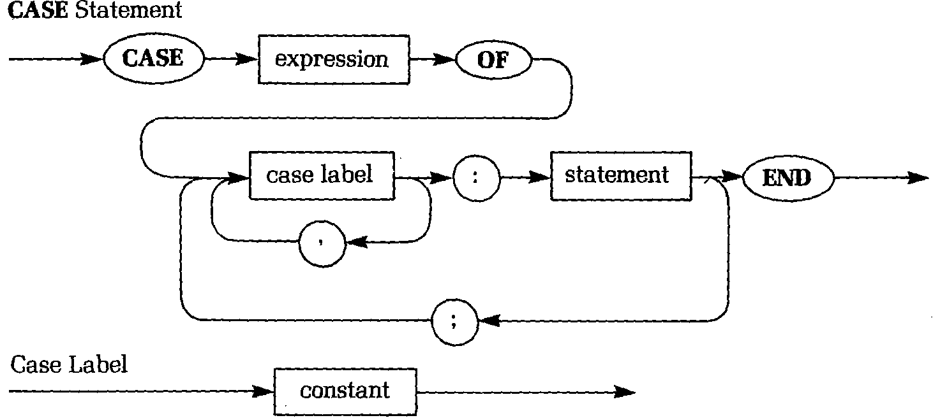
Alternative specification: Railroad Diagrams
Pascal
Easy to read
Verbose
Challenging to automate
Exercise: convert to EBNF
From Pascal: Understanding Programming and Problem Solving, Nance, 1986, West Publishing

Slide 27
Ambiguous Grammars
More than one parse tree
More than one derivation sequence is not enough!
Multiple parse trees = multiple structural interpretations
Example:
Expr → Expr Op Expr
Expr → [0-9]+
Op → ‘+’ | ‘*’ | ‘-’ | ‘/’
Apply to 3 - 4 / 5
Fix: Separate different operator types using Expression/Term/Factor grammar from earlier…
Allow (+|-) in Expression
Allow (* | /) in Term, but then…
Expr
Expr
Expr
Op
Expr
Expr
Op
Expr
Expr
Op
Expr
Expr
Op
Expr
3
-
4
/
5
3
-
4
/
5

Slide 28
Ambiguous Grammars
More subtle example:
Expression → Expression (+|-) Expression | Term
Term → Term (*|/) Term | Factor
Factor → Constant | Variable | ( Expression )
Constant → [0-9]+
Variable → [a-zA-Z][a-zA-Z0-9_]*
Apply to 3 - 4 - 5
Significance: Is the result -6 or 4?
For predictable results, must have unambiguous grammar or additional rules
For example, could have a rule that we always work left to right
In this case, it’s easier just to fix the grammar

Slide 29
Textbook Specification of Grammars
Note textbook uses a notation that uses ‘:’ instead of →
nonterminal : expansion ;
and
[name] nonterminal : expansion ;
Advantage: it is close to ANTLR syntax
Disadvantage: it is not very standard in the PL community
A fact of life: there are as many notational systems as programming languages!

Slide 30
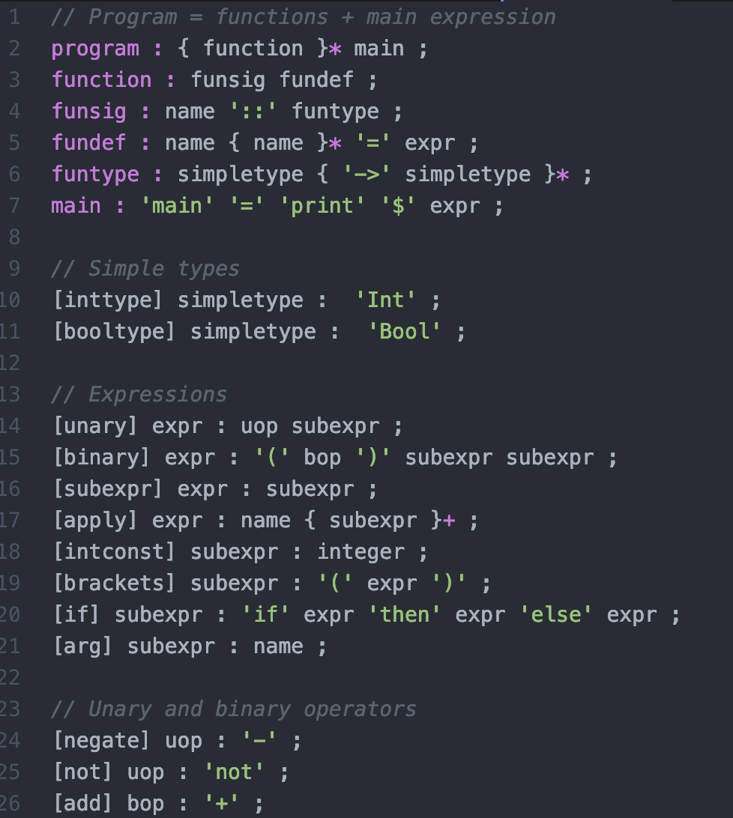
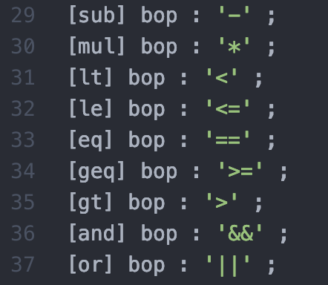
Exercise: Haskell-like programs
Use this grammar to construct a 10-line program

Slide 31
Meta-meta-level Languages
Textbook: Discusses using CFGs to specify CFGs
Shows that CFGs are powerful
A common standard for programming languages through the 80s and 90s: if a language is powerful, one should be able to write the compiler in that language
00s and beyond: there is no real difference in power, just expressiveness
The only people who care about the compiler’s language are those who are maintaining the compiler
Get the job done
Challenge with using CFGs to specify CFGs: notation like ‘:’ can either be part of a grammar rule or a meta-symbol
This is why we are skipping this material…

Slide 32
Review
Specifying context free grammars using Backus-Naur Form (BNF)
The formal definition of a grammars and the language generated by a grammar.
Extended BNF and how it adds no power but does add expressivity.
Well-formed grammars
Understanding mathematical definitions
Writing context-free grammars to solve a problem.
An alternative to BNF: rail-road diagrams
Ambiguity in context free grammars.

