Slide 1
CS 3040
Programming Languages & Translators
Note 5: parsing Ch 7
© Robert W. Hasker, 2020

Slide 2
How to (automate) parsing?
Consider the expression grammar:
Draw a parse tree generating 3 + 4 * 5
Note this requires applying logic
How to automate?
Neural networks may not be a good choice…
Consider parsing (3 + 4) * 5 * 6
Key: rewrite productions in English:
An expression is a term followed by zero or more of a ‘+’ and a term
A term is a factor followed by zero or more of a ‘*’ and a factor
A factor is a constant or a left parenthesis followed by an expression followed by a right parenthesis
A constant is one or more digits
Expression → Term { ‘+’ Term }*
Term → Factor { ‘*’ Factor }*
Factor → Constant | ( Expression )
Constant → [0-9]+

Slide 3
Automating parsing
Expression → Term { ‘+’ Term }*
Term → Factor { ‘*’ Factor }*
Factor → Constant | ( Expression )
Constant → [0-9]+
Productions in English:
An expression is a term followed by zero or more of a ‘+’ and a term
A term is a factor followed by zero or more of a ‘*’ and a factor
A factor is a constant or a left parenthesis followed by an expression followed by a right parenthesis
A constant is one or more digits
In code:
void parse_expression() { void parse_factor() {
parse_term(); if ( next_token() == ‘(‘ ) {
while ( next_token() == ‘+’ ) { parse_expression();
parse_term(); if ( next_token() != ‘)’ )
} fail();
} } else
parse_constant();
void parse_term() { }
parse_factor();
while ( next_token == ‘*’ ) { void parse_constant() {
parse_factor(); if ( ! isdigit(next_character()) ) fail();
} while ( isdigit(next_character()) )
} advance();
}

Slide 4
Automating parsing
Expression → Term { ‘+’ Term }*
Term → Factor { ‘*’ Factor }*
Factor → Constant | ‘(‘ Expression ‘)’
Constant → [0-9]+
In code:
void parse_expression() { void parse_factor() {
parse_term(); if ( next_token() == ‘(‘ ) {
while ( next_token() == ‘+’ ) { parse_expression();
parse_term(); if ( next_token() != ‘)’ )
} fail();
} } else
parse_constant();
void parse_term() { }
parse_factor();
while ( next_token == ‘*’ ) { void parse_constant() {
parse_factor(); if ( ! isdigit(next_character()) ) fail();
} while ( isdigit(next_character()) )
} advance();
}
Known as a recursive descent parser
Note how parse_expression() ends up calling itself…

Slide 5
Automating parsing
See full implementation as simple-expr-recognizer.cpp in samples
Recursive descent:
A function for each nonterminal
Direct translation of grammar to code
Has problems with left recursion; must refactor into right recursion
Advantages
Easy to implement
No additional tools needed
Problems
Lots of repeated code, difficult to validate
Does not scale well to large languages
Alternative: table-driven parsers

Slide 6
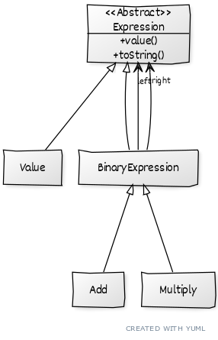
Implementing the rest
simple-expr-recognizer.cpp: only states if expression legal or not
How often have you wanted to know if something was just legal?
How to extend to compute expressions?
We want a solution that’s robust enough to re-evaluate the expression over and over
This is looking towards compilation
It’s also what we want for word macros, animation scripts
Turnstile example: would want to execute the machine
Solution: create classes for each type of expression
See simple-expr.cpp in samples
Note must separate elements with spaces: ( 3 + 4 ) * 5
expr.cpp in samples: adds subtraction, division
Mixing evaluation with parsing makes it clear we
need a better way!
Notes:
animation script: operation to apply to video to introduce animations into that video – might think what “language” is being used in this case since the user probably interacts through a GUI
handling other tools:

Slide 7
YUML for diagram (yuml.org)
[Expression]^[Value]
[Expression]^[BinaryExpression]
[BinaryExpression]^[Add]
[BinaryExpression]^[Multiply]
[<<Abstract>>;Expression|+value();+toString()]
[BinaryExpression]-left>[Expression]
[BinaryExpression]-. right>[Expression]

Slide 8
Exercise
Assumptions:
next_token returns an entire terminal
it does not advance
returns null if at end of input; use to check end
advance moves to the next terminal
expect(target):
if next_token() == target then advance
else fail(“missing “+ target)
Build a parser for directions
go left, right, straight 3 blocks, then left
Grammar:
Directions -> ‘go’ SegmentDirection CantMiss
SegmentDirection -> Segment { ‘,’ Segment }* ‘.’
Segment -> ‘left’ | ‘right’ | ‘straight’ Number ‘blocks’ | StopAt
Number -> [0-9]+
StopAt -> ‘stop’ ‘at’ (‘sign’ | ’light’ | ‘destination’)
CantMiss -> ‘you’ ‘cannot’ ‘miss’ ‘it’ ‘.’ | ‘and’ ‘you’ ‘are’ ‘there’ ‘.’
Sample:
go left, straight 3 blocks, right, stop at light. you cannot miss it.
Assume have next_token(); advance(); bool next_token_is_number();
fail(“message”); expect(target);
Notes:
Note this grammar this allows StopAt to appear multiple times.

Slide 9
Exercise
In class, done in small teams: build a recursive descent parser for Ruby statements: handle
if x > 0
while y > 0
print y
y = y - 1
end
print x
elif z > 0
print a
else
print x
end
Specifically:
Tests for if, while are always “if variable > 0”
Assignment is always “x = constant” or “x = x +/- constant”
Print always prints a single variable
Ensure end always matches
No functions, no other statement types

Slide 10
Additional exercise
Longer exercise: build a recursive descent parser for simple HTML (tags only)
Note checking HTML is well-formed is NOT context-free
Simple solution: we add it as a constraint after constructing the parse

Slide 11
How to parse without recursive descent?
Recursive descent: write lots of code, doesn’t work with some CFGs
Is it possible to parse all CFGs?
Yes: the proof will be to construct a top-down parser
Assumption: CFG is well-formed
No non-terminals that cannot be used in legal derivations
Assumption: CFG is written in BNF
Recall any EBNF can be converted to BNF!
Top-down parser: try all possible derivations until the input is matched

Slide 13
But see next page!

Slide 14
Top-Down Parser Algorithm
Given: input (a list of terminal symbols; no whitespace)
Given: a CFG G = <N, T, P, s>
to_match <- stack containing JUST the start symbol s
while input is not empty or to_match is not empty,
if to_match is empty, fail
if top(to_match) ∈ T
// consume input
match top(to_match) to head(input) or fail
pop(to_match), input <- tail(input)
else (top is a nonterminal)
// expand nonterminal
choose a production X -> 𝛼 ∈ P where X = top(to_match)
and where 𝛼 = z₁ z₂ … z_{n} (z_{i} ∈ N U T)
fail if no such rule!
pop(to_match)
push z_{n}, push z_{n-1}, … push z₁
end while
// input is now empty and to_match is empty
return success
Brief version:
m ← stack(s)
while i != [] or !empty(m)
empty(m): fail
top(m) ∈ T:
head(i)!=top(m): fail
pop(m), i ← tail(i)
else if X -> z₁ … z_{n} ∈ P
where X = top(m)
pop(m)
push(z_{i}) for i in n..1
else: fail (no rule in P)
return success

Slide 15
Top-down acceptance – Example
Binary Number Language
(BNL) Grammar:
Number -> Bits Rest
Bits -> Bit
Bits -> Bit Bits
Bit -> 1
Bit -> 0
Rest -> 𝜀
Rest -> ‘.’ Bits
Step | Remaining input | Stack (TOS left) | Action
1 | ‘1’ , ‘0’ | Number | Expand Number->Bits Rest
2 | ‘1’ , ‘0’ | Bits Rest | Expand Bits->Bit Bits
3 | ‘1’ , ‘0’ | Bit Bits Rest | Expand Bit->1
4 | ‘1’ , ‘0’ | ‘1’ Bits Rest | Consume terminal ‘1’
5 | ‘0’ | Bits Rest | Expand Bits->Bit
6 | ‘0’ | Bit Rest | Expand Bit->0
7 | ‘0’ | ‘0’ Rest | Consume terminal ‘0’
8 | -- | Rest | Expand Rest->𝜀
9 | -- | -- | --
m ← stack(s)
while i != [] or !empty(m)
empty(m): fail
top(m) ∈ T:
head(i)!=top(m): fail
pop(m), i ← tail(i)
else if X -> z₁ … z_{n} ∈ P
where X = top(m)
pop(m)
push(z_{i}) for i in n..1
else: fail (no rule in P)
return success

Slide 16
Top-down acceptance – Implementation
Applying the acceptor (true, false cases):
► accept bnlGrammar “101.01”
True
► accept bnlGrammar “x”
False
Haskell values, types used to represent a grammar:
data GSymbol = T Terminal | N Nonterminal
type Terminal = Char
type Nonterminal = String
type Rule = (Nonterminal, [GSymbol])
type Grammar = [Rule]
Capturing the BNL grammar:
bnlGrammar :: Grammar
bnlGrammar = [
(“Number”, [N “Bits”, N “Rest”]),
(“Bits”, [N “Bit]),
(“Bits”, [N “Bit”, N “Bits”]),
(“Bit”, [T ‘0’]),
(“Bit”, [T ‘1’]),
(“Rest”, []),
(“Rest”, [T ‘.’, N “Bits”])
]
Recall:
data: introduce a type name and alternative ways to construct objects of that type
Upper case: type names, values
N, T: are type constructors
[ElementType] – list of the given type
x :: SomeType – declares x of that type
Used tuple for each rule:
Number -> Bits Rest
Bits -> Bit Bits
Bits -> Bit
Bit -> ‘0’ | ‘1’
Rest -> 𝜀 | ‘.’ Bits

Slide 17
Top Down Implementation
See topdown.hs in https://faculty-web.msoe.edu/hasker/cs3040/samples/parser/
Review lists, patterns: https://faculty-web.msoe.edu/hasker/cs3040/samples/cards.hs
accept: takes two arguments, returns bool
Look at f x y z = x * y + 6; :type f
g: list of grammar rules
where: pick start symbol from first rule
_: don’t care; can appear multiple times
steps: uses pattern matching on arguments
map: apply operation to list
\ (lambda): anonymous function
[ ] and <-: similar to Python list comprehensions
Example:
pairs = [(1, 10), (2, 22), (3, 333)]
[ a | (a, _) <- pairs ]
[ a | (a, b) <- pairs, b > 2 ]
m ← stack(s)
while i != [] or !empty(m)
empty(m): fail
top(m) ∈ T:
head(i)!=top(m): fail
pop(m), i ← tail(i)
else if X -> z₁ … z_{n} ∈ P
where X = top(m)
pop(m)
push(z_{i}) for i in n..1
else: fail (no rule in P)
return success

Slide 18
Note: see sample code directory
accept: takes two arguments, returns bool
Look at f x y z = x * y + 6; :type f
g: list of grammar rules
where: pick start symbol from first rule
_: don’t care; can appear multiple times
steps: uses pattern matching on arguments
map: apply operation to list
\ (lambda): anonymous function
[ ] and <-: similar to Python list comprehensions
Example:
pairs = [(1, 10), (2, 22), (3, 333)]
[ a | (a, _) <- pairs ]
[ a | (a, b) <- pairs, b > 2 ]
\

Slide 19
m ← stack(s)
while i != [] or !empty(m)
empty(m): fail
top(m) ∈ T:
head(i)!=top(m): fail
pop(m), i ← tail(i)
else if X -> z₁ … z_{n} ∈ P
where X = top(m)
pop(m)
push(z_{i}) for i in n..1
else: fail (no rule in P)
return success
\

Slide 21
But with a constraint: no 𝜀 productions
(𝜀 productions result in infinte loops)

Slide 22
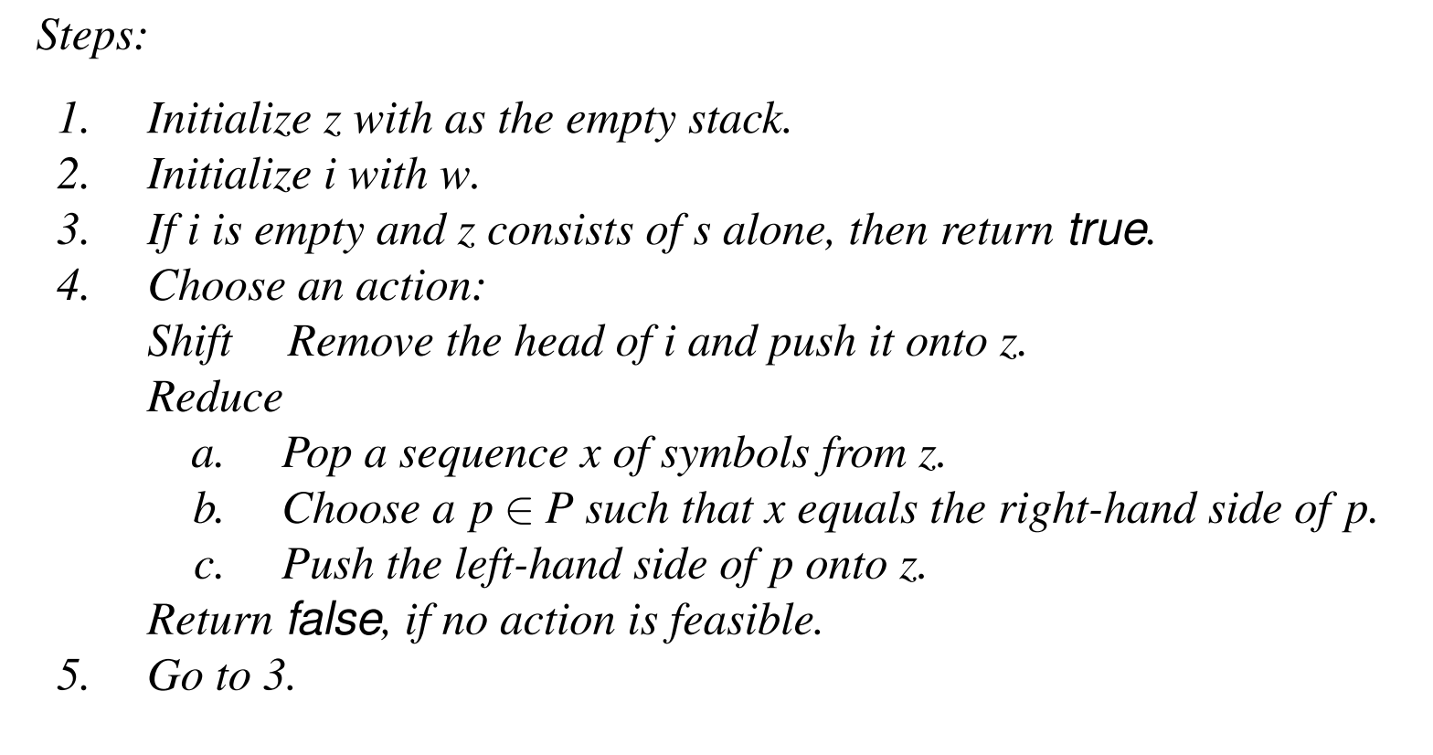
z ← stack()
while i != [] or z != [s]
either:
z ← [head(i)] ++ z
i ← tail(i)
or:
let z = rev(α) ++ z’,
n -> α ∈ P
in z ← [n] ++ z’
if neither, fail
return success
Bottom-Up Acceptance
reversed!

Slide 23
Note: see sample code directory for Haskell version

Slide 24
Bottom-up acceptance – Example
(BNL) Grammar
without 𝜀 productions):
Number -> Bits
Number -> Bits Rest
Bits -> Bit
Bits -> Bit Bits
Bit -> 1
Bit -> 0
Rest -> ‘.’ Bits
Step | Remaining input | Stack (TOS left) | Action
1 | ‘1’ , ‘0’ | -- | Shift terminal ‘1’
2 | ‘0’ | ‘1’ | Reduce by [Bit->1]
3 | ‘0’ | Bit | Shift terminal ‘0’
4 | -- | ‘0’ Bit | reduce by [Bit->0]
5 | -- | Bit Bit | Reduce by [Bits->Bit]
6 | -- | Bits Bit | reduce by [Bits->Bit Bits]
7 | -- | Bits | reduce by [Number->Bits]
8 | -- | Number | accept
z ← stack()
while i != [] or z != [s]
either:
z ← [head(i)] ++ z
i ← tail(i)
or:
let z = rev(α) ++ z’,
n -> α ∈ P
in z ← [n] ++ z’
if neither, fail
return success

Slide 25
See bottomup.hs in samples directory
\

Slide 26
Epsilon rules can be introduced at any time
causes loop in implementation

Slide 28
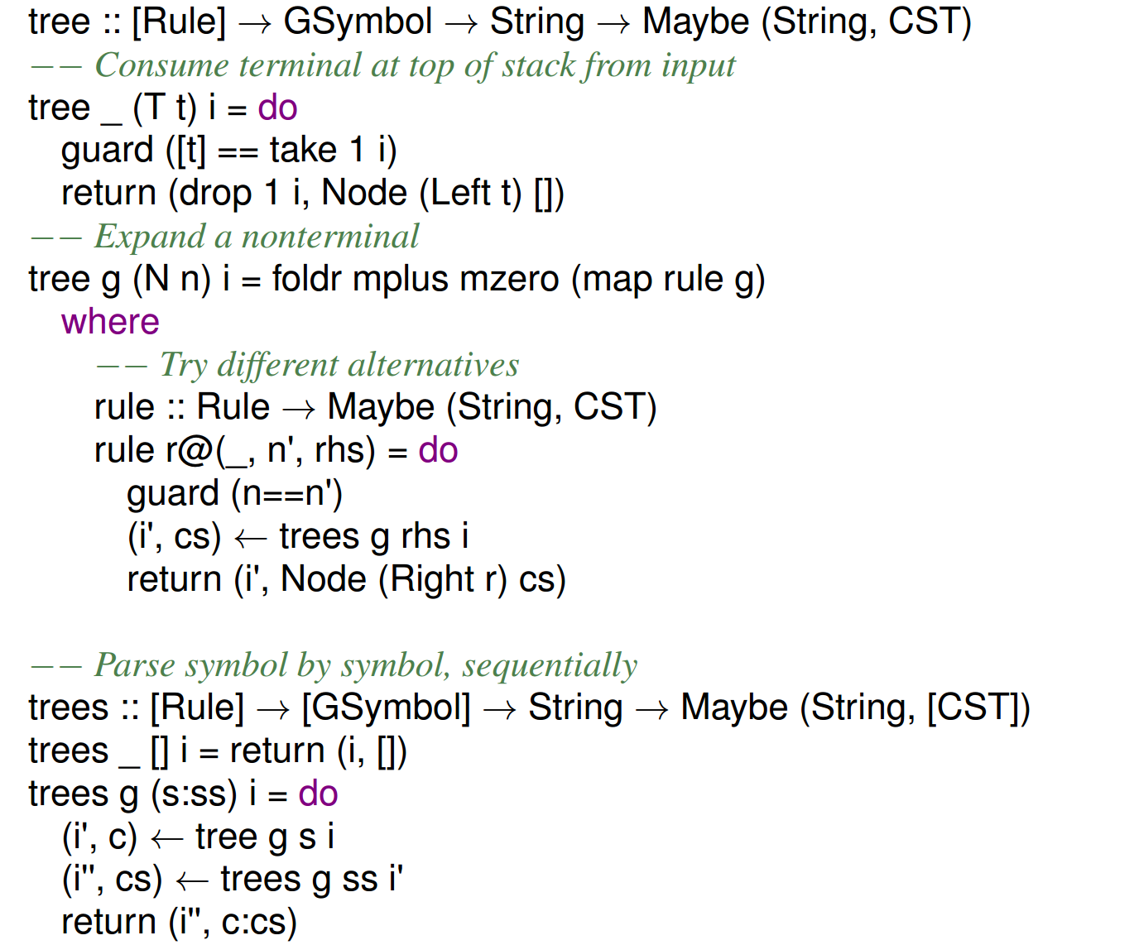

Slide 29
Building Parsers
A compiler construction course would introduce various algorithms
Classic solution: LALR(1)
Lookahead parser working left to right with one token of lookahead
Requires building a finite state machine with a stack
The method behind YACC (Yet Another Compiler Compiler), and it’s free implementation, Bison
ANTLR: one of many similar tools
Can’t process all CFGs, but covers ones that are easy to work with
Ideal for DSLs
Integrates lexical analysis so have just one file to track, one tool to use
Supports a wide range of implementation languages

Slide 30
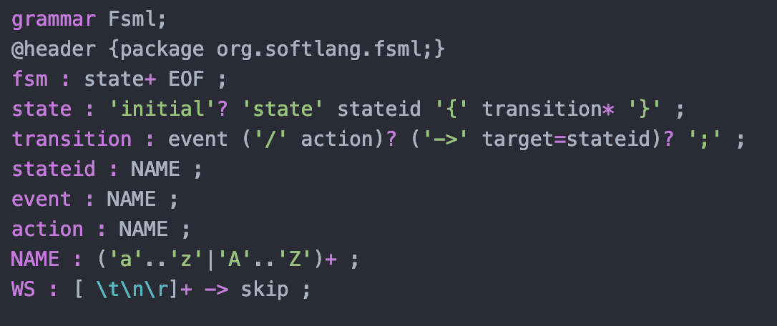
Semantic Actions
Finite State Machine Language
(FSML) Grammar:
FSM -> State+
State -> initial? StateID ‘{‘ Transition* ‘}’
Transition -> Event (‘/’ action)?
(‘->’ StateID)?
StateID -> Name
Event -> Name
Action -> Name
Name -> [a-zA-Z]+
Consider FSML (finite state machine language):
Review: construct an FSM recognizing (ab)*
Semantic actions: making our parser do work besides recognizing inputs…

Slide 31
Building FSML Interpreters
Java Implementation
Code between braces
Execute action after matching everything earlier
$action.text: returns the terminal associated with the nonterminal
Notes:
yas/languages/FSML/Java/FsmlToObjects.g4

Slide 32
Building FSML Interpreters
@members, line 3: create FSM object
Stored in attribute fsm
getStates(), getTransitions(): retrieve collections
… then add new states, transitions

Slide 33
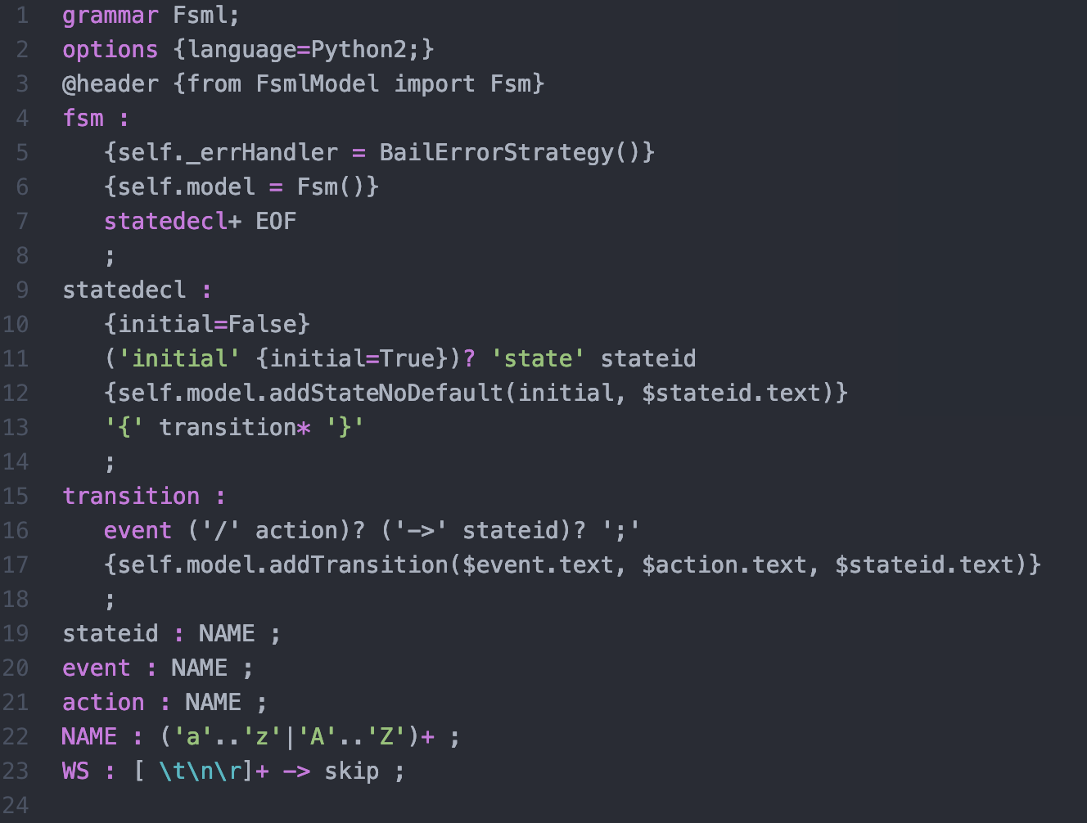
Python Version
Notes:
yas/languages/FSML/Python/Fsml.g4

Slide 34
In-Class Exercise
Extend the FsmlToObjects code to notify the user of the following errors:
A state that has two transitions out where the transitions have the same event
A state that cannot be reached
Failing to specify an initial state
Your implementation can be in Java or Python

Slide 35
Assignment 6
To be completed in one week
Build an ANTLR-based checker for the subset of Ruby (that you built a recursive descent parser for earlier)
The checker must have well-defined error messages for incorrect programs
Display a pretty-printed output for well-formed programs

Slide 36
Project
This will be a multi-week assignment with multiple deliverables
Week 1: build an ANTLR grammar for a context-free language
Week 2: Construct a checker for the grammar that would check both syntax and two additional properties
Week 3: Build an interpreter for the grammar that “executes” the CSL in some meaningful way
Examples:
A CSL for drawing circles, lines, and groups of circles and lines on the screen
A CSL for a calculator with memory and at least one operation beyond +, -, *, / (as well as clear operations)
A CSL for displaying binary search trees

