Slide 1
CS 3040
Programming Languages & Translators
note 7: Interpreters ch 5
Robert Hasker, 2019

Slide 2
Interpreters
Name some interpreted languages
How do interpreted languages differ from compiled languages?
Basic model of interpreter:
Read file(s)
Parse code into an abstract syntax tree
“abstract” meaning just the detail needed
Execute syntax tree

Slide 3
Goal: build a BTL interpreter
BTL: Binary TAPL Language, where TAPL is Types and Programming Languages (Benjamin Pierce)
The name isn’t important!
It’s a simple language for numeric expressions over natural numbers
Natural numbers: {0, 1, 2, 3, …}
But, instead of lots of numbers, use a successor term:
{zero, succ(zero), succ(succ(zero)), succ(succ(succ(zero))), …}
This simplifies logic over numbers:
succ(succ(zero)) + succ(succ(zero)) = succ(succ(succ(succ(zero))))
succ(X) + succ(Y) = succ(succ(X + Y))

Slide 4
Goal: build a BTL interpreter
Logic over {zero, succ(zero), succ(succ(zero)), succ(succ(succ(zero))), …}
Addition:
add(X, zero) = X
add(X, succ(Y)) = succ(add(X, Y))
Compute add(succ(zero), succ(succ(zero)))
A Haskell Solution: samples/nats.hs
Showing add(A, B) = add(B, A):
True if B is zero: add(A, zero) = add(zero, A)
If true when B is U, then show true for succ(U):
Inductive hypothesis: add(A, U) = add(U, A)
So add(A, succ(U)) = succ(add(A, U)) – definition of add (above)
= succ(add(U, A)) – change order of U and A by inductive hypothesis
= add(succ(U), A) – definition of add (rewriting succ of add to add of succ)
Proof that add(zero, V) = V:
V = zero:
add(zero, zero) = zero – def of add
V = succ(U):
show add(zero, succ(U)) = succ(U):
add(zero, succ(U))
= succ(zero + U) – def of add
= succ(U) – inductive hyp.

Slide 5
BTL definition
Grammar:
Expr → true
Expr → false
Expr → zero
Expr → succ( Expr )
Expr → pred( Expr )
Expr → iszero( Expr )
Expr → if(Expr, Expr, Expr)
Textbook way:
Example:
if(iszero(zero)), succ(succ(zero)), succ(zero))
Notes:
Note: pred is used for predecessor - effectively subtracting one; pred(0) will be defined as 0

Slide 6
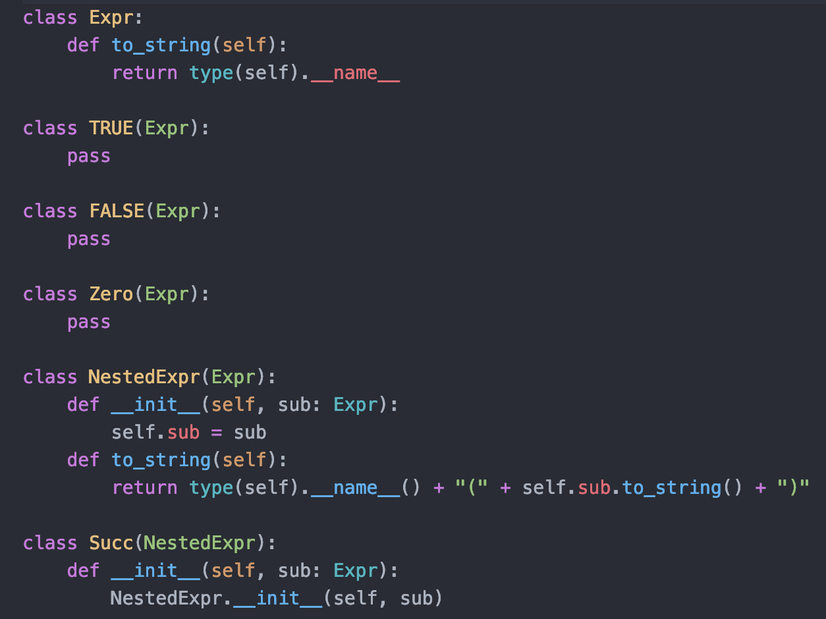
Representing BTL in Python
See sample code directory
Classes for each language element
Example: from this portion:
val = Succ(Succ(Zero()))

Slide 7
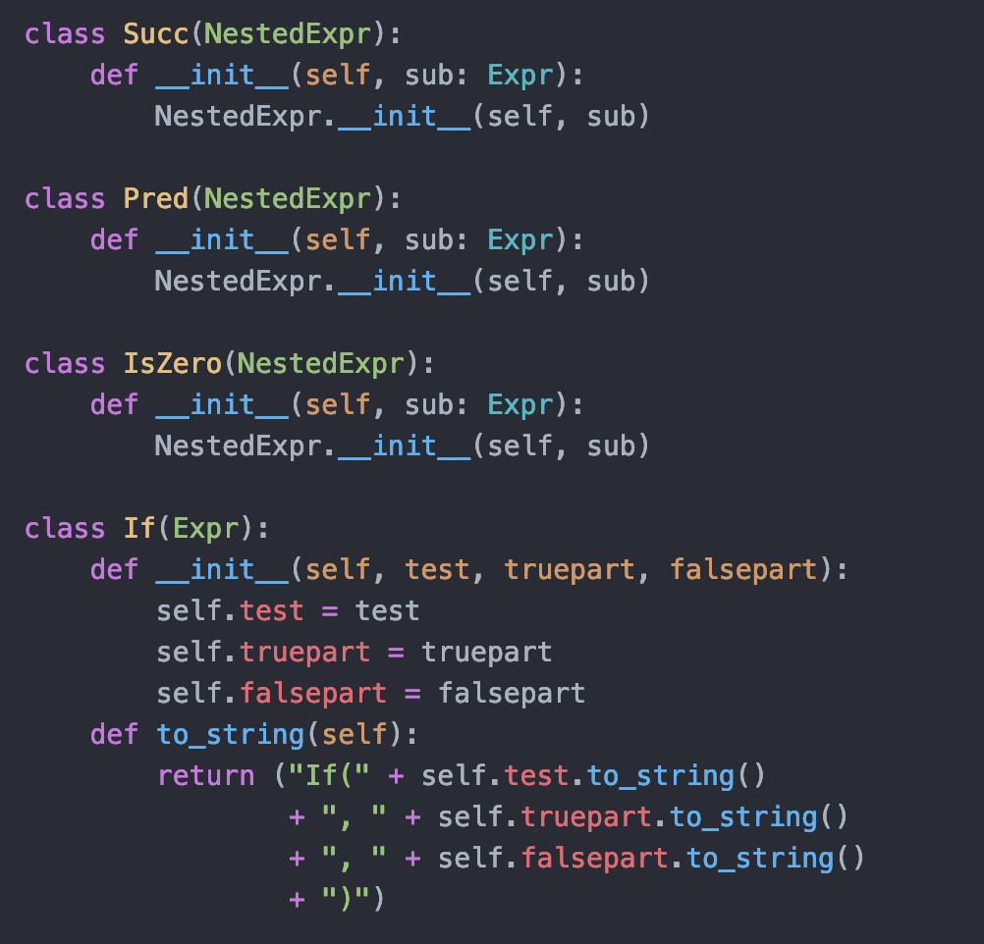
Representing BTL in Python
Successors, predecessors, zero check, if
For example:
print(sample.to_string())
If(IsZero(Zero), Succ(Succ(Zero)), Zero)
Notes:
The print operation just confirms that the result matches the input

Slide 8
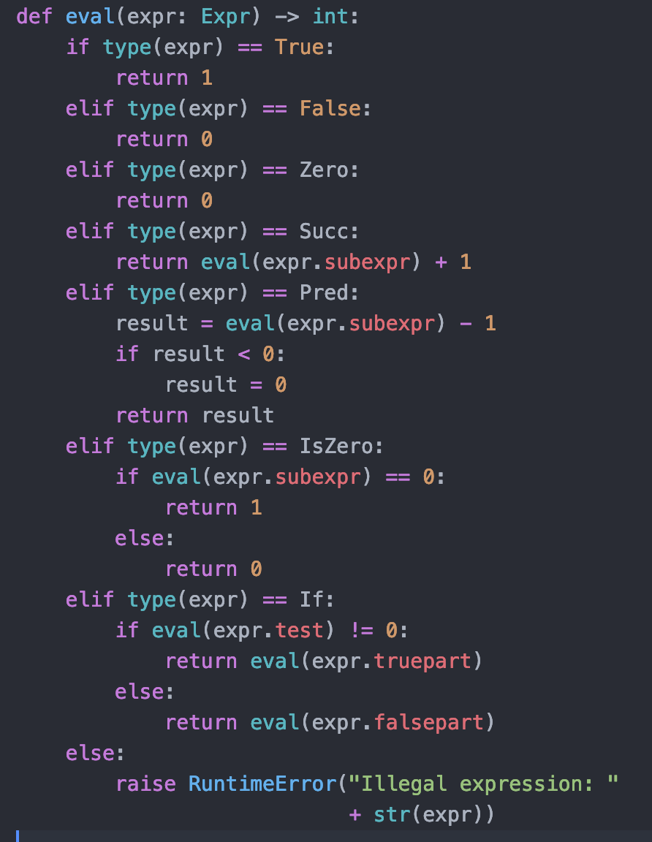
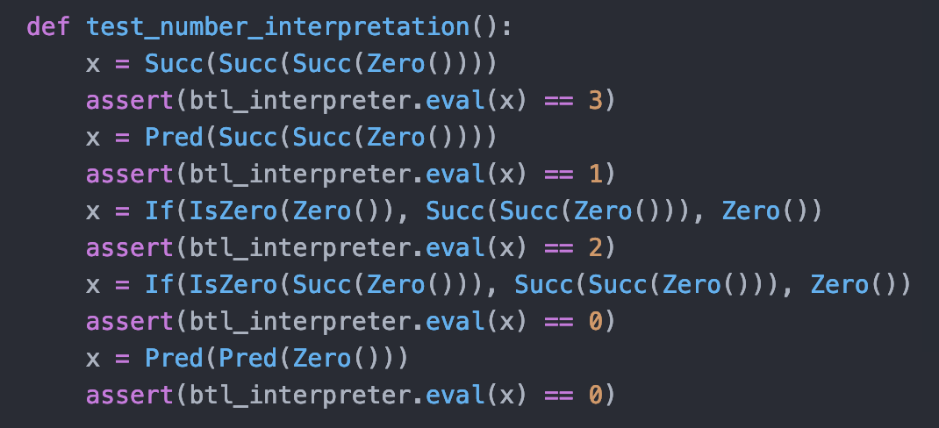
Python BTL interpreter
TRUE:
FALSE:
Eval of expression returns a Python Bignum
Tests:
Note last check that pred(zero) is zero
This version treats True as 1, False as 0 (unlike textbook version)
One of many possible choices!
Notes:
… well, not the BTL that’s in the book since there’s a small difference over the test in if statements

Slide 9
Elements of interpreters:
Metalanguage: language used to implement the interpreter
Object-program representation: data used to represent code to execute
Could even be binary! Programs are data…
Semantic Domains: object model, types used for code being executed
Informal semantics: implementation defines what the code means
Test cases: checking interpreter works
Executable documentation!

Slide 10
BTL interpreter in Haskell
TBD: bring in definitions of
Left, Right
Haskell version of BTL interpreter
Right, Left:

Slide 11
In class exercise: adding variables
Extend BTL with x = expr, sequence
Simplifying: make both into expressions, adding:
expr → variable
expr → variable = expr
expr → expr ; expr
Allow one-letter variables
Last case: return second expression
Need to add a store to track values of variables
Accessing unknown variable: throw exception

Slide 12
Supporting functions
Syntax:
expr → def name(variable) expr
expr → name(expr)
Semantics:
Def: define function with given name
Call: temporarily store expr for variable
Need to restore value of variable after execution
Store: associate a variable with a stack of values
All non-parameter variables: global

Slide 13
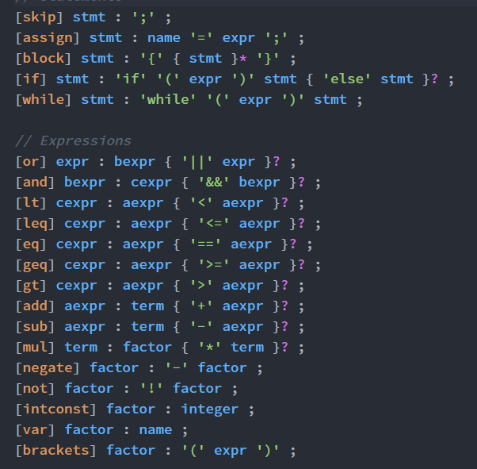
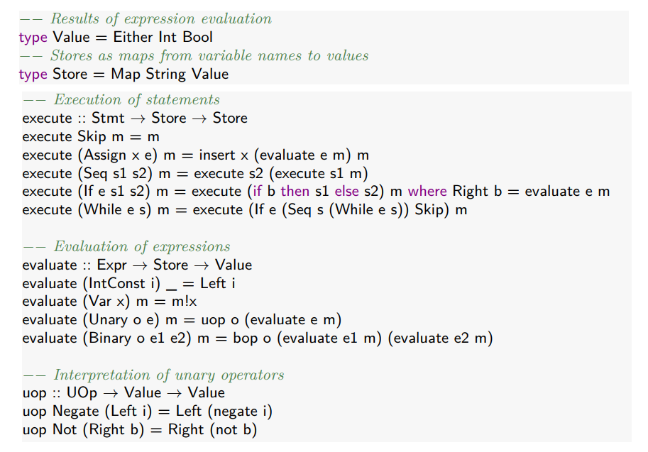
Imperative Language Semantics: BIPL
Notes:
Keys: using m to track variable values, Assign to assign a value, Var to get a value

Slide 14
Compilation
Purest form of interpretation: parse code just before execution
Model we have implemented: translate to an abstract syntax, then execute the abstract syntax
Expensive: lots of comparisons, table lookups, runtime checks
The model for most scripting languages
Typically: ten times slower to compute the same result
Compilation: precompute as much as possible
Executable instructions
Minimal run-time checks
Store data at specific addresses – no runtime lookups
Optimization: eliminate redundant operations

Slide 15
Architecture of a Compiler: Front End
Lexical analysis
Semantic analysis
Identifiers, types, etc.
Create parse tree
Preprocessing
#define, #include, etc.
Syntactic analysis
Identifying tokens
Removing whitespace
Create symbol table
Lexical analysis: typically regular expressions
Syntactic analysis:

Slide 16
Architecture of a Compiler: Back End
Large-scale optimization
Liveness analysis
Peephole Optimization
Remove push followed by pop, etc.
Code Generation
Generate executable
Loop optimization
Program analysis
Analyzing control flow
Identify dead code, errors
Etc.
See full compiler construction book for details

Slide 17
Code Generation
If(x, y = zero, z = succ(zero)) translates to (in pseucode)
load x
compare x, 0
jumpzero else_part_7
load 0
store y
jump end_7
else_part_7:
load 1
store z
end_7:
… remaining code …
Typically use a register transfer language, translate that to machine code
There would be a different fragment for each syntactic element
Generally, tracking register usage is the most challenging part
Optimization is far more challenging – many cases

Slide 18
Review
Building a BTL interpreter
Representing BTL programs in Python
Executing BTL programs in Python
Representing, executing BTL programs in Haskell
A BIPL interpreter: imperative languages
Adding a store
Haskell implementation
Compilation, code generation

