Slide 1
CS 3040
Programming Languages & Translators
Note 10: ANTLR
Robert Hasker, 2020

Slide 2
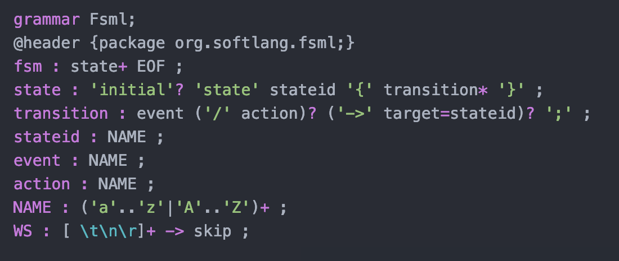
ANTLR
Introduced earlier; now covering in depth
Earlier ANTLR file:
Lower case text: non-terminals
Capital letters: terminals
Uses : instead of ->
Semicolon marks end of production – makes it easier to catch ANTLR errors

Slide 3
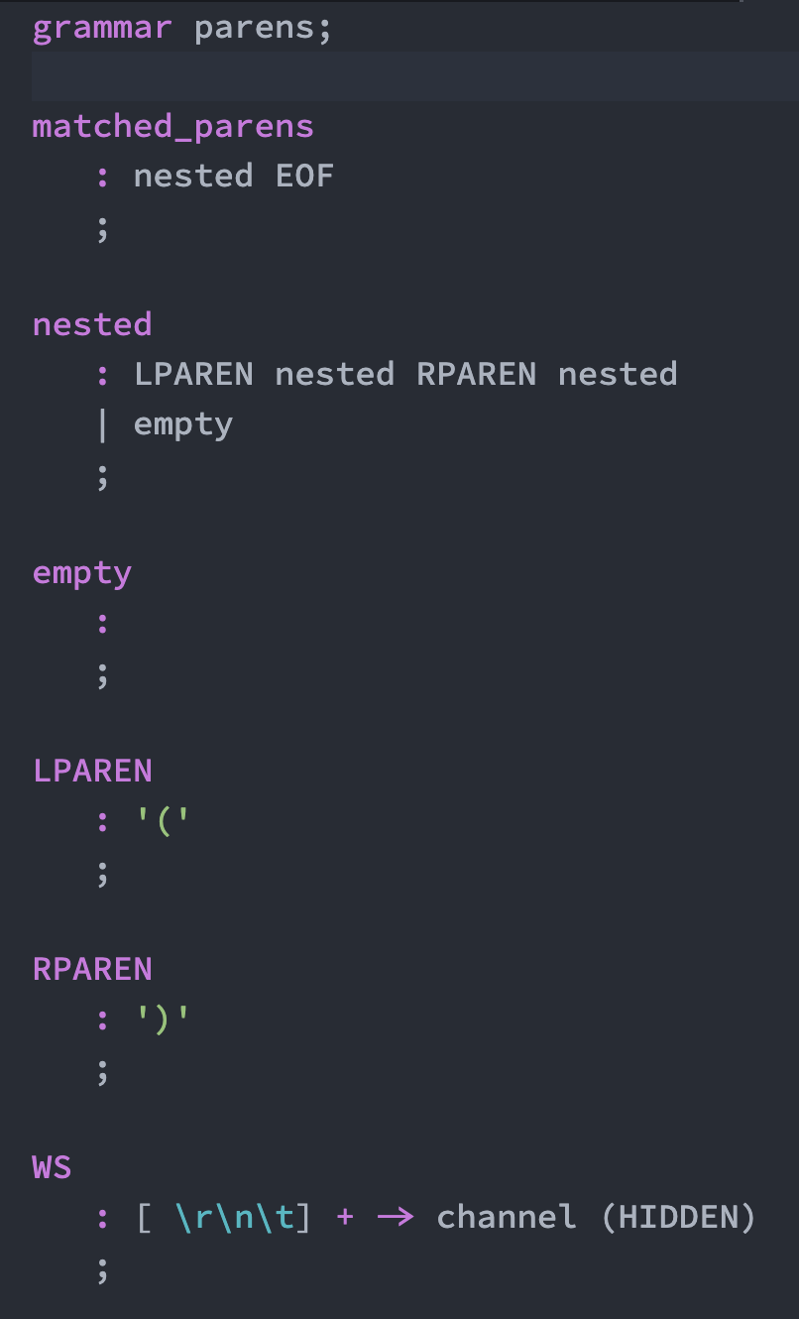
A simple ANTLR grammar
Matched parentheses:
MatchedParens -> Nested
Nested -> ‘(‘ Nested ‘)’ Nested
Nested -> ε
draw tree for (())()
ANTLR spec:
Name of grammar; must match file name (parens.g4)
Core Grammar, using : for ->, ; to mark end of productions
empty: it’s easier to make empty productions explicit
LPAREN, RPAREN: regular expressions for tokens
channel (HIDDEN): boilerplate for ignoring whitespace (here: spaces, returns, newlines, tabs)
The WS name is a convention
Could add REs for comments

Slide 4
Making it work
Code available at https://faculty-web.msoe.edu/hasker/cs3040/samples/antlr/
First, execute command to generate ANTLR parser code:
antlr –Dlanguage=Python3 parens.g4
Default: generates Java code
this command creates .interp and .tokens files – ignore these
it also creates code: parensLexer.py, parensListener.py, parensParser.py
Ignore the details of these files, but will have to create driver that uses it
Need a driver to run the parser
Imports – boilerplate for projects
see match.py
use grammar name in place of “parens”
This is what ties your code to the code generated by ANTLR

Slide 5
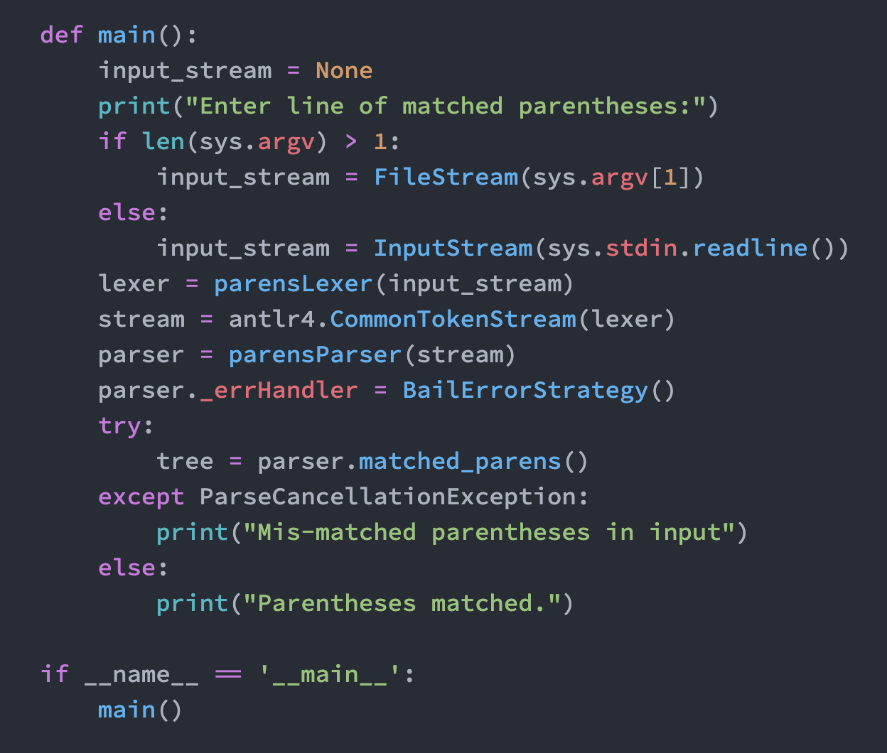
Making it work
Code to drive the parser
First part: read from file or stdin
Initialize lexer, stream, parser
BailErrorStrategy: force exit on error, otherwise continues to find errors
parser.matched_parens() – executes top-level production in grammar
ParseCancellationException – catch the error thrown on syntax error
Run: python match.py
Test: ( () (()) )
Notes:
Try with (), (()), (())((())), (, ()(, ()))
Note EOF ensures will find error if end in unmatched right parens

Slide 6
Adding Actions
Capturing a grammar is not very useful...
Need to add actions
Using the fact that ANTLR produces bottom-up parsers with shift/reduce steps
First example: count the depth of (matched) parentheses
Examples: depth of ‘()’: 1, ‘(())’: 2, ”( () (()) )”: 3
Key: suppose have a production
a: b c {code} ;
When reduce b and c to a, executes code
Simpler view: when recognizes the b and c, execute the code
Can also put code inside a production
a: b {code1} c {code2} ;
Execute code1 when recognize the b, code2 after recognizing the c

Slide 7
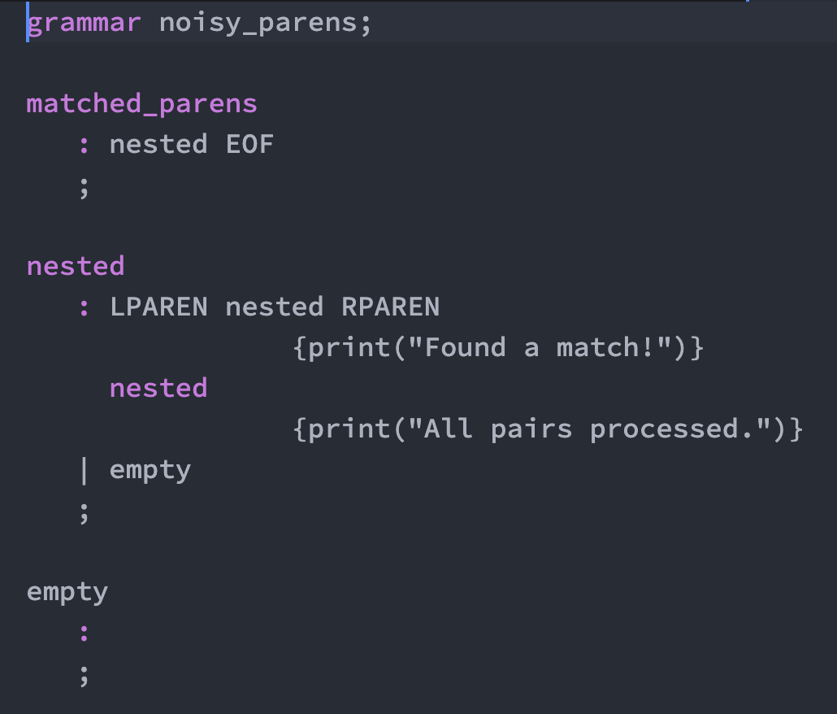
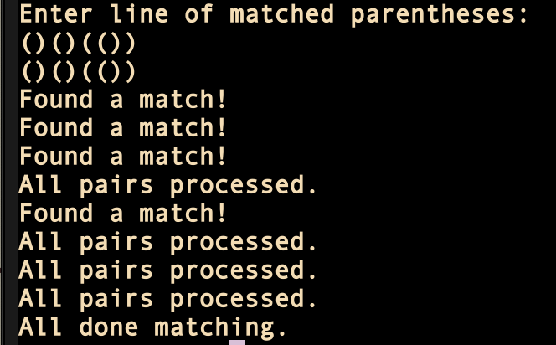
For example...
Change the parens parser to report matches
The tokens (LPAREN, RPAREN, WS) are unchanged
Can put actions with those, but generally only non-terminals have actions
main (online): simply prints “all done matching” at end
Running:

Slide 8
Computing Results
Review noisy_matchParser.py – note each action embedded in bigger code
May be able to use global variables to communicate between productions, but it is not robust
Solution: have each production return a result
Review paren_count.g4
productions return depth
int: simply documentation; it’s not checked
But useful documentation!!
If the returned result is x, set it using $x = ...
Use $ to refer to nonterminal, .depth to get the depth
See code online

Slide 9
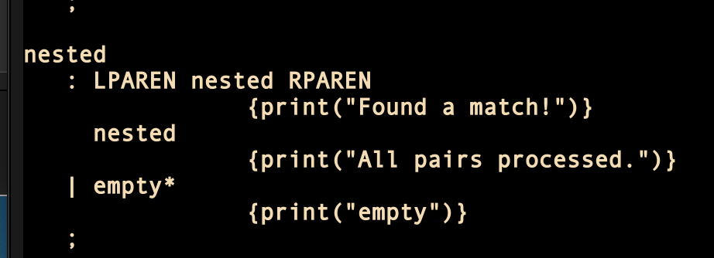
Caveats
Note no spaces between { and Python code
Whitespace is copied over, invalidating indentation
Use ; for multiple steps, call functions for complex actions
Epsilon rules with *, + can create problems:
Message from ANTLR:
Removing the * works, but there may be other, less obvious cases; get help (eg, SO)
*: Kleene Closure Operator
Notes:
In this case there’s an action, but it’s true any time there’s an empty production with * or +

Slide 10
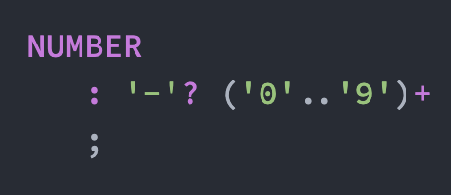
Exercise
Sum a list of numbers
Numbers separated by commas
Word “add” is at the start
Print the sum at the end
Grammar?
Example: ”add 5, 3, 12, -24”
Assume all numbers are integers; extending to floats another exercise
Question: how to get the value of a token?
Solution: can use the .text attribute of the token:

Slide 11
Last Major Assignment
Rewrite your building example using ANTLR
Submit an evidence document showing your solution works (along with source files)

Slide 12
Review
ANTLR: specify grammar
non-terminals: lower case
terminals: upper case
WS: whitespace (to be ignored)
Note could extend this to comments, other details
Adding actions
Each action: code executed when recognize a symbol (typically non-terminals)
Computing values in actions
Specify return value (with type) for production
Use that value in productions computing new values

