Slide 1
CS 3040
Programming Languages & Translators
Note 11: Operational Semantics Ch. 8
Robert Hasker, 2020

Slide 2
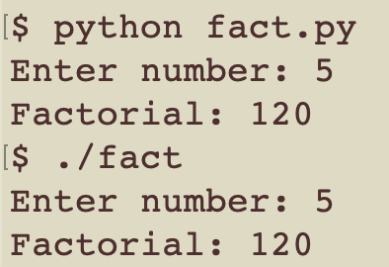
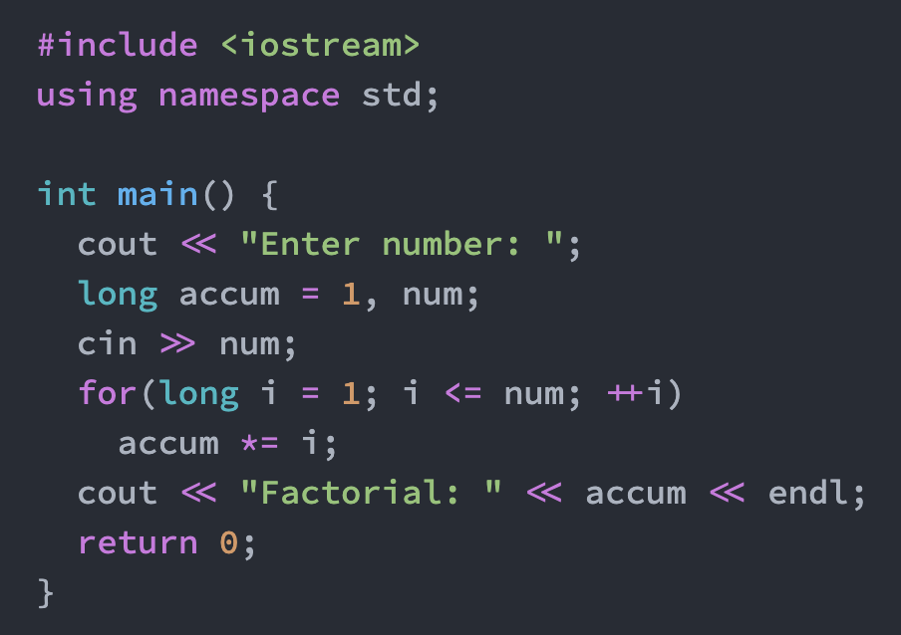
Semantics
Common usage: ”that’s just semantics”
That is, trivial differences
Why are semantics important in programming?
Two factorial programs: (Python, C++)
Assume compile by
g++ -o fact fact.cpp
What should both print if enter 5?
What about 30?
Why are these different?
Why doesn’t C++ use BigInt on overflow?

Slide 3
Semantics
Semantics: what happens when we execute program
its “meaning”
Same issue for domain-specific languages: need to know what the utterances mean...
In general, how do we know what a Python, C++, or Java
program will do?
Standard solution: implement it, use this implementation
Known as ad-hoc semantics since it’s based on arbitrary decisions made by the programmer
Why might this be good?
Why might it dangerous?
Wictionary:
For a particular purpose.
Created on the spur of the moment; impromptu

Slide 4
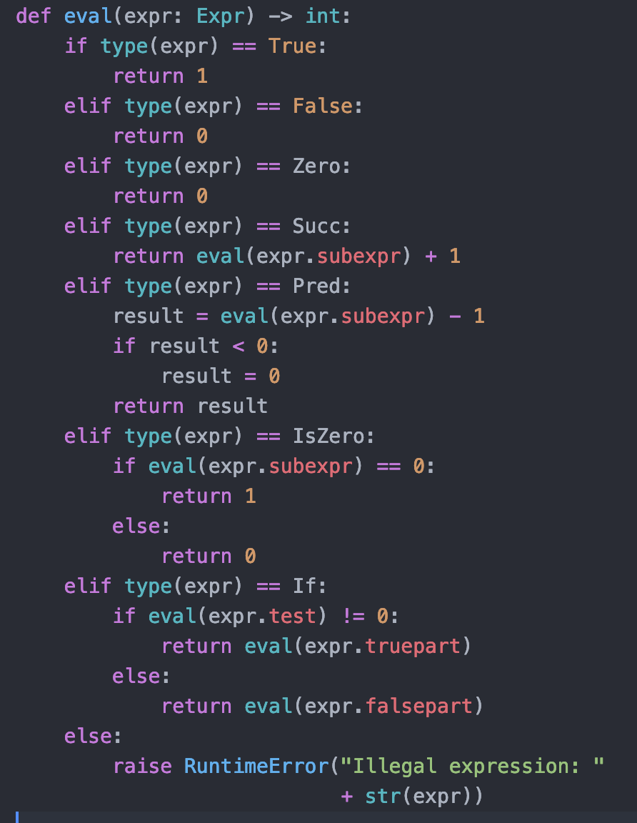
Ad-hoc semantics for BTL
Language:
expr → true
expr → false
expr → zero
expr → succ( expr )
expr → pred( expr )
expr → iszero( expr )
expr → if(expr, expr, expr)
Challenging for even a small language
Extremely difficult to track all details for more extensive language
Try to prove “y = eval(x) ⇒ y ≥ 0”
Theorems are very hard…
Notes:
in y = eval(x) => y >= 0: that is, eval(x) is always greater than or equal to zero (reading => as ‘implies’). It’s true because if result < 0, result is changed to 0.

Slide 5
Improvement: operational semantics
Unlike ad-hoc, will allow us to prove some theorems
I will cover just “big-step” operational semantics; see the textbook for “small-step”
Concept: relate fragments of code to what that code does at runtime
One or more rules for
every language
construct
Rules for zero, succ
e: expression
n: natural number
Recall: nats =
{0, 1, 2, 3, …}
zero → 0 That is, zero evaluates to the natural number 0.
・・・・・・・・・・・・・・・・・・・・・・・・・・・・・・・・・・・・・・・・・
e → n
_________________ That is, succ(e) evaluates succ(n), if e evaluates to n.
succ(e) → n + 1
Notes:
zero -> zero: means you can’t reduce zero further

Slide 6
A word on notation…
Read each one as if the top part is satisfied, then the bottom part is satisfied
A conclusion all by itself is just an axiom
This notation is especially useful when have multiple steps
0

Slide 7
Improvement: operational semantics
Unlike ad-hoc, will allow us to prove some theorems
I will cover just “big-step” operational semantics; see the textbook for “small-step”
Concept: relate fragments of code to what that code does at runtime
One or more rules for
every language
construct
Rules for zero, succ
e: expression
n: natural number
Recall: nats =
{0, 1, 2, 3, …}
zero → 0 That is, zero evaluates to the natural number 0.
・・・・・・・・・・・・・・・・・・・・・・・・・・・・・・・・・・・・・・・・・
e → n
_________________ That is, succ(e) evaluates succ(n) if e evaluates to n.
succ(e) → n + 1
・・・・・・・・・・・・・・・・・・・・・・・・・・・・・・・・・・・・・・・・・
e → 0
_______________ That is, pred(e) evaluates to 0 if e evaluates to 0.
pred(e) → 0
・・・・・・・・・・・・・・・・・・・・・・・・・・・・・・・・・・・・・・・・・
e → m, m > 0, n = m - 1
____________ That is, pred(e) evaluates to n if e evaluates to n + 1
pred(e) → n

Slide 8
Judgements
Judgements: claims about the semantics of particular expressions
Textbook uses ↬, but the regular arrows are easier to read…
Could use the words ‘evaluate’, ‘execute’, but the arrow saves clutter
Prefix notation | Infix notation | Meaning
evaluate(e, v) | e → v | The evaluation of a BTL expression e results in the value v.
execute(m, s, m') | m Ⱶ s → m' | The execution of statement s in an imperative programming language transforms store m into store m'.

Slide 9
Judgements
Prefix notation | Infix notation | Meaning
evaluate(e, v) | e → v | The evaluation of a BTL expression e results in the value v.
execute(m, s, m') | m Ⱶ s → m' | The execution of statement s in an imperative programming language transforms store m into store m'.
evaluate(fs, m, e, v) | fs, m Ⱶ e → v | The evaluation of expression e in a functional programming language for the arguments m and function definitions fs results in the value v.
Judgements: claims about the semantics of particular expressions
Textbook uses ↬, but the regular arrows are easier to read…
Could use the word ‘evaluate’, but the arrow saves clutter

Slide 10
More notation
Important: must be consistent on use of metavariables:
Type | Meta-Variable | Purpose
expr nat bool value stmt | e n b V s | Expressions according to the abstract syntax Natural numbers, i.e., zero, succ(zero),… Boolean values, i.e., true and false Values, i.e., Boolean values and natural numbers A statement in an imperative language
By these rules,
e is any expression
n is a specific number
That is, if e evaluates to n, then successor of e evaluates to successor of n
e → n
_______________ [SUCC]
succ(e) → succ(n)
Notes:
The n is always a constant value

Slide 11
All inference rules for BTL
true → 1 [TRUE]
false → 0 [FALSE]
zero → 0 [ZERO]
e → n [SUCC]
succ(e) → n + 1
e → 0 [PRED1]
pred(e) → 0
e → m, m > 0, n = m-1 [PRED2]
pred(e) → n
e → 0 [ISZER01]
iszero(e) → 1
e → n, n > 0 [ISZER02]
iszero(e) → 0
e₀ → 1 e₁ → v₁ [IF1]
if(e₀, e₁, e₂) → v₁
e₀ → 0 e₂→ v₂ [IF2]
if (e₀, e₁, e₂) → v₂
These rules were introduced back in slide 5
Note: the ad hoc semantics used 0, 1; this version uses true and false
Notes:
The switch to true, false just makes it more consistent with modern programming...
(The 0/1 sort of works at the machine level, but note that true is ANY non-zero value, so there isn’t a unique “true” in machine code)

Slide 12
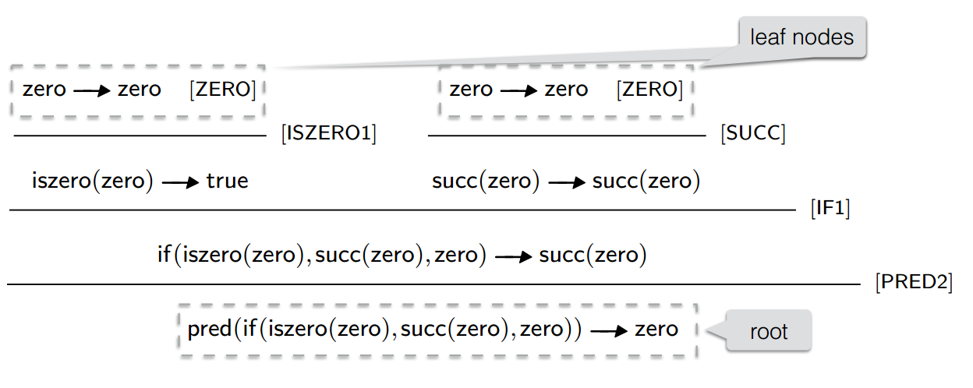
Proof trees: multi-step proofs
Semantics rules used:
zero → 0 [ZERO]
e → m, n = m - 1 [PRED2]
pred(e) → n
e → zero [ISZER01]
iszero(e) → true
e₀ → 1 e₁ → v₁ [IF1]
if(e₀, e₁, e₂) → v₁
Known as derivation trees
These trees capture a particular execution of the code
Bottom: original input; top: nodes that evaluate to themselves
0
0
1
1
1
0

Slide 13
Implementing the rules
true → 1 [TRUE]
false → 0 [FALSE]
zero → 0 [ZERO]
e → n [SUCC]
succ(e) → n+1
e → 0 [PRED1]
pred(e) → 0
e → m, m>0___ [PRED2]
pred(e) → m - 1
e → 0 [ISZER01]
iszero(e) → 1
e → n, n > 0 [ISZER02]
iszero(e) → 0
e₀ → m, m > 0, e₁ → v₁ [IF1]
if(e₀, e₁, e₂) → v₁
e₀ → 0 e₂→ v₂ [IF2]
if (e₀, e₁, e₂) → v₂
Semantics: requirements document for compiler writer!
Bonus: can reason about the document
That is, the implementation is the ad-hoc semantics we introduced earlier
a direct translation into Python...
However, this version easier to reason with

Slide 14
Semantics of simple imperative programs
(BIPL: Basic Imperative Programming Language)
m Ⱶ skip → m [SKIP]
m Ⱶ e → v [ASSIGN]
m Ⱶ assign(x, e) → m[x→ v]
m₀ Ⱶ s₁ → m₁ m₁ Ⱶ s₂ → m₂ [SEQ]
m₀ Ⱶ seq (s₁, s₂) → m₂
m Ⱶ e₀ → true m Ⱶ s₁ → m’ [IF1]
m Ⱶ if(e₀,s₁,s₂) → m'
m Ⱶ e₀ → false m Ⱶ s₂ → m’ [IF2]
m Ⱶ if (e₀, s₁, s₂) → m’
m Ⱶ if(e, seq(s, while(e, s)), skip) → m’ [WHILE]
m Ⱶ while(e,s) → m'
From earlier:
m Ⱶ s → m’
Execution of statement s with...
m: the state of the store before execution
m’: the store after execution
m Ⱶ e → v — Evaluation of expression e with v as the evaluation result and m as the store
Type | Meta-variable
stmt expr value store | s e v m

Slide 15
Review
Semantics: defining what a program computes
it’s meaning
Ad-hoc: defined by some bit of code, perhaps a bit of language
Better than no definition, slightly…
Operational semantics: rules stating what values are computed by each expression
Also discussed rules, proof trees
Next: scope and lifetime

Slide 16
Application: derivation tree
Derivation tree for pred(if(iszero(zero), succ(zero), zero)
(Remember, read this bottom-up)
iszero(zero) → true | [iszero2]
if(iszero(zero), succ(zero), zero) → if(true, succ(zero), zero) | [if1]
pred(if(iszero(zero), succ(zero), zero)) → pred(if(true, succ(zero), zero)) | [pred1]

Slide 17
Proof trees: multi-step proofs
Known as derivation trees
These trees capture a particular execution of the code
Bottom: original input; top: nodes that evaluate to themselves
zero→zero [ZERO] zero→zero [ZERO]
___________________[ISZER01] _____________________[SUCC]
iszero(zero)→true succ(zero)→succ(zero)
____________________________________________________________[IF1]
If(iszero(zero), succ(zero), (zero)→succ(zero)
________________________________________________________________[PRED2]
pred(if(iszero(zero), succ(zero), zero))→zero

Slide 18
Semantics of simple imperative programs
(BIPL Basic Imperative Programming Language)
Type | Meta-variable | Purpose
stmt expr uop bop string int bool value store | s e uo bo x i b v m | Statements according to abstract syntax Expressions according to abstract syntax Unary operators according to abstract syntax Binary operators according to abstract syntax Variable names Integer values Boolean values Integer and Boolean values Collections of variable name-value pairs
• m Ⱶ s →m’ — Execution of statement s with m and m’ as the stores prior and past execution, respectively.
• m Ⱶ e → v — Evaluation of expression e with v as the evaluation result and m as the observed store.

Slide 19
Expression evaluation (BIPL)
m Ⱶ intconst(i) → i [INTCONST]
m(x) → v
_____________ [VAR]
m Ⱶ var(x) → v
m Ⱶ e → v unary(uo,v) → v’
_________________________ [UNARY]
m Ⱶ unary(uo,e) →v’
m Ⱶ e1 → v1 m Ⱶ e2 → v2 binary ( bo,v1,v2) → v’
____________________________________________ [BINARY]
m Ⱶ binary(bo, e1, e2) → v’
See textbook for function program semantics
Auxiliary Relations
unary
binary

Slide 20
Styles of operational semantics
Relation between program phrases and execution/evaluation results
Above: “big step” operational semantics
Each step ended with a concrete value
Matches programmer intuition
Large steps can be difficult for reasoning
Alternative: “small step” operational semantics
Captures each logical step of executing the program
Similar to executing instructions at the assembly level
Easier to debug the semantics
big step – e → v
small step – e → e’
[BTL]
Relation between program phrases such that one step of computation was completed

Slide 21
Small-step BTL operational semantics
e → e’ _________________ iszero(e) → iszero(e') | [iszero1]
iszero(zero)→ true | [iszero2]
iszero(succ(n)) → false | [iszero3]
eo → e’o ___________________________ if(eo,e1,e2) → if(e'o,e1,e2) | [if1]
if(true,t1,t2) → t1 | [if2]
if(false,t1,t2) → t2 | [if3]
e → e’ _________________ succ(e) → succ(e') | [succ]
e → e’ ________________ pred(e) → pred(e') | [pred1]
pred(zero) →zero | [pred2]
pred(succ(n)) → n | [pred3]
Example: compute pred(if(iszero(zero), succ(zero), zero)
Notes:
-> pred(if(true, succ(zero), zero) -> pred(succ(zero)) -> zero

Slide 22
Small-step semantics of simple imperative programs (BIPL — Basic Imperative Programming Language)
m Ⱶ e —►v ___________________________________ (m,assign(x,e)) —► (m[x—►v], skip) | [assign]
(m, seq(skip, s)) —► (m,s) | [seq 1]
(m,s1) —► (m’,s’1) _______________________________ (m,seq(s1,s2)) —► (m’,seq(s’1,s2)) | [seq 2]
m Ⱶ eo —► true ____________________________ (m,if(eo,s1,s2)) —► (m,s1) | [if1]
m Ⱶ eo —► false __________________________ (m,if(eo,s1,s2)) —► (m,s2) | [if2]
(m,while(e,s)) —► (m,if(e,seq(s, while(e,s))),skip)) | [while]
N.B.: Make a step with the statement and possibly transform a store along the way.

Slide 23
(Tentative) Assignment 7 (for teams of 2 - 3)
R the robot can walk along a number line, stopping at each number
It starts at position 0, and cannot travel to any space below 0
R moves one position each step
R can turnaround at any time
If there is a beeper under it, R can pick up the beeper
If R has a beeper in its bag, it can drop it; a location can have more than one beeper.
If R touches a wall in the current direction, it must either turn around or jump it
On paper, give the instruction set for R and define operational semantics.
Hint: define a mapping from positions to beepers and another for walls
Track Rs position in each step

