Slide 1
CS 3040
Post-2nd midterm: topics from traditional programming language courses
Programming Languages & Translators
note 12: Primitive types
Robert Hasker, 2020

Slide 2
Typing details: Primitive Data Types
Early on: language designers tried to anticipate all types
Algol 68: primitives + ways to combine
Usual primitives
integer & variants: byte, short, long, long long
close mapping to hardware
two’s complement: see Comp Arch
in C: sizeof short <= sizeof int <= sizeof long <= sizeof long long
floating point:
not trivial – can’t represent 0.1/etc. as finite series of binary digits
designers choose axioms: trans, anti-reflexive, if a < b, then a+c < b+c
note: 1e6 + 1.0 is typically 1e6

Slide 3
Primitive Data Types
3. Decimal; sometimes known as fixed point
For business applications (money)
Store a fixed number of decimal digits (coded)
Cobol declaration: PHONE-BALANCE Z,ZZ9V99
Store up to 9,999.99; prints without leading zeros
Advantage: accuracy
Disadv.: either wastes memory or limited range
4. Boolean
5. Character
Both are essentially encodings of ints

Slide 4
User-Defined Ordinal Types
An ordinal type is one in which the range of possible values can be easily associated with the set of positive integers
Things you can count with
(Sub)Ranges
Pascal: array indices
Ada: attempt to eliminate errors
C: useless in this language!
Ruby: integrates nicely w/ slices

Slide 5
User-Defined Ordinal Types
Enumeration Types – programmer enumerates all possible values as symbolic constants
Alternative: #define RED 1
Promotes readability
Compiler can check values
Issue: allow a constant to be in more than one enum type?
For instance:
enum Color { ORANGE, RED, GREEN, BLUE, WHITE };
enum Light { RED, GREEN, YELLOW };

Slide 6
Arrays
Design Issues:
1. What types are legal for subscripts?
2. Are subscripting expressions in element
references range checked?
3. When are subscript ranges bound?
4. When does allocation take place?
And is this dynamic at runtime?
5. What is the maximum size of the array?
6. Can array objects be initialized?
7. Are any kind of slices allowed?

Slide 7
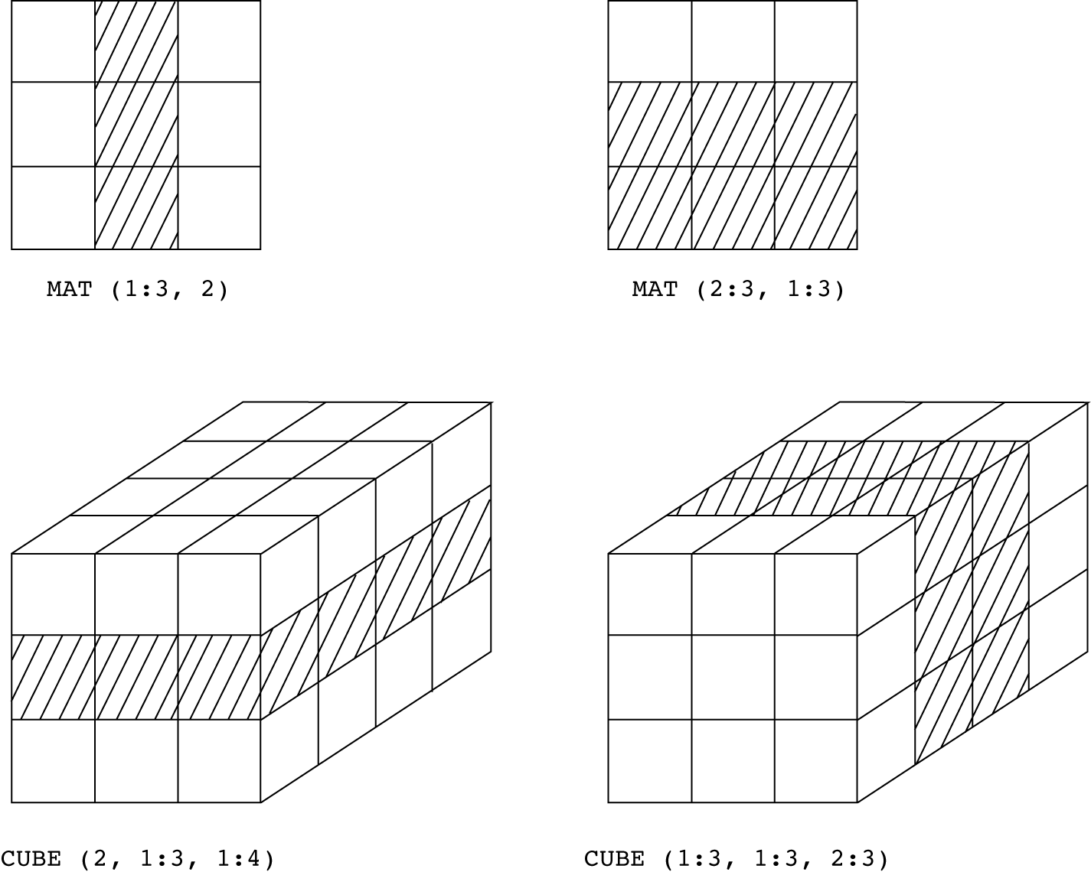
Arrays
Slices
A slice is some substructure of an array; nothing more than a referencing mechanism
Slices are only useful in languages that have array operations
Slice Example:
1. FORTRAN 90
INTEGER MAT (1:4, 1:4)
MAT(1:4, 1) - the first column
MAT(2, 1:4) - the second row

Slide 8
Array Implementation
Implementation of Arrays
Access function maps subscript expressions to an address in the array
Row major (by rows) or column major order (by columns)
Fortran: column major (see next page)
Speeds up accessing data in same column
Most languages, notably C and C++: row major
makes student[300] meaningful in
char student[9999][40]; // 9999 names, 40/name

Slide 9
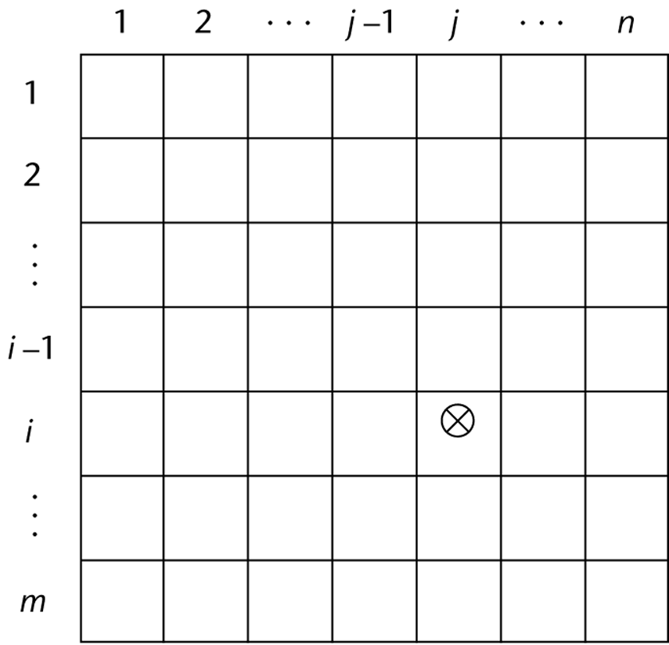
Locating an Element
Row major:
a[i][j] at a[1,1] + ((i-1) * n + (j-1)) * size
n: number of columns
(Reminder: C, C)
Matrix
| 1 2 3 |
| 4 5 6 |
| 7 8 9 |
stored as
-+-+-+-+-+-+-+-+-+-+-+-+-+-+-+-+-+-+-+-
| 1 | 2 | 3 | 4 | 5 | 6 | 7 | 8 | 9 |
-+-+-+-+-+-+-+-+-+-+-+-+-+-+-+-+-+-+-+-
Col major: a[1,1] + ((j-1) * m + (i-1)) * size
(Reminder: Fortran)
I will only ask you to calculate addresses for row major
Notes:
See https://stackoverflow.com/questions/33862730/row-major-vs-column-major-confusion for more discussion

Slide 10
Records
A record: a possibly heterogeneous aggregate of data elements in which the individual elements are identified by names
struct Food
{
float weight;
int color;
char name[50];
};
Design Issues:
1. What is the form of references?
2. What unit operations are defined?

Slide 11
Records
Record Definition Syntax
COBOL uses level numbers to show nesting:
01 BALANCE-LINE.
02 BALANCE-ITEM-NUM PICTURE IS 9(5).
02 BALANCE-ITEM-DESCR.
03 BAL-ITEM-NAME PICTURE IS X(30).
O3 BAL-ITEM-AMT PICTURE IS 999V99.
Almost all others: recursive definition
Referencing fields:
1. COBOL: field_name OF record_name_1 OF ... OF record_name_n
2. Others: record_name_1.record_name_2. ... record_name_n.field_name

Slide 12
Unions
A union is a type whose variables are allowed to store different type values at different times during execution
Union types in Haskell: data AtBat = Hit int | Walk | Out
C++ Example:
union Message
{
char text[1000];
float xs[200];
} msg;
strcpy(msg.text, “Hello, World”);
msg.xs[0] = 3243.5234e12; msg.xs[1] = -1e5;
cout << msg.text;
Prints “z_8Y” using g++ on Linux.
Design Issues for unions:
1. What kind of type checking, if any, must be done?
2. Should unions be integrated with records?

Slide 13
Unions
Pascal example:
type intreal =
record isint : boolean of
true : (blint : integer);
false : (blreal : real);
end;
var oddnum : intreal;
oddnum.blint = 32; … oddnum.blreal = 84.5;
Also known as “variant records”
The discriminator (isint in this case) is optional
Design Issues for unions:
1. What kind of type checking, if any, must be done?
2. Should unions be integrated with records?

Slide 14
Unions
Why C’s unions cannot be type checked effectively:
User can create inconsistent unions – can assign tag separately:
var blurb : intreal;
x : real;
blurb.isint := true; { it is an integer }
blurb.blint := 47; { ok }
blurb.isint := false; { it is a real }
x := blurb.blreal; { treat integer as real! }
Similarly for C/C++
Worse yet: the tag is optional!

Slide 15
Haskell
Union types in Haskell: OR types
Type X = A | B
Turned an odd hack into a useful tool!!
Effect of the Haskell syntax: it is not possible to store data in one format and read it in another using unions
In fact, probably can’t do that with any Haskell mechanism…

Slide 16
Review
Primitive types in multiple languages
Array implementation, including two-dimensional arrays
Union types

