Slide 1
CS 3040
Programming Languages & Translators
NOTE 13: Scope and LIFETIME CH. 9
Robert Hasker, 2019

Slide 2
Scope
Def: The scope of an identifier is the section of code over which it is visible
Def: The nonlocal variables of a program unit are those that are visible but not declared there
Static scope
Based on program text
Location (on stack, in memory) determined at compile & link time
Examples:
C/C++: for(int n = 0; n < 100; ++n)
{
int index;
...
}

Slide 3
Scope
Variables can be hidden from a unit by having a "closer" variable with the same name
C++ and Ada allow access to these "hidden" variables
In Ada: unit.name
In C++: class_name::name

Slide 4
Scope
Blocks
A method of creating static scopes inside program units--from ALGOL 60
Examples:
C/C++: for(int n = 0; n < 100; ++n)
{
int index;
...
}

Slide 5
Dynamic Scope
Alternative to static scoping
Dynamic Scope
Based on calling sequences of program units rather than textual layout
Temporal rather than spatial
Basic implementation:
When variable created, it’s put in a (single) table
Stack of values in table; new declarations hide earlier ones, old ones restored when lifetime over
Lookup: find variable in table, take topmost value

Slide 6
Dynamic Scope Example
MAIN
- declaration of x
def SUB1
- declaration of x -
...
call SUB2
...
def SUB2
...
- reference to x -
...
...
call SUB1
…
MAIN calls SUB1
SUB1 calls SUB2
SUB2 uses x
Which x is used?
Lexical scope: MAIN.x
Dynamic scope: SUB1.x

Slide 7
Evaluation of Dynamic Scope
Useful application: temporarily redefine some configuration parameter:
print: uses colsize to control printing
main
int colsize = 8;
print(); // print normally
{ int colsize = 20; print(); }
Evaluation of Dynamic Scoping:
Advantage: convenience
Disadvantage: poor readability, no static type checking
Better methods: classes, “bomb” pattern

Slide 8
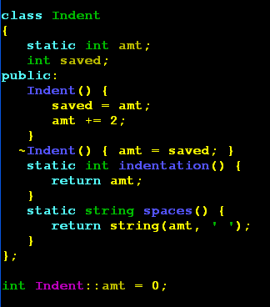
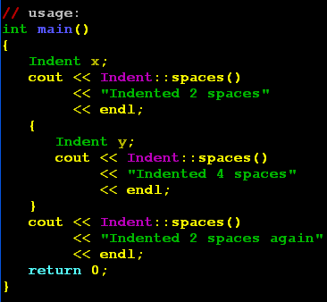
Bombed out indentation

Slide 9
Scoping, other topics
Note: scope & lifetime generally related, but still independent
scope in C++: from declaration to end of containing block: spatial concept
lifetime: temporal concept
C++: declare local variable as static to get global lifetime:
int calls() {
static int count = 0;
return ++count;
}
Used frequently for random number generation (eg, rand() )
next random number: multiply previous random value by large prime, mask off high order bits
Especially useful before advent of classes
I now generally just use it for debugging

Slide 10
static: C++ keyword for adjusting scope and lifetime
Static local variable: global lifetime, static scope (as illustrated on previous slide)
int calls() { static int a = 0; return ++a; }
“Statically” allocated at runtime – not on call stack
Compilation unit:
int doit() { … do_something_internal();… }
static void do_something_internal() { … }
do_something_internal cannot be called from other compilation units
Static data in a class: class variable (vs. class instance variable)
class X { static int y; … };
Question: is it reasonable to use the same keyword for all of these?
Are they really related, or is it just a case of making every string legal C++ code?

Slide 11
printf, scanf: binding at run-time
C++ i/o: cout <<, cin >>
C i/o: printf, scanf
Issue: How to read and write data?
C has no overloading
Want to do i/o without lots of specialized rountines such as print_int, print_double, print_str
Solution: creating an interpreter for data in strings
Given int x; double z; x = 5; z = 23.4;
printf(“X is %d, Z is %f\n”, x, z);
prints X is 5, Z is 23.4
C++ version: cout << “X is “ << x << “, z is “ << z
<< endl;
Weakness: can perform only limited checks on types at compile time!

Slide 12
More on printf
In general:
%d decimal
%o octal
%c character
%s null-terminated string
%g, %f floats; %g is friendlier
%5d print number in 5 places
%05d print number with leading 0s
%5.2f print float in 5 places with 2 decimal digits
%% print a %
Examples:
printf(“%d^3 is %d”, 4, 4 * 4 * 4); // 4^3 is 64
printf(“His name is %s”, “Bob”); // His name is Bob
printf(“5 %c 9 = %d“, ‘+’); // 5 + 9 = [random value]

Slide 13
scanf: reading in data
scanf(“%d”, &x); - sets x to next value
scanf(“%f”, &z); - same for a float
char name[100]; scanf(“%s”, name);
scanf(“x: %d”, &x);
matches “x: “ in input
Both scanf, printf have other forms
fscanf, fprintf: input/output from file
sscanf, sprintf: input/output using string buffer
Types (using C++ nomenclature):
int printf(const char* fmt, ...);
int scanf(const char* fmt, ...);
What does “...” mean?
Do both printf, scan implement a DSL?

Slide 14
Review
Variables, binding, aliasing
Dynamic vs. static scoping
Lifetimes
Typing with printf, scanf

Slide 15
Exercise
You have been asked to develop a formal type system for C++ expressions over char, integers, longs, floats, and doubles
Give rules for inferring the type of x + y where the type of x and the type of y are known
Use the proof rule format discussed earlier
Develop rules for assignments: z = x + y, where the type of variable z is declared in advance

