Slide 1
CS 3040
Programming Languages & Translators
note 14: memory management
Robert Hasker, 2019

Slide 2
Pointers
Dangling pointers (dangerous)
A pointer points to a heap-dynamic variable that has been deallocated
Creating one (with explicit deallocation):
Allocate a heap-dynamic variable and set a pointer to point at it: Node *a = new Node(10);
Set a second pointer to the value of the first pointer:
Node *b = a;
Deallocate the heap-dynamic variable, using the first pointer: delete a;
Use the second pointer:
b->value = 42;
Problem: what if another process (eg, graphical user interface code) runs here – may re-allocate the space pointed to by a

Slide 3
Pointers
list
Lost Heap-Dynamic Variables (wasteful)
A heap-dynamic variable that is no longer referenced by any program pointer
Creating one:
void add_to_end(Node *list, int val)
{
Node *x = new Node; // node on heap
for(x = list; x->next != NULL; x=x->next) ;
x->next = new Node(val); // create new
// space for original x now lost
}
Result: memory leak
x

Slide 4
Pointers
Evaluation of pointers:
Problems:
Dangling pointers
Memory leaks
Heap management overhead
Claim: pointers are like goto's--they widen the range of cells that can be accessed by a variable
This is overstated!
W/o pointers: must allocate all data statically
How to know how much needed?
Result: waste space or unnecessary limits to data

Slide 5
Living with pointers
Solution 1: manual memory management – works, but requires discipline
Solution 2: automated garbage collection
Need to be able to detect that memory is no longer in use
Must be able to reorganize memory so can reuse the bits that are no longer in use
One method: reference counters
maintain a counter in every cell that store the number of pointers currently pointing at the cell
When counter reaches 0, free the space
Problems:
Extra bits for counter in every object
Overhead for every assignment
Circular lists/mutual references cause problems
Reference counters are rarely used!

Slide 6
Living with pointers
Alternative solution: allocate until no available cells, then gather all garbage
Known as “garbage collection”
Common scheme: mark and sweep
Set aside a bit for every object on the heap
Often use the low order bit
Initialize all objects to indicate they are “garbage”
Trace each pointer into heap, clearing garbage bits
Recursively clear garbage bits for those points
Starting point: “alive” program variables
Note compiler or runtime must track these alive variables!
Return remaining objects (garbage) to available list

Slide 7
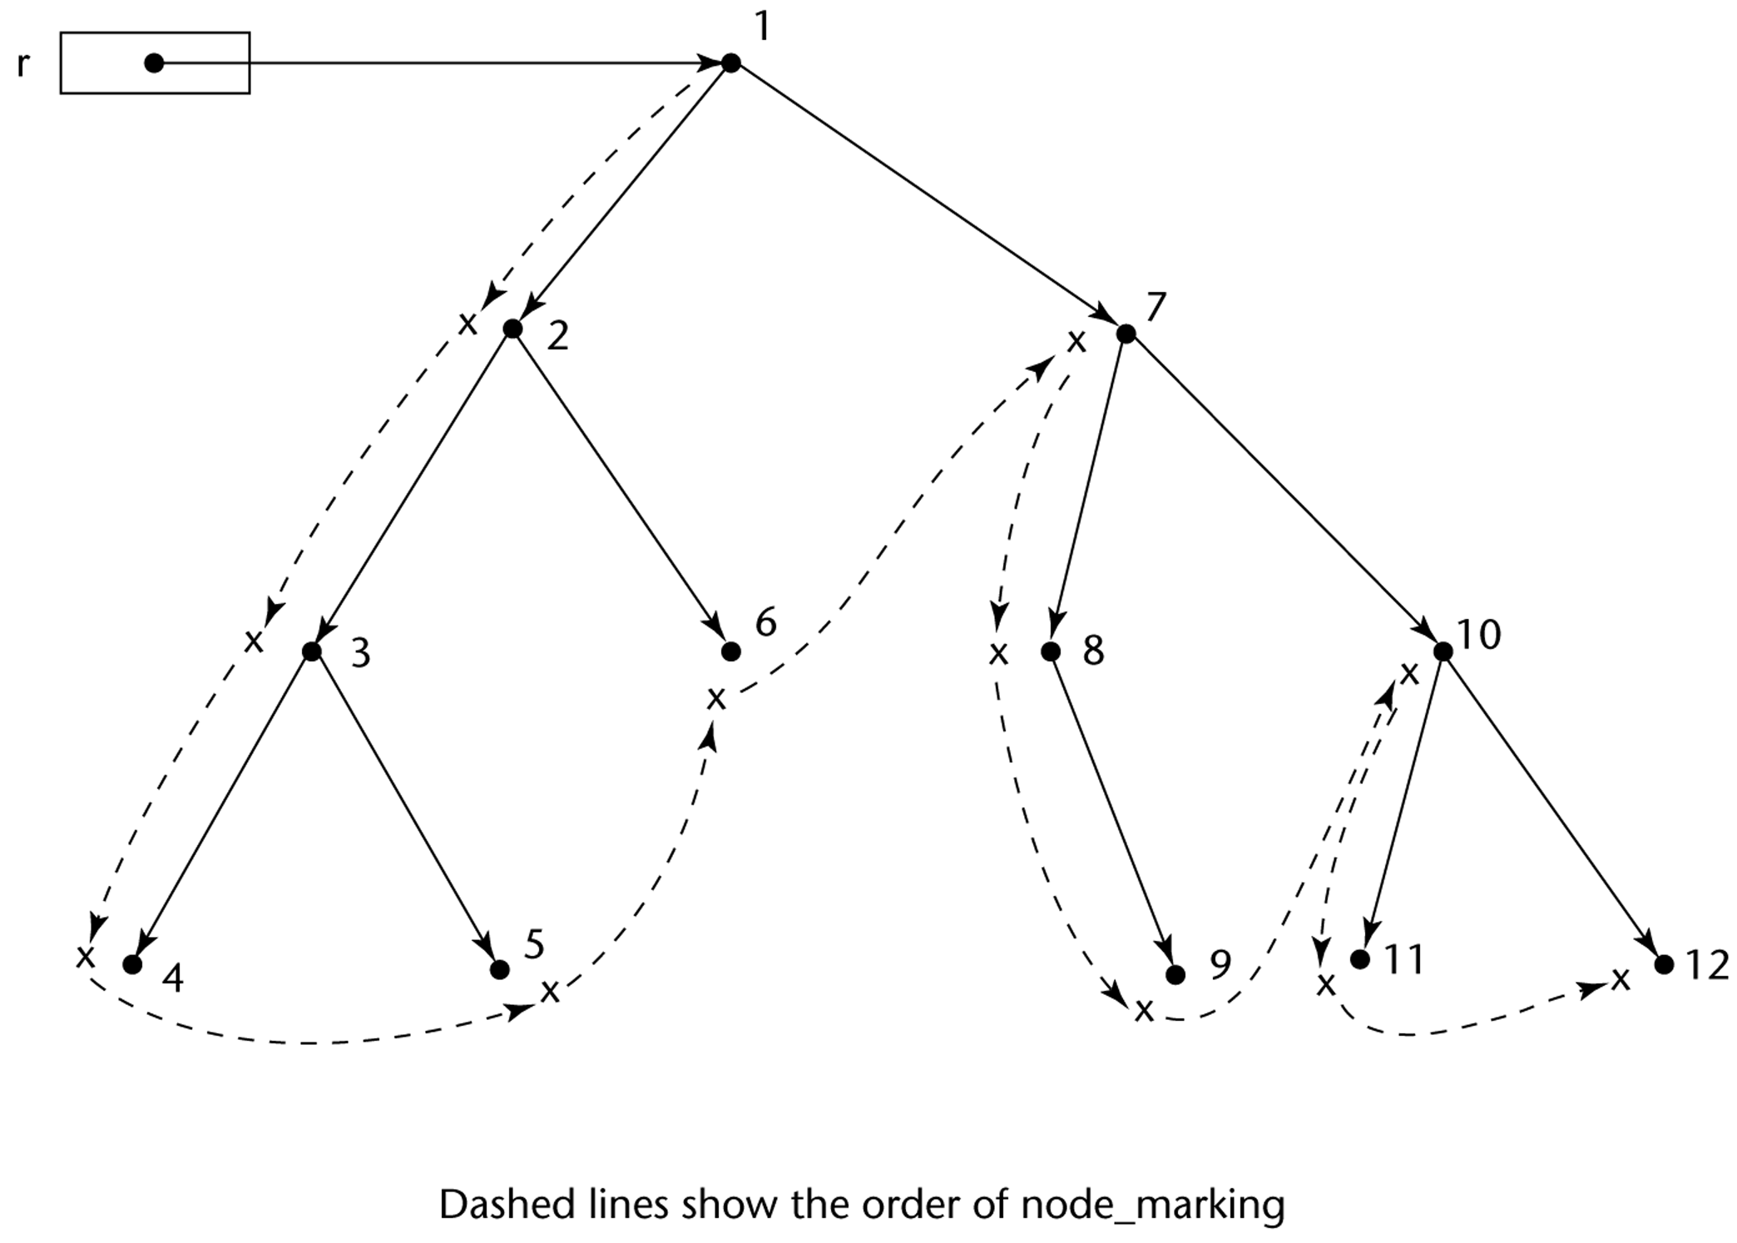
Marking Algorithm

Slide 8
Mark & Sweep, Continued
Advantages
no overhead until need to collect garbage
little space overhead
circular lists not a problem
Disadvantages
big cost to collection
highest cost when you need it the most!
that is, when you actually need the space is exactly when there’s the most data to search
Almost impossible to use for real-time systems

Slide 9
Generational Collection
Observation: new objects die quickly, “surviving” objects likely to survive for many more collections
Divide heap into generations: youngest in G₀, G₁ containing only objects older than G₀, G₂ older objects than G₁, etc.
Collecting: collect G₀ most frequently, G₀+G₁ less often, G₀+G₁+G₂ even less often, etc.
start by collecting in G₀, move up only if that doesn’t give you enough space
Issue: “alive” program variables not enough – also need to track entry points from G_{i} to G₀ for i > 0
But: such pointers are rare – most are set once and never changed
Can use VM page locking: when change ptr on page, check reference and update list of entry points to each generation

Slide 10
GC Wrap-up
Generational GC: little overhead in most cases
Generational scheme may fail to reclaim unreachable objects – combine w/ full mark & sweep
http://msdn.microsoft.com/msdnmag/issues/1200/GCI2/: .NET framework uses generational GC
http://www.devx.com/Java/Article/21977: also used in Sun’s Java HotSpot virtual machine
What about real-time systems?
predictability is key: incremental collection
incremental collection: run mark & sweep in parallel
synchronization can make this expensive
can take advantage of VM page locking to reduce costs dramatically!
Conclusion: GC is not a horrible thing!

