Slide 1
CS 3040
Programming Languages & Translators
NOTE 15: Compilation, Translation
Robert Hasker, 2019

Slide 2
What is my experience
Implemented compiler, HiC
Goal: introductory environment with good error messages
Recursive descent parser – simplified error handling
Set of classes representing runtime execution
Parser: text into a syntax tree
Each statement, expression: an eval() operation for that time of element
Running a program: executing eval operations until crash or reach end of main

Slide 3
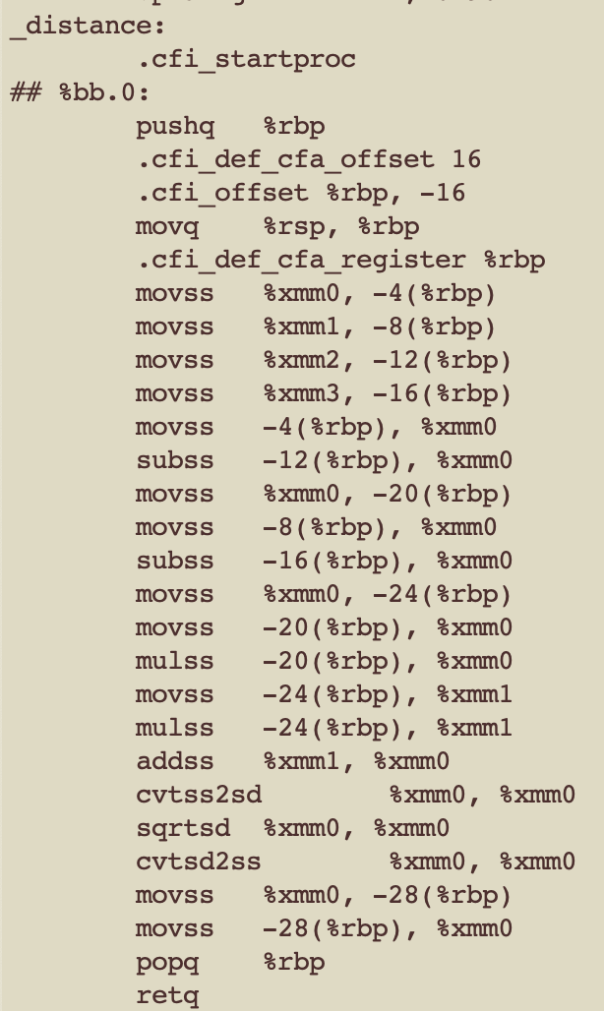
The Problem
Start with code:
float distance(float x1, float y1, float x2, float y2)
{
float delta_x = x2 – x1;
float delta_y = y2 – y1;
float dist = sqrt(delta_x * delta_x
+ delta_y * delta_y);
return dist;
}
Machine needs basic instructions
How to get there?

Slide 4
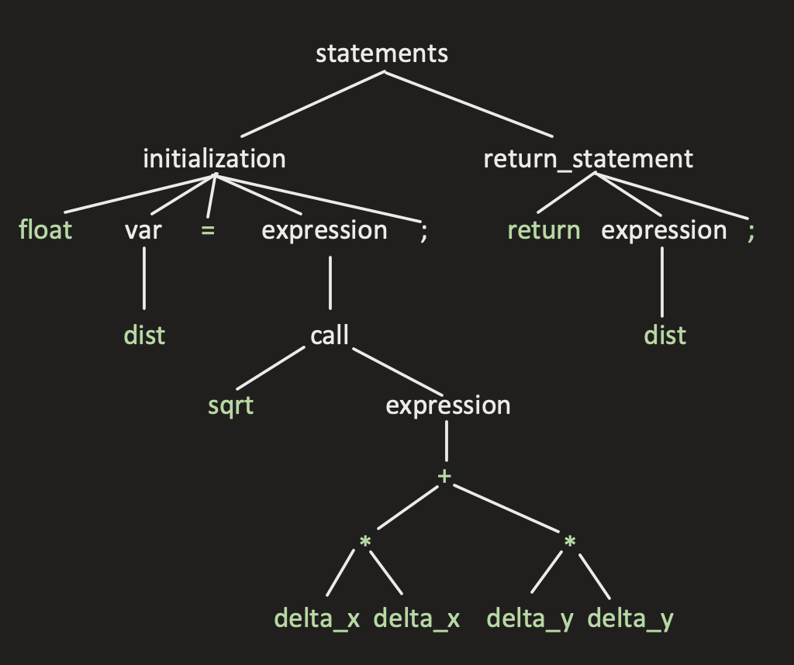
First step: decomposing the program
float distance(float x1, float y1,
float x2, float y2)
{
float delta_x = x2 – x1;
float delta_y = y2 – y1;
float dist = sqrt(delta_x * delta_x
+ delta_y * delta_y);
return dist;
}
That is: generating a parse tree
Code structure, syntax errors
But then what?

Slide 5
Architecture of a Compiler: Front End
Syntactic analysis
Parsing
Preprocessing
#define, #include, etc.
Semantic analysis
Identifiers, types, etc.
Identifying structure
Templates
Lexical analysis
Identifying tokens
Removing whitespace
Lexical analysis: typically regular expressions
Syntactic analysis: CFGs
CS 2040

Slide 6
Architecture of a Compiler: Back End
Large-scale optimization
Liveness analysis
Instruction Selection
Code Generation
Link libraries
Loop optimization
Program analysis
Analyzing control flow
Identify dead code, errors
etc.
Peephole optimization
Simplify code like
push X
pop X
Translate to assembly code
Generate final executable

Slide 7
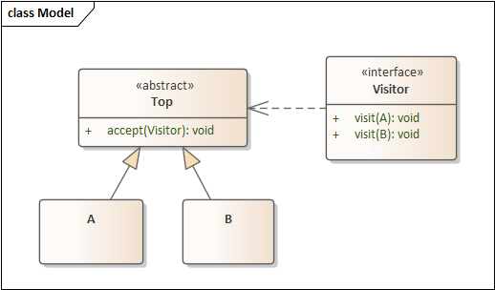
What happens after parse code?
Our ANTLR solutions: process each element as it is reduced (popped from the stack and replaced by a nonterminal)
This doesn’t scale: large amounts of code in the ANTLR file
Better solution: use parse trees
Create a tree representing the program
Build visitors (the design pattern) to process it
Visitor pattern

Slide 8
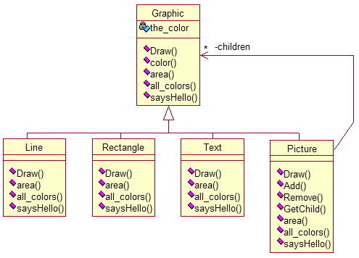
Visiting graphics
Added methods to support various inquiries:
area: compute area of graphic - reasonably general-purpose, though there are lots of ways to compute this
all_colors: return set of colors in image - somewhat specialized
saysHello: does picture contain the text "Hello" - very specific to a problem
Issue: adding these methods makes a class very specific to a particular problem
Needed: a way to process all items in hierarchy without having to add methods to those items
Solution: set up a visitor designed to visit each sort of item (but do nothing for each):
Line::accept(GraphicVisitor *gv) { gv->visit(*this); }
Picture::accept(GrpahicVisitor *gv) {
gv->visit(*this);
for(c in children) c.apply(gv); }
Visiting parse trees
Tree nodes: expressions, statements, etc.
Visit operations: type checkers, code generators
Win: visitors separated from the parsing
New machine architecture? Just update the visitor
Preferred use of ANTLR: write visitors
Each parse creates an internal tree, use visitor to process this tree
class GraphicVisitor
{
public:
virtual void visit(Line &) { }
virtual void visit(Rectangle &) { }
virtual void visit(Text &) { }
virtual void visit(Picture &) { }
};

Slide 9
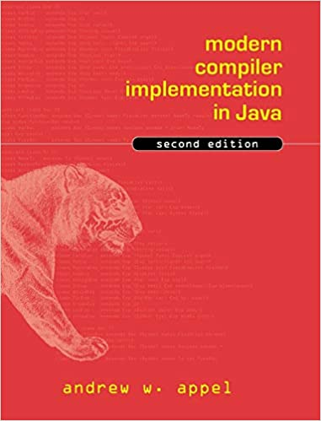
Generating code
Basic issues
Create an intermediate language to avoid being too processor-specific too quickly
Must translate the tree generated by the parser into an instruction sequence
Will start by translating it to a simpler tree with core instructions
Will manipulate these into a canonical form
That is, a form in which each expression corresponds to a unique form
Will use tiling to map this tree into an instruction sequence
Will determine how to maximize registers
Last: optimizations
Material based on modern compiler implementation in Java
Andrew Appel

Slide 10
Intermediate Representation
Could go straight to code: difficult to analyze, lots of detail
Usual solution: Intermediate representation
Expressed as a Haskell Datatype:
data Expression =
CONST Int -- integer constant
| NAME Int -- ref to identified location
| TEMP Int -- numbered temporary
-- often allocated to a register
-- have an infinite number of temporaries
| BINOP Char Expression Expression
-- apply operator to expressions e1, e2
| MEM Int -- reference word at given address
| CALL String [Argument]
-- call named function with argument list
-- evaluate arguments left-to-right
| ESEQ Statement Expression
-- eval statement; expression is result
data Statement =
MOVE_TEMP Int Expression
-- store Expression result at identified temp
| MOVE_ADDR Expression Expression
-- result of second expr put at addr of first
| EVAL Expression
-- evaluate expression, discard result
| JUMP Expression
-- evaluate expr and jump to that address
| CJUMP Compare Expression Expression Statement Statement
-- use operator to compare expressions
-- if true: jump to first statement
-- false: jump to second statement
| SEQ Statement Statement -- execute s1 then s2
| LABEL Int -- define label at current address
-- will use NAME Int to refer to label
data Compare = EQ|NE|LT|LE|GT|GE
Notes:
ESEQ: evaluate statement then expression, and the expression is the result

Slide 11
Examples
Code:
if ( a < b && c >= d ) {
... true block with label t
} else {
... false block with label f
}
Translation, where
z is a unique integer (generated for a new label)
a, b, c, d are variables 10, 11, 12, 13
SEQ (CJUMP LT (NAME 10) (NAME 11) z f)
(SEQ (LABEL z)
(CJUMP GE (NAME 12) (NAME 13) t f))
Translate x = n + 99;
assume x is a global at 17
assume n on stack - local variable 5
assume frame pointer in (TEMP 1)
Translation:
MOVE_ADDR (NAME 17)
(BINOP ‘+’
(BINOP ‘+’
(TEMP 1)
(CONST 5))
(CONST 99))
Exercises: while loop example, array index example
Other constructs: very similar!
Notes:
Array index: a[i] translates to MEM (BINOP ‘+’ (translate ‘a’) (BINOP ‘*’ (translate ‘i’) (CONST w)))
where w is the word size and translate for a variable looks up its location in memory

Slide 12
Basic Blocks
Note there are type issues; treat linearize as pseudocode
Apply linearize until cannot be applied any more
More efficiently: recursively call linearize on each subexpression
Result: all ESEQs of the form
ESEQ (SEQ a (SEQ b ..)) e
Can also reorganize CALLs to top level or in MOVE
Can then identify basic blocks, translate any CJUMP into appropriate machine instructions
Why introduce CJUMP? it simplifies the initial translation
Consider the IR instruction
CJUMP Compare Expression Expression Statement Statement
Most architectures: conditional jumps are similar to
JE Label
Conditional jump to specified label if result of last comparison is equal to zero
Can reorganize code into basic blocks
a sequence with no internal jumps
linearize (ESEQ s1 (ESEQ s2 e)) = ESEQ (SEQ s1 s2) e
linearize (BINOP op (ESEQ s e1) e2) = ESEQ s (BINOP op e1 e2)
linearize (BINOP op e1 (ESEQ s e2)) | (commutative op) =
ESEQ s (BINOP op e1 e2)
linearize (BINOP op e1 (ESEQ s e2)) =
let t = newNumber in ESEQ (MOV (TEMP t) e1)
(ESEQ s (BINOP op (TEMP t) e2))
linearize x = x -- remaining cases

Slide 13
Generating Machine Code
Program: Instruction, Expression tree
How to generate code from this?
This might be implemented as
mov r4, #22 ; r4 = constant 22
mov r0, @36 ; r0 = data at addr 36
mul r0, r4 ; r0 = r0 * r4
mov @12, r0 ; M[12] = r0
Basic idea: map portions of the tree to instructions
In some cases, will have multiple instructions for a subtree
Instruction selection: match segments of trees to instructions
tiling: the process of identifying instructions for each part of the tree
T4 = 22; x = y * T4
SEQ
MOVE_TEMP
MOVE_ADDR
TEMP
CONST
NAME
BINOP
22
12
‘*’
NAME
TEMP
4
36
4

Slide 14
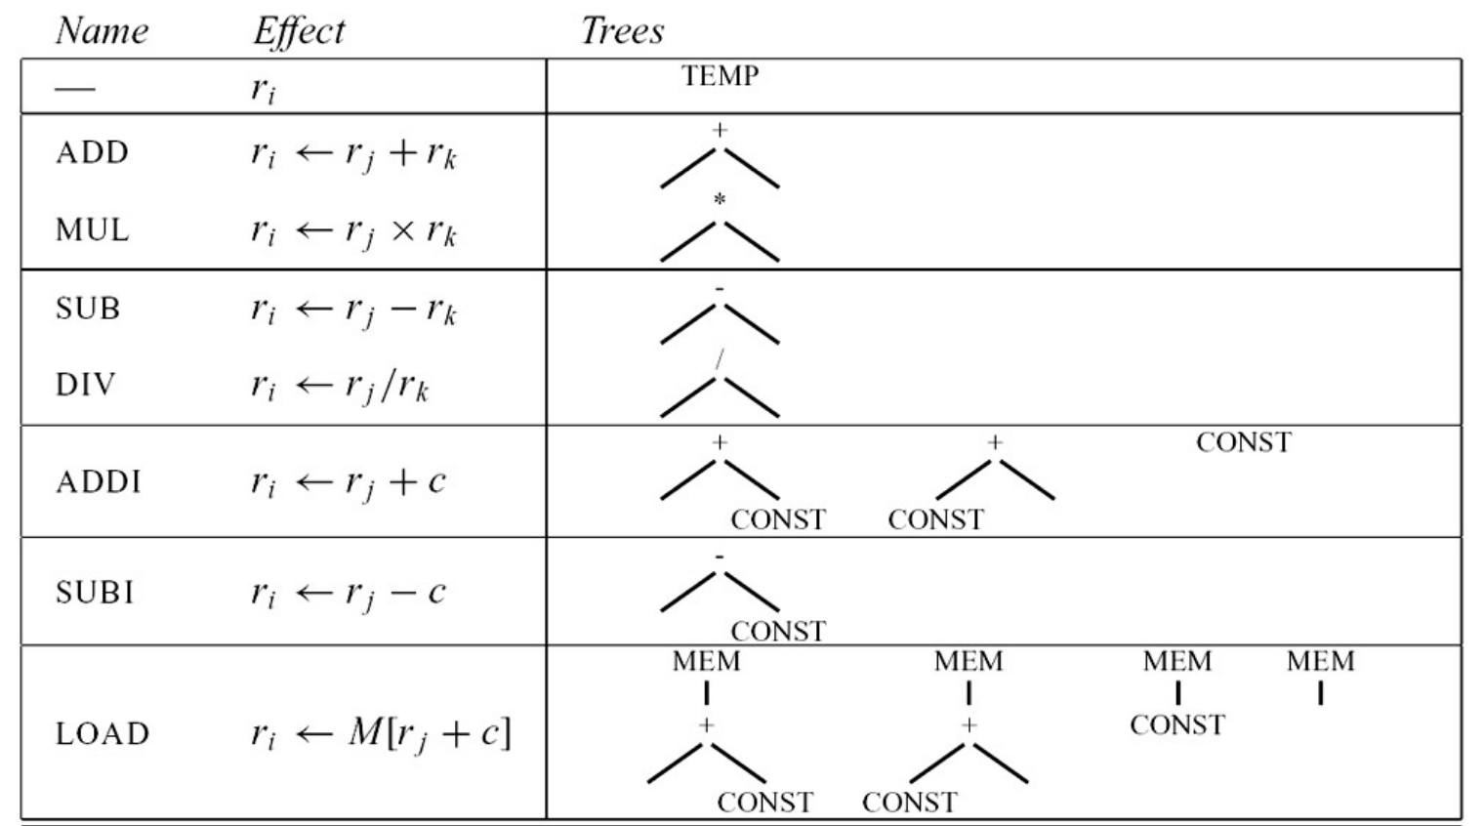
Sample tiles

Slide 15
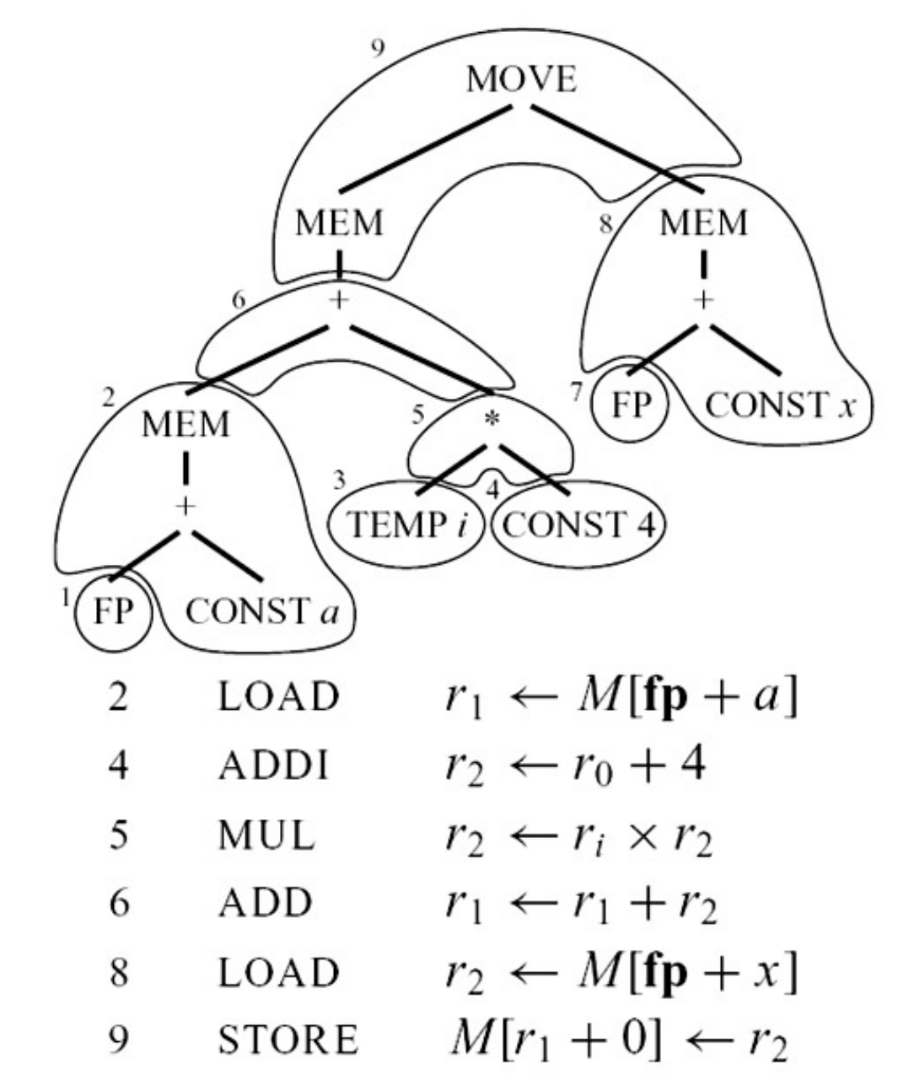
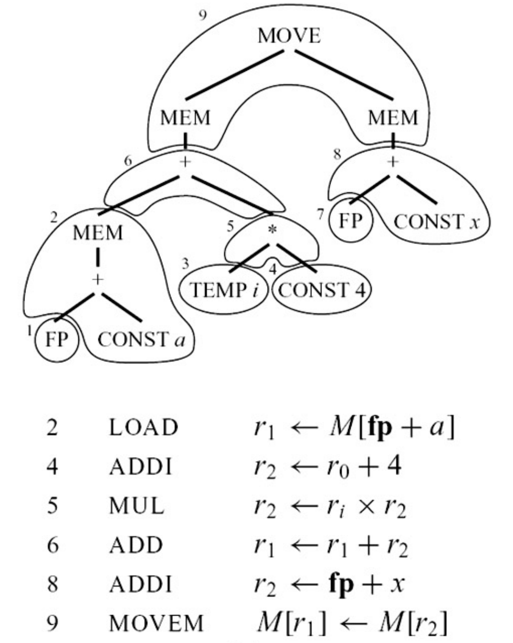
Tiling code fragments
But this is not the only way!
Alternative:

Slide 16
Tiling code fragments
Cost of Maximum Munch:
Let N = number of nodes in tree
K = average number of non-leaf nodes per tile
K’ = maximum number of nodes to examine for any tile
T = number of different tiles
T’ = average number of tiles matching at each node
COST: (K’ + T’) N / K, or O(N)
What tiling might we prefer?
Best tiling: lowest-cost instruction sequence
Implies we can assign a cost to each tile
optimum tiling: sum of tiles is the lowest possible value
optimal tiling
no two adjacent tiles can be combined to create a lower-cost tile
Optimum is often easier to compute than optimal
Maximal Munch algorithm:
find largest tile fitting root of tree
cover root and appropriate children by tile
recurse on uncovered children

Slide 17
Actual Instruction Sets
Common issue: RISC vs CISC
Reduced Instruction Set Computers vs Complex ...
Pentium: six general-purpose registers, sp, fp
multiply requires argument to be in eax, result in eax and edx
Has side-effect instructions such as autoincrement
How to use?
Ignore?
Match as a special case (ad-hoc)?
construct special algorithms?
Item | RISC | CISC
registers | 32 | 6, 8, 16
register classes | one | many; dedicated registers for some ops
arithmetic operations | register only | memory and register (modes)
instruction type | three address: r1 <- r2 op r3 | two address: r1 <- r1 op r2
addressing modes | M[reg+const] | many
instruction size | one word | variable
side effects | none | auto-increment, others
Argument for RISC: complex instructions are difficult to use in compilers
Result: few compilers take advantage of the complexity
Solution: maximize registers
keep instructions lightweight and fast
Some architectures: ”register files” that are swapped in and out on calls

Slide 18
Allocating Registers
Core issue: all machines have a finite number of registers
Key concept: determining where a variable is live
That is: where a variable holds a value that may be needed in the future
Consider
a = 0 // node 1
L1: b = a + 1 // node 2
c = c + b // node 3
a = b * 2 // node 4
if a < N goto L1 // node 5
return c // node 6
Where is b alive?
Where is a alive?
Where is c alive?
The lines: control-flow graph
Notes:
For each: draw a control flow graph
b: live range is {2 through 4}
a: live range is {1->2, 4->5->2}
c: live on entry (either as parameter or uninitialized) and alive throughout entire code fragment

Slide 19
Allocating Registers
Control-flow graph: captures which values cannot be stored in the same register
Additional issue: some registers are interdependent
Example: Intel imul
imul AX, location
multiplies register AX by value at given location, storing result in AX and DX
Register allocation: application of graph coloring
Graph coloring:
assign colors to all nodes such that no two adjacent nodes have the same color
use a minimum number of colors
Application to register allocation:
different colors = different registers
need distinct registers for u, v, x, y
Can store u, w, z in same register
u
v
w
Does this graph
require 4 colors?
x
y
z
Notes:
QUESION: do we have to have four colors in this graph?
Answer:

Slide 20
Allocating Registers
Register allocation as graph coloring: different colors represent different registers
Issue: graph coloring is NP-Complete
All known algorithms take exponential time
If have N values and k registers, must try k^{N} possible allocations
Eg: 20 variables, 10 registers, then 10²⁰ possibilities!
Being NP-Complete means that it shares this exponential time behavior with many other problems
That is, there are a large group of problems that also seem to take exponential time
We do not know if there is a polynomial time solution!
However, people have tried for 50-60 years and haven’t found one yet...
Approximate algorithms: see compiler construction textbook
Typically: use up all available registers, then start storing registers on stack as need new ones
See Appel’s book...
Now ready to build full, non-optimizing compiler!
This is left as an exercise...
Notes:
For each: draw a control flow graph
b: live range is {2 through 4}
a: live range is {1->2, 4->5->2}
c: live on entry (either as parameter or uninitialized) and alive throughout entire code fragment

Slide 21
Review
Compilation: translating code from source form to executable binaries
Intermediate representation: easy to generate from parse trees, easy to translate to actual instructions
Basic blocks: sequences with no embedded branches
These are important to many optimizations
Tiling: fitting instructions to intermediate representation
maximal munch: optimum, but possibly not optimal

Slide 22
Review
Compilation: translating code from source form to executable binaries
Intermediate representation: easy to generate from parse trees, easy to translate to actual instructions
Basic blocks: sequences with no embedded branches
These are important to many optimizations
Tiling: fitting instructions to intermediate representation
maximal munch: optimum, but possibly not optimal
RISC vs CISC
Allocating registers as a form of graph coloring

