Slide 1
SE 2800 Software Engineering Process
Dr. Rob Hasker
email: hasker@msoe.edu
Syllabus: on Canvas
GitLab: must use MSOE email address

Slide 2
Logistics
Syllabus
Lets look at it together…
Gitlab accounts
Look for the emails!
Weekly structure
Typically 1 hr instruction each day, 1 hr lab time
This week: 2 hr lab on Thursday

Slide 3
Textbook
Essential Scrum
A Practical Guide to the Most Popular Agile Process, Kenneth S. Rubin
Good reference on process framework – not a real textbook
Needs supplement on practices

Slide 4
Process
How should we plan and execute a project of moderate size (small team)?
How would you do it?
What process did you use in SE 2030, SE 2811?
What was good or bad about it?
What is a software process?

Slide 5
How should we execute a project of moderate size for a small team?
How would you do it?
What is your current software process?
What was your SE-2030/2811 experience?
What is good/bad about it?
How long will it take?
How will you ensure quality?

Slide 6
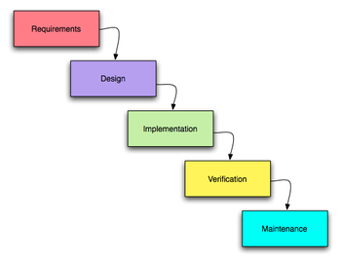
SE2030 Review: Software Life Cycle
Requirements Analysis
Plan – left for SE2800
High-level Design
Low-level (Detail) Design
Implementation
Unit Test
Integration
System Test
Deploy
Maintain

Slide 7
Process Goals
Overwhelmingly, [software development] managers and stakeholders ask us for two things:
Predictability
+ Quality
Software Engineering = Producing useable, maintainable software systems on-time and on-budget

Slide 8
Practice and Process Activities
Activity planning
Requirements analysis & specification
Architecture & high-level design (HLD)
HLD review
Detailed design
Detailed design review
Implementation (coding)
Code review/inspection
Unit testing
Integration testing
System testing
Size/effort estimation
Time tracking
Defect tracking
Quality analysis (bugs/kLOC)
Productivity analysis (LOC/hr)
There are many different ways to break down software development activities; this is just one way of doing it.

Slide 9
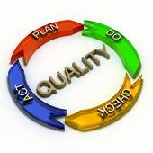
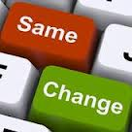
Practice vs Process
Practice = “what we do”
Analyze requirements, create architectural/detail designs, implement, test
Process = “how we do it” “how we measure what we do” “how we improve what we do”

Slide 10
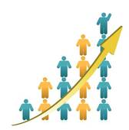
Process models provide frameworks for organizing software development activities
One pass, sequential (“waterfall”)
Iterative/incremental
“Agile”: XP, Scrum
PSP/TSP
“Spiral”

Slide 11
Waterfall vs. Incremental

Slide 12
Comparing Process Models
 | Waterfall | Incremental (Scrum/others)
Planning model | Upfront, track and adjust | Iterative, team experience, integrated customer
Quality management | Explicit focus on defects after release | Short cycles to provide monitoring, make improvements
Final product definition | Schedule target, defined | Flexible, adaptive

Slide 13
Course Goal
Experience with one approach to software process
Why Scrum/Iterative?
Widely used in industry
Well-suited for a lot of SW projects

Slide 14
Tools
GitLab
Plan/track progress
Wiki
Git repository
JUnit
Test automation

Slide 15
Tool Setup
First lab session (on day2 this week)
You will receive an email from GitLab
Set up your account (if needed) before lab
You MUST use your MSOE email and username!
Groups will appear on GitLab and Canvas

Slide 16
Review
SE 2800: Software Process I
Introduction to software process
Practice vs. process
Practices: what needs to be done
Process: how & when
Process models
Sequential vs. iterative
Predictive vs. agile
Scrum: Read Ch. 2 – quiz on Canvas later this week.

