Slide 1
Requirements and User Stories
Textbook:
Ch. 5
Notes:
Critical: make sure students read this chapter before doing the notes

Slide 2
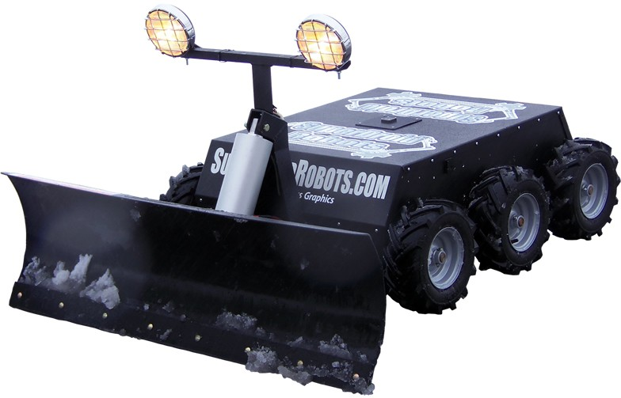
Requirements-based Development
System specification: series of “shalls”
The registration system shall support lecture, discussion, and lab-based courses.
The Snowba shall clear sidewalks of up to 4 inches of snow.
The Snowba shall commence clearing snow when the depth is greater than ½ inch.
Forms a contract
Changes can be very expensive, so focus is on obtaining correct set of requirements early.

Slide 3
Correctness
Why “shall”?
Ensures requirements distinct from discussion.
Example: 4 inches is the maximum height allowed since greater heights would require wheels that are too large for a self-contained unit.
What if we find errors later?
Either an error in the contract or implementation.
In practice, a large percentage of project failures trace to errors in requirements.
Problem: natural languages are not always precise – is this model even feasible?

Slide 4
Alternative to requirements
PBIs could be requirements
Could write lists of high-level and low-level requirements, organized by feature.
Traditional requirements require lots of grooming.
Alternative: Use cases
Collection of detailed scenarios – advantages?
Usual agile approach: user stories:
As a user_role, I want to goal so that benefit.
Light-weight requirement: focused on asking client for details rather than writing a contract.
Agile manifesto: collaboration over contracts

Slide 5
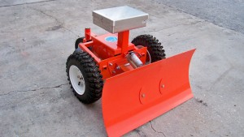
Elements of stories
As a user_role, I want to goal so that benefit.
As a homeowner, I want the snowba to commence clearing snow when the accumulation reaches ½” so that I do not have to pay the city to clear my sidewalk.
user_role: how user interacting with system
Same user might have multiple roles!
goal: what user wants to achieve
benefit: why – critical to understanding story
How long should these stories be?
What are the conditions of satisfaction?
Examples for the Snowba?

Slide 6
A matter of scale
Stories can be very detailed:
As a student, I want to see the total number of credits for the courses which I have added to my schedule so I can limit my workload.
Stories can be very broad – epics.
As a student, I want to take courses that allow me to complete major requirements so I can graduate in four years.
Why can’t we just write epics?
Why not have lots of detailed stories?
How do epics and stories interact w/ the PB?
Notes:
Why not all one or the other:

Slide 7
Size hierarchy
 | Time Unit | Scale of Enclosing Entity
Epic | Months | Product
Feature/ Theme | Weeks | Release
Story | Days | Sprint
Task | Hours

Slide 8
Sprintable stories
What, not how
Capture important detail, but no analysis paralysis
Not: must leave all details unstated…
I
N
V
E
S
T
Independent
Negotiable
Valuable
Estimatable
Sized appropriately
Testable
Why should one story (or PBI) never fill a sprint?
Why each?
How do acceptance criteria play a roll?
Notes:
Independent: independent of other stories in same sprint (CAN assume previous stories), use explicit references if needed
Key issue: sprintable – stories at top of backlog need to meet full criteria (with stories IN the sprint backlog also being estimated and tasked)
NOTE: other textbooks use “small” for S, which is ok as long as one understands that “small” means “small enough to be sprintable”

Slide 9
Sprintable stories
I | Independent
N | Negotiable
V | Valuable
E | Estimatable
S | Small (appropriate size)
T | Testable
What do these qualities mean?
Why do we want them?

Slide 10
Example
As a locksmith, I would like to be able to enter a code from a database into the door keypad so I can help residents get into their house when they forget the combination.
Acceptance criteria:
Given the lock code is in the database
When I look up the code for lock #921
And I enter that code into its keypad
Then the lock opens
Also need error cases (lock not in database, wrong code entered)
Notes:
How does this meet INVEST?
Note that we need to know what happens if the lock isn’t in the database or the wrong code is entered.

Slide 11
How would we “test” stories?
Best practices: integrate testing throughout product cycle
So how to test a story?
How do we know when we’re done?
Thoughts???
How have you tested your code previously?
Is there more that you should do?
Solution:
Acceptance criteria
Given/when/then

Slide 12
Nonfunctional requirements
Definitions:
A property of the system, not a specific operation
Cross/cutting concerns/needs which apply to many user stories.
Not bad
Examples?
Safety, security, performance, robustness
Learnability, natural language support
Traditional concern: hard to test
How to handle in Scrum?
Include in definition of done?

Slide 13
Knowledge-acquisition stories
What?
Examples?

Slide 14
Knowledge-acquisition stories
What?
Examples?
How about “Learn C#”?
What about “Create website with node.js”?

Slide 15
Knowledge-acquisition stories
Prototype/spike/experiment/proof of concept
Example: evaluate alternative designs
Key: repeatable results
Why shouldn’t these be allowed?
Why should they be allowed?
How does the cost to unwind factor in?

Slide 16
Knowledge-acquisition stories
Prototype/spike/experiment/proof of concept
Example: evaluate alternative designs
Key: repeatable results
Why shouldn’t these be allowed?
Be suspicious of anything not delivering value
Why should they be allowed?
Important principle: fail fast
How does the cost to unwind factor in?

Slide 17
Gathering stories
Who should do it?
Should product owner be the sole team rep?
Basic method: ask user
Why might this not be effective?
User-story-writing workshop
What? Who? Why? How long? Goal?
Steps:
User role analysis: give names, personas to roles
Brainstorm: bottom-up, top-down, story map
Story Mapping: epics, themes, stories – p. 97
Often more focused on prioritization.

Slide 18
Stories vs. Requirements
Are stories just another form of requirements?
Can document reqs in criteria
Why wouldn’t reqs work as sprint tasks?
Why might we still need a traditional requirements document?
Safety critical systems: must trace requirements through project.
Would stories be the most effective way to organize such requirements?

Slide 19
Review
Traditional requirements: shalls
Collaboration over contract negotiation
Stories
Basic form
As a user_role, I want to goal so that benefit.
Non-functional requirements, knowledge acquisition
Gathering stories
User-story-writing workshop
Story mapping

