Slide 1
SCRUM
Textbook:
Ch. 2, 4

Slide 2
What is Scrum?
Definition from rugby football:
  a scrum is a way to restart the game after an interruption, where the forwards of each side come together in a tight formation and struggle to gain possession of the ball when it is tossed in among them

Slide 3
Scrum video
http://www.youtube.com/watch?v=D8vT7G0WATM
Watch the rest on your own and read your book!

Slide 4
Introduction
Classical methods of software development have many disadvantages:
  huge effort during the planning phase
  poor requirements conversion in a rapid changing environment
  treatment of staff as a factor of production
New methods:
Agile Software Development

Slide 5
Scrum has been used by:
Microsoft
Yahoo
Google
Electronic Arts
Lockheed Martin
Philips
Siemens
Nokia
IBM
Capital One
BBC
Intuit
Nielsen Media
First American Real Estate
BMC Software
Ipswitch
John Deere
Lexis Nexis
Sabre
Salesforce.com
Time Warner
Turner Broadcasting
Oce
Notes:
5

Slide 6
Scrum has been used for:
Video game development
FDA-approved, life-critical systems
Satellite-control software
Websites
Handheld software
Mobile phones
Network switching applications
ISV applications
Some of the largest applications in use
Commercial software
In-house development
Contract development
Fixed-price projects
Financial applications
ISO 9001-certified applications
Embedded systems
24x7 systems with 99.999% uptime requirements
the Joint Strike Fighter
Notes:
6

Slide 7
Scrum - an agile process
SCRUM is an agile, lightweight process for managing and controlling software and product development
  in rapidly changing environments.
  Iterative, incremental process
  Team-based approach
  developing systems/ products with rapidly changing requirements
  Controls the chaos of conflicting interest and needs
  Improve communication and maximize cooperation
  Protecting the team form disruptions and impediments
  A way to maximize productivity

Slide 8
History of Scrum
1995:
  analysis of common software development processes → not suitable for empirical, unpredictable and non-repeatable processes
  Design of a new method: Scrum by Jeff Sutherland & Ken Schwaber
  Enhancement of Scrum by Mike Beedle & combination of Scrum with Extreme Programming
1996:
  introduction of Scrum at OOPSLA conference
2001:
  publication “Agile Software Development with Scrum” by
  Ken Schwaber & Mike Beedle
Successful appliance of Scrum in over 50 companies
Founders are members in the Agile Alliance
Notes:
Successful = increase in productivity, satisfied/ happy team

Slide 9
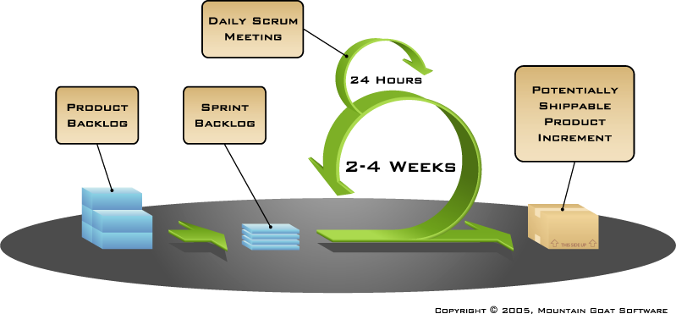
Functionality of Scrum

Slide 10


Sequential vs. overlapping development
Requirements
Design
Code
Test
Rather than doing all of one
thing at a time...
...Scrum teams do a little of
everything all the time
Notes:
10

Slide 11
Scrum framework
Roles
Product owner
ScrumMaster
Team
Ceremonies
Sprint planning
Sprint review
Sprint retrospective
Daily scrum meeting
Artifacts
Product backlog
Sprint backlog
Burndown charts
Notes:
11

Slide 12
Scrum framework
Roles
Product owner
ScrumMaster
Team
Ceremonies
Sprint planning
Sprint review
Sprint retrospective
Daily scrum meeting
Artifacts
Product backlog
Sprint backlog
Burndown charts
Notes:
12

Slide 13

Product owner
Define the features of the product
Decide on release date and content
Be responsible for the profitability of the product (ROI)
Prioritize features according to market value
Adjust features and priority every iteration, as needed
Accept or reject work results
Notes:
13

Slide 14

The ScrumMaster
Represents management to the project
Responsible for enacting Scrum values and practices
Removes impediments
Ensure that the team is fully functional and productive
Enable close cooperation across all roles and functions
Shield the team from external interferences
Notes:
14

Slide 15





The team
Typically 5-9 people
Cross-functional:
  Programmers, testers, user experience designers, etc.
Members should be full-time
  May be exceptions (e.g., database administrator)
Teams are self-organizing
  Ideally, no titles but rarely a possibility
Membership should change only between sprints
Notes:
15

Slide 16
Scrum framework
Roles
Product owner
ScrumMaster
Team
Ceremonies
Sprint review
Sprint planning
Sprint retrospective
Daily scrum meeting
Artifacts
Product backlog
Sprint backlog
Burndown charts
Notes:
16

Slide 17
Sprint Planning Meeting
A collaborative meeting in the beginning of each Sprint between the Product Owner, the Scrum Master and the Team
Traditionally takes 8 hours and consists of 2 parts
  before lunch
  after lunch
1st Part (before lunch):
  Creating/updating Product Backlog
  Determining the Sprint Goal
  Participants: Product Owner, Scrum Master, Scrum Team
2nd Part (after lunch):
  Creating/updating Sprint Backlog
  Participants: Scrum Master, Scrum Team
We will be performing this during class/lab time

Slide 18


Team capacity
Sprint planning meeting
Sprint prioritization
Product backlog
Sprint
goal
Analyze and evaluate product backlog
Select sprint goal
Business conditions
Sprint planning
Decide how to achieve sprint goal (design)
Create sprint backlog (tasks) from product
backlog items (user stories / features)
Estimate sprint backlog in hours
Current product
Sprint
backlog
Technology
Notes:
18

Slide 19

Sprint planning- 2nd part
Team selects items from the product backlog
they can commit to completing
Sprint backlog is finalized
  Tasks are identified and each is estimated
    Each team member develops and estimate and they are compared
    all at once during the meeting to determine the group estimate
  Collaboratively, not done alone by the ScrumMaster
High-level design is considered
Code the middle tier (8)
Code the user interface (4)
Write test fixtures (4)
Code the foo class (6)
Update performance tests (4)
As a vacation planner,
I want to see photos of
the hotels.
Notes:
19

Slide 20
The daily scrum
Parameters
  Daily
  15-minutes
  Stand-up
Not for problem solving
  Whole world is invited
  Only team members and ScrumMaster can talk
Helps avoid other unnecessary meetings
Just the team (including PO, SM, possibly managers
Notes:
20

Slide 21

Everyone answers 3 questions
1
What did you do yesterday?
2
What will you do today?
3
Is anything in your way?
These are not status for the ScrumMaster
  They are commitments in front of peers
Notes:
21

Slide 22
The sprint review
Team presents what it accomplished during the sprint
Typically takes the form of a demo of new features or
underlying architecture
Informal
  2-hour prep time rule
  No slides
Whole team participates
Invite the world
We will do these during class
Notes:
22

Slide 23
Sprint retrospective
Periodically take a look at what is and
is not working
Typically ~15 minutes
Done after every sprint
Whole team participates
  ScrumMaster
  Product owner
  Team
  Possibly customers and others
Notes:
23

Slide 24

Start / Stop / Continue
Whole team gathers and discusses
what they’d like to:
Start doing
Stop doing
This is just one
of many ways
to do a sprint
retrospective.
Continue doing
Notes:
24

Slide 25
Scrum framework
Roles
Product owner
ScrumMaster
Team
Ceremonies
Sprint planning
Sprint review
Sprint retrospective
Daily scrum meeting
Artifacts
Product backlog
Sprint backlog
Burndown charts
Notes:
25

Slide 26

Product backlog
The requirements
A list of all desired work
on the project
Ideally expressed such that
each item has value to
the users or customers
of the product
Prioritized by the
product owner
Reprioritized at the start of
each sprint
This is the product backlog
Notes:
26

Slide 27
A sample product backlog
For a hotel reservation system
Backlog item
Estimate
Allow a guest to make a reservation
3
As a guest, I want to cancel a reservation.
5
As a guest, I want to change the dates of a reservation.
3
As a hotel employee, I can run RevPR reports (revenue-per-room)
8
Improve exception handling
8
...
30
...
50
Notes:
27

Slide 28
The sprint goal
A short statement of what the work will be
focused on during the sprint
Life Sciences
Support features necessary
for population genetics studies.
Database Application
Make the application run on SQL Server in
addition to Oracle.
Financial services
Support more technical indicators than company
ABC with real-time, streaming data.
Notes:
28

Slide 29
Managing the sprint backlog
Individuals sign up for work of their own choosing
  Work is never assigned
Estimated work remaining is updated daily
Only team member can add, delete or change the
sprint backlog (not the product owner)
Work for the sprint emerges
If work is unclear, define a sprint backlog item with
a larger amount of time
  Break it down later
Update work remaining as more becomes known
Tasks should not take more than 10 hours
Notes:
29

Slide 30
Burndown Charts
Are used to represent “work done”.
Are wonderful Information Radiators
  "Two characteristics are key to a good information radiator. The first is that the information changes over time. This makes it worth a person's while to look at the display... The other characteristic is that it takes very little energy to view the display."
3 Types:
  Sprint Burndown Chart (progress of the Sprint)
  Release Burndown Chart (progress of release)
  Product Burndown chart (progress of the Product)
Axes
  X-Axis: time (usually in days)
  Y-Axis: remaining effort

Slide 31
Sprint Burn down Chart
Depicts the total Sprint Backlog hours remaining per day
Shows the estimated amount of time to release
Ideally should burn down to zero to the end of the Sprint
Actually is not a straight line
Can bump UP
  When?

Slide 32

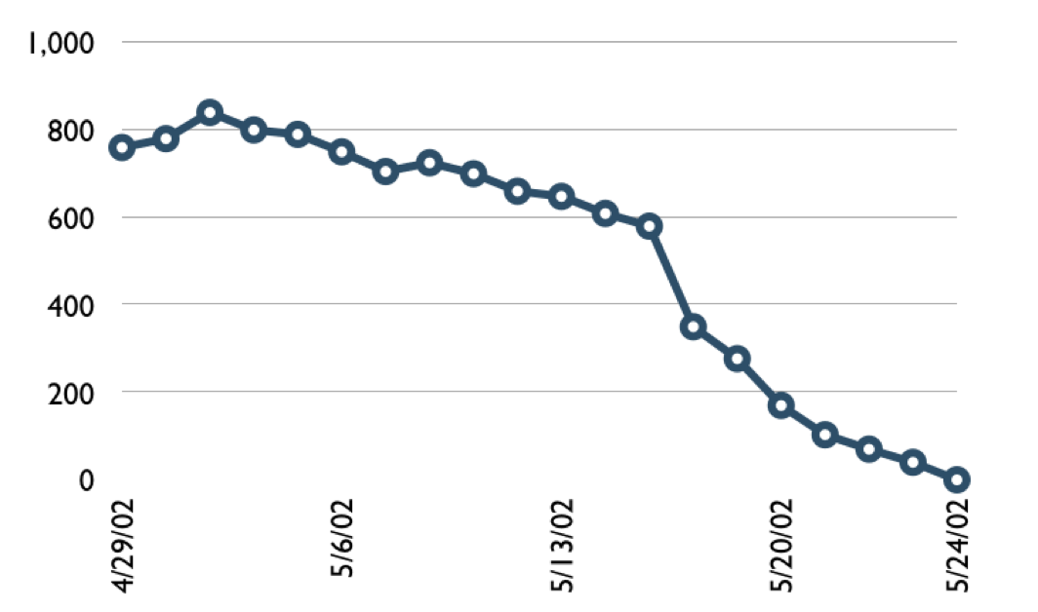
A sprint burndown chart
Hours
Notes:
32

Slide 33
Tasks
Mon
Tues
Wed
Thur
Fri
Code the user interface
8
4
8
Code the middle tier
16
12
10
7
Test the middle tier
8
16
16
11
8
Write online help
12
50
40
30
20
10
0
Mon
Tue
Wed
Thu
Fri
Hours
Notes:
33

Slide 34
Release Burn down Chart
Will the release be done on right time?
X-axis: sprints
Y-axis: amount of hours remaining
The estimated work remaining can also burn up

Slide 35
Scalability
Typical individual team is 7 ± 2 people
  Scalability comes from teams of teams
Factors in scaling
  Type of application
  Team size
  Team dispersion
  Project duration
Scrum has been used on multiple 500+
person projects
Notes:
35

Slide 36
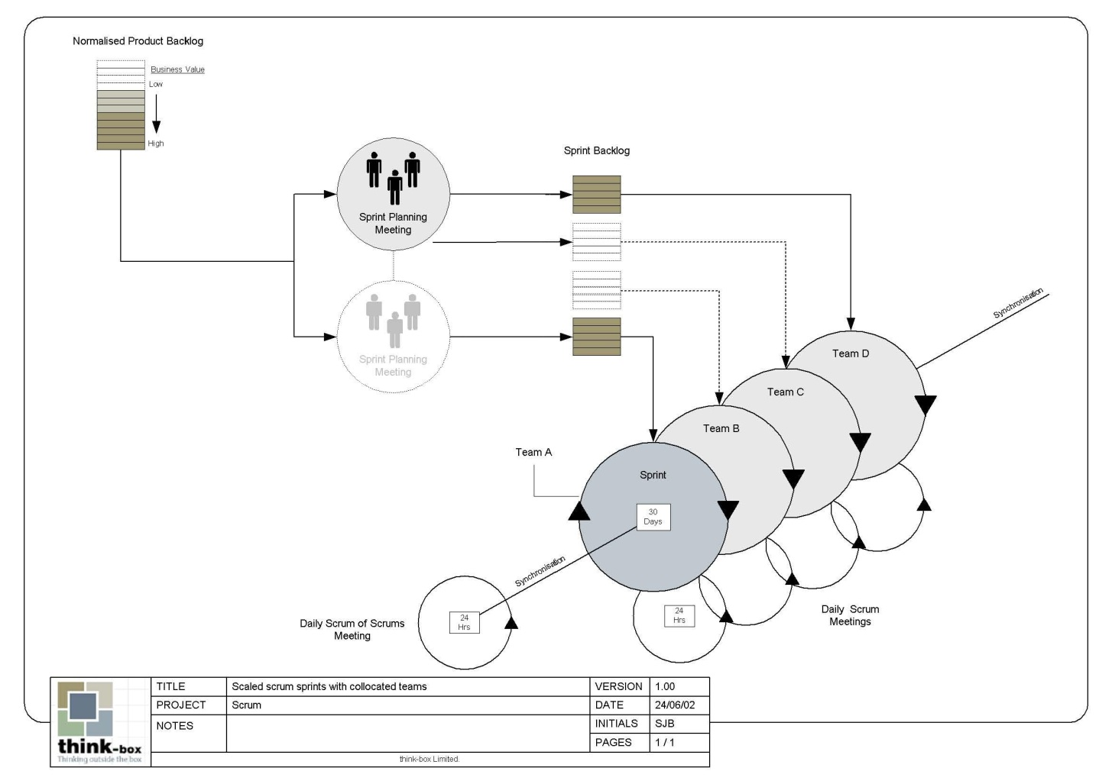
Scaling Scrum

