Slide 1
Agile Software Development
Textbook:
Ch. 3
“Optimism is an occupational hazard of programming;
testing is the treatment.”
-- Kent Beck
Agile Process innovator

Slide 2
Rapid software development motivation
Rapid development and delivery is now often the most important requirement for software systems
Businesses operate in a fast –changing requirement and it is practically impossible to produce a set of stable software requirements
Software has to evolve quickly to reflect changing business needs.
Rapid software development
Specification, design and implementation are inter-leaved
System is developed as a series of versions with stakeholders involved in version evaluation
User interfaces are often developed using an IDE and graphical toolset.

Slide 3
History of SE Methodology
1950’s and 60’s
What is software engineering?
1970’s
Structured programming
1980’s
Data flow diagrams
1990’s
O-O
UML
Notes:
This is a bit oversimplified (major events only) and the dates are more related to popularity than to when a technology was introduced.
Structured Programming -- Dijkstra, Hoare and Knuth
DFD -- Yourdon, Constantine, Shlaer
O-O -- B. Meyer, Booch

Slide 4
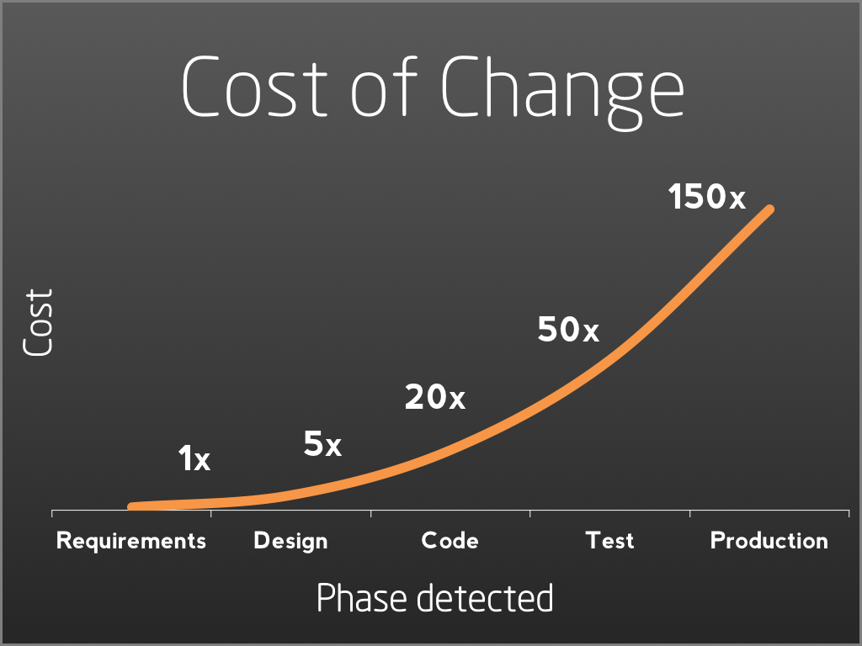

Slide 5
Agile - Another Idea
Traditional SE
- called “monumental”
- predictive
- plan carefully
Agile
- a light-weight methodology
- adaptive
- minimize initial planning
Notes:
Other forms of engineering spend perhaps 10% to 15% on analysis and design. Traditional SE spends perhaps 10% on implementation.

Slide 6
Agile manifesto
We are uncovering better ways of developing
software by doing it and helping others do it.
Through this work we have come to value:
Individuals and interactions over processes and tools
Working software over comprehensive documentation
Customer collaboration over contract negotiation
Responding to change over following a plan
That is, while there is value in the items on the right, we value the items on the left more.

Slide 7
Agile method applicability
Product development where a software company is developing a small or medium-sized product for sale.
Custom system development within an organization,
Where there is a clear commitment from the customer to become involved in the development process
Where there are not a lot of external rules and regulations that affect the software.
Because of their focus on small, tightly-integrated teams, there are problems in scaling agile methods to large systems.

Slide 8
Problems with agile methods
It can be difficult to keep the interest of customers who are involved in the process.
Team members may be unsuited to the intense involvement that characterizes agile methods.
Prioritizing changes can be difficult where there are multiple stakeholders.
Maintaining simplicity requires extra work.
Contracts may be a problem as with other approaches to iterative development.

Slide 9
Problem: software maintenance
Most organizations spend more on maintaining existing software than they do on new software development.
So, if agile methods are to be successful, they have to support maintenance as well as original development.
Key issues:
Are systems that are developed using an agile approach maintainable, given the emphasis in the development process of minimizing formal documentation?
Can agile methods be used effectively for evolving a system in response to customer change requests?
Problems may arise if original development team cannot be maintained.

Slide 10
Technical, human, organizational issues
Most projects include elements of plan-driven and agile processes.
Deciding on the balance depends on:
Is it important to have a very detailed specification and design before moving to implementation?
If so, you probably need to use a plan-driven approach.
Is an incremental delivery strategy, where you deliver the software to customers and get rapid feedback from them, realistic?
If so, consider using agile methods.
How large is the system that is being developed?
Agile methods are most effective when the system can be developed with a small co-located team who can communicate informally.
This may not be possible for large systems that require larger development teams so a plan-driven approach may have to be used.

Slide 11
Technical, human, organizational issues
What type of system is being developed?
Plan-driven approaches may be required for systems that require a lot of analysis before implementation (e.g. real-time system with complex timing requirements).
What is the expected system lifetime?
Long-lifetime systems may require more design documentation to communicate the original intentions of the system developers to the support team.
What technologies are available to support system development?
Agile methods rely on good tools to keep track of an evolving design
How is the development team organized?
If the development team is distributed or if part of the development is being outsourced, then you may need to develop design documents to communicate across the development teams.

Slide 12
Technical, human, organizational issues
Are there cultural or organizational issues that may affect the system development?
Traditional engineering organizations have a culture of plan-based development, as this is the norm in engineering.
How good are the designers and programmers in the development team?
It is sometimes argued that agile methods require higher skill levels than plan-based approaches in which programmers simply translate a detailed design into code
Is the system subject to external regulation?
If a system has to be approved by an external regulator (e.g. the FAA approve software that is critical to the operation of an aircraft) then you will probably be required to produce detailed documentation as part of the system safety case.

Slide 13
Extreme programming
One of the early approaches to agile
Has recently lost favor to Scrum…
Extreme Programming (XP) takes an ‘extreme’ approach to iterative development.
New versions may be built several times per day;
Increments are delivered to customers every 2 weeks;
All tests must be run for every build and the build is only accepted if tests run successfully.

Slide 14
XP and agile principles
Incremental development is supported through small, frequent system releases.
Customer involvement means full-time customer engagement with the team.
People not process through pair programming, collective ownership and a process that avoids long working hours.
Change supported through regular system releases.
Maintaining simplicity through constant refactoring of code.

Slide 15
XP testing difficulties
Programmers prefer programming to testing and sometimes they take short cuts when writing tests.
For example, they may write incomplete tests that do not check for all possible exceptions that may occur.
Some tests can be very difficult to write incrementally.
For example, in a complex user interface, it is often difficult to write unit tests for the code that implements the ‘display logic’ and workflow between screens.
It difficult to judge the completeness of a set of tests.
Although you may have a lot of system tests, your test set may not provide complete coverage.

Slide 16
Test-first development
Writing tests before code clarifies the requirements to be implemented.
Tests are written as programs rather than data so that they can be executed automatically.
The test includes a check that it has executed correctly.
Usually relies on a testing framework such as Junit.
All previous and new tests are run automatically when new functionality is added,
thus checking that the new functionality has not introduced errors.

Slide 17
Pair programming
In pair programming, programmers sit together at the same workstation to develop the software.
Pairs are created dynamically so that all team members work with each other during the development process.
The sharing of knowledge that happens during pair programming is very important as it reduces the overall risks to a project when team members leave.
Pair programming is not necessarily inefficient and there is evidence that a pair working together is more efficient than 2 programmers working separately.

Slide 18
Advantages of pair programming
It supports the idea of collective ownership and responsibility for the system.
Individuals are not held responsible for problems with the code. Instead, the team has collective responsibility for resolving these problems.
It acts as an informal review process because each line of code is looked at by at least two people.
It helps support refactoring, which is a process of software improvement.
Where pair programming and collective ownership are used, others benefit immediately from the refactoring so they are likely to support the process.

