Slide 1
Product Backlog
Textbook:
Ch. 6

Slide 2
Product Backlog
PBI types (extended list)
Feature (User Story)
Change
Defect
Internal (Technical) improvement
Knowledge acquisition

Slide 3
Good PBI characteristics
D
E
E
P

Slide 4
Good PBI characteristics
Detailed appropriately
Emergent
Estimated
Prioritized

Slide 5
Grooming the PB
Name/define three grooming activities
Hint: DEEP concepts
Who makes the decisions?
Who else is involved?
When is it done?
It depends . . .
Continuously?
During sprint review?

Slide 6
Definition of Ready
Ensure top PBI’s are good enough to take action on (to be worked on in a sprint)
Business value articulated
Details understood
No blocking dependencies
Small enough
Acceptance criteria

Slide 7
Estimation in Scrum
Estimation target | Size unit
Product backlog item (PBI)
Task
Fill in the blanks
PBIs are estimated in Story points
Tasks are estimated in hours

Slide 8
Estimation Practices
Estimate as a team
Estimates are not commitments
Focus on accuracy, not precision
Use relative versus absolute sizes
… and why is each important?

Slide 9
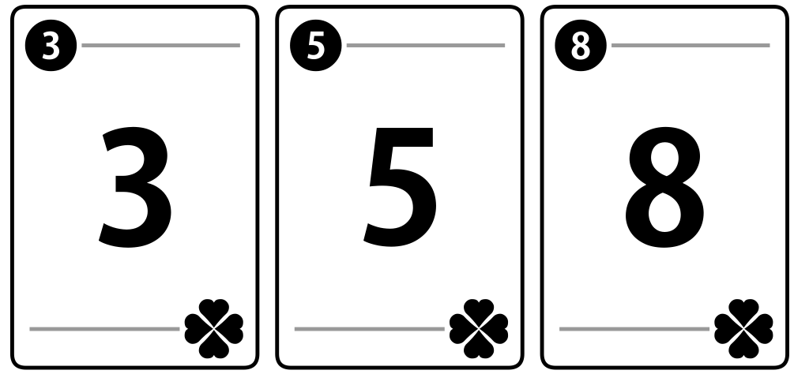
Planning Poker
What is this all about?
Consensus
Expert opinion
Discussion
Relative size
Accurate grouping
Use of history
Why do we do it?
Why the funny values? 1/2, 1, 2, 3, 5, 8, 13, 20, 40, ...

Slide 10
0 - the item is already done or is so trivial it doesn't warrant giving it a finite value; for example, correcting the spelling on a button from “quite” to “quit”. Used for fixing trivial defects.
1/2 - a tiny item - perhaps a minor defect fix, such as catching an otherwise uncaught exception.
1,2,3 - small defects, knowledge acquisitions, or stories that might take from 1 to several hours to fix, research, or implement.
5,8,13 - medium stories (not defects or knowledge acquisition, unless a significant re-write or amount of research is needed).
A 13 is the largest single story that could be completed within a sprint. Anything larger must be broken down into smaller stories.
20, 40 - significant features that would take longer than a sprint to implement
100 - huge sets of features (comprising an entire product release)
infinity - obviously too big to even guess at without further detailed discussion
? - the defect or story under consideration needs further discussion - not enough is known about the story or defect to make sense of it or provide an estimate. More discussion is needed.
pi - not used in SE2800, since you won't be doing day-long or multi-day spring grooming. Used to indicate a break is needed during a multi-hour planning session.
Story points

Slide 11
Estimation Exercise
In your team:
Choose a PBI to estimate
Discuss the item
Each estimator privately chooses a card
Show all cards at once
Check for consensus; repeat if none

Slide 12
Checkpoint
Turn to your partners…
What is good about Scrum planning?
What seems not so good?
What questions do you have?

Slide 13
Playing Planning Poker
In your team:
Choose a PBI to estimate
Discuss the item
Each estimator privately chooses a virtual card
Show all cards at once
Check for consensus; discuss and repeat if none
Planningpoker.com
You can use this site to “play” if you want

Slide 14
Planning
For User stories 1 and 2 (or 3 or 4 or 5) (the ones you are already implementing)
For tasks as well as any defects
Come up with a story point estimate using planning poker
Add up the story points and enter it as the new issue weight, you may add a note to the end of a task about it weight contribution if you like.

Slide 15
Review
Product Backlog Items
Item types used at MSOE
Characteristics of PBIs: DEEP
Grooming, ensuring PBIs are ready
Estimation: Planning Poker

Slide 16
UI Testing in Java
Assumption: painful but readily available
Research: lots of vaporware, abandonware
Many solutions for web, but not a lot for Java
FrogLogic, RAutomation, MarathonTesting, UISpec4J, Mspec, abbot
Method that works:
JavaWorld TestUtils; see also counter.zip

Slide 17
UI Testing in Java
Each component: call .setName with unique string
Test code:
TestUtils.getChildNamed(frame, name-of-child)
Use .doClick, .value(), etc. to exercise code
Robust
Doesn’t depend on screen locations, specialized test frameworks
But no auto-capture/replay

