Slide 1
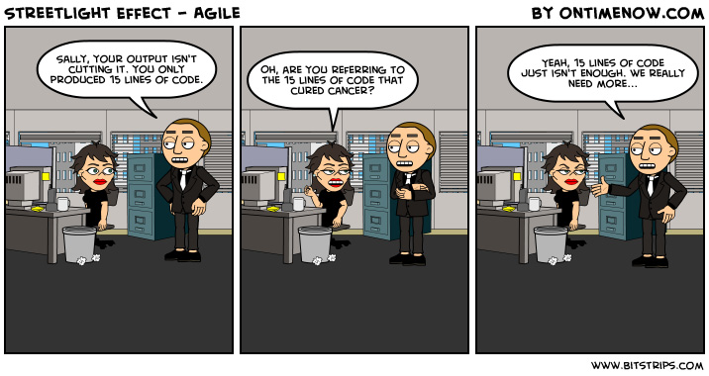
Metrics and Velocity
Textbook:
Ch. 7

Slide 2
Software Product Measures/Metrics
Design Complexity
Algorithmic, architectural, data flow
Code Complexity
Size (Function Pts, SLOC, Modules, Subsystems, Pages, Documents )
Deliverable Quality
Correctness, Maintainability, Reliability, Efficiency, Usability, Flexibility, Testability, Portability, Reusability, Availability, Complexity, Understandability, Modifiability
Error density ( errors/ SLOC )
Defect density ( defects/ SLOC or defects/ FP )

Slide 3
SLOC vs. FP
Relationship between lines of code and function points depends upon
the programming language
the quality of the design
Empirical studies show an approximate relationship between SLOC and FP

Slide 4
SLOC/FP (average)
Assembly language 320
C 128
COBOL, FORTRAN 106
C++ 64
Java 55
Visual Basic 32
Smalltalk 22
SQL 12
Graphical languages (icons) 4
http://www.qsm.com/resources/function-point-languages-table

Slide 5
What’s a metric?
It measures something, like:
The software product
Its quality
Its degree of completeness, so far
Its suitability for some use
The process and people creating it
How close to “on plan” are we?
Tracking how the team is working
Or what our test coverage is
Or how we are cutting risks
It’s a number, a measure, vs some standard
Like “burndown” or “velocity”

Slide 6
The Cone of Uncertainty
4x
2x
1.5x
1.25x
1.0x
.8x
.67x
.5x
25x
Estimate of Variability
Initial Concept
Software Complete

Slide 7
Team Velocity
Velocity is the number of story points per sprint completed
You calculate velocity to predict how much work to commit to in a sprint
Velocity only works if you estimate your story points consistency
Over time you will know: team has a velocity of 32 story points per sprint
Over time this will self-correct
Over time you will be able to predict the project schedule (and release)

Slide 8
Calculating Team Velocity
Select a regular time period (sprint) over which to measure velocity
Add up the story point estimates for 100% completed stories
At the end of the sprint, the figure you have is your velocity
You can then use your velocity as a basis for your future commitments

Slide 9
Re-estimation
As you complete more sprints, velocity changes
Velocity changes because of minor inconsistencies in the story point estimates
Team velocity will typically stabilize between three and six iterations
Re-estimation of the entire project happens after each sprint
New velocity
New story points added and removed (completed)
Use the cone!

Slide 10
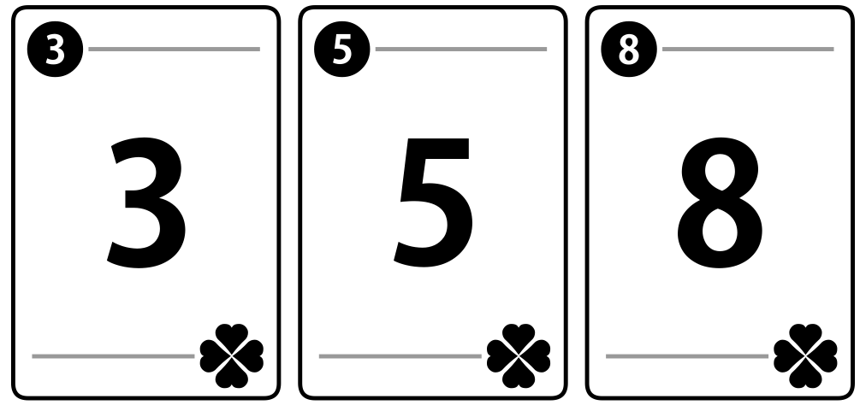
Planning Poker
What is this all about?
Consensus
Expert opinion
Discussion
Relative size
Accurate grouping
Use of history
Why do we do it?
Why the funny values? 1/2, 1, 2, 3, 5, 8, 13, 20, 40, ...
Lets try this out!

Slide 11
Playing Planning Poker
In your team:
Identify the PBI to estimate
Discuss the item
Each estimator privately chooses a virtual card
Show all cards at once
Check for consensus; discuss and repeat if none
Planningpoker.com

Slide 12
Keys to velocity
Can velocity be compared between teams?
Story points are not comparable between teams!
Can sprints have different lengths?
No! This makes velocity to be a useless metric
The only time to vary sprint length: team needs to experiment with different models
NEVER extend a sprint “just to complete one more story”!
What if get to end of sprint backlog before the end of the sprint?
Simply pick up the top PBI and start to work – keep moving forward!
No commitment to finish this!
This is why a sprint’s worth of PBIs should be at the top of the Product Backlog at all times!

Slide 13
Review
Metrics: measurements of a team’s effectiveness
SLOC: possibly useful at a developer level; generally not comparable between developers
Function Points: a more robust measure
Story Points: very useful within a team
Velocity: story points/sprint
Increases in velocity is a worthwhile team goal
Process improvement is a key element of Scrum, so velocity is important!
Not comparable between teams
Relies on consistent sprint lengths

