Slide 1
Definition of Done, Design and Code Reviews
Textbook:
pp. 74-78

Slide 2
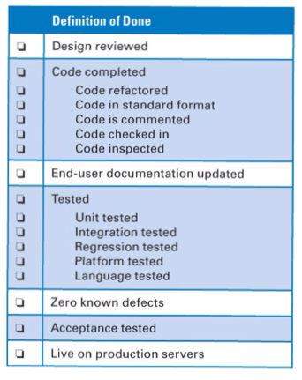
Definition of Done
- When is a PBI done?
- Goal: be “done done”
- “Done” components
Repository usage
Design
Reviews/inspections
Testing techniques & strategies
Integration/build
Textbook, Table 4.1

Slide 3
Code Reviews
How have you (or your team) reviewed code in the past?
How effective are these reviews?
Potential problems
Difficulty in maintaining attention/focus
Knowing what to look for

Slide 4
Types of Code Reviews
Personal review
Code author reviews his/her own work
Peer review
Review by another team member
Inspection
Review by whole team (or subset)
What are the tradeoffs among these approaches?

Slide 5
Code Review Checklists
What is a checklist?
Pre-flight example
Why?
For code:
Based on historical defects
Used to guide review

Slide 6
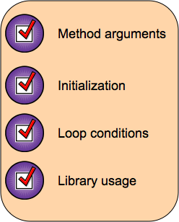
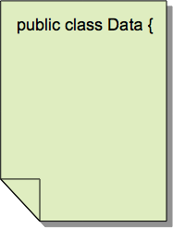
Checklist Usage

Slide 7
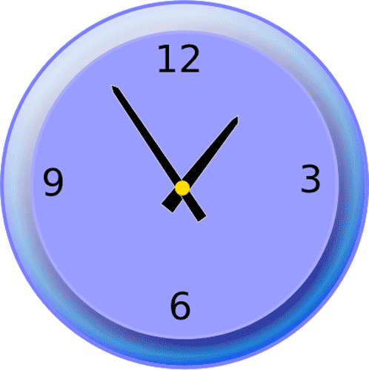
Review Timing
Review code before committing to build?
Ensures review is done
Delay for peer/team reviewers?
Later
May tend to lower priority of review

Slide 8
What About Design Reviews?
What is your experience with reviewing designs?
Have you ever done a design review?
What exactly do you review?
What do you look for?
What kinds of design defects have you found?

Slide 9
Reviewing Designs w/ Test-Driven Development?
Design documentation with "design" tools
Will developers use it & keep updated?
Possible alternative
Embed design specs into unit tests
How does design review work in this case?

Slide 10
Review Team Roles
(Some would call this an Inspection Team)
Review leader
Invites reviewers, possibly including customer
Ensures materials published before review
Ensures review session stays on track
Producer
Person(s) who created document
Recorder
Record notes from review so issues not lost
Generally one of the reviewers
a non-technical person probably won't be able to follow the discussion adequately
Reviewers

Slide 11
Effective Reviews/Inspections
Software Engineering: A Practitioner’s Approach, Pressman, 2005
Review the product, not the producer
Constructive tone, not an inquisition
Producer likely the one to find the most problems!
Do not use review results for simple evaluation
Set an agenda and maintain it
Leader must ensure this
Limit debate
If there’s disagreement, record the issue and move on
Further discussion can happen off-line
Reviews are expensive!

Slide 12
Effective Reviews/Inspections
Identify problems, don’t try to solve them
Short discussion can be fine, but don’t let it bog down the review
Very few good decisions are developed during meetings!
Generating ideas is important and useful during a brain-storming session, but a review is not a brain-storming session
Take written notes
If rely on people’s memories, important decisions will be forgotten

Slide 13
Effective Reviews/Inspections
Limit the number of participants
< three: not enough heads to see problems
Too many: meeting can get bogged down easily
Too many cooks spoil the soup
Formal reviews w/ customer: likely to have more people present, but don’t expect as many errors to be found!
Use a checklist
Helps keep review focused
Allocate, schedule time for reviews
They don’t happen if just “slide them in” to other work

Slide 14
Effective Reviews/Inspections
Limit review sessions to 1-2 hours
Longer: review loses effectiveness quickly
Difficult to schedule long meetings
Large documents: break into pieces, review separately
Train for reviews
Ensure engineers know how to conduct a review
Key issue: review product, not producer
Review early reviews
Make sure your reviews are effective!

Slide 15
Review (of reviews?)
Definition of Done
Caution: start small, extend as needed
“Tested” is too vague; give coverage metric
Name review checklist
Review types
Effective reviews; especially
Review the product, not the producer
Limit debate
Take notes
Ensure a reasonable number of people participate
Allocate time!

