Slide 1
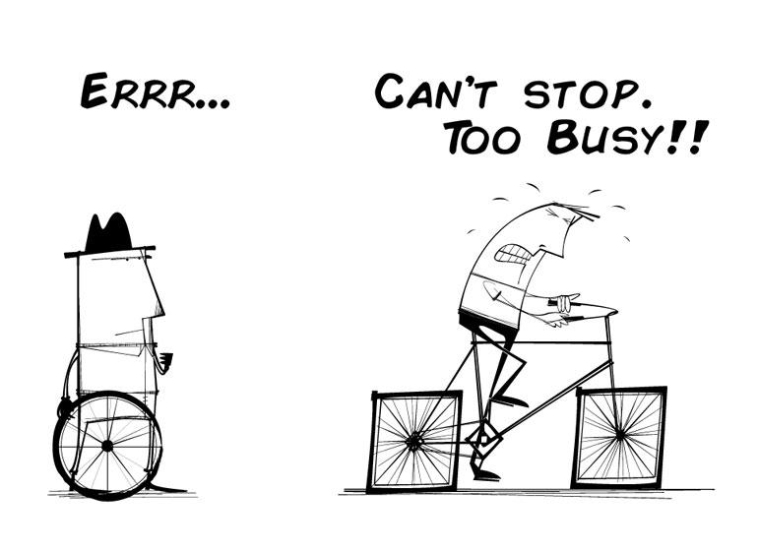
Technical Debt
80% of Americans carry financial debt,
100% of software projects have technical debt

Slide 2
Technical Debt
What is debt (in a financial sense)?
Principal, interest, payments, compounding
What’s the basic idea of “technical debt”?
Additional effort required to “fix” poor designs
Refactoring time
Kicking the can down the road…

Slide 3
Technical Debt Metaphor
What would technical debt look like in a building project?
When new dorms are built for MSOE?
What are the phases of the project?
How could debt be accumulated?
How is debt paid back?
How does accumulated debt affect the project?

Slide 4
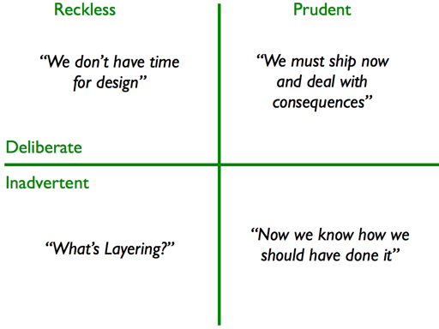
Kinds of Technical Debt
Unfit (bad) design
Defects
Insufficient test coverage
Excessive manual testing
Poor integration and release management
Lack of platform experience
Other kinds?

Slide 5
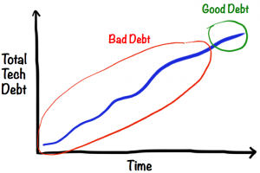
Technical Debt Age
Is old or new debt “better” to carry?
Why?
“A fresh mess is easier to clean”

Slide 6
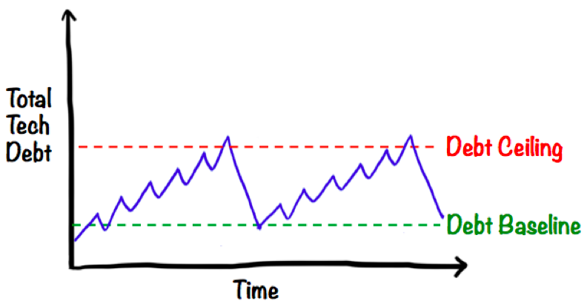
Types of T. Debt
How do the following types differ?
Naive technical debt
Unavoidable technical debt
Strategic technical debt

Slide 7
Consequences of Unaddressed Technical Debt
Increased delivery time
Unpredictable tipping point
Significant # of defects
Decreased customer satisfaction
Rising development & support costs
Universal frustration (morale)
Product atrophy
Under-performance
Decreased predictability

Slide 8
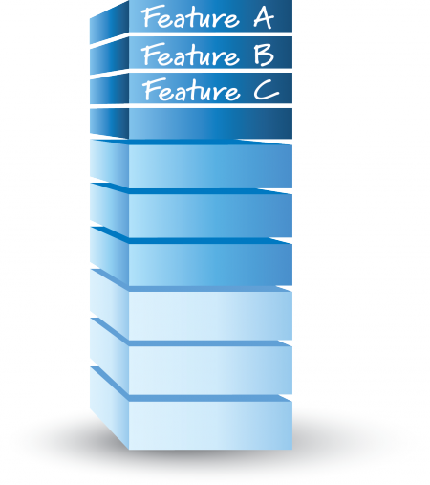
Making Technical Debt Visible
Technical Debt Backlog?
Feature Backlog

Slide 9
Managing Technical Debt
Managing debt accrual | Making debt visible | Servicing the debt
Good technical practices | Visibility at the business level (balance sheet) | Deciding whether to repay
Strong “done” definition | Visibility at the technical level (defects, PBIs, cards) | Repay when found, incrementally, high-interest first
Understanding of debt economics (delay vs repayment costs) | Technical Debt Items in Product Backlog? | Repay while producing value (avoid balloon payments)

Slide 10
Servicing Technical Debt
Sprint PBI’s/Activites
Technical Debt Backlog

