Slide 1
Product Owner & ScrumMaster
Who are these people, anyway?
What are their basic jobs?
Ch. 9 & 10

Slide 2
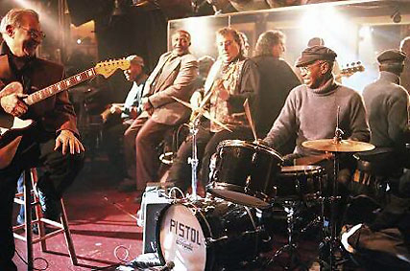
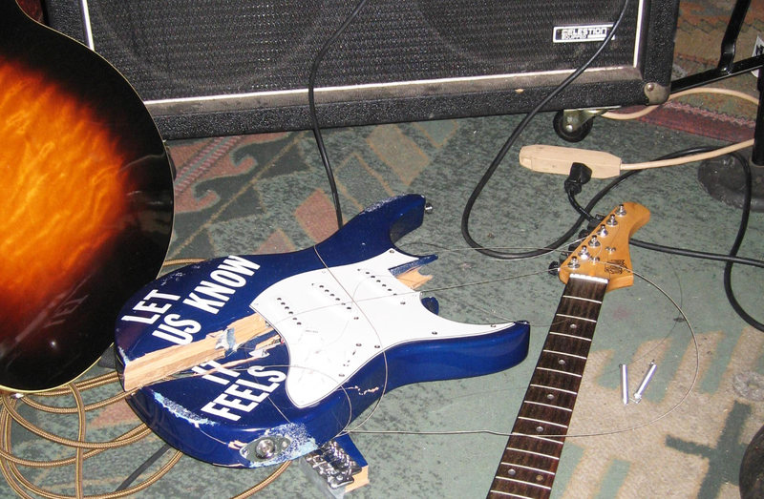
What’s the ideal developer?
What do you look for?
Maybe not…
The Funk Brothers MoTown, ~100 #1 songs

Slide 3
Studio Musicians vs. Rock Stars...
Suggested addition to Agile Manifesto:
We prefer attitude over aptitude
Great value in aptitude, but prefer attitude more
Be willing to learn, open to suggestions
What you know will become obvious
No need to tear down others
Scrum Shortcuts without Cutting Corners, by Ilan Goldstein
Notes:
From Scrum Shortcuts without Cutting Corners, by Ilan Goldstein

Slide 4
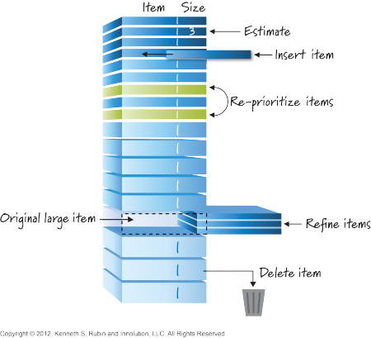
Product Owner Responsibilities
Manage economics
Participate in planning
Groom the product backlog
Define acceptance criteria and verify satisfaction
Collaborate with development team
Collaborate with stakeholders
Not!
Notes:
Economics: release level (opportunities, sprint funding justification, when to quit/ship), sprint level (ensure ROI), product backlog (cost/benefit ratio)
Planning: envision product, define release content)
Acceptance: define criteria before sprint, confirm testing DURING sprint BEFORE review

Slide 5
Product Owner Skills
Domain skills
People skills
Decision making
Accountability
Notes:
Domain: visionary, domain knowledge, business expertise
People: relationships, negotiation/consensus, communicator, motivator
Decisions: empowered, willing to make hard decisions, decisive, economic view (balance technical)
Accountability: accepts responsibility, committed/available, acts like team member

Slide 6
Product Owner - Variations
Combine with other roles?
Product owner team?
Product owner proxy?
Chief (or product line?) product owner?
Notes:
Combine: not with ScrumMaster, maybe PO for more than one team
PO team: need ONE, but may have others for input/guidance
Proxy: balance proxy authority with owner responsibility -- difficult?

Slide 7
ScrumMaster Responsibilities
Coach
Servant leader
Process authority
Interference shield
Impediment remover
Change agent
Notes:
Authority: fidelity to chosen Scrum process

Slide 8
ScrumMaster Characteristics
Knowledgeable
Questioning
Patient
Collaborative
Protective
Transparent
Goal: servant-leader
Leading without authority
drop the ego
genuinely care about team, product
exude confidence & humbleness at same time
approachable at all times
Change without fear
Diplomat w/o being political/manipulative
Behave selflessly, but confident in role
Right hand side: Scrum Shortcuts without Cutting Corners, by Ilan Goldstein
Notes:
Questioning: almost never answer a question directly, but pose them

Slide 9
ScrumMaster - Filling the Role
Who should do it?
Project manager?
Technical lead?
Functional managers?
Full-time job?
Combine with other roles?
Team member?
Serve more than one team?
Product owner?
Notes:
Questioning: almost never answer a question directly, but pose them

Slide 10
Common Team Problems
Ineffective leadership
Leadership must be developed…
Failure to compromise, cooperate
Peer pressure, getting help
Lack of participation
Use personal dynamics
Some work best under pressure
Some like to do all work in advance
Procrastination, lack of confidence
Make decisions in timely manner
Tackle hard problems early
Poor quality
Review!
Function creep
Team decides on new features (with PO!)

Slide 11
Building Effective Teams
Cohesion
Goal: tightly knit team, unified working group
Free, frequent communication
Friendship not required; respect, support
Challenging Goals
Meaningful
Lead to teams which jell
Feedback
Team-based performance, progress evaluation
Avoid pointing fingers!
Common working framework
Must have achievable tasks, clear roles, responsibilities
All: what must be done, when, what order, by whom?

Slide 12
Review
What do we want from developers?
What characterizes a product owner?
What characterizes a ScrumMaster?
How does this work in SDL?
All have same experience: SM rotates
Product Owner cannot be there every week!
Product Owner Proxy: local decision maker...

