Slide 1
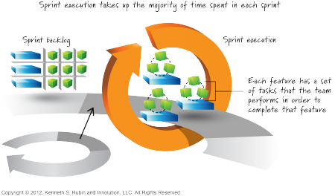
Sprints
Sprint planning
Sprint execution
Chs. 14, 15

Slide 2
Sprint Planning
What are we trying to accomplish in sprint planning?
Goal for the sprint
PBI’s aligned with that goal
Realistically deliverable in the sprint
Plan to complete chosen PBI’s

Slide 3
Timing
When do we do sprint planning?
Why then?
How long should it take (for a full-time team)?
Notes:
When: recurring, just-in-time, at beginning each sprint -- why: best information available then
How long: 4-8 hours for a 2-4 week sprint

Slide 4
Participants
Who is involved in sprint planning?
Who does what?
Product owner
Development team
ScrumMaster
Notes:
Who: whole Scrum team
Product owner: presents prioritized backlog, answers questions
Team: determines what is deliverable, makes a realistic commitment
ScrumMaster: observes, asks probing questions, facilitates, challenges commitment

Slide 5
Planning Inputs
Input | Description
Product backlog | Topmost PBI’s groomed to Ready state
Team velocity | Indicator of how much work is practical to complete (units?)
Constraints | Business or technical
Team capabilities | Team member skills and availability
Initial sprint goal | Product Owner’s business goal for the sprint

Slide 6
Planning Approaches
Two related activities
Choosing what to do
Planning how to do it
How can these activities be arranged?
Choose all items, plan all, repeat till done
Choose one item, plan it, repeat till done
Notes:
Choosing: based on PBI size (story points)
Planning: breaking down into tasks and estimating task hours
All: may have to go back and add/subtract PBI’s after planning initial set
One: Build confidence along the way by planning/estimating each PBI’s work

Slide 7
Capacity
A measure of the team’s capacity to do work
Taking into account “task hours” available
Allowing for planning, review, retrospective
Don’t forget time off, holidays, etc.
Notes:
“Task hours” is not a Scrum term, it is a general software process term, but useful concept

Slide 8
Measuring Capacity
What units?
Story points (PBI size) [velocity?]
Effort hours (task size)
How do we determine team capacity?
What adjustments might be needed?
Notes:
Determine capacity from historical data (do we track hours on tasks?)
Adjust for time off, holidays, other pressing activities
Leave a buffer -- how much?

Slide 9
Selecting PBIs
Seems obvious: choose topmost PBIs!
But what about the PO’s sprint goal?
Why can’t the PO align priorities?
Rule: start only what you can finish
Why?
Notes:
Shouldn’t the PB priorities be groomed in alignment with sprint goal?
But maybe PO can’t predict what PBIs will fit in sprint?

Slide 10
Sanity Check
PBIs
Tasks
Effort hours
Total
Total

Slide 11
Sanity Check
PBIs
Tasks
Effort hours
What about special skills that some tasks may require?
Total
Total

Slide 12
Sprint Execution
Sprint execution planning
Didn’t we just do sprint planning?
Managing task sequence, allocation
Who does this?
Flow management
Parallel work (multitasking)
Swarming: completing high priority PBIs
NOT: “bunch-ball development” – everyone watching one person work
Mini-waterfall – What is this? Why bad?
Notes:
Execution planning: on the fly, but manage task sequence and allocation
Swarming: many team members (possibly not all!) concentrating on one PBI or task set (or a few) – do to complete high
Mini-waterfall (not ideal): doing design for all PBIs, then coding, then testing, etc.

Slide 13
Role-Based Thinking
What does the “testing expert” do before there is anything to test?
Work together in rapid increments?
Develop (by practice during execution) a wider range of team skills?
Better idea: write tests from ACs!
Helps ensure PBIs are well-understood…
Replace “individual” emphasis with ongoing team collaboration – also true for UX, DB experts…
Notes:
Team skills: complete separation of duties/responsibilities is not good for the team or for team members; how do people gain/broaden/develop skills?
Individual: “I got my part done, the rest is your problem” – is not a good approach
This also applies for UI experts, DB experts, etc.

Slide 14
Role-Based Thinking
What does the “testing expert” do before there is anything to test?
Work together in rapid increments?
Develop (by practice during execution) wider range of team skills?
Replace “individual” emphasis with ongoing team collaboration
Using good technical practices is a team responsibility!

Slide 15
Daily Scrum
Daily, 15-minute (time boxed) activity
How does this translate to a course project?
Don’t forget the three questions!
Also: identify “blocking” items that need attention

Slide 16
Task Board
PBIs
To Do
In Progress
Complete

Slide 17
Task Board
PBIs
To Do
In Progress
Complete
Notes:
Physical or virtual task board?

Slide 18
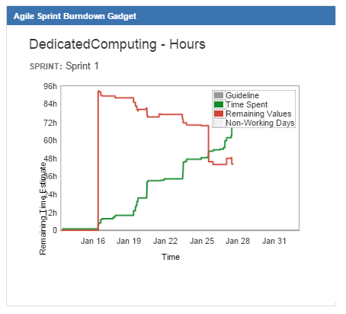
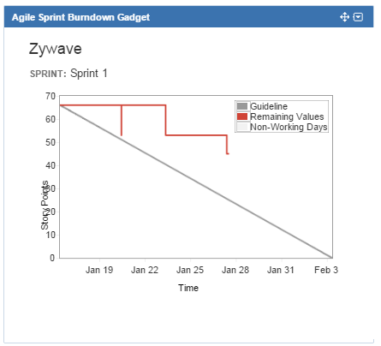
SDL Burndowns
What happened here?
What happened here?

Slide 19
Review
Additional discussion of
Sprint planning
Sprint execution
Tools: divide and conquer, swarming
Monitoring progress

