Slide 1
3. Strategy, Singleton Patterns
SE2811 Software Component Design
Dr. Rob Hasker
Notes:
Ch. 9 of Design Patterns Explained (Strategy); Singleton: Ch. 21, but not material on double-locked
OLD:
Ch. 22 of Java Design Patterns
Reference to “Program to interfaces rather than implementations” in Software Design Principles

Slide 2
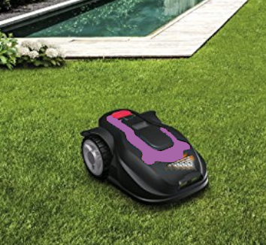
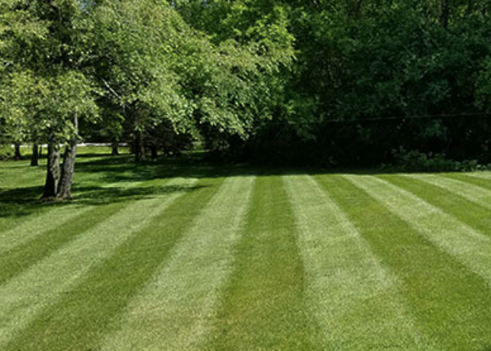

Grassba
Goal: automatically mow your lawn
Issue: need to support different patterns
Classic solution: if statement
Notes:
Maybe you don’t care, but lots of people do!

Slide 3
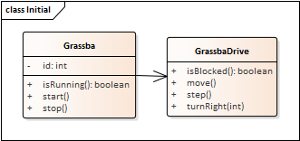
public class GrassbaDrive {
public void move() {
step();
if ( blocked() ) {
if ( style == STRIP )
turnRight(180);
else if ( style == CROSS )
turnRight(90);
else
turnRight(random(180));
}
}
public void turnright() {...}
…
}
But what about more interesting patterns?
What if need to store pattern-specific information?
What if there are large numbers of patterns?
Notes:
Other patterns to suggest: stars, pictures of people, a picture of grassba mowing a lawn

Slide 4
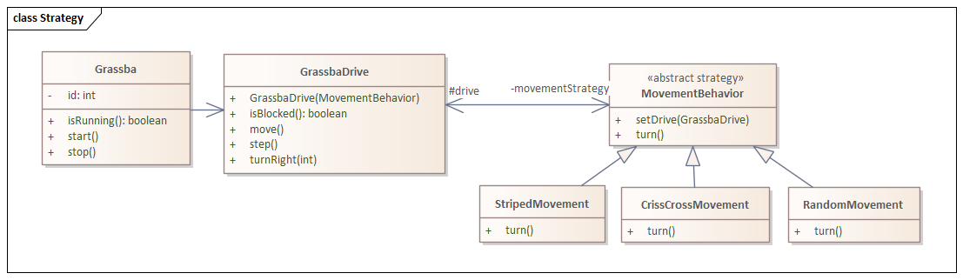
Solution: write a class
public class GrassbaDrive {
public MovementBehavior movementStrategy;
public GrassbaDrive(MovementBehavior s) {
movementStrategy = s;
movementStrategy.setDrive(this);
}
public void move() {
step();
is ( isBlocked() )
movementStrategy.turn();
}
public void turnRight() { … } …
}
public class StripedMovement extends MovementBehavior {
…
public void turn() {
drive.turnRight(180);
}
}
Strategy Pattern: Ch. 14 of Design Patterns Explained
Notes:
Note # indicates an attribute is protected – this is particularly important for the drive

Slide 5
public class CrissCrossMovement extends MovementBehavior {
…
public void turn() {
drive.turnRight(90);
}
}
public class RandomMovement extends MovementBehavior {
…
public void turn() {
drive.turnright(random(180));
}
}

Slide 6
Using the strategies:
GrassbaDrive stripedDrive = new GrassbaDrive(new StripedMovement());
GrasbaDrive randDrive = new GrassbaDrive(new RandomMovement());
// recall the GrassbaDrive constructor:
public GrassbaDrive(MovementBehavior s) {
movementStrategy = s;
movementStrategy.setDrive(this);
}
Why do we need this line?
But what problems does it create?
Notes:
Need the reference back to the container because the movement will depend on sensors, actuators on the Grassba
But needing a reference to the container SIGNIFICANTLY reduces reusability.

Slide 7
Containers and elements
Class Hive {
private List<Bee> workers;
public void addBee(b) { workers.add(b); }
…
}
class Bee {
private Hive myHive;
public Bee(Hive h) { myHive = h; }
…
}
Sensible?
  Sure: bees live in hives
  But consider:
  Bee drone = new Bee(null);
  Drone (male) bees wander
  Effectively need new class for bees that are not in a hive
General issue:
  If element has reference to container, can only use with that container
  This makes reusing the class much harder
  An example of tight coupling
Principle: Avoid having elements refer to their containers
Notes:
Programmers are used to using null for something like a non-existent hive, but it means we are not reflecting the domain!
If the distinction is truly important, create drone-specific classes, but then need worker class; maybe the rule “all bees have hives” is getting in the way of development!

Slide 8
Using the strategies:
GrassbaDrive stripedDrive = new GrassbaDrive(new StripedMovement());
GrasbaDrive randDrive = new GrassbaDrive(new RandomMovement());
// recall the GrassbaDrive constructor:
public GrassbaDrive(MovementBehavior s) {
movementStrategy = s;
movementStrategy.setDrive(this);
}
In this case, strategy must be tightly coupled with GrassbaDrive, so rule violation is ok
Notes:
Need the reference back to the container because the movement will depend on sensors, actuators on the Grassba

Slide 9
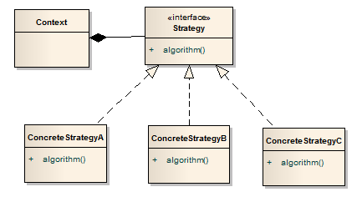
General form
Is there a preference for interfaces over abstract classes?
Elements:
Context: class that encapsulates, uses specific behavior
Strategy: interface that defines the behavior
ConcreteStrategy: implements a specific behavior

Slide 10
When to use the Strategy pattern?
Strategy pattern: a behavioral pattern
  Captures run-time behavior
  Indicator: application requires similar objects whose behavior varies
  But is there another way to capture the different behavior?

Slide 11
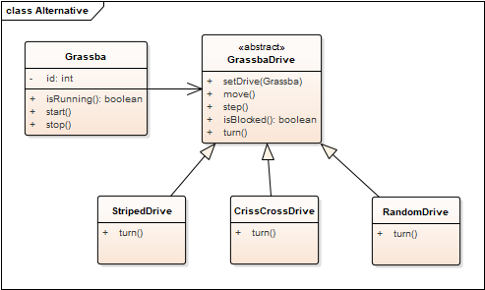
Alternative to Strategy pattern
Have an abstract base class with alternatives
But what happens if add gas engine/electric motor option?

Slide 12
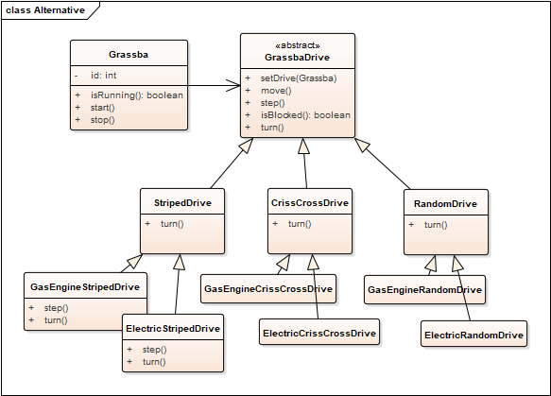
Alternative to Strategy pattern
Have an abstract base class with alternatives
But what happens if add gas engine/electric motor option?
In general: significant code duplication, too many overrides
What is this like with Strategy?
Inheritance simpler in some cases,
strategy pattern better in others.

Slide 13
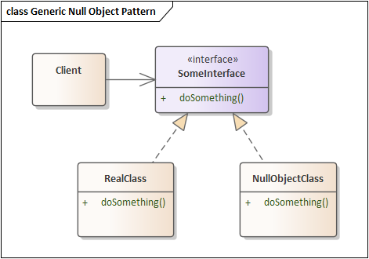
Null Object pattern, reconsidered
How are the Strategy, Null Object patterns similar?
How are they different?
Notes:
A significant part of the course: identify problems and solve those problems using (design) patterns

Slide 14
Exercise
Find cases in which the strategy pattern is used in the Java API
  Especially: JavaFX
Create an example where the strategy pattern is useful in Java FX application code
Notes:
javafx.scene.chart
java checkedinputstream, checkoutputstream

Slide 15
Review
Strategy pattern
  Problem?
  Solution?
  Advantages?
  Consequences?
Principle at work:
  Program to an interface, not an implementation
    Software Design Principles, Ch. 3
    For example, write methods/classes that take Collection<E>, not (say) ArrayList<>
  What does this mean in general?
  Does the Strategy Pattern have more to it than programming to an interface?
  When did you program to an interface in CS 2852 (Data Structures)?

Slide 16
Singleton
Ch. 21 of Design Patterns Explained
Sometimes it is important to have only one instance of a class
  Easy to do of course, just declare a variable in a block
  But what if need global access?
Examples:
  Factory (that creates many “product” instances)
    More on this later!
  Window manager
  Event logger
The challenge:
  Ensure that a certain class has only one instance
  Provide global access to it
Notes:
Singleton: a creational pattern

Slide 17

Question:
How can you prevent any instances of a class from being created?
Don’t write it?...
Tell programmers, “just don’t
create instances”?
Notes:
Telling programmers, “be good” works for a time, but sooner or later someone will make a mistake…

Slide 18
Moving towards a solution…
Restrict the ability to construct more than one instance of a Singleton class
Make the class responsible for keeping track of its one and only instance
Provide a global (static) access method

Slide 19
Basic solution
public class Singleton {
private static Singleton uniqueInstance = new Singleton();
// private constructor cannot be called;
// no instances can be created.
private Singleton() {
}
// return the same instance to all callers of this method
public static Singleton getInstance() {
return uniqueInstance;
}
// add other methods…
}

Slide 20
Example
public class Printer {
private static Printer uniqueInstance
= new Printer();
private Printer() { }
public static getInstance() { return uniqueInstance; }
public void write(String text) {
System.out.println(text); // or something fancier…
}
}
Usage: Printer.getInstance().write(“Hello, Dolly!”);
Usage: ?

Slide 21
Important Concepts
Could you make the constructor protected?
Why a private constructor?
  Instantiating the Singleton class directly: compilation error
    Only the Singleton class can create instances of itself
How can you access the single instance of the Singleton class?
  getInstance() is a static method, so accessible through the class name
    Singleton.getInstance()
    Provides global access to the instance

Slide 22
Alternative model
public class Printer {
private static Printer uniqueInstance; //= new Printer();
private Printer() { }
public static getInstance() {
if ( uniqueInstance == null )
uniqueInstance = new Printer();
return uniqueInstance;
}
public write(String text) {
System.out.println(text);
}
}
Eager initialization
“Lazy” initialization – initialize on use

Slide 23
Eager instantiation has pros and cons
Global/static objects created whether used or not
  Created on application load, before call to main()
If creating singleton object is resource intensive, get delay on start
  Example: object establishes a network connection to a remote database server upon creation
Not all information may be available at static initialization time
  Example: the specific file/database/resource that you are connecting to may not be known at application load time
Win: static initialization is guaranteed to be “thread-safe”
  Relevant for GUI apps

Slide 24
Multithreading
Threads: sequence of instructions that can run on a processor
  Example: thread computing locations of polygons on a 3D scene
Multithreading
  Multiple threads, sometimes one per processor
  Thread A: compute locations of objects on scene
  Thread B: predict if two objects will collide
  Advantage: separate processors can run each in parallel
Classic application: computing spreadsheet in background
Challenge: now have to think of operations happening in parallel

Slide 25
Lazy Initialization with Multithreading
public static getInstance() {
if ( uniqueInstance == null )
uniqueInstance = new Sintleton();
return uniqueInstance;
}
Thread1 | Thread2 | Value of uniqueInstance
Singleton.getInstance() |  | null
 | Singleton.getInstance() | null
if (uniqueInstance == null){ |  | null
 | if (uniqueInstance == null) { | null
uniqueInstance = new Singleton() |  | Object 1
return uniqueInstance; |  | Object 1
 | uniqueInstance = new Singleton() | Object 2
 | return uniqueInstance; | Object 2
A serious problem!
We will return to this later in the term…
Goal for now: introducing the problem

Slide 26
Summary
Lazy versus eager instantiation
  Lazy initialization: create instance when needed
  Eager initialization: instance created at load time, before needed
    And whether or not it is actually ever accessed
Singleton class: encapsulates its sole instance
  Only one instance, has global access
  Wins over public, global variables
    Retain control of the instance
    Can ensure just a single instance
  Issue: often don’t really need just one instance
    Eg: a kitchen in a house…

Slide 27
Patterns of patterns
What patterns have we looked at?
  Null Object, Adapter, Strategy, Singleton
  Will cover many more
  Is there a way to organize them?
Singleton: based on how objects are created
Strategy: how objects behave at run time
Adapter: the structure of objects/classes
Null Object: doesn’t quite fit in any of the 3 primary categories
  Probably closest to behavioral
Will look at more examples in each category
Common feature: all reduce coupling between classes, increase cohesion within classes
Notes:
Will discuss cohesion, coupling further

Slide 28
Review
Strategy Pattern
  Indicator: excessive behavior overrides, code duplication among classes
  Consequence: allows changing behavior “late” – at runtime
  Introduces typically highly-coupled classes to maintain
Singleton Pattern
  Indicator: need single instance of a class (with global access)
  Consequence: guarantee one instance, globally accessible
  Multi-threaded applications: must use more complex solution
  Possible overuse
Creational, Behavioral, Structural Design Patterns
Reducing coupling, increasing cohesion

