Slide 1
11. MVC
Wikipedia Page on MVC
SE2811 Software Component Design
Dr. Rob Hasker (based on slides by Dr. Josiah Yoder)

Slide 2
Model-View-Controller
What is the model?
What is the view?
What does the controller do?
Notes:
Full agenda:
Return Exam
Questions about lab due tomorrow in class?
Threads: Locking on null object
Threads: invokeLater
Threads: The squares example
Decorator Class Diagram
More on Java IO
Class diagrams
Design Principles
in the patterns we’ve seen so far
Compare with alternatives
Decorator vs. array approach suggested in class
Non-decorator array – decorator can be added on without modifying the original hierarchy
Decorator has “before-after” and possibly other combinatorial control that would be hard-coded in array
[Show “screenshot” of discussion from class? Or just re-type?]
Strategy vs. Decorator class diagrams side-by-side
Structural difference (inheritance optional in Strategy pattern?)
Decorator vs. “Strategy” array
Perhaps next:
Coding Starbuzz coffee (?)
Add real patterns
ArrayList – null-checking
Java I/O: Students do coding examples
http://stackoverflow.com/questions/9358821/should-i-extend-arraylist-to-add-attributes-that-isnt-null

Slide 3
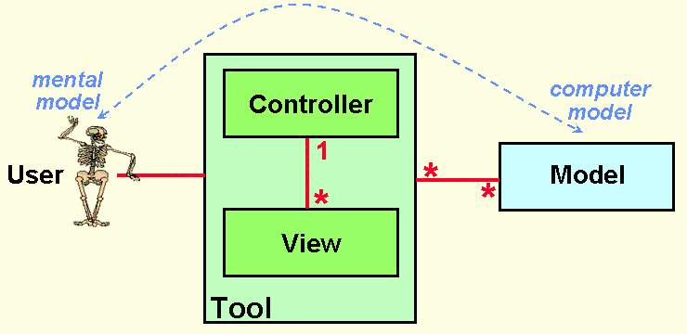
Why MVC?
To support the user’s mental model
http://heim.ifi.uio.no/~trygver/themes/mvc/mvc-index.html
Notes:
Image by a creator/discoverer of MVC

Slide 4
Why focus on models?
How does a vacuum cleaner work?
What does a repair person need to know?
What does an engineer need to know?
Software: provides a mental model
Should reflect the user’s model
User’s model: does not include button logic, scenes, databases

Slide 5
What is MVC?
click, drag, type
display
User
Controller
View
manipulate
update
Model
Notes:
Architectural pattern popular for user interface design

Slide 6
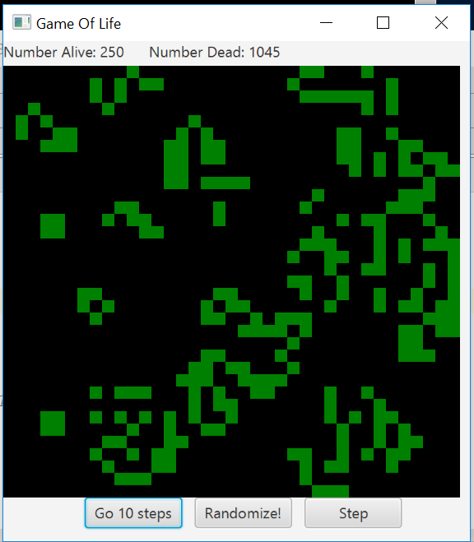
Game of Life
(SE 1021, Winter 2017)

Slide 7
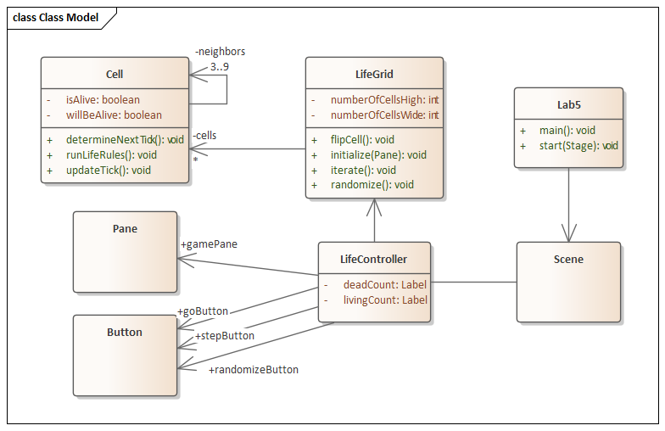
Game of Life
(SE 1021, Winter 2017)

Slide 8
What is MVC (2)
User
display
click, drag, type
forward events
update
View
Controller
manipulate
update
Model

Slide 9
What is MVC? (3)
user clicked, etc.
change . . display
View
update
update
state, . please
Controller
change state
Model
Notes:
Model – The data and “business logic” – how it works
View – What the user sees
Controller – Strategy for handling events / interface between Model and View

Slide 10
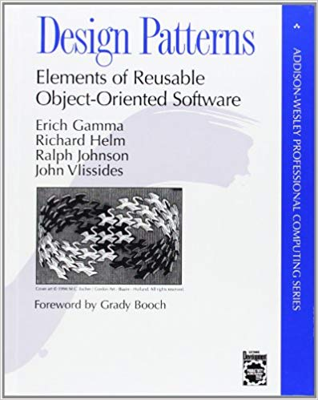
MVC and Design Patterns
From the “Gang of Four”:
“MVC decouples views and models by establishing a subscribe/notify protocol between them [and] lets you attach multiple views to a model”
What design pattern is this?
Notes:
Answer: Observer

Slide 11
MVC and Design Patterns
From the “Gang of Four”:
“Another feature of MVC is that views can be nested.”
What design pattern is this?
Notes:
1 view per form: application is a combination of views
Alternatively: a view for each panel, develop view for the panel that contains those panels

Slide 12
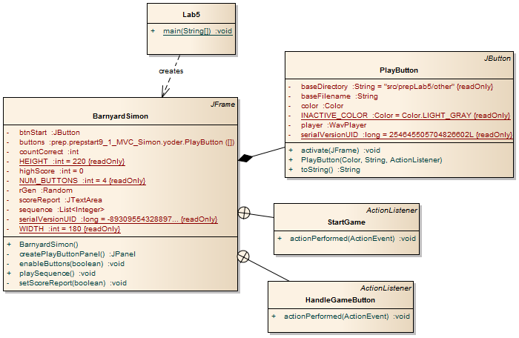
Simon without MVC

Slide 13
Goal: Make web version of Barnyard Simon
RESTful programming – Representational State Transfer
SOAP – Simple Object Access Protocol
HTTP/2 – HTTP for an interactive web

Slide 14
What will go where?
Model
View
Control
Button responses
Sequence
Current position
Scores
Playing sounds
GUI stuff
User selects option

Slide 15
MVC
Model: data, user model
Largely: domain classes + containers
View: display the data
May also include handling user actions
Often: app contains multiple views
Controller: business logic, interface to model
May include handling user actions
Advantages:
Distributed logic
Separate messy display code from the domain implementation
Supports automated testing of model, business logic
Challenges:
Not clear what functionality goes where
Confusing to novice programmers
When to use?
When you want maintainable apps!

