Slide 1
12. Command Pattern
see https://www.oodesign.com/command-pattern
SE2811 Software Component Design
Dr. Rob Hasker (based on slides by Dr. Mark Hornick)

Slide 2
Excise
Excise: actions not contributing to goal
Financial excise: taxes, insurance
Bicycle locks, repairing flats, oiling the chain
Software excise: configuration, manuals
Goal: eliminate excise so user more effective

Slide 3
Sources of excise
GUI excise
Must move/resize window before can do work
Command-line interface excise: learning commands
GUI menus help beginner, intermediate; short cuts & commands for expert
Training wheels
allow dismissing support for beginners
Example: apps that prompt you with “here’s are new features” but don’t remember that you already dismissed them
Example: EA adding sample classes, packages to initial class diagram
Notes:
Power saver notifier: displays message about turning off wireless/Bluetooth/etc at 30% - great idea, just do it; don’t need non-dismissible banner on my nofications page!

Slide 4
More excise
Computer excise
Frequent & expensive updates for security features that affect few users
Visual excise
Work user does to decode visual information
Old software: special icons for beginners
printer icons, fax machines
help beginner, eat screen space for everyone else

Slide 5
Visual Clutter
Notes:
http://www.firemountaingems.com
http://www.harborfreight.com

Slide 6
Visual Clutter
General UX goal:
remove excise
Current (improved) site:
https://www.firemountaingems.com/
Scrolling down several screens:
Notes:
http://www.firemountaingems.com
http://www.harborfreight.com
General UX

Slide 7
Disney Version – 2007 website
Flash-heavy
Each item had very little content
Confusing! Blast vs. ToonTown vs Kids Island?
Where do I go first?
What user goals are reflected?
https://malindalloyd.wordpress.com/

Slide 8
Redesigned Disney website
Icons at top direct navigation
Invites informed exploration
Clues to age groups to explore each
https://malindalloyd.wordpress.com/

Slide 9
Undo
Removing excise: a key part of improving user interfaces
Most of it is just looking at software from different perspectives
Another source of excise: “are you sure you want to do that?”
Annoying at best
Can be interpreted as saying: are you qualified to use this software?
Solution: Undo
Every action should be undoable
Goal of undo: permit exploration
Simple solution: save, restore state
Each action: save state of system before the action
Doesn’t scale: every video edit could require saving gigabytes of data…
Even if have that much memory, undo/redo will be very slow!

Slide 10
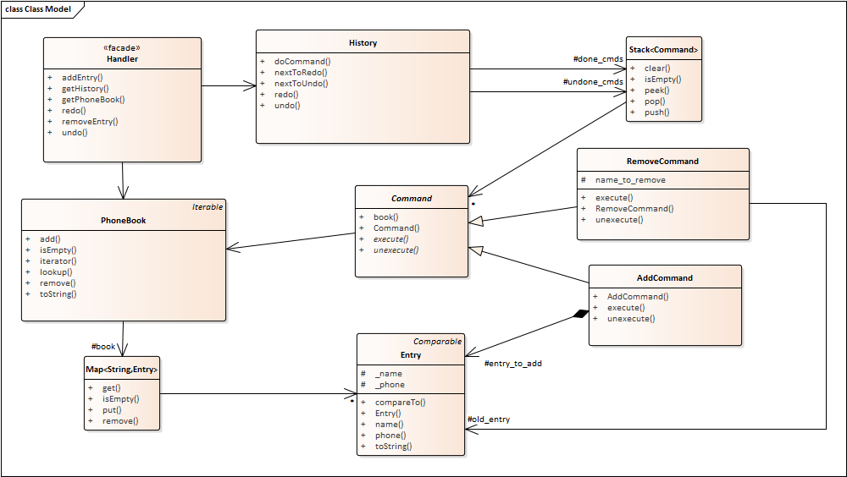
Review: phonebook & commands
What happened when we an entry was added?
What happened when one was removed?
What happened when undoing a remove?

Slide 11
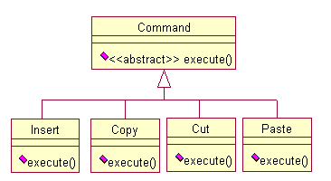
Command Pattern
Basic behind command pattern: store commands as objects
base class defines
abstract execute()
subclasses:
implement execute()
undo/redo: add unexecute
Uses
All menus, buttons, etc. can invoke same action
Stack commands for undo/redo
Share common bits of operations

Slide 12
Command pattern applied
phonebook.java
Core commands: add and remove
Add: book().add(entry_to_add);
Remove:
old_entry = book().lookup(name_to_remove); book().remove(name_to_remove);
2 lists: done_cmds, undone_cmds
clear undone on new cmd
Notes:
Undo for add: book().remove(entry_to_add.name()); Undo for remove: book().add(old_entry);

Slide 13
More phonebook details
Implements GUI/policy/data layers
History part of policy layer, encapsulates undo/redo
Handler doesn’t need to track this!
Phonebook: current contents; Map provides lookup
Add: points to entry so can redo the add
Remove: uses entry in undo

Slide 14
More phonebook details
Issues to decide
What data to store?
Have a few “intelligent” commands, or lots of small ones?
Provide way to group commands into a unit?
Need way to save commands without exposing internal details?

Slide 15
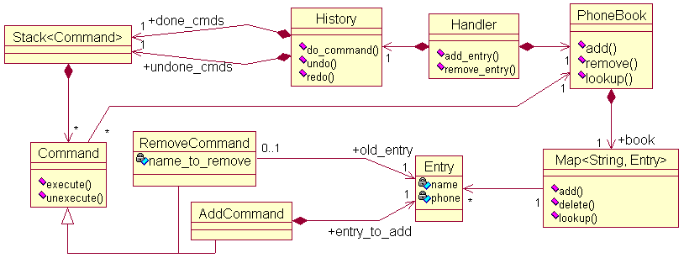
More phonebook details
Other ramifications:
Macro = sequence of commands
User might define own commands & assoc w/ menus
Can log commands to handle system crashes, accountability, etc.

Slide 16
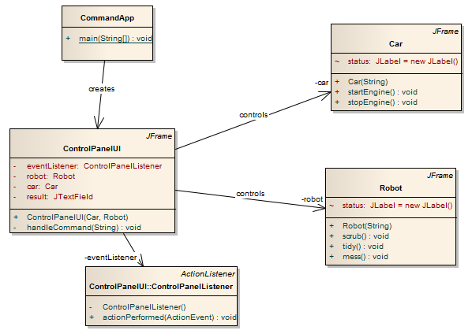
A different application
How to support operations like startEngine, scrub?
Should control panel team implement both?
UI should be independent of actions

Slide 17
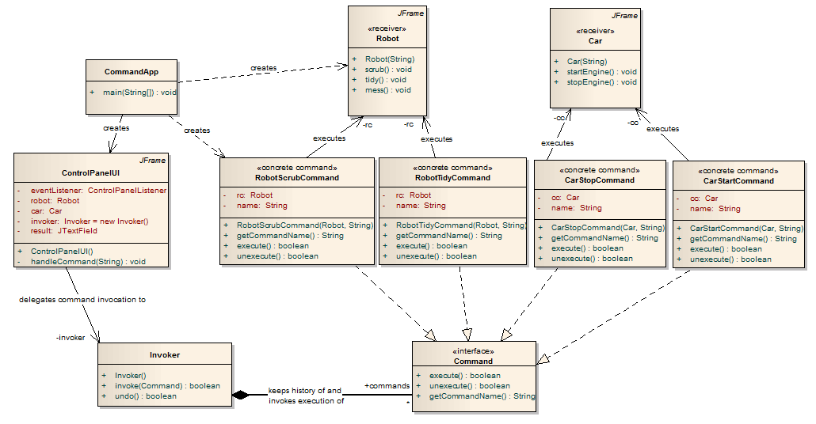
Using command pattern with this

Slide 18
Command Pattern
Move the code in an action into an execute() method in a new class
Derive that class from an abstract Command class
Results:
Can create collections of commands to be executed
Supports undo/redo: eliminating unnecessary “do you want to do that” questions – eliminating excise
Macros: a sequence of commands
Negative consequences? Impact to coupling and cohesion?
Issues: how much data to store in each command? Undo large chunks?
Notes:
Coupling: commands no more coupled with the rest of the system than whatever would have held the actions in the first place; if two commands interact, there may be hidden couplings between their classes
Cohesion: each command has one class to hold it, strong cohesion. Moving some functionality out of original policy class, possibly improving and possibly hurting its cohesion

