Slide 1
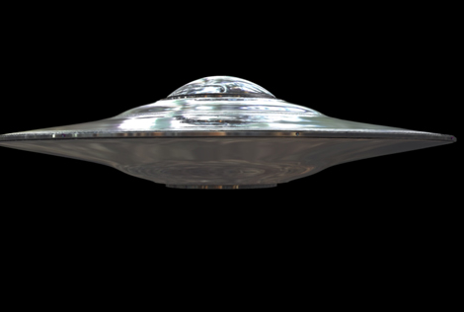
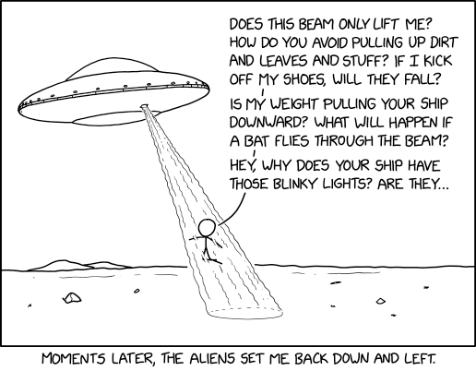
16. Visitors
SE2811 Software Component Design
Dr. Rob Hasker (based on slides by Dr. Mark Hornick)
See https://www.oodesign.com/visitor-pattern
Notes:
https://m.xkcd.com/2579/

Slide 2
Recall the Composite example: computer
Structure
Computer System as a collection of Components (Parts & Composites)
Operations
Compute total price
Compute power consumption
Compute total weight
computer
keyboard
monitor
System Unit
Fan
HDD
Cabinet
Chassis
CPU
Memory
GPU
Motherboard

Slide 3
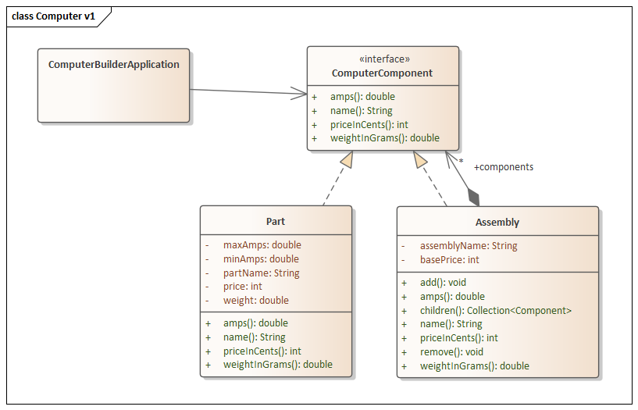
Diagram, code…
class Composite {
…
public void priceInCents() {
int total = basePrice;
for(Component c : components)
total += c.priceInCents();
return total;
}
public double weight() {
double total = 0.0;
for(Component c : components)
total += c.weight();
return total;
}
public double amps() { /*similar*/ }
}
computer
keyboard
monitor
System Unit
Fan
HDD
Cabinet
Chassis
Duplicated code: loops, accumulator
Does not scale
CPU
Memory
GPU
Motherboard
Notes:
Scaling: suppose we add checks for hazardous materials, checks that no price/weight/amp is negative, no composite has empty component lists

Slide 4
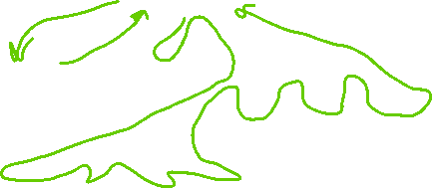
A problem and a solution
Violates DRY: Don’t repeat yourself!
Repeated code: traversing the structure
Solution:
Construct class to visit all the elements of the structure
Visitor: “walk through” the structure, recursively visiting sub-elements
computer
keyboard
monitor
System Unit
Fan
HDD
Cabinet
Chassis
CPU
Memory
GPU
Motherboard

Slide 5
A problem and a solution
Violates DRY: Don’t repeat yourself!
Repeated code: traversing the structure
Solution:
Construct class to visit all the elements of the structure
Visitor: “walk through” the structure, recursively visiting sub-elements
Another case of making an action into a class
Visitor: apply the action everywhere
computer
keyboard
monitor
System Unit
Fan
HDD
Cabinet
Chassis
CPU
Memory
GPU
Motherboard

Slide 6
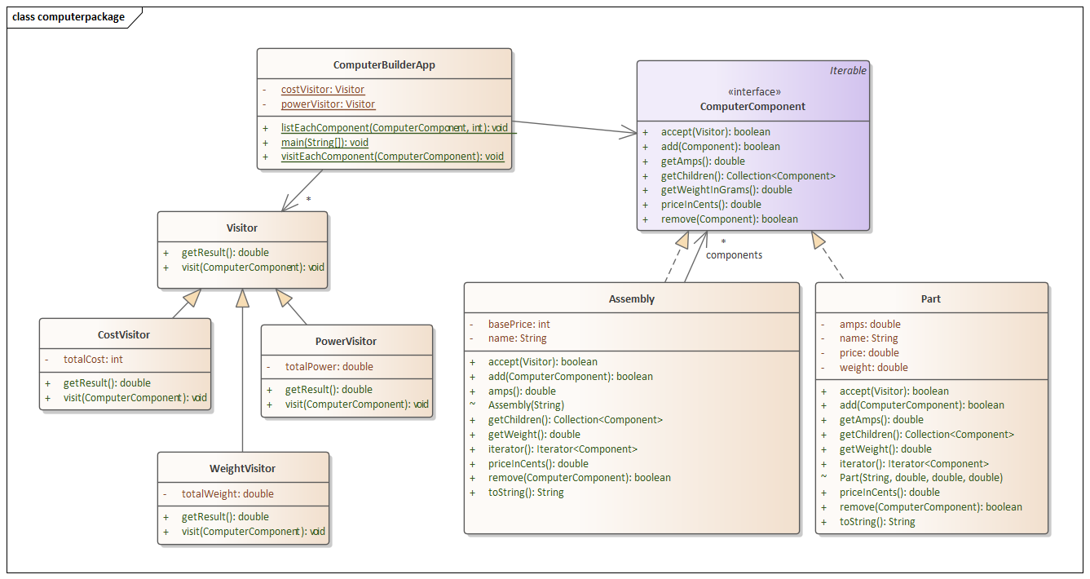
The Visitor pattern in UML:
public abstract class ComponentVisitor {
public abstract void visit(Component c);
}
public class CostVisitor extends ComponentVisitor {
private int totalCents = 0;
public int getTotalCents() {
return totalCents;
}
public void visit(Component c) {
totalCents += c.unitCost();
}
}

Slide 7
The Visitor pattern in UML:
public void visit(Component c) {
totalCents += c.unitCost();
}
abstract class ComputerComponent {
abstract void accept(ComponentVisitor);
}
public class Part extends Component {
public void accept(ComponentVisitor v) {
v.visit(this);
}
…
}
public class Assembly {
public void accept(ComponentVisitor v) {
v.visit(this);
for(Component c : components)
c.accept(v);
}
…
}

Slide 8
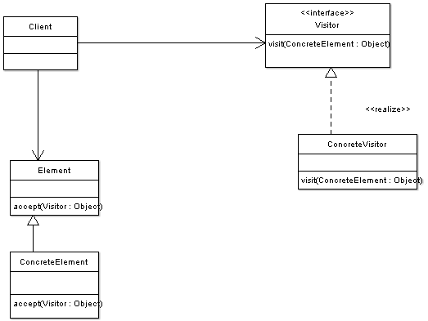
Simple visitor
Client creates visitor to acquire information
Apply visitor to each element
Call accept()
Pass element to accept
Simple case: single ConcreteElement
Element interface modified to allow visitor
ConcreteElement: provides public methods that can be invoked by visitor
Visitor keeps running tally of operations
Example: running total, count of items meeting a condition

Slide 9
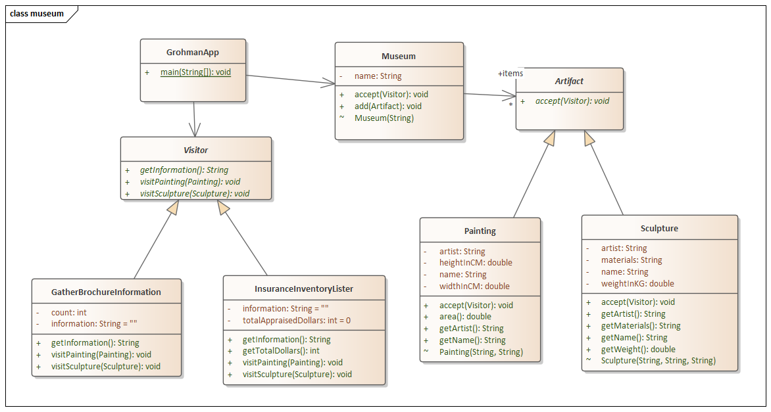
Museum Example: see demo folder

Slide 10
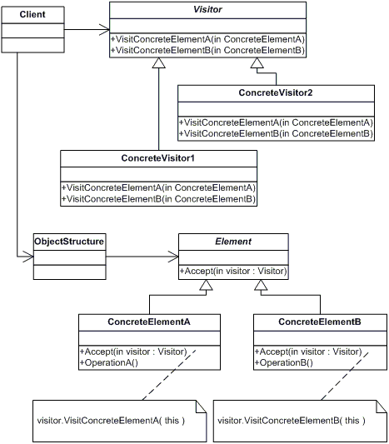
Visiting multiple types of objects
Each Visitor: methods for each type of target
Often used with Composite
Not mandatory!
Client: traverses the hierarchy
Client applies visitor to each element
Each ConcreteElement: make attributes visible to visitors,
Applies visitor

Slide 11
Collaborations
Client
ConcreteElementA
ConcreteElementB
aVisitor=new ConcreteVisitorA()
ConcreteVisitorA
accept(aVisitor)
visitConcreteElementA(this)
operationA()
getResultA()
accept(aVisitor)
visitConcreteElementB(aConcreteElementB)
operationB()
getResultB()

Slide 12
Advantages
Adding new operations relatively easy
An operation for each type of concrete visitor
Great cohesion!
Not repeating code to traverse the data structure

Slide 13
Disadvantages
Many methods to support visitors
Visitor: has abstract visit methods for each type of concrete element
Each concrete element: add accept method
If visitor needs access to hidden data, must add methods to allow visitor to process that data
Code is more obscure
Accept calls visit which calls accept…
Moving domain logic from class to visitor (similar to Strategy Pattern)
Encapsulation can be compromised: adding methods to access/process private data
Can expose internal implementations

Slide 14
Review
Visitor: traverse through nested structure, applying an operation to each element
Useful when have large number of operations to apply to structure
Tracing the visitor call sequence is challenging

Slide 15
So how to design software systems?
Answer the following in small groups and share w/ the class:
What are the elements of design (for software)?
How can we apply those elements to implement requirements?
What are the two forms of requirements?
Not discussed: ensuring testability!
Why start with the domain during design?
What is the goal of applying design patterns?
How should patterns be picked?
How many patterns should we use on a project?
Notes:
Elements of design: identify domain, introduce containers and consider other big-O issues, introduce patterns
Real projects: also design the interface

