Slide 1
SE 3800 Software Engineering Process II
Dr. Rob Hasker

Slide 3
Project: ABL, Automated Bridge Lifter
Hired to design a system to automate raising and lowering bridges for boats
Bridge designed
Multiple traffic, boat sensors available
Budget cuts mean it must be delivered in two years
Ready, set, go!
Now what? Work in teams.

Slide 4
Questions
Did you consider multiple boats?
What if someone is on the bridge?
Are existing sensors adequate?
Likely must use off-the-shelf components
What are the testing requirements?
Do you think the schedule is reasonable?

Slide 5
The course
How would you design a course on software process?
A project in every process?
Problem, there are hundreds of processes...
What would you like to have in the course?
How would you ensure students understand the material?
Notes:
Have students answer these in small groups

Slide 6
Course details
Class roster, attendance policy
Book, schedule, policies, grading
Course web site
Prereq check:
SE 2800, Software Process I
SE 2832, Verification

Slide 7
Curricular Context
1st year: implementation
2nd year: basic elements of SE process
3rd year: project experience
This course: software quality goals and tools, tailoring process to project

Slide 8
Curricular Context
Senior Design
SE 3800 Process II
SE 2800 Process I
Software Development Lab
SE 3821 Requirements
SE 2832 Verification

Slide 9
Course Goals
Build on SE 2800: increase knowledge and skill in following software process
Tailor software process (especially Scrum) to project needs
Add continuous integration, verification, software quality components
Industrial strength tool use
Real-world experiences – mine and yours!
Common theme: reduce risks
Notes:
I’ve done software projects in many industries ranging from cell phone billing to real-time systems for avionics
I do tell several short stories of mistakes I’ve made or others have made – these help you avoid the same mistakes! I don’t expect you to know all of the details, but knowing what NOT to do is an important part of software engineering...

Slide 10
A new process: YOGA
You only Go Ahead
10 Principles
Ignore the past, only look ahead
Be artists, free to create
Meditate on code each day: what to fix?
Daily meeting: discuss meditation results
Flexibility: choose a change of the day
Rotate often: switch roles for flexibility
Strengthen your core: exercises for the developers that make 80% of all changes
Improve balance: one foot stance at mtg
Salute the sun: celebrate yesterday’s changes, ensure enough food and coffee to for the day
Relax: stop thinking about code, chant UUUMMMLLL

Slide 11
Textbook: Scrum Shortcuts
Addison Wesley, 2014
“an approach rather than the approach to implementing Scrum.” (p. xix)
Scrum is a framework; organizations can and must specialize to their needs
Key questions: what’s mandatory?
What can we change and still be effective?

Slide 12
Tools
Google Test
Test automation
Make
GitLab, Pipelines
Cucumber, behavior driven development

Slide 13
Course themes
What is Scrum, exactly?
What can we change
What are things we want to not do?
How would you introduce Scrum to an organization?
How to improve your use of Scrum
How to solve the “it works on my machine” problem?
Building effective automated test environments

Slide 14
Other topics
Are there other ways to develop software?
Can we get customers to write some of our tests?
How to ensure the development environment is the same as the production environment?

Slide 15
SE 2800 Review
What do you remember from SE 2800?
Process models?
Software development activities?
Scrum process?
Teamwork issues?
What do you think wasn’t precise in 2800?

Slide 16
Scrum Refresher
Who are these people?
Product owner
ScrumMaster
Development team
Give short definitions!

Slide 17
Scrum Refresher
What will be developed, and in what order
Who are these people?
Product owner
ScrumMaster
Development team
Guiding team on creating, following process; removing impediments
5-9 people: determines how to deliver what product owner requests.

Slide 18
Scrum Refresher
Who are these people?
Product owner
ScrumMaster
Development team
Is the product owner the only interface to the customer?
How to qualify as ScrumMaster?
How to approach being ScrumMaster?
Scrum Team

Slide 19
What is the product backlog?
What qualifies as a PBI?
Who manages these?
What is “grooming”?
How are PBIs ordered?
How are PBIs estimated?
Differences on internships?

Slide 20
Reviewing Scrum Activities
The Scrum activity cycle
Pair Exercise:
Draw picture

Slide 21
Reviewing Scrum Activities
The Scrum activity cycle
Sprint planning
Sprint execution
Daily scrum
What are some issues that this does not clarify?
What needs to change about Scrum for SDL?
Sprint retro-spective
Sprint review

Slide 22
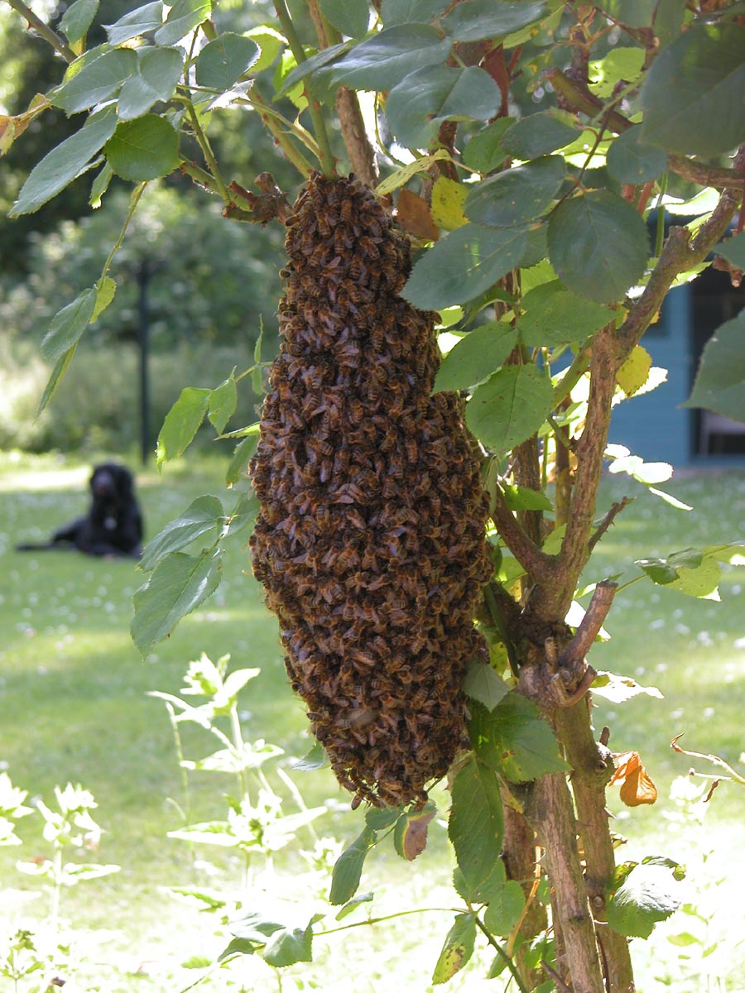
What is swarming?
An exercise in “bunch ball” – everyone just watching others do work?
Not very efficient use of time!

Slide 23
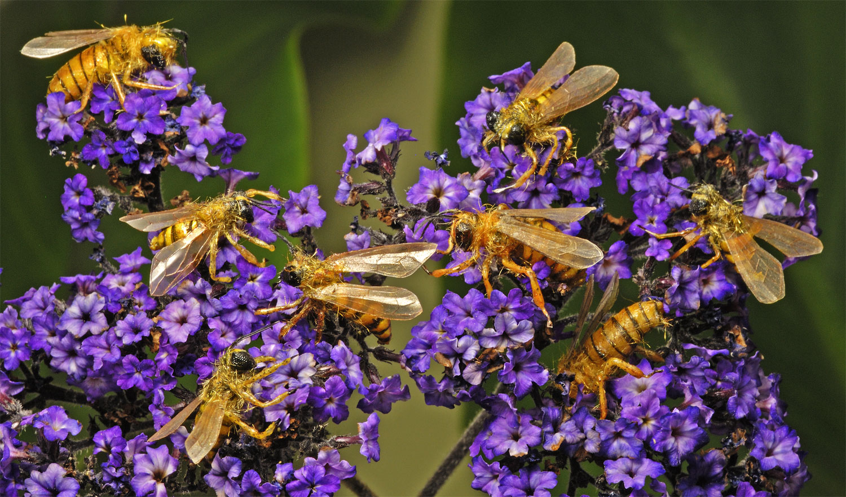
What is swarming?
More effective image – everyone doing their own tasks to get the work done

Slide 24
Effective swarming
Need to ensure high priority PBIs finished by end of sprint
Procedure
Monitor progress; engage when becomes clear will not finish all PBIs by end of sprint
Pick highest priority PBIs that can be completed
Move developers from lower priority PBIs to higher ones
GOAL: complete PBIs

Slide 25
Review
Course goals
Scrum roles
Scrum activities
Product backlog
Next class: Read Ch. 1, Shortcuts 1 & 2
Start Assignment 1

