Slide 1
SE 3800 Note 3 Ch. 4, 5
Dr. Rob Hasker

Slide 2
Upcoming…
Last week of term: book presentations
Based on technical on software process you might read for work
Examples:
agile practices
interviews
software design
analysis patterns
Just read portions you are presenting
Start thinking about a book now
Will select book about week 6

Slide 3
Today: Story Time
What are the elements of a Scrum story?
As a <user>, I want to <action> because <reason>.
Acceptance criterion – when stakeholder satisfied
In contrast, a standard requirement:
The system shall allow the user to export the grade data as a .CSV file.
The MSOE scale shall be used to compute grades from percentages.

Slide 4
Today: Story Time
What are the elements of a Scrum story?
As a <user>, I want to <action> because <reason>.
Acceptance criterion – when stakeholder satisfied
How does a story differ from a requirement?
 | Requirements | Story
Form
Detail
Size
Readiness check
Estimation
Errors?

Slide 5
Today: Story Time
What are the elements of a Scrum story?
As a <user>, I want to <action> because <reason>.
Acceptance criterion – when stakeholder satisfied
How does a story differ from a requirement?
 | Requirements | Story
Form | “shall” | (above)
Detail | not said = not done | promise to discuss details w/ customer
Size | each has small scope | ?
Readiness check | ? | INVEST
Estimation | person-effort-hours | Story points
Errors? | Rework/renegotiate | Add to backlog

Slide 6
Sprintable stories
What, not how
Capture important detail, but no analysis paralysis
Not: must leave all details unstated…
I
N
V
E
S
T
Independent
Negotiable
Valuable
Estimatable
Sized appropriately
Testable
Why should one story (or PBI) never fill a sprint?
Why each?
How do acceptance criteria play a roll?
Notes:
Independent: independent of other stories in same sprint (CAN assume previous stories), use explicit references if needed
Key issue: sprintable – stories at top of backlog need to meet full criteria (with stories IN the sprint backlog also being estimated and tasked)
NOTE: other textbooks use “small” for S, which is ok as long as one understands that “small” means “small enough to be sprintable”

Slide 7
Example
As a locksmith, I would like to be able to enter a code from a database into the door keypad so I can help residents get into their house when they forget the combination.
Acceptance criteria:
Given the lock code is in the database
When I look up the code for lock #921
And I enter that code into its keypad
Then the lock opens
Also need error cases (lock not in database, wrong code entered)
Notes:
How does this meet INVEST?
Note that we need to know what happens if the lock isn’t in the database or the wrong code is entered.

Slide 8
Example
Consider the story… [to be written]
Notes:
Include a fixable story.
Acceptance criteria: “Given a 12, when a 13, then display the sum as 25.” (illustrating rules of grammar - need better example,
But don’t violate grammar)

Slide 9
Example
Consider the story
As a developer, I would like to build an Android project so I can estimate PBIs for the Android platform.
How does this meet INVEST?
How to fix?
Known as a spike solution
Designed to address a specific problem
Notes:
Minimal independence (other Android stories guaranteed to depend on it); minimal value (why not hire a programmer who knows this?); not estimatible (when done?); not testable; developer is never a user. Fix: specify application to build, probably as acceptance criteria. Probably drop the story format in this case – developers are not users, estimating PBIs are not user goals – not everything is a story!

Slide 10
Spike Solutions
Also known as a prototype
Often: user interface prototype
Are these useful?
More generally: build what’s needed
Basic goal: reduce risk
UI risk: developing the wrong app
Technical risk: don’t know how to use tool, tool won’t work
Performance risk: tool too slow for job
Notes:
Useful: probably not given GUI apps, CSS, other tools to quickly change the UI.

Slide 11
Spike Solutions
Spike: tight scope, address question ONLY
Science experiment: hypothesis, method, evaluation
Clear goals + clear termination + recorded results
Examples:
Build Android app with a text box, button, and have it write the box to the database
Build application to confirm graphics API will display 5000 triangles in 10 ms.
Build a standalone LDAP login interface to ensure you can communicate with the LDAP server
Notes:
Useful: probably not given GUI apps, CSS, other tools to quickly change the UI.

Slide 12
Spike Solution/Prototyping Rules
Do not build out any more than needed to answer the question
Minimal design, no documentation
No testing, no standards – hack it out!
No code should move to product without a careful rewrite
Must design with team input, meet standards
If you don’t build one to throw away, you will anyways.
Notes:
Note: this spike solutions often happen in industry long before most team members involved in the project

Slide 13
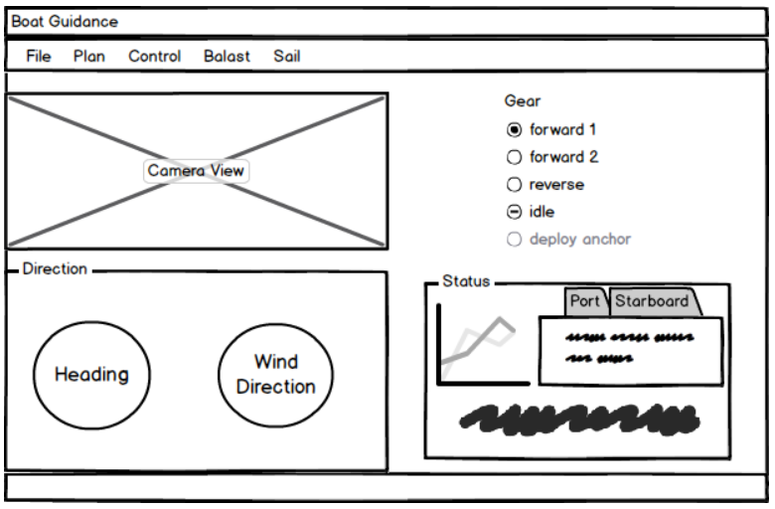
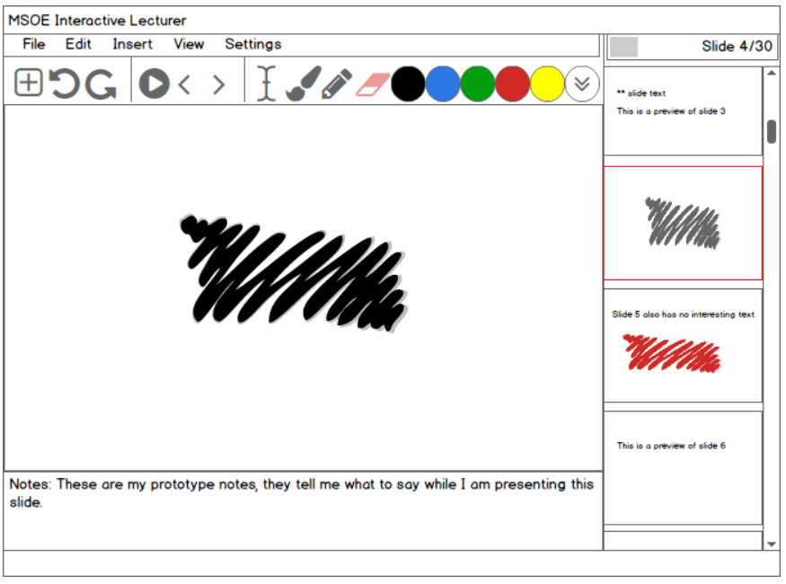
Wireframes: Low vs High Fidelity
Higher fidelity
Low fidelity
(These are from Balsamiq, but
there are many alternatives)
Notes:
Can also generate these using a number of different tools

Slide 14
Shortcut 10: Story Telling 102
What is wrong with the following sequence of PBIs?
How else to break down the work?
Write functional tests
Generate test data
Develop database layer
Develop business logic layer
Develop UI layer
Automate functional tests
Really, tasks!
Vertical stories

Slide 15
Shortcut 10: Story Telling 102
If vertical tasks are better, why not keep splitting stories until each is very small?
Cohn: Customer must be able to assign value to the story
Are the tasks truly independent – can they be prioritized on their own?
How do we handle technical debt stories?
Try to move them to tasks w/in a story
If it is a PBI, must it follow the story format?
Give examples of technical debt!

Slide 16
In-class Exercise
Interest in delivery-by-air for individual packages
Requires customer to be present
Write stories to specify when customer can take delivery, ensuring package arrived
(No acceptance criteria for now)
Notes:
Consider having them write these to Slack or Blackboard discussion groups.
If long AC, probably an epic!
Application that works well: restaurant serving food and beverages to folks in ice fishing houses on a lake

Slide 17
Acceptance Criteria
A simple format for acceptance criteria:
given [condition]
when [condition]
then [result]
Example:
given the system has asked the user for a delivery
address and delivery time
and that user entered that address
when the user clicks on “order”
then the system schedules the delivery at that address&time
Helps ensure they are adequately rigorous
Not necessary for all projects, but should be considered the default!

Slide 18
Add Acceptance Criteria for Delivery-by-Air
Will likely need a “dictionary” describing terms!
Is this story sprintable?

Slide 19
Shortcut 11: DoD
Ch. 4
Where does DoD apply?
Why need careful definition of done?
At the start of the project, how long should it take to write the DoD?
How does DoD differ for the following?
programming tasks?
user story readiness?
user story completion?
release?
What is the recommended starting DoD for PBIs?
Key: feature not done until ready for production release
Notes:
Elements to consider putting into the first DoD: pass tests, including integration tests; deployment scripts updated; approved by PO/POP; end-user documentation written & reviewed; localization in place and reviewed; demonstrated to full team
Textbook: DoD is like cooking: you can always add salt, but it’s hard to remove it; it’s hard to remove things from DoD, but you can always add!

Slide 20
Shortcut 11: DoD
What are issues to consider beyond “does it work”?
When should a requirement be part of the acceptance criteria or the DoD?
Why not throw in the kitchen sink?
RCI definition (2017): All tests pass.
scalability
portability
maintainability
security
extensibility
interoperability
Notes:
The “all tests pass” criteria presumes the team has operationalized non-function tests (response time, security) and that maintainability, etc. also have measurement tools

Slide 21
Shortcut 12: Walkthroughs
Walkthroughs: intra-sprint activities to ensure stories are as intended
… more useful in industry – skip in 3800 …

Slide 22
Shortcut 12: Walkthroughs
Goal?
When do they occur?
Are they mandatory?
Why have them?
Why aren’t reviews enough?
What are issues to watch for?

Slide 23
Shortcut 13: Estimating
Is estimation necessary?
#1 retrospective recommendation
“Need better estimates”
Why might that not be the most important process goal?
Is it wrong to ask teams to reevaluate estimates?
What is the estimation scheme used in 2800?
What is relative estimation? Why?
Notes:
Estimation scheme in 2800: Fibonacci-based story points (1/2, 1, 2, 3, 5, 8, 10, 20, 40, infinity, pie);
Asking teams to reevaluate estimates is important so that that skills improve: you do need estimation skills, it’s just that the consequences of getting it wrong can be minimized.

Slide 24
Shortcut 13: Estimating
Relative estimation in software
What is velocity?
Why might it not be useful?
Complexity
Repetition
Risk

Slide 25
Shortcut 14: Planning Poker
Why use the Fibonacci story point numbers?
What’s an alternative?
How do we do a session?
Why must everyone participate?
PO describes PBI
Members place card face-down
Simultaneous flip
How to agree?
Reselect cards & repeat
Go to next PBI

Slide 26
Shortcut 14: Planning Poker
When should planning poker occur?
What’s a team warm-up?
Why remove 20+, ½ playing cards?
Why not remove them?
What to do if no consensus?
What are some of the benefits of PP?
Why is it necessary to time-box PP?
Notes:
basic model for planning poker: if have disagreement, have the high and low explain their estimate and then repeat process

Slide 27
Estimating exercise
Form group of 4-6
Use planning poker model to estimate one of following:
length of Mississippi river from the Chippewa National Forest to the gulf
number of miles of streets in Milwaukee
square miles of continental US
population of Kansas
Notes:
have them download a planning poker app while they’re at this – I use Scrum Poker, but others might be better
alternatives: number of hours to watch all harry potter movies with credits: 19 hrs, 41 minutes
miles of streets in milwaukee by http://city.milwaukee.gov/cityclerk/LRB/AnswerstoFAQ#.Vm5QZhorLUo - 1,450.5 miles of streets

Slide 28
Shortcut 15: Estimating II
Issue: how to map old estimation scheme to new
Not relevant for students - skip

Slide 29
Chs. 4, 5 Review
Structuring stories
goals, breaking into tasks, technical issues
Definition of done
Starting point, multiple levels, DoD vs. acceptance criteria
Goal for stories: feature ready for production release
Estimating
Why, relative estimation, influential factors
Planning Poker at Pace
Mechanics, warm-up, spinoff benefits

