Slide 1
SE 3800 Note 4 Ch. 6
Dr. Rob Hasker

Slide 2
Waterfall model
What is it?
Draw a picture!
What are the problems?
Notes:
Have students label boxes (planning, reqs, design, implementation, test)
Point out curriculum goes backwards through this list
Discuss problem with testing at end (why was it there? To convince people to test, but it was frequently dropped when schedule slipped)
Move testing throughout; testing reqs: validation, functional; testing design: prototypes (with discussion of what this means – not just UI prototypes)
Relabel last box “maintenance” – this leads to next slide

Slide 3
Shortcut 16: Creeping bugs
Programmers build entire system
Testing team verifies system
Maintenance
Squishing bugs in the waterfall model:
Programmers fix bugs
Testers verify fixes
Software released
Users identify bugs
Bugs verified, documented
Bugs prioritized

Slide 4
Terminology
A history of bugs
Early use of “bug” in modern computing:
Term implies they creep in to software
Recommended: “fault” or “error”
But “bug” works if you accept responsibility!
Harvard Mark II project
Story popularized by Admiral Grace Hopper
See https://en.wikipedia.org/wiki/Software_bug
Notes:
Goal: discuss how “bug” may not be appropriate, but acceptable as long as you take responsibility

Slide 5
Terminology
Textbook: issues vs. bugs
Issue
Problem found during story development
Generally, just fix it - don’t create PBI!
If need documentation, extend acceptance criteria – until fixed, story is not done
Bugs
Fault identified after story delivered
Usually found by users
Create a PBI to track
OK to not follow story format
Notes:
Not a universal distinction, but the difference in fault types is useful to name

Slide 6
Scrum principles & Bugs
Remove red tape
Don’t spend longer documenting bugs than fixing them!
Address issues “immediately”
The longer you wait, the harder it is to work out the logic
It ain’t over ‘till it’s over
Issues mean story not deliverable
Undeliverable stories are not done
If you don’t have a test, you can’t know if done!
Notes:
Agile principle at work: “working software over comprehensive documentation”
Importance: developers reluctant to use scrum can use the threat of 10-page documents for each bug as a way to keep organizations from moving to scrum; author’s point is that while Scrum can be read as “create a pbi for every fault”, that is NOT the intent.

Slide 7
What to do about it?
Exploratory testing failure
Walk over, tell the developer
If the story is this close to being done, it should be a top priority, so fixes are top priority!
Developer deep into another story
Don’t interrupt flow!
Acceptance testing finds a number of small issues
Document as acceptance criteria with details
Discuss with developer when free
Light-weight solution: document as single PBI
Only works if all at same priority & related
Critical production bug found during sprint
Check: can it wait? – Fixes often make problems!
Will it fit in “slack”? Or close out sprint now?

Slide 8
Shortcut 17: Love for Testers
Goal?
What’s success for testing?
CANNOT test all cases: see dont-shoot-the-puppy
What makes a good tester?
Systematic, but pursues “smells”
Learns to apply principles to find problems
Focuses testing around a theme, mission statement
Time boxes sessions, side trips
Thinks about what experts, novices will do
Checks out similar, competitive applications
Concern: no room for testing experts in Scrum
Crispin & Gregory, 2009
Notes:
Motivation: through the 90s, popular to have separate testing team; if scrum requires firing testers (since all must be able to code), that can be used to keep scrum from being adopted. My goal: to discuss what is going on with testing and testers in more detail.
Don’t shoot the puppy: how would you full test this (very simple) game?

Slide 9
Shortcut 17
Testers in waterfall model:
Independent, high-value
Scrum: tester in team – loss of prestige
Fears
Loss of QA identity
Concern can’t become developers
Loss of support & community
Cause: different mindset
A successful test is one that fails!
Development is constructive, testing destructive

Slide 10
Shortcut 17: Tester Roles
Testers as consultant
Improve quality of tests written by developers
Pair testing: write tests in pairs
More useful than pair programming?
PO: use tester to strengthen acceptance criteria
Tester as designer
Tester well positioned to ensure design testable, stable
Tester as explorer
Give them time to find bugs and they will!
Note: T model
Notes:
T model: all must be able to contribute as a developer, but some people can specialize in an aspect of the project (while continuing to contribute to the overall work); it’s ok to have specialists and testers are great specialists to have around

Slide 11
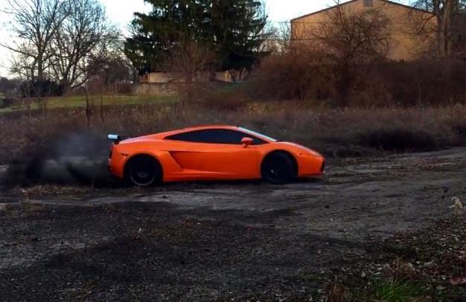
Shortcut 18: Automation
Classic model: hand-executed tests
Goldstein:
Won’t reach full potential
Car just might be damaged
Trying to implement Scrum without automation is like trying to drive a sports car on a beaten-up dirt track.

Slide 12
Shortcut 18: Automation
Classic model: hand-executed tests
Goldstein:
Won’t reach full potential
Car just might be damaged
Result:
Trying to implement Scrum without automation is like trying to drive a sports car on a beaten-up dirt track.
Notes:
This is a reference to Breaking Bad, episode 7 of season 4 (https://en.wikipedia.org/wiki/Problem_Dog) in which Walt blows up a new Challenger out of frustration.

Slide 13
Integration Hell
What you did after others tested their bit
Often as much work as implementation
Results of waiting: increased expense
Identifying Requirements
Design
Implementation
Verification
Deploy
Integration
Integration: combining subsystems (databases, clients, etc.)

Slide 14
Shortcut 18: Automation
Solution: Continuous Integration
All developers build their software against baseline at least daily
Integration verified by automated build, including executable tests
Goal: identify errors as soon as possible
Benefits:
Avoid integration hell
Development team first to know about problems!

Slide 15
How CI Works
CC=g++
lookup: util.o Section.o lookup.o
$(CC) -o lookup util.o Section.o
lookup.o: ookup.cpp
$(CC) -c lookup.cpp
Section.o: Section.cpp
$(CC) -c Section.cpp
Build
script
2. Change
Notification
CI Server
1. Push
3. Pull
4. Results
Git Server
Developers
Feedback
mechanisms

Slide 16
Shortcut 18: Automation
Opportunities
Auto-generate documentation/Javadoc check
Auto-format code to standard
Auto-generate UML diagrams
Static analysis tools
Common coding errors
Evaluate race conditions
UI checkers
Daily: expensive tests
Performance
Build from scratch
Note: CI is about more than just “integration”
Building, running tests, mechanical checks for quality
Can also include deployment

Slide 17
The case for test automation
Automation beats documentation?
Negatives: takes time, maintenance
Positives
Executing tests by hand is tedious, error prone
Can end up with test sprints – all we do is test!
Developers can focus on constructive work
Automation gives a safety net
Repeated mistakes never look good…
Tests document what the system does!
A great return on investment

Slide 18
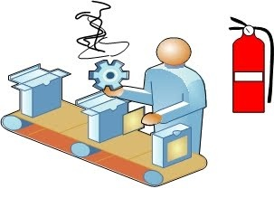
Types of testing
What is
unit testing?
FIRST for unit tests: Fast, Independent, Repeatable, Self-validating, Thorough
functional testing?
integration testing?
performance testing?
smoke testing?
preliminary testing: is build stable, ready for full tests?
Who does each? When?
How does test-driven development work?
Notes:
[note: will cover stress testing in next slide deck]
Smoke testing: is a build stable enough to warrant further testing?
See http://softwaretestingfundamentals.com/smoke-testing/ for a discussion of smoke testing

Slide 19
CI in 3800
Pipelines
Image + build/test/deploy commands
Test, deploy: optional
Formerly used in SDL: Jenkins, TeamCity
Both integrate well with Bitbucket
In 3800: GitLab
Donated license
Easy setup
DEMOSTRATE: Pipelines in GitLab

Slide 20
Keys to stable products
When possible, you should develop in an environment that is similar to production.
Environment must be clearly documented.
Setup needs to be automated as much as possible.
Ensure setup is reusable by entire team.
Docker!

Slide 21
Environments
Developers: flexible, but mimic deployment
At least ensure data meets integrity constraints
If no CI, must match deployment!
CI environment
Match deployment
Staging environment: identical to deployment
Continuous delivery
Always deployable and releases are frequent with small functionality changes
Can release in seconds or minutes
Attitude: every pull request must be shippable!
Business decides when to deploy, not IT

Slide 22
Stable development
Issue: minimizing multi-person problems during implementation
What are the rules for repositories?
Never check in binaries?
What about documentation in .docx files? EA files?
Better: never check in build products! Why?
How to use branches?
Minimize maintenance
Lower case filenames, IDE formatting
Tests are friends!
Who owns the code?
Notes:
May want build snapshots so can reproduce bugs reported by users.
Professional projects: capture the build tools as well!
Team owns code – don’t need extensive ceremonies to change & refactor code if have strong tests

Slide 23
Should there be a testing team?
IKEA effect (NPR’ s TED Radio Hour, Oct. 3, 2017)
Building an object makes you believe it’s better
Study: people valued origami creations they built five times higher than those built by others
Especially true if built without instructions!
Application: we believe our software works
Independent testing team
Review existing tests, perform system tests
Could Scrum have this wrong??

Slide 24
Ch. 6 Review
Bugs vs. issues
Issues: revised acceptance criteria
Bugs: new PBIs
What it takes to be a tester
The need for experts, their skills & contributions
Automated testing with CI
Tightening the loop

