Slide 1
Dr. Rob Hasker
SE 3800 Note 5 Beyond Functional Testing

Slide 2
Discussion
First part of the course:
More on Scrum – material not in SE 2800
Testing issues related to Scrum
Today: different types of testing activities
Motivation: system behavior and reliability
Where this is leading
Motivation for new testing technologies
… especially behavior-driven development

Slide 3
Core need for all users: reliability
Starting point: how reliability is different for software
Physical systems: typically linear
response to complex input can be described as a sum of responses to simpler inputs
Gears: output speed depends directly on input speed
A
B
C

Slide 4
Core need for all users: reliability
Physical systems: typically linear
response to complex input can be described as a sum of responses to simpler inputs
Gears: output speed depends directly on input speed
Total reliability: product of reliability for each gear
If each gear has a 5% chance of failing in a week, full system has a 14% chance of failing
A: 95% Reliable
B: 95%
C: 95%
Reliability: .95³ ≈ .86

Slide 5
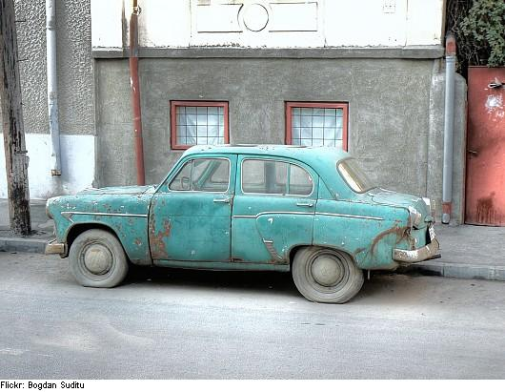
Core need for all users: reliability
Physical systems: typically linear
response to complex input can be described as a sum of responses to simpler inputs
Gears: output speed depends directly on input speed
Total reliability: product of reliability for each gear
If your car has a 14% chance of failing each week, it may be time for a replacement!
Fortunately, most real, physical systems are >86% reliable…
A: 95% Reliable
B: 95%
C: 95%
Reliability: .95³ ≈ .86

Slide 6
Reliability in software
Reliability: critical feature of any system
Required to know when can make plans based on the system working
Software system reliability: challenging
Software systems are non-linear
That is, the output is not a simple function of the inputs
Physical system example:
Electric Grid: output depends on generator states, speed of light in aluminum, switches
Managing an electrical grid is a challenging task!
Almost any complex system is non-linear
Software: thousands or millions of components
No general relationship between inputs and outputs
A: 90% Reliable
B: 90%
C: 90%
Reliability: .9³ = .73
Notes:
Time
Once upon a time: seen as constricting to force every build to pass tests – need branching

Slide 7
Basic software reliability tool: testing
Starting point: functional, unit testing
Additional aspects of reliability testing:
Performance: test processing time for heavy loads
Especially databases: dropping an index a big problem
Stress testing: response when exceed specification
Goal: system should exhibit graceful degradation
Security – challenging to test
Websites: SQL injection, cross-site scripting
Attackers have more time!
Many non-functional requirements address reliability
Must identify testable component

Slide 8
Testing strategy
Issue: with this much to test, running all tests likely takes too long…
Long cycles mean tests don’t get run!!
How to prioritize tests?
Regression set minimization: identifying a subset that would reveal most bugs
Research question!
Should be able to run all unit tests, majority of system tests
Less frequently: performance, other tests
Maybe these are just run once per day

Slide 9
General qualities of a good test suite
Thorough – coverage
Start with statement coverage
Might get some coverage at unit level, other at system
Repeatable
Generate small data sets that have predictable outputs
Test runs should not depend on each other
Understandable
Maintainable
Easy to identify failed case
“TRU”!

Slide 10
Additional testing tools
Fuzz testing: randomized input testing
Typically random variations based on a pattern
Examples: random numeric values, random names
Useful for checking for cross-site scripting vulnerabilities
Weakness?
Test oracles
If use large data set, how to know if results are correct?
Test oracle: check result – often easier than producing it
Common form: matching output between versions
Key: differentiate between tests for robustness and correctness
Notes:
“grandma testing”: sexist, agist

Slide 11
System Testing
Primary focus: functional testing
That is, are there errors in features?
Test all observable functionality
In some sense, this is the only test that matters
If can’t exercise a bug, then the bug doesn’t exist!
So why not do all testing at this level?
harder to test deeply
harder to know how to fix system if test fails
Acceptance testing: system testing w/ focus on common scenarios

Slide 12
Functional/unit testing
How is functional/system testing different from unit testing?
Scope: unit test exercises pieces, functional is end-to-end
How are they the same?
Written by developer organization
Likely to use mocks to isolate components

Slide 13
Acceptance/functional testing
How does acceptance testing differ from functional testing?
Functional:
Internal, verify features
Focus on full system; test all requirements
Acceptance:
External, validate requirements
Likely focus on high priority areas/requirements
Rare to use mocks – only for very low probability/high impact errors that must be tested
Production environment (as close as possible)

Slide 14
The Real Differences Lies in What You Are Asking
Does this feature meet the customer requirement?
Acceptance Test
Does this feature work?
Functional Test
Does this feature work with the graphics API?
Integration Test
Does this class do what I want it to do?
Unit Test

Slide 15
V-Model
Customer requirements
Operational use
Product specifications
System test
High-level design
Integration test
Low-level design
Component test
Coding & unit test
Is this for just the waterfall model?
Notes:
Review of SE 2832; chart based on Software Quality Engineering, Jeff Tian, Wiley Press, 2005

Slide 16
Acceptance
Engineers: what I make for you works
I’ve verified it does what I understand you need
Customer: does it solve my problem?
They validate the system solves their problem
Software correctness: both verification and validation
The difference: perspective
SE 2832: software verification
Tools for verifying code “works”
Missing: validating that software meets needs
Notes:
Common phrase: verification = checking we built the system right, validation = checking we built the right system
This turn of phrase is too confusing; simply remember validation is validating that the system has the correct requirements

Slide 17
V-Model with V&V
validate
Customer requirements
Operational use
verify/validate
Product specifications
System test
verify
High-level design
Integration test
verify
Low-level design
Component test
Coding & unit test
Notes:
Review of SE 2832; chart based on Software Quality Engineering, Jeff Tian, Wiley Press, 2005

Slide 18
Who should write acceptance tests?
Obvious answer: client
Probably manual tests
Step | Req | Pass Conditions | Pass?
1. Select the Biology program. | UIR-2 | System displays biology classes w/ first class BIOLOGY 1150, Section 01, Title GENERAL BIOLOGY, Instructor Block, Anna, Filled/Seats 52/53, Class# 1311, Credits 5, Meets BOE 0221 MWF 8:00-8:52 | P / F
2. Double-click on Class# 1330 | UIR-1 | System includes Class# 1330 in schedule at bottom | P / F
3. Scroll down to Class# 1331 (BIOLOGY 1650, Section 01) | UIR-9 | System displays Class# 1331 with a pink background | P / F
4. | UIR-9 | All sections listed between #1311 and #1331 have a white background | P / F
5. Select the GENENG program. | UIR-2 | System displays general engineering courses | P / F
Lots of detail
Must document passes manually
Maintenance issue when steps depend on each other

Slide 19
Who should write acceptance tests?
Obvious answer: client
Probably manual tests
Not much help to development team

Slide 20
Who should write acceptance tests?
Obvious answer: client
Probably manual tests
Not much help to development team
Alternative: behavior-driven development
Functional, acceptance tests written in domain language
Use tools to run the tests
Simple model: acceptance criteria for each story = collection of system-level tests

Slide 21
Getting clients to write tests
Assumptions:
Our clients are the ones who know what the system should do
However, clients don’t write code – can’t write (executable) tests!
Solution: Cucumber
Testing language: specify start conditions, expected results
Supports tables when have several examples
Developer: provides hooks defining how the tests are executed

Slide 22
Acceptance tests in
https://cucumber.io/
Supports Ruby, Java, .NET, C++, all web applications
Underlying language: Gherkin

Slide 23
Steps: 1. describe behavior
Feature: Addition
In order to avoid silly mistakes
As a math-challenged person
I want to be told the sum of two numbers
Scenario: Add two numbers
Given I have entered 50 into the calculator
And I have entered 70 into the calculator
When I press add
Then the result should be 120 on the screen

Slide 24
Steps: 1. describe behavior
Feature: Addition
In order to avoid silly mistakes
As a math-challenged person
I want to be told the sum of two numbers
Scenario: Add two numbers
Given I have entered 50 into the calculator
And I have entered 70 into the calculator
When I press add
Then the result should be 120 on the screen
These actually all have
the same effect.

Slide 25
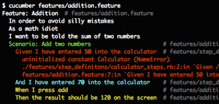
2. Step definition in Ruby
Given /I have entered (.*) into the calculator/ do |n|
calculator = Calculator.new
calculator.push(n.to_i)
end
Run and watch it fail:

Slide 26
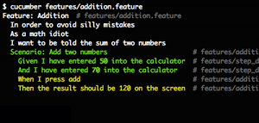
2. Write code to make it pass
class Calculator
def initialize()
@args = []
end
def push(n)
@args << n
end
end
Run see step pass:

Slide 27
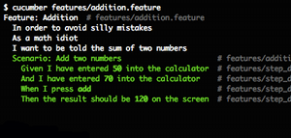
3. Repeat until “green like a cuke”

Slide 28
Behavior-driven development
Basic model: test-driven development
Developers code to tests written by POs, clients
Alternatively, clients review tests written in Gherkin by developers
If only programmers reviewing or writing tests, Gherkin is probably not useful

Slide 29
Gherkin Syntax
Each feature described in single .feature file
3 elements:
Feature: a name – free form syntax
Description: documentation
Any line not starting w/ a keyword
Scenario: concrete example

Slide 30
Gherkin Syntax
Keywords:
Feature
Scenario
Given, when, then, and, but: steps
Background
Scenario outline
Examples
Feature: Refund item
Sales associates required by law to refund purchases
Scenario: Jeff returns a faulty microwave
Given Jeff has bought a microwave for $100
And he has a receipt # don’t assume this is true!
When he returns the microwave
Then Jeff should be refunded $100

Slide 31
Gherkin Syntax
Keywords:
Feature
Scenario
Given, when, then, and, but: steps
Background
Scenario outline
Examples
Documentation
- no keyword,
multiline
Feature: Refund item
Sales associates required by law to refund purchases
Scenario: Jeff returns a faulty microwave
Given Jeff has bought a microwave for $100
And he has a receipt # don’t assume this is true!
When he returns the microwave
Then Jeff should be refunded $100
On same line
Can also comment with #

Slide 32
Gherkin Syntax
Keywords:
Feature
Scenario
Given, when, then, and, but: steps
Background
Scenario outline
Examples
Feature: Refund item
Sales associates required by law to refund purchases
Scenario: Jeff returns a faulty microwave
Given Jeff has bought a microwave for $100
And he has a receipt # don’t assume this is true!
When he returns the microwave
Then Jeff should be refunded $100
No distinctions between these
Key tool: readability
Given: put system in known state
When: describes key action
Then: Final result
compare actual to expected

Slide 33
Gherkin Syntax
Keywords:
Feature
Scenario
Given, when, then, and, but: steps
Background
Scenario outline
Examples
Background:
Given a $100 microwave was sold on 2015-08-26
And today is 2015-08-26
Background: steps which are assumed before each scenario

Slide 34
Scenario outline
Parameterize values, specify with table:
Scenario Outline: feeding a suckler cow
Given the cow weighs <weight> kg
When we calculate the feeding requirements
Then the energy should be <energy> MJ
And the protein should be <protein> grams
Examples:
| weight | energy | protein |
| 450 | 26.5 | 215 |
| 500 | 29.5 | 245 |
| 575 | 31.5 | 255 |
| 600 | 37.0 | 305 |

Slide 35
Scenario outline
Parameterize values, specify with table:
Scenario Outline: feeding a suckler cow
Given the cow weighs <weight> kg
When we calculate the feeding requirements
Then the energy should be <energy> MJ
And the protein should be <protein> grams
Examples:
| weight | energy | protein |
| 450 | 26.5 | 215 |
| 500 | 29.5 | 245 |
| 575 | 31.5 | 255 |
| 600 | 37.0 | 305 |
One or more examples sections
Required header row
‘|’ is a key symbol

Slide 36
Implementing tests – step definitions
Scenario:
Given I have 48 cukes in my belly
Java code implementing this step:
import cucumber.api.java8.En;
public class MyStepdefs implements En {
public MyStepdefs() {
Given("I have (\\d+) cukes in my belly", (Integer cukes) -> {
System.out.format("Cukes: %n\n", cukes);
});
}
}
Notes:
https://thomassundberg.wordpress.com/2014/05/29/cucumber-jvm-hello-world/

Slide 37
Implementing tests – step definitions
Scenario:
Given I have 48 cukes in my belly
Java code implementing this step:
Capture group
Usually regular expression
d+: one or more digits
Matches and, then, etc.
import cucumber.api.java8.En;
public class MyStepdefs implements En {
public MyStepdefs() {
Given("I have (\\d+) cukes in my belly", (Integer cukes) -> {
System.out.format("Cukes: %n\n", cukes);
});
}
}
Declaration
Action – here, just return string w/ #cukes

Slide 38
Implementing tests
Scenario:
Given I have 48 cukes in my belly
C++ code implementing this step:
Given(“^I have (\\d+) cukes in my belly$”) {
REGEX_PARAM(int, cukes);
USING_CONTEXT(MyAppCtx, context);
std::cout << “Cukes: “ << cukes;
}

Slide 39
Values: regular expressions
Flexible tool for capturing words with specific patterns
Will generally use several simple cases:
\d+, \w+
^, $: anchor to start and end
backslash to escape special characters
more later
Regular expression
Given(“^I have (\\d+) cukes in my belly$”) {
REGEX_PARAM(int, cukes);
USING_CONTEXT(MyAppCtx, context);
std::cout << “Cukes: “ << cukes;
}

Slide 40
Full example
(from here)
public class Belly {
private int cukes;
public void eat(int cukes) {
this.cukes = cukes;
}
public String getSound(int waitingTime) {
if (cukes > 41 && waitingTime >= 1) {
return "growl";
} else {
return "silent";
}
}
}
Notes:
Example from https://thomassundberg.wordpress.com/2014/05/29/cucumber-jvm-hello-world/

Slide 41
Full example
(from here)
public class Belly {
private int cukes;
public void eat(int cukes) {
this.cukes = cukes;
}
public String getSound(int waitingTime) {
if (cukes > 41 && waitingTime >= 1) {
return "growl";
} else {
return "silent";
}
}
}
Target behavior:
Scenario Outline: a few cukes
Given I have 42 cukes in my belly
When I wait 1 hour
Then my belly should growl
Notes:
Example from https://thomassundberg.wordpress.com/2014/05/29/cucumber-jvm-hello-world/

Slide 42
Full example
Scenario Outline: a few cukes
Given I have 42 cukes in my belly
When I wait 1 hour
Then my belly should growl
public class StepDefinitions implements En {
private Belly belly;
private int waitingTime;
public StepDefinitions() {
Given("I have (\\d+) cukes in my belly", (Integer cukes) -> {
belly = new Belly();
belly.eat(cukes);
});
When("I wait (\\d+) hour", (Integer waitingTime) -> {
this.waitingTime = waitingTime;
});
@Then("my belly should (.*)", (String expectedSound) -> {
String actualSound = belly.getSound(waitingTime);
assertThat(actualSound, is(expectedSound));
});
}
}

Slide 43
Automating the locksmith problem
How to automate the following?
Feature: Unlock with code
Using the keypad to unlock the lock.
Scenario: Locksmith lockout override
Given The locksmith is opening lock #921
And The override code for lock 921 is 18058
When The locksmith enters 18058 on the keypad
Then the lock releases
Notes:
This is based on the acceptance criteria for the sample locksmith story in note 3.
Issue: building a robot to test this would be expensive and overkill – don’t need to check that keypad entry works, just that the code unlocks the lock. But do need strong test – this is critical functionality.
Solution: take a keypad, revise to take codes from a serial port, configure lock with sensor to check release – not terribly expensive!
Note VP, sales, lots of people can read, confirm this test works as intended.

Slide 44
Client-written tests
Wins:
Test documents what system supposed to do in a verifiable manner!
Expected behavior is very concrete
Customer gets to control behavior from start
Problems
Extra time to write tests – if client not writing tests, probably should use other methods
But then client may not really want system!
Must maintain tests
But manual tests need maintenance, too

Slide 45
Review
Unit vs. functional vs. acceptance testing
Testing non-functional requirements: performance, security, etc.
Behavior-driven development with Cucumber
Lots of tools – how do they fit together?

Slide 46
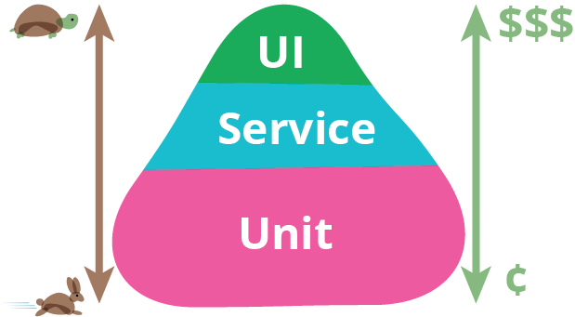
Fowler’s Test Pyramid
Automated testing at UI level: slow, high cost
Manual UI testing: higher cost for same quality!
Automation expensive, brittle tests
Testing at unit level: fast, relatively low cost
Failed UI test: both found bug, missing unit tests
Service = policy/business logic, integration
Key: break down testing just like architecture
Notes:
This discussion is geared towards web services, but applies across the board (with Service layer substituted by policy/business logic).

Slide 47
Test Pyramids & BDD
Where does BDD fit in this?
When would BDD drive unit tests?
When would BDD drive UI tests?
What must be tested at the UI level?
What are the goals of BDD?
Notes:
Answer on BDD & unit tests: unlikely!!
BDD & UI tests: hopefully rare – these are expensive to maintain with Cucumber as well!

