Slide 1
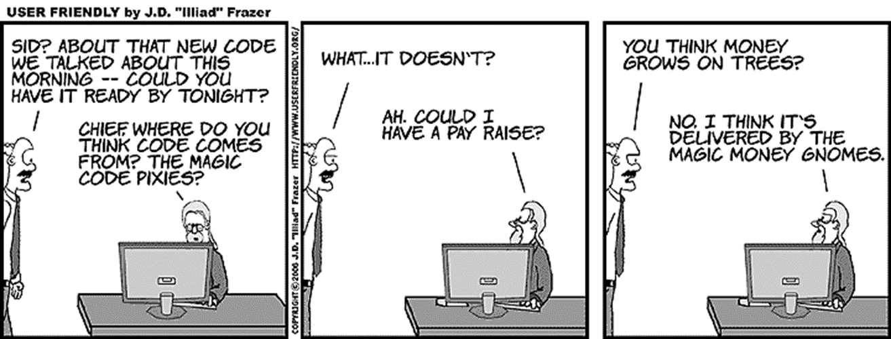
SE 3800 Note 8 Other ways to get there
Dr. Rob Hasker

Slide 2
Where in the world is se3800?
What were the main points up to now?
What do you know of software process beyond Scrum?

Slide 3
Should every project use Scrum?
Types of projects
Internal development: unit as customer
External client, software as loss leader
External client, time & materials contract
External client, fixed bid contract
Vertical market: small customer base, high need
Shrinkwrapped software: off the shelf, general public
These are generally in order by increasing risk exposure, profitability
Notes:
Loss leader: product sold below cost to stimulate other sales – eg: billing software given away since actual income from printing bills
Time & Materials: great tool when estimates are unavailable, have a great relationship
Fixed bid: typically the highest reward in the contract business
Shcrinkwrapped

Slide 4
Should every project use Scrum?
When might Scrum not be an appropriate model?
What are some of its limitations?
Hard to get the big picture
Early choices may have to be undone
What if we need to design the hardware that will run the system?
How would a fixed-price project work?
What if tasks can’t be planned out for just 2 weeks?
What to do about critical production issues?
How to handle fixed deadlines?
Notes:
Ask the questions & write down responses

Slide 5
What do we really need?
What must a process provide?
Minimal requirements (Pressman):
communication: communication/collaboration with customers & other stakeholders: goal is to figure out what system is to do
planning: establishing plan for technical work, identifying risks, scheduling
modeling: creation of models to clarify requirements and outline the design
construction: code generation (possibly automatic), testing to identify errors in the construction
deployment: delivering the product including customer evaluation

Slide 6
Why have a process?
What must a process provide?
Minimal requirements (Pressman):
communication: communication/collaboration with customers & other stakeholders: goal is to figure out what system is to do
planning: establishing plan for technical work, identifying risks, scheduling
modeling: creation of models to clarify requirements and outline the design
construction: code generation (possibly automatic), testing to identify errors in the construction
deployment: delivering the product including customer evaluation
“Compile more code” - (Kasmir Siekierzynski, 2007)

Slide 7
Process framework
How Scrum satisfies this list:
communication: communication/collaboration with customers & other stakeholders
?
planning: establishing plan for technical work, identifying risks, scheduling
?
modeling: creation of models to clarify requirements and outline the design
?
construction: code generation (possibly automatic), testing to identify errors in the construction
?
deployment: delivering the product including customer evaluation
?

Slide 8
Process framework
How Scrum satisfies this list:
communication: communication/collaboration with customers & other stakeholders
PO, daily standups, reviews – LOTS!
planning: establishing plan for technical work, identifying risks, scheduling
Sprint planning, grooming backlog, daily standup
modeling: creation of models to clarify requirements and outline the design
Acceptance criteria, diagrams
construction: code generation (possibly automatic), testing to identify errors in the construction
Executing sprint
deployment: delivering the product including customer evaluation
Potentially releasable product at end of every sprint

Slide 9
Traditional Model - Waterfall
Requirements Analysis
What system does
Design
How to impl. reqs
Implementation
Coding
Verification
Testing
Deployment
Delivery
Requirements Analysis
Design
Implementation
Verification
Deployment
Notes:
Review: what is the difference between requirements (analysis) and design?
What do you think we will discuss about the waterfall method?
Why am I asking these questions? Research shows reviewing topics, predicting future topics leads to higher scores on exams.

Slide 10
Traditional Model - Waterfall
Requirements Analysis
What system does
Design
How to impl. reqs
Implementation
Coding
Verification
Testing
Deployment
Delivery
Requirements Analysis
Design
Implementation
Verification
Deployment
Communication,
Planning
Modelling
Construction
Deployment

Slide 11
Traditional Model - Waterfall
Wins:
Covers all deliverables
Similar process to other engineering disciplines
Problems:
Nothing executable until end
Difficult to evaluate progress
Reviews block progress
What to do if find problem?
Requirements Analysis
Design
Implementation
Verification
Deployment

Slide 12
Traditional Model - Waterfall
Wins:
Covers all deliverables
Similar process to other engineering disciplines
Problems:
Nothing executable until end
Difficult to evaluate progress
Reviews block progress
What to do if find problem?
Requirements Analysis
Design
Implementation
Verification
Deployment
2 solutions:
Go back to top
Wait until next project
Basic problem:
No model, no tracking

Slide 13
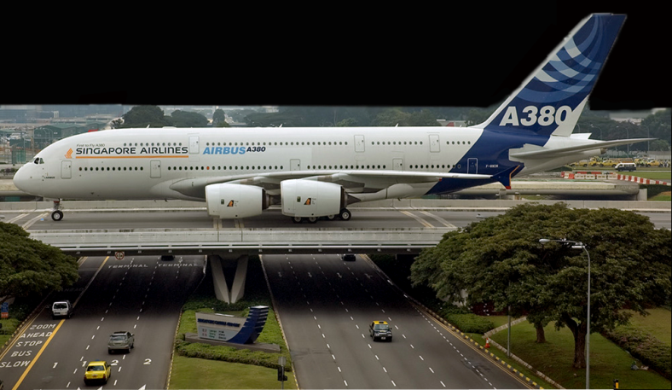
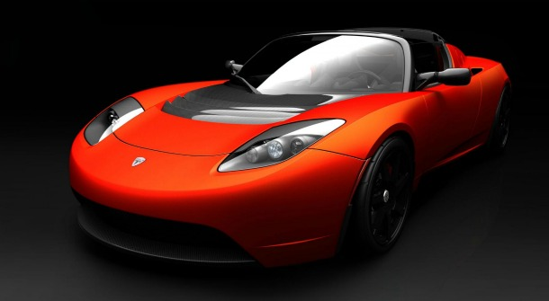
So why use the waterfall model?
Easy to understand
Fits projects w/ hardware + software
Hardware development: expensive, slow
Great for well-understood domains
Notes:
Question: what do I mean by domain? Why might it be good for well-understood domains? (ans: we know what to do!)

Slide 14
So why use the waterfall model?
Easy to understand
Fits projects w/ hardware + software
Great for well-understood domains
Cost to fix errors
From http://istqbexamcertification.com/what-is-the-cost-of-defects-in-software-testing/

Slide 15
So why use the waterfall model?
Easy to understand
Fits projects w/ hardware + software
Great for well-understood domains
Cost to fix errors
But rarely used!

Slide 16
So why use the waterfall model?
Easy to understand
Fits projects w/ hardware, software
Most frequent alternative: Iterative
Requirements
Design
Implement
Test
Requirements
Design
Implement
Test
Requirements
Design
Implement
Test
Notes:
More specifically, the Iterative Waterfall Model

Slide 17
Iterative Waterfall Model
Requirements
Design
Implement
Test
Requirements
Design
Implement
Test
Requirements
Design
Implement
Test
Start w/ core,
add features
Cycles done in parallel or sequenced
Advantages
clear feedback
shows progress
Disadvantage over waterfall:
Customer evaluates on basis of what’s missing
Revisiting design can be expensive
Notes:
Note this is the “terative waterfall model” as opposed to generic “iterative models” – the latter is really a large class of models

Slide 18
Spiral Model
Berry Boehm, 1980s
Wikipedia
Spirals: project phases
Key contribution: reassess risks each iteration
No longer covering

Slide 19
Activities within each spiral
Project Phases
(purposefully vague)
No longer covering
Development,
test actions

Slide 20
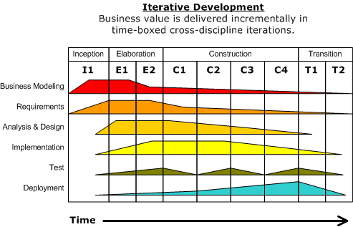
Rational Unified Process (RUP)
Wikipedia
Observation: no phase ever really complete
Varying levels of effort by time
Dutchguilder, Wikipedia

Slide 21
Unified Process Phases
Business Modeling, Requirements
identify preliminary use cases, develop preliminary architecture, outline development
Primary goal: establish goals for project and each iteration (with input from all stakeholders)
Key issue: address business and requirements risks
Analysis & Design:
establish baseline architecture
Rest of project: filling "gaps" within the architecture
Implementation, Test
Make use cases operational for end users
Deployment
End result: available for customers/end users

Slide 22
Unified Process Phases
Business Modeling, Requirements
identify preliminary use cases, develop preliminary architecture, outline development
Primary goal: establish goals for project and each iteration (with input from all stakeholders)
Key issue: address business and requirements risks
Analysis & Design:
establish baseline architecture
Rest of project: filling "gaps" within the architecture
Implementation, Test
Make use cases operational for end users
Deployment
End result: available for customers/end users
Very flexible
Detailed definitions for each phase
Robust enough for very large projects

Slide 23
Alternative process models
Waterfall, iterative, RUP: plan-based
Agile alternatives:
Scrum
XP: Extreme Programming
FDD: Feature-driven Development
Kanban

Slide 24
Extreme Programming
Kent Beck, late 90s
Scrum dates from the early 90s!
Planning: set of stories
User decides to add Math 264. User selects the Math program, scrolls to first open section not conflicting with previously chosen classes. User adds that section to schedule.

Slide 25
Extreme Programming, cont.
Stories then used to organize project
Customer assigns a "value" to each
Priority of each with respect to overall business need
Developer assigns a cost:
number of development weeks to implement story
split any story that costs more than 3 weeks
Customer & developer: group stories into releases
High value, high risk stories typically in first releases
Keep releases small, frequent

Slide 26
XP Design
Keep it simple
Light documentation of design
Don't design more than necessary to support stories
…keeping design open to future plans
Avoid detailed designs for features that might not be implemented
Also: spike solutions - implement prototype when necessary to test element of design
Long term: refactor as needed to revise designs
Design is flexible and "owned by all”!
The Rules of Extreme Programming

Slide 27
Even more XP
Implementation: pair programming
when possible, have pairs of people work together
XP rule: anyone working alone is subject to being drafted
Also: ensure code always meets standards
Testing
Test-driven development (TDD): write tests before writing code, implement until tests pass

Slide 28
Scrum vs. XP
Exercise:
Differences?
Similarities?
When might XP be preferable?

Slide 29
Feature-Driven Development
Wikipedia
Weakness of Scrum: no up-front design
Also a strength! Why?
FDD: an agile process with up-front design
Feature: small, client-valued function
expressed in the form: <action> <result> <object>
Example: “calculate the total of a sale”
Typically: 3-5 days to develop

Slide 30
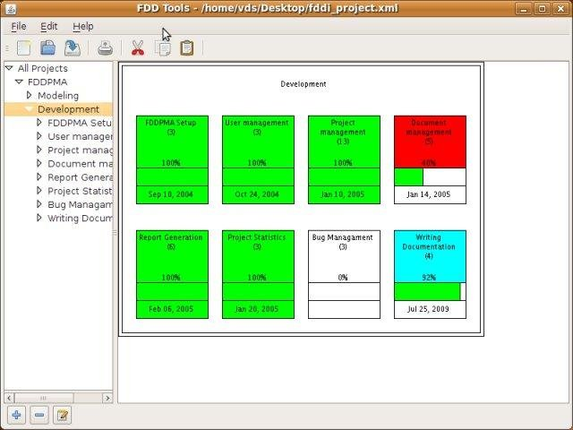
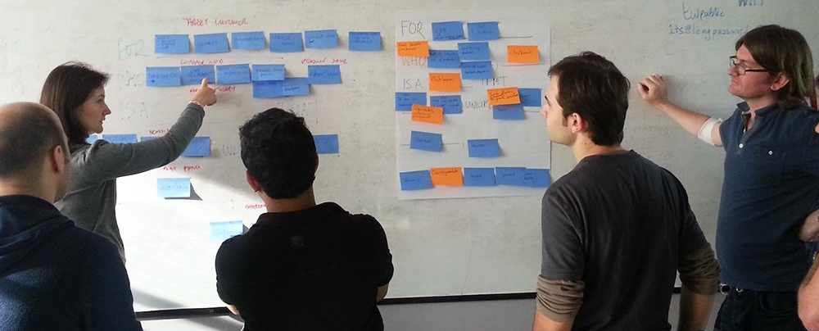
FDD Feature List
Project = collection of features
Organize features hierarchically
Feature board captures this
https://sourceforge.net/projects/fddtools/
openxcell.com: 9 Things for FDD
Notes:
Lower left: feature board w/ 1 sticky per feature; group them, plan order
Upper right: image from an open source FDD manager showing collections of features and the progress of each; can click on the squares to identify subfeatures to develop

Slide 31
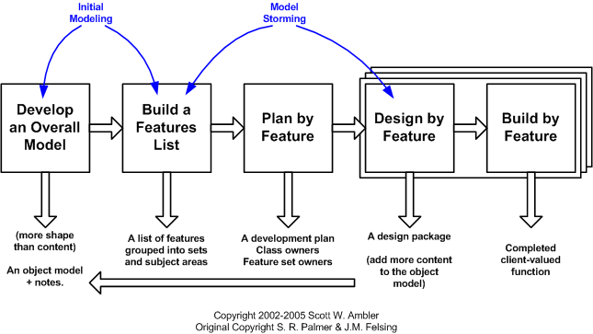
Feature-Driven Development
Wikipedia
Process: 1) develop feature list 2) architect system 3) schedule feature development, 4) build

Slide 32
Feature-Driven Development
Wins: up front design, planning
Issues: all the problems of up-front design
Possible wasted effort
Developers become attached to their designs
Can become a whack-a-mole development model
Take feature, design, implement, repeat

Slide 33
Alternative process models
Waterfall, iterative, RUP: plan-based
Agile alternatives:
Scrum
XP: Extreme Programming
FDD: Feature-driven Development
Commonality: Agile manifesto
Individuals/interactions > processes & tools
Working software > comprehensive documentation
Customer collaboration > contract negotiation
Responding to change > following a plan

Slide 34
Kanban
(看板)
‘Signboard’ or ‘billboard’ in Japanese
First developed by Toyota for manufacturing
Motivation: supermarket
people take just what they need when they need it
people can assume constant supply, no need to stock up
store obtains just what it needs to stay stocked
Wikipedia
leankit.com

Slide 35
Kanban
1
3
2
4
(看板)
On factory floor (simplified):
Products in bins
When bin is empty, send to supplier with a Kanban card
Supplier returns correctly filled bin with card
Supply control: control number of cards
Reactive: never have unnecessary product
Allows careful inventory control

Slide 36
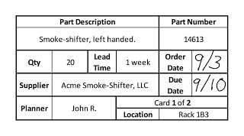
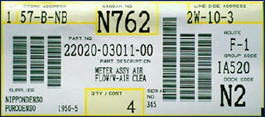
Sample Kanban Cards
Notes:
Keys: product identifier, quantity needed

Slide 37
Kanban in Software
Maintain to-do list in order of importance
When team needs work, take top item
Team applies process to complete item
Key metric: cycle time
Total time in process: removed from to-do list to done
Consistency allows predicting delivery of future work
Limit work in progress (WIP)
Keeps team focused, ensures efficiency
Weekly: retrospective reviewing metrics, process
Can use with almost any other process

Slide 38
Sample Kanban board
Initially: all waiting progress
WIP (work-in-progress), for each team, across top
Developers help testers complete tasks so can deploy
With new slot, can advance other tasks
Notes:
How the board might look with stickies on a whiteboard. Each stage is performed by a different team, so this board follows the waterfall model.
WIP captures that testing should be less time than development.

Slide 39
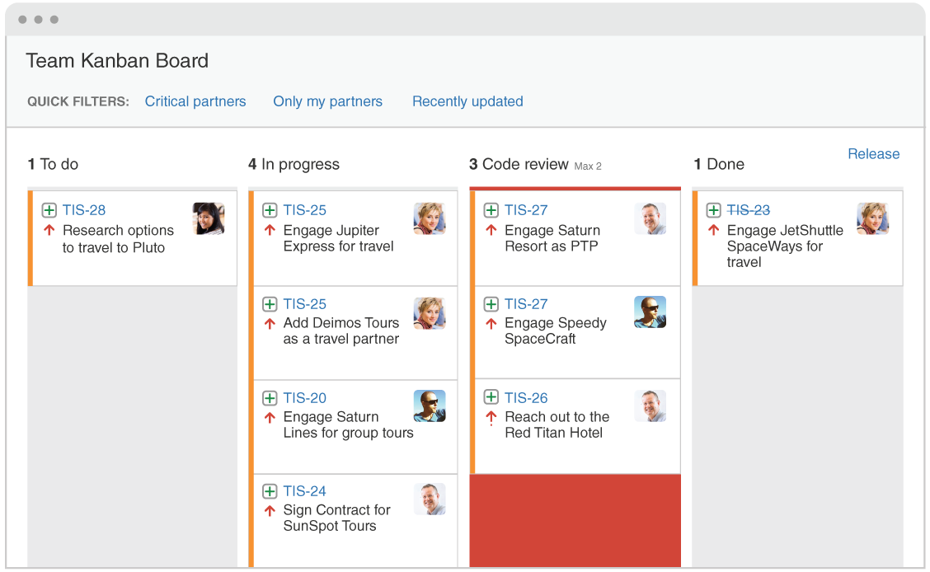
Atlassian Kanban Board
Notes:
How Kanban looks in Atlassian; simply move across board

Slide 40
Scrum vs. Kanban
 | Scrum | Kanban
Cadence | Regular, fixed-length sprints | Continuous flow
Release methodology | Possibly at end of sprint; business decision | Continuous delivery or business decision
Roles | Product owner, scrum master, development team | No existing roles. Some teams enlist the help of an agile coach.
Key metric | Velocity | Cycle time
Change philosophy | Teams should strive to not make changes to the sprint forecast during the sprint. Doing so compromises learnings around estimation. | Change can happen at any time
Notes:
Arguably the cadence is the most important difference – everything else essentially follows from that.

Slide 41
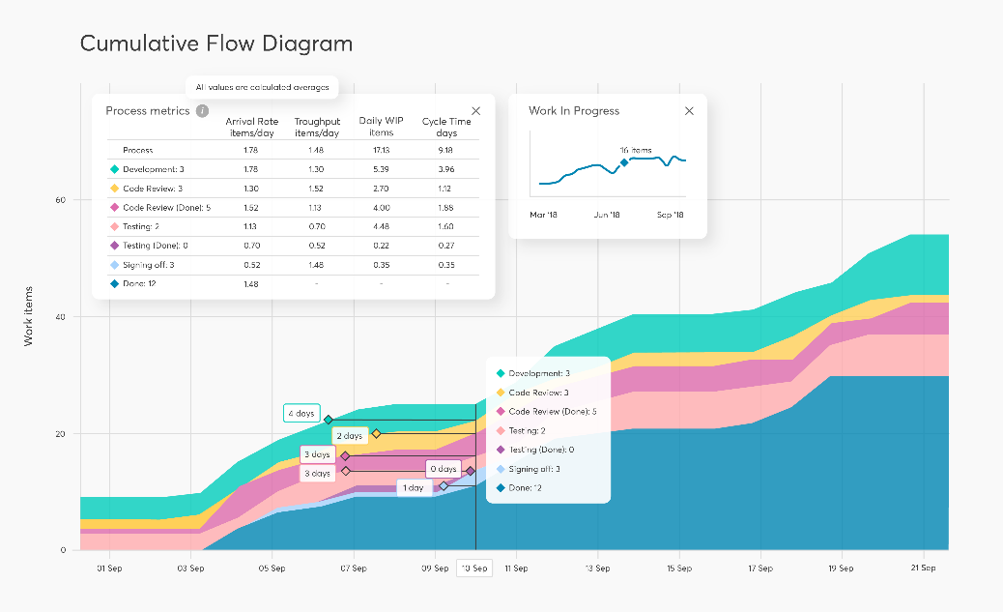
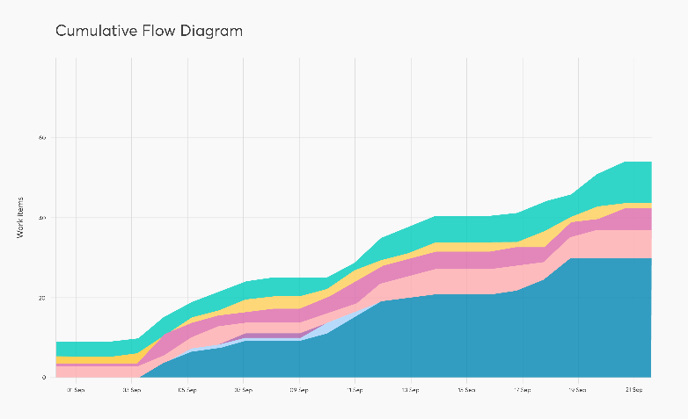
Kanban Metrics
Applying cumulative flow: looking for bottlenecks
Stages with WIP limit blocking further progress on card
Signs: decreased throughput & sharp increase in gradient for cumulative flow diagram
Metrics: necessary, or Kanban is just to-do lists
Cycle time: done time – time started by 1st team
Work in progress: work to which committed but not completed
Average time in queues
Measure how long items
wait for attention
Limit total time in queues
Cumulative flow: # tasks in each stage, by day
done
Notes:
These metrics essentially capture where time spent between inception and completed product.
See various sources; graphics from https://getnave.com/blog/kanban-metrics/

Slide 42
Advantages, disadvantages
Kanban advantages:
Low overhead
Great for small teams
Often used in startups
Great for production support
Difficult to predict new work
Work needs to be done as it comes in
Easy to work in planning, etc: more Kanban cards
Disadvantages
Less definition – can become todo lists
No clear goals, no regular reviews/retros
No ceremony for celebrating successes

Slide 43
Evaluating Kanban
Review: what is “compile more code”?
Communication: ?
Planning: ?
Modeling: ?
Construction: ?
Deployment: ?
Does this differ from other agile processes?

Slide 44
Scaled Agile Framework
Aka “SAFe”
Goal: support enterprise-level projects with multiple Scrum teams
Estimate: used by 45% of large corporations
What are the problems with classic Scrum?
Hard to support hard deadlines
How to coordinate between dozens of teams?
Big picture view for SAFe:
work flows from product management
through project governance, then
program management and development teams,
to customer
Notes:
Much of this information is from https://en.wikipedia.org/wiki/Scaled_agile_framework

Slide 45
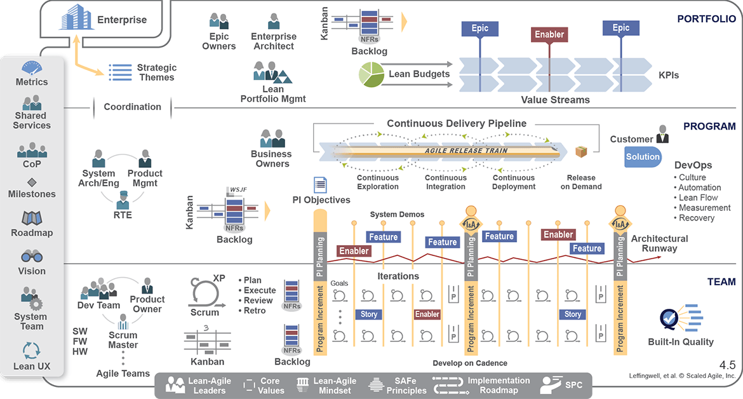
SAFe capturing 3 levels: (development) team, program (management), portfolio (management)
Note supports Scrum, Kanban, CD
Teams must coordinate (so lose ownership of schedule!)
Enabler epics, PBIs: establish common architecture
Notes:
notes: RTE is Release Train Engineer – schedules releases
Image from https://www.scaledagileframework.com

Slide 46
SAFe Principles
Take an economic view
Apply systems thinking
Assume variability; preserve options
Build incrementally with fast, integrated learning cycles
Base milestones on objective evaluation of working systems
Visualize and limit work-in-progress, reduce batch sizes, and manage queue lengths
Apply cadence (timing), synchronize with cross-domain planning
Unlock the intrinsic motivation of knowledge workers
Decentralize decision-making

Slide 47
SAFe evaluation
Is this agile?
PO is more of a management position
Teams lose control of how, even how long
Release coordinated among multiple teams
Do we care?

Slide 48
Review: Alternative Processes
Plan-driven:
Waterfall, Iterative, Rational Unified Process
Predictable if estimate right!
Agile:
Scrum, XP, FDD, Scaled Agile Framework
Kanban: just-in-time work, no sprint cycle
Common elements:
communication, planning, modelling,
construction, deployment
Why so many?
What’s best?

Slide 49
Model-Based Development
What are the possible causes of the chart to the right?
Suggestion: high expense of turning specification into executable code

Slide 50
Standard model of development
Process
Hand-written spec
Hand-drawn design
Hand-written code
Hand-written tests
Is there a better way?
Working
System?
Errors are expected!

Slide 51
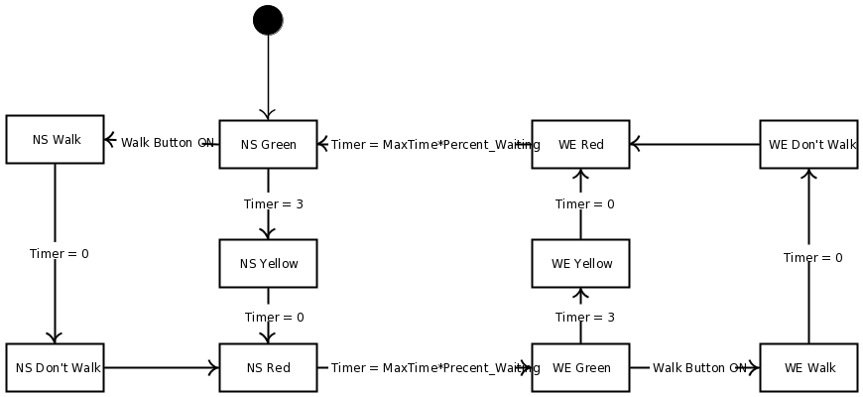
Example: Traffic Light Model
Notes:
Starting point: develop state, UML, sequence diagrams that capture system structure and behavior.
[Note: this particular diagram has many errors…]

Slide 52
Alternative
Requirements Model
Design Decisions
Generation Tool
Executable System
Model-based development (MBD)

Slide 53
Applying the model
Simulation: visualize in action
Proof: no light displays 2 colors
Never have NS and WE green at same time
Test suite: captured simulations

Slide 54
Generating code
Process:
Create model
Generate code
Identify improvements
Revise model
Go back to step 2 until done
Model compiler
int main() {
TrafficLight light = new TrafficLight;
light->NS->setGreen();
light->EW->setRed();
…

Slide 55
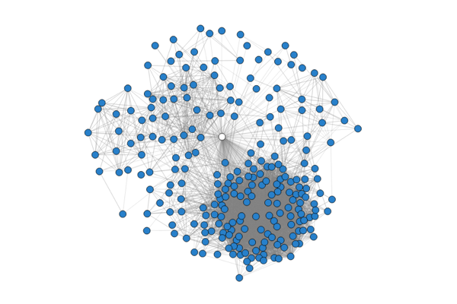
What’s the limitation?
Models tend to be terrible programming languages:

Slide 56
Analysis
Advantages of MBD:
Maintain the model, not the code
Reusable models
Easier to see details
Models aren’t requirements!
Fewer opportunities to inject mistakes
Problems with MBD:
Building models can be expensive
Some code still needs to be written by hand!
If client not maintaining model, unlikely to have savings
Iteration can be especially hard to model
Need validated tools to convert to code
Reduced testing, but still need testing!!
Notes:
Rockwell Collins: uses MBD extensively for user interfaces on the navigation and radio subsystems.

