Slide 1
SE 3800 Note 12 Quality
Dr. Rob Hasker

Slide 2
Classic Quality Assurance
Ensure follow process
Solid, reviewed requirements
Reviewed design
Reviewed, passing tests
Why doesn’t “we did a good job” work?
Why isn’t this model needed for Scrum?
Why do we need something?

Slide 3
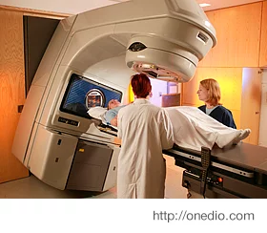
A little history
What’s the Hippocratic oath?
Therac-25: medical linear accelerator
Generates high-energy beams
Targets tumors from multiple angles
June, 1985
61-year old woman receives radiation therapy
She received 15,000 to 20,000 rads
Typical therapeutic does: in range of 200 rads
1000 rads can be fatal
Her breast had to be removed, constant pain in arms
Nov 3, 1985: patient dies after receiving 13,000 to 17,000 rads

Slide 4
A little history
March, April 1986
Patient receives 16,500 to 25,000 rads in < 1 sec
Within weeks: paralysis in an arm, legs, vocal cords
Died 5 months later
At least 3 other documented deaths
Cause: poor software design
Interface assumed operators would type slowly
Experienced operators could type faster than SW allowed, so data entry was setting a different field than shown on screen
Classic race condition: timing assumptions gone wrong

Slide 5
What is the root cause?
Simple root cause analysis:
ask why 6 times
Multiple failures beyond design
Manufacturer: poor safety model
Relied on hardware reliability
Reliability: likely to work ≠ safety: no harm
Hardware engineers: assumed SW worked
Inadequate logs
SW Developers: poor specs, no process
Medical authorities: slow to respond
Notes:
These notes started from my Fall 2004 SE 273 notes; see also http://sunnyday.mit.edu/papers/therac.pdf

Slide 6
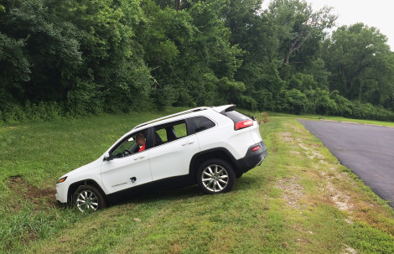
But that can’t happen today, right?
July, 2015: Wired reports ability to remotely control Jeeps
Set radio blaring
Engaged windshield
wipers
Disabled accelerator
Disabled brakes
Method:
Connect via cellular
Rewrite entertainment firmware
Connect to CAN bus
Send signals to engine, brakes, etc.
Can only control steering when in reverse gear…
Did Chrysler do anything wrong?
What are the standards?

Slide 7
The SE Code of Ethics
ACM & IEEE, 1997
Principle 1, Public Interest
Software engineers shall act consistently with the public interest
Accept full responsibility for work
Moderate interests of employer against public
Approve software only if it's safe and has been tested
Disclose potential harms to the public
Commun. ACM 40, 11 (November 1997), 110-118

Slide 8
Principle 2, Client and Employer
Software engineers shall act in a manner that is in the best interests of their client and employer, consistent with the public interest
Provide service in areas of competence
Don't use software obtained illegally or unethically
Keep confidential information private
Unless, of course, to support principle 1!
Don't collect company-wide email without authorization!
Report time honestly

Slide 9
Principle 3, PRODUCT
Software engineers shall ensure that their products and related modifications meet the highest professional standards possible
ensuring appropriate goals, methods, standards, costs, schedule
ensuring qualified to work on project
Principle 4, JUDGMENT: Software engineers shall maintain integrity and independence in their professional judgment
Endorse documents you believe in
Don't engage in deceptive financial practices
Disclose conflicts of interest

Slide 10
Principle 5, MANAGEMENT:
Software engineering managers and leaders shall subscribe to and promote an ethical approach to the management of software development and maintenance
providing good management
consider skills when assigning work (but allow for growth!)
make realistic estimates
show respect for concerns about ethical issues for a project
Principle 6, PROFESSION:
Software engineers shall advance the integrity and reputation of the profession consistent with the public interest
Promoting public knowledge of SE
Stay current in SE best practices
Report violations of the code

Slide 11
Principle 7, COLLEAGUES:
Software engineers shall be fair to and supportive of their colleagues
Assist in professional development
Give credit where it's due
Review objectively
Principle 8, SELF:
Software engineers shall participate in lifelong learning regarding the practice of their profession and shall promote an ethical approach to the practice of the profession

Slide 12
ACM/IEEE SE Code of Ethics
Ordered by importance:
Public Interest
Client & Employer
Product
Judgment
Management
Profession
Colleagues
Self
Notes:
Note what’s NOT in the code: “professional” – too vague
Likewise, no “use own judgment”!
Also: not obvious stuff like “don’t cheat”

Slide 13
How to guarantee quality products?
Requirements Analysis
Design
Implementation
Verification
Deployment
Software Quality Assurance
Monitoring the SE processes and methods used to ensure quality
Need a process to ensure SW well-designed, tested
Key element: metrics; for example:
Code coverage metrics (for tests)
Errors per line of code during development
Defects identified after deployment per feature
SQA & Agile
Waterfall: verification step
Agile: focus on team testing their own code
Who signs off on SQA in an agile model?
What do they look for
Open questions!!
Notes:
SQA: see https://en.wikipedia.org/wiki/Software_quality_assurance

Slide 14
DO-178C
Software Considerations in Airborn Systems and Equipment Certification
Used by FAA, EASA (European), Transport Canada
Core: documentation standards
Plan for Software Aspects of Certification
Software Quality Assurance Plan
Software Development Plan
Software Verification Plan…

Slide 15
Software Levels: failure conditions
Level A: Catastrophic
Multiple fatalities, often loss of aircraft
Level B: Hazardous
Crew under high stress, workload
Potential fatalities among passengers
Level C: Major
Reduced safety margin, slight increase to crew workload
Possible passenger discomfort and even injuries
Level D: Minor
Slight crew function impairment, routine change in flight plan
Level E: No safety effect

Slide 16
Tool Qualification
Criteria 1: Development Tools
Output in airborn software
Could insert an error
Criteria 2: Verification Tools
Could fail to detect an error
Used to reduce work needed for development, verification
Criteria 3: Verification tools
Could fail to detect an error

Slide 17
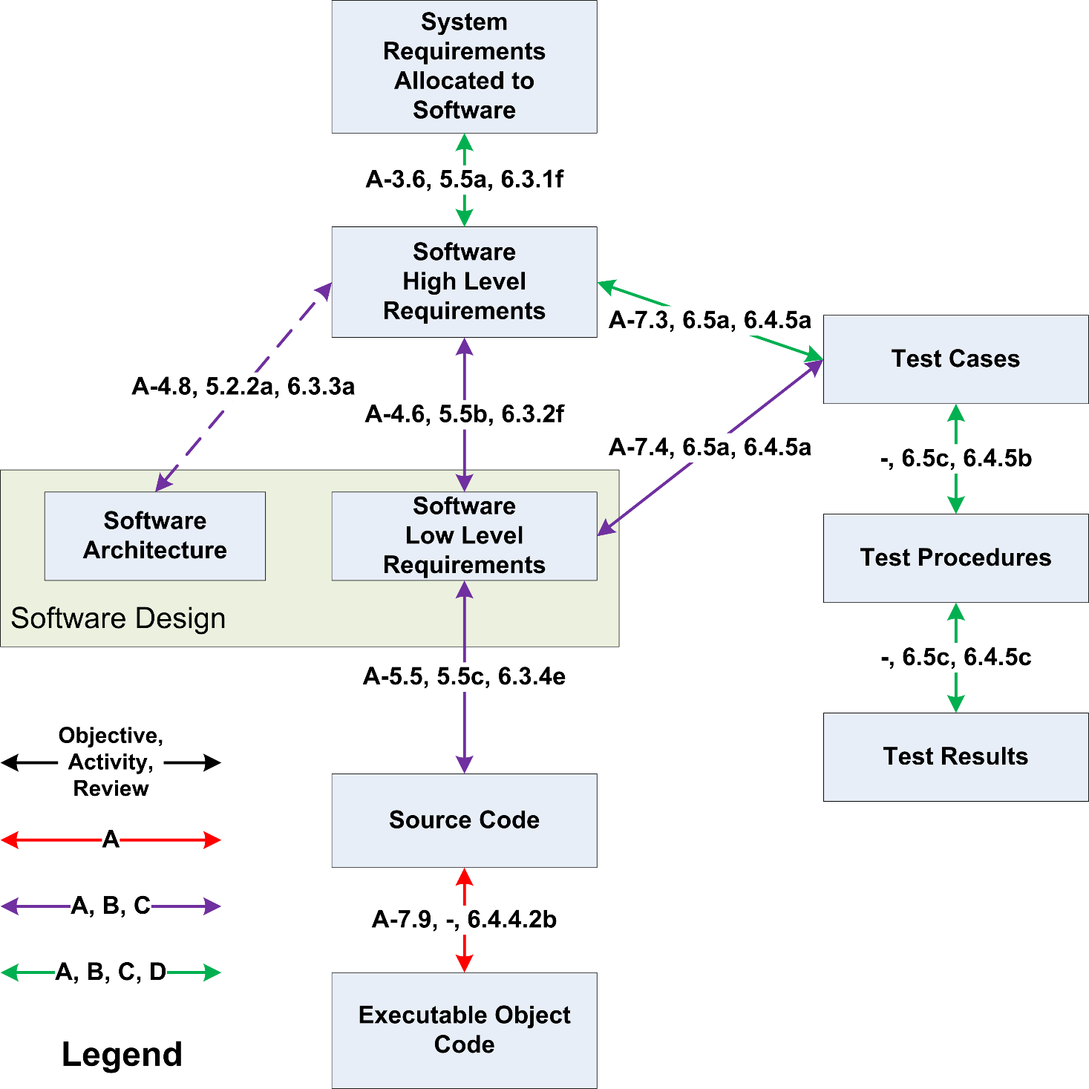
DO 178C
Traceability
Requirements
Starting point for quality assurance
Trace required for this certification level

Slide 18
CMMI
How to show SQA works?
One solution: capability maturity model

Slide 19
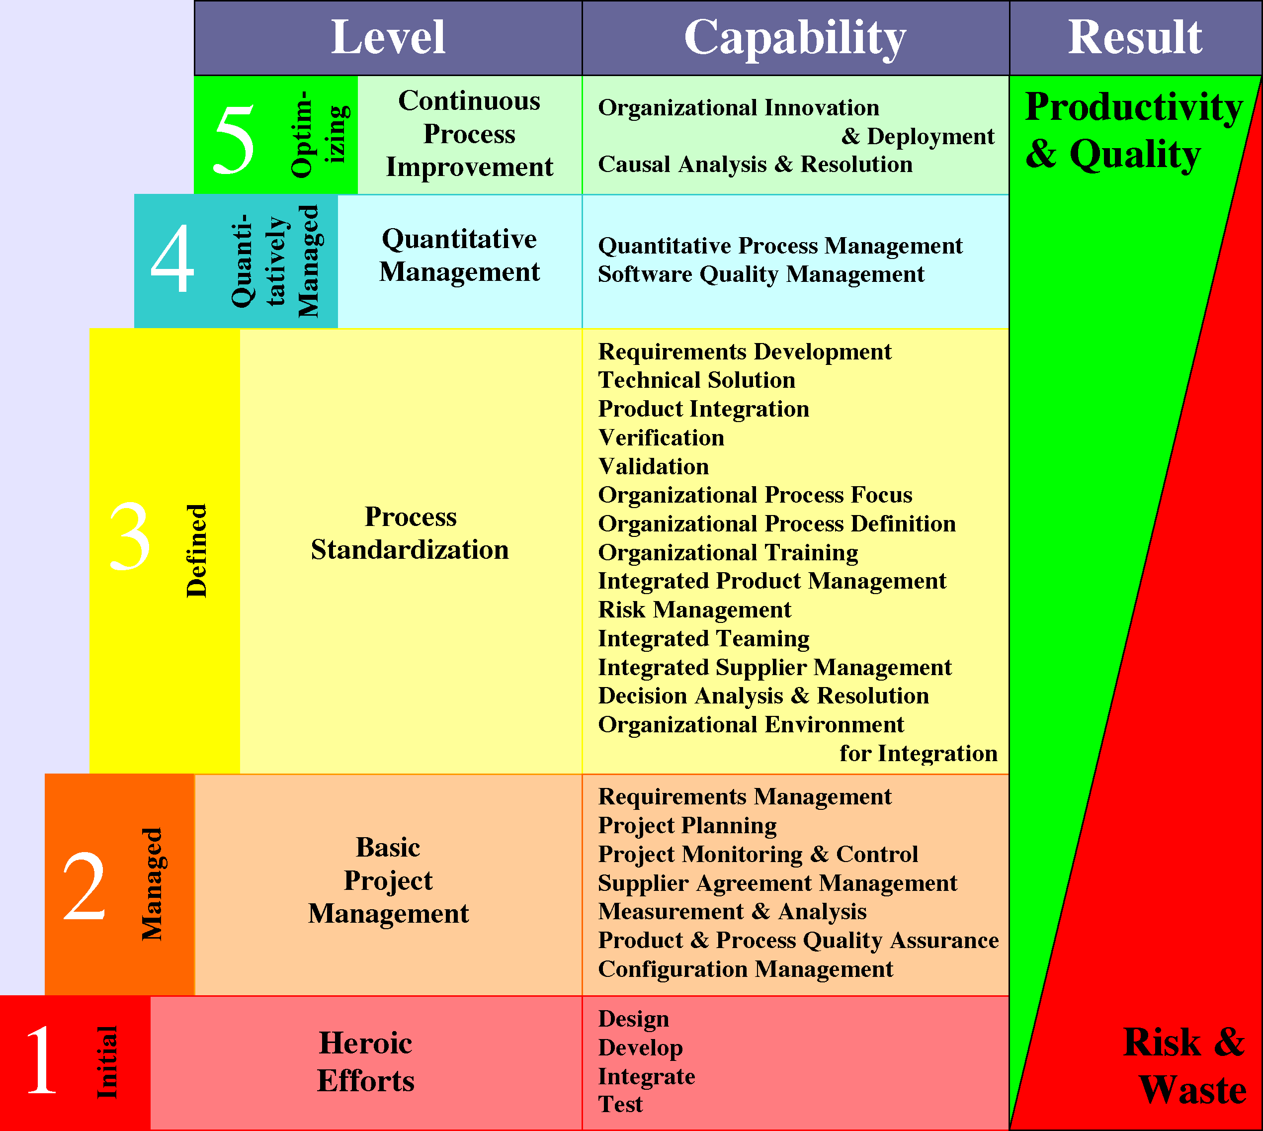

Slide 20
Another approach
What can you accomplish by testing?
Showing the existence of bugs
NOT: showing system has no bugs
Solution: prove system correct
Provide formal specification
Basic tool: mathematics – esp. set theory
Can then prove theorems
Limitations
Writing specifications is difficult
Limited support for theorems
Has been done for compilers, safety critical systems
Easy to dismiss, but strong limits to testing

Slide 21
Quality past and future
“Old school” software quality
Convincing “engineers” to follow process
Ensuring adequate testing
CMMI: ensuring quality standards in place, effective
Agile: software quality assurance is dead?
Problem: how to certify?
Future: proven quality

