Slide 1
Note 3 Computers 101
CSC 2210 Procedural and Object-Oriented C++
Copyright © 2023 Robert W. Hasker

Slide 2
What do you know?
How is information stored on a computer?
What are the major components of a computer?
What are the primary types of storage on a computer?
How are programs stored?
How is a program executed?
Give examples of individual instructions

Slide 3
Textbook: great overview of how computers work,
but what’s inside the box?
Power supply
Motherboard
Notes:
Images captured from https://www.lifewire.com/tour-inside-a-desktop-pc-2624588
This page: photo by Asim Bijarani / Flickr / CC-BY-2.0

Slide 4
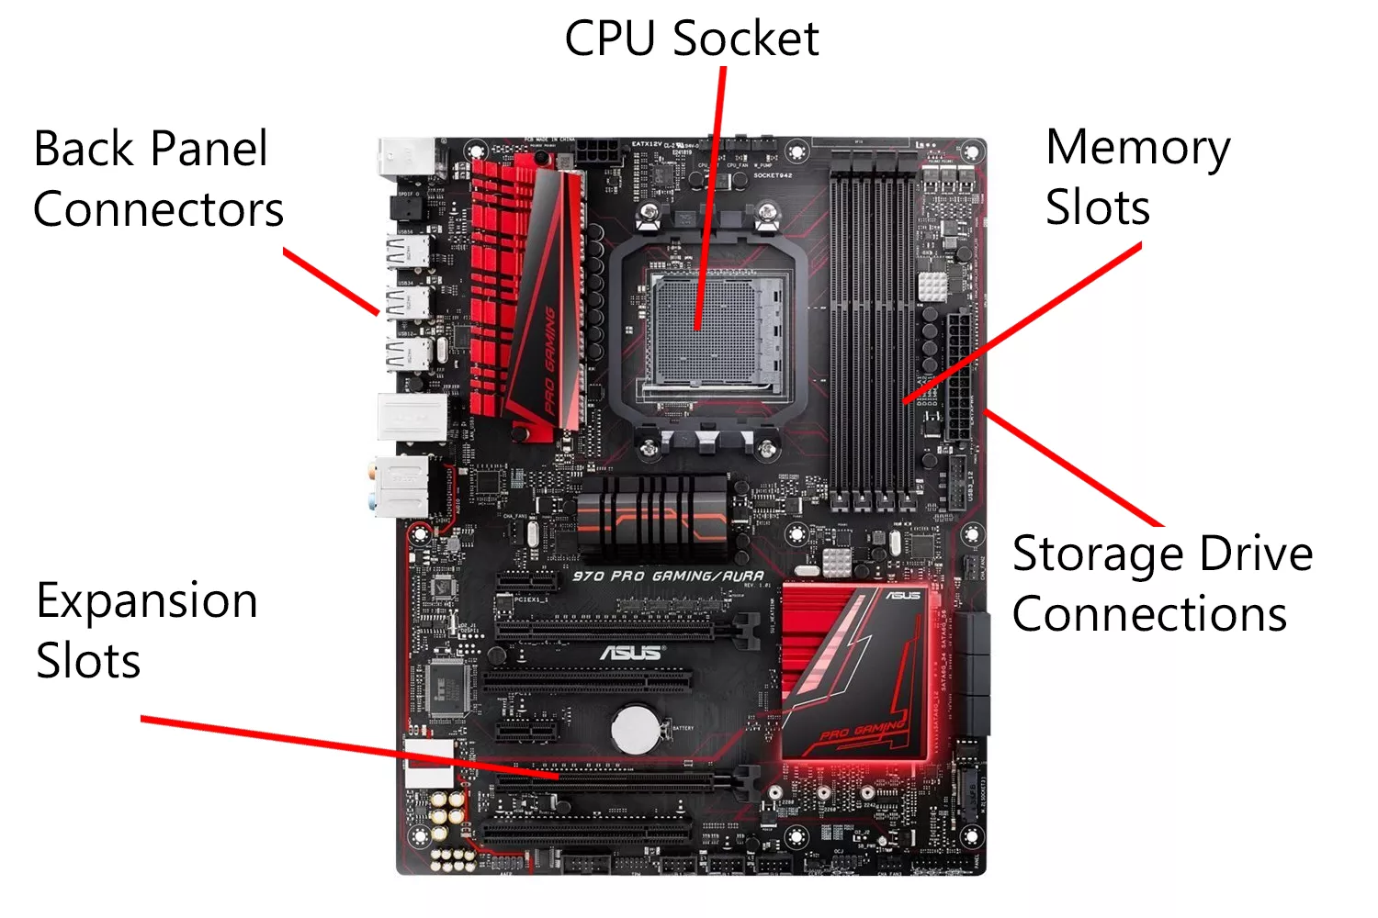
(Central Processing Unit)
Notes:
Photo from Amazon

Slide 5
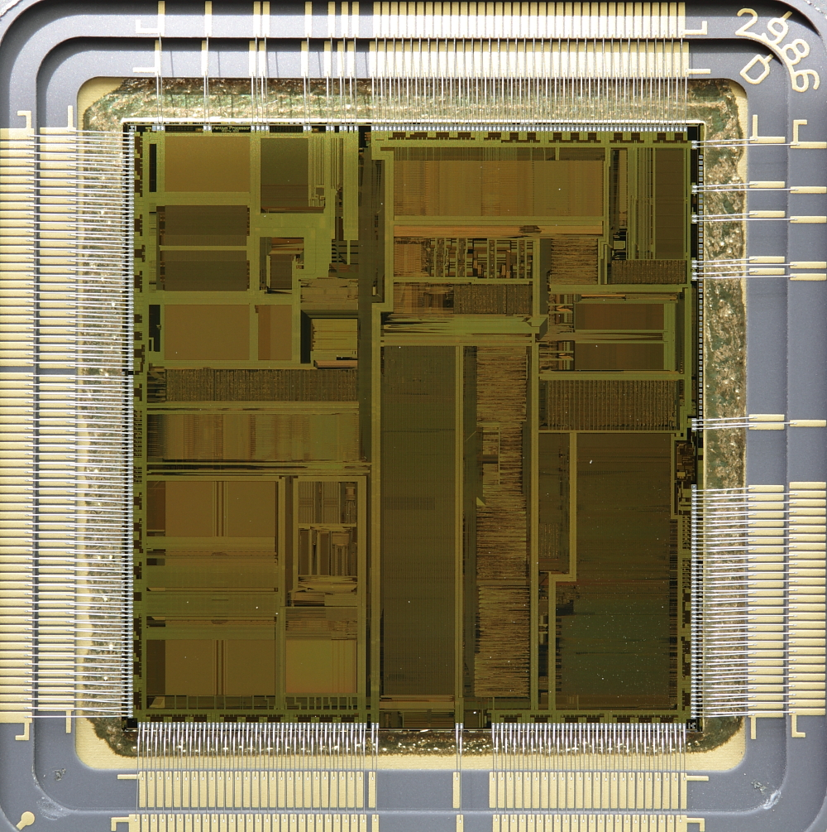
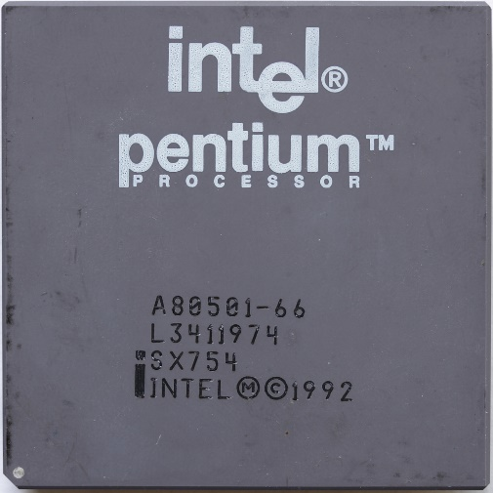
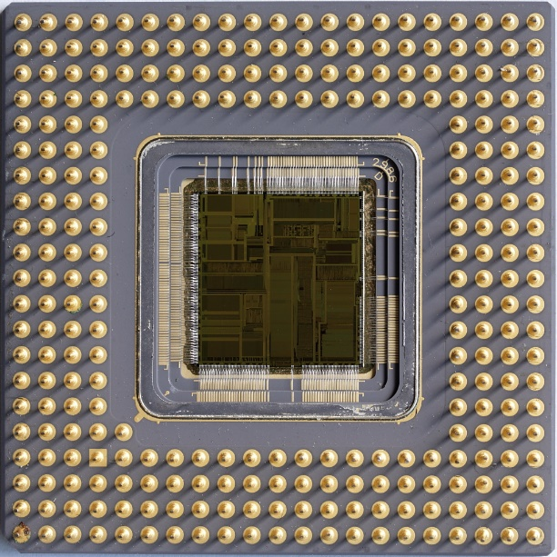
CPU – package, internals
Notes:
Images from https://notabs.org/pictures/intel-pentium-p5/
For more images, see https://en.wikipedia.org/wiki/Central_processing_unit

Slide 6
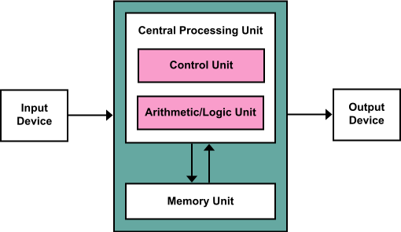
Schematic view
Memory: data store
Input: long term storage (eg, SSDs), network ports, mouse, keyboard
Output: long term storage, display, various lights
Control: what happens when
ALU: basic math
This is known as the Von Neumann architecture – first described by him (w/ help!) in 1945
Dominates computing even today
Notes:
Image from https://en.wikipedia.org/wiki/Von_Neumann_architecture; see https://en.wikipedia.org/wiki/First_Draft_of_a_Report_on_the_EDVAC for link to where von Neumann architecture described (though note other people also contributed to this!!)

Slide 7
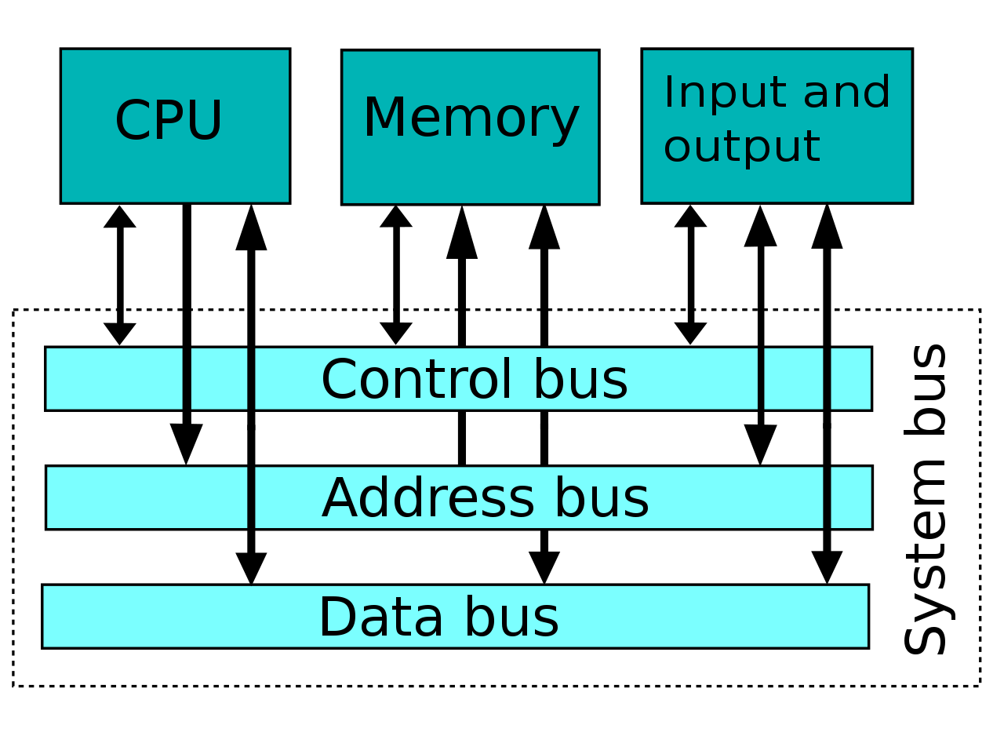
Basic mechanism for transferring data
More precisely, the system bus
General model: to transfer data from (say) CPU to RAM:
put the address on the address bus,
value on the data bus,
set control line to indicate cpu->memory
Bus width: generally, one bit (0 or 1) per line
Each line costs, but more information at a time gives faster performance
Word size: typically matches the size of address and data bus
Notes:
Image from https://en.wikipedia.org/wiki/System_bus

Slide 8
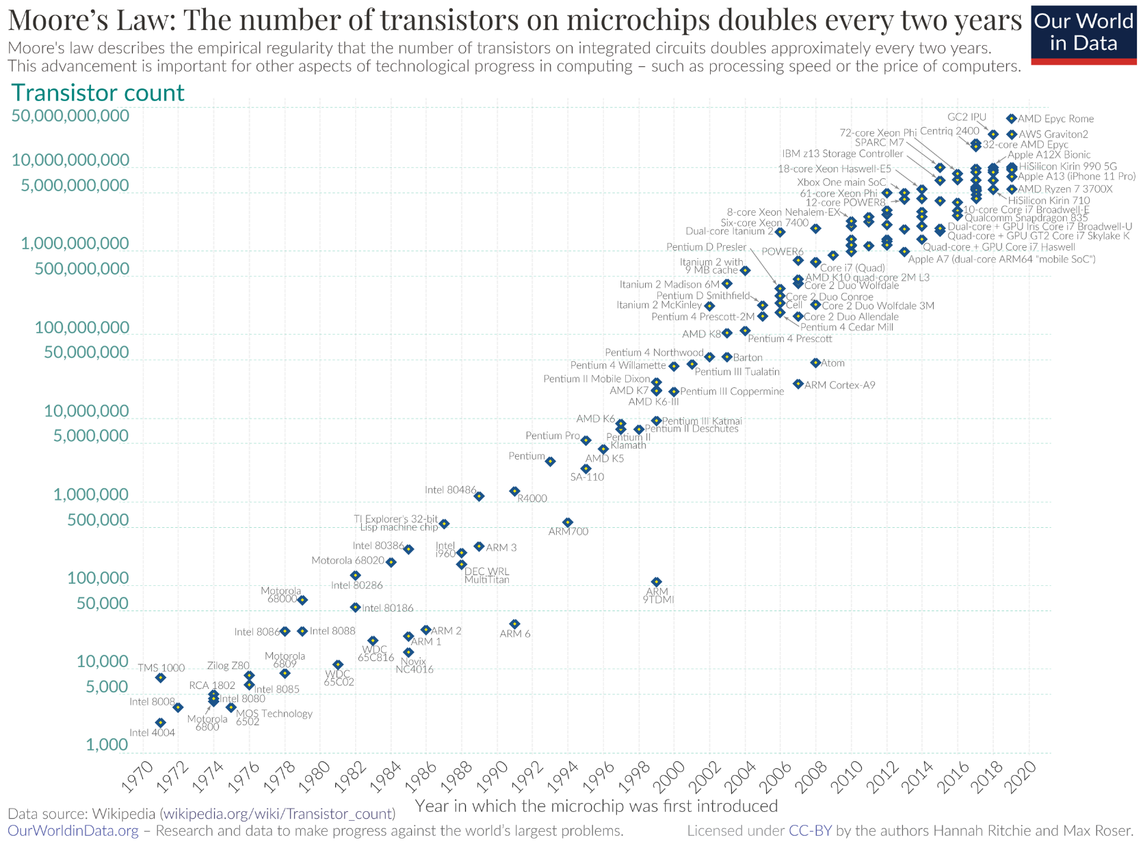
Issue: Speed of light
About 3e8 meters per second in vacuum
97% fewer meters pre second in copper
In a billionth of a second (a nanosecond), light travels 11.8 inches
Fast, but not instantaneous!
Question: how much work can we get done in (say) 11.5 inches?
Compare to a processor that might be ¼ inch on a side…
More detail: work done by series of gates built from transistors, etc
Notes:
Grace Hopper explains a nanosecond: https://kottke.org/19/05/grace-hopper-explains-a-nanosecond
Yes, it’s 299792458m/s in vacuum, but engineers often use 3e8 for computations
Image of Moore’s law from https://en.wikipedia.org/wiki/Moore's_law – ackmowledge that this is slowing quickly 2 decades later
uploaded from Max Roser, Hannah Ritchie from https://ourworldindata.org/uploads/2020/11/Transistor-Count-over-time.png with UploadWizard

Slide 9
Issue: Speed of light
About 3e8 meters per second in vacuum
97% fewer meters pre second in copper
In a billionth of a second (a nanosecond), light travels 11.8 inches
Fast, but not instantaneous!
Question: how much work can we get done in (say) 11.5 inches?
Compare to a processor that might be ¼ inch on a side…
More detail: work done by series of gates built from transistors, etc
Impact: transferring data from/to processors is relatively slow
Key point: where data is stored is critical to computations!
Minimize transfer from/to RAM
Notes:
Grace Hopper explains a nanosecond: https://kottke.org/19/05/grace-hopper-explains-a-nanosecond
Yes, it’s 299792458m/s in vacuum, but engineers often use 3e8 for computations

Slide 10
Solution: on-CPU (“on-chip”) memory
Register
Very high speed – feeds directly to arithmetic logic
Typically: all computations involve registers, though sometimes hidden
Limited number: 8, 12, 16, 32, 64, etc.
On-CPU Cache: copies of recent values in memory
Managed by CPU, avoids unnecessary reads/writes on bus
Our focus: registers
Cache is important to optimization, but not programmers
Basic way code is executed: load values into registers, compute result, store register to memory

Slide 11
Register sizes
Typically: register size is the machine’s word size
Eg: 32-bit, 16-bit, 64-bit, but there are 8-bit, 24-bit processors
Can have register = half-word – early 32-bit processors did this, but not common
A bit: 0 or 1
Represented by high/low voltages in a circuit
For example,
logical zero: up to 0.8 volts
logical one: might be 2 volts or more
Circuit design: ensuring correct logical values – programmer can ignore these
What is a byte, nibble?
How to represent an integer as a sequence of bits?
Notes:
END OF LECTURE 1 (on this topic)

Slide 12
Review
Name 4 classes of memory on personal computers and compare the performance of each
What controls the word size on a machine?
What is a bit?
Why is computer logic hardware bit-centric?
Today: how to represent numbers as “bit strings” (that is, sequences of bits)

Slide 13
Binary to Decimal
How do we count in binary?
How does this relate to decimal?
What is the decimal value of 1011₂?
How to convert from binary to decimal?
How to convert from decimal to binary?
Assume need “most significant” bit first – bit for highest power
Big-endian vs. little-endian
Reference to Gulliver’s Travels, whether people break an egg shell starting at large end or small end (big-end vs. little-end)
Big-endian: left-to-right order of bits (and why I prefer this terminology!)
A similar issue is relevant for the order of bytes within a word
Notes:
Binary to decimal: one’s place, two’s place, four’s place, eight’s place, etc.
Decimal to binary: divide by 2, read bits backwards
Big vs little endian: important terms for computer engineers, but not so useful for more abstract computing!

Slide 14
Examples
Binary of 1178 (compute by long hand, dividing by 2’s)
Compute binary of 42, 35
Add them
How many bits in the result?
What if the word size is just large enough for 42, 35?
What do we get if we multiply the values?
Processors: carry bit, overflow bit (flags)
Notes:
END OF LECTURE 2

Slide 15
Question, how to represent negatives?
Simple model: sign bit followed by number
Problems: two representations for zero, lots of cases for addition/multiplication
1’s Complement: negatives = the complement of positive values
“Complement”: flip all bits
Eg: 1’s complement of 01101₂ (13) is 10010, so this represents -13
Challenge: still have multiple cases for addition
2’s Complement: complement and add one
Eg: -01101₂ (for -13) would give 10010 + 1 = 10011
MSB = 0: positive; 1: negative
Write table for -8 to 7

Slide 16
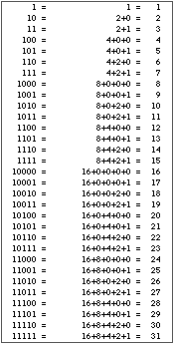
2’s complement math
13 + -12:
-12: inv(1100₂) + 1 = 0011 + 1 = 0100
13: 1101
Add: 0001 (with 1 carry) – positive result = 1
12 + -13:
12: 1100₂
13: inv(1101) + 1 = 0010 + 1 = 0011
Add: 1111 = -1
Negating 0: inv(0000) + 1 = 0000
Advantage: 0 and -0 have same representation
Notes:
Image from http://www.mathmaniacs.org/lessons/01-binary/Magic_Trick/

Slide 17
More examples
See https://sandbox.mc.edu/~bennet/cs110/tc/index.html

Slide 18
Range of values
The range of 4-bit values: -8 to 7
Largest positive 4-bit value: 0111 = 7
Largest negative 4-bit value: 1000 = -8
The range of 16-bit values: -32768 to 32767
Why? (review the bit patterns)
General formulas: 2^{n-1} – 1 down to -2^{n-1}
Always one more value in negative space vs. positive space
Oddity of 2’s complement: unequal ranges
What is the range for 32-bit registers?
Summary:
Computer (logical) circuits: low/high voltage for zero, one
Represent numbers in binary
Most common binary representation: 2’s complement

Slide 19
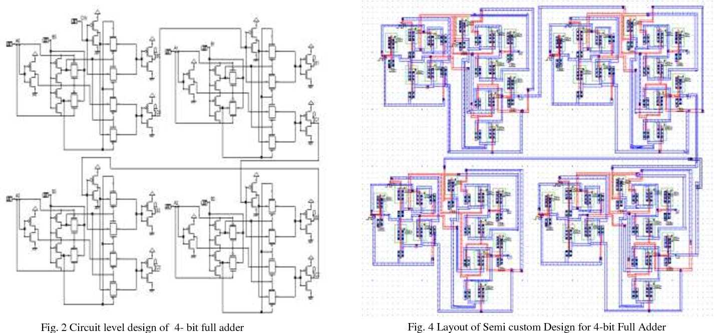
(A) circuit for 4-bit full adder
Will discuss solution based on logic gates later.
Notes:
Full adder: handles carry bits; don’t memorize the diagram (this is just one example), but observe how it does not take a lot of components (typically, transistors, resistors, & diodes) to construct such a circuit.
From https://www.semanticscholar.org/paper/Efficient-Layout-Design-of-4-Bit-Full-Adder-using-Yadav-Mehra/c0772414c13a27b564b6074cb1a9100df5a214bb/figure/3
Efficient Layout Design of 4-Bit Full Adder using Transmission Gate
Anurag Yadav, R. Mehra, M. Scholar
Published 2015
DOI:10.14445/22312803/ijctt-v23p125

Slide 20
Hexing our data
How to represent binary values in code?
In C, C++ (and many others): put 0b at the front: 0b11111100111
But what is this number?
Compute!
But often we don’t need the decimal value!
Example: bits 0, 3, 5 control whether three LEDs are lit
Solution: Hexadecimal – base 16
Give table of (unsigned) values 0-16, write hex digits
Note why we use 16 bits for hex values!
This number in hex (as written in C, C++): 0x7E7
You will sometimes see octal values (written with leading 0): 03747
Can also use \ in characters: ‘\007’ (BEL), ‘\177’ for DEL
ASCII charts: typically decimal, hexadecimal: see https://ss64.com/ascii.html
Note the patterns between within the table: ^A to A is +0x40, A to a is +0x20, ^[ to [, etc.
Note: we often show data in hex, but the computer does all computations in binary!
Notes:
… it’s the 1st year this course was offered: 2023

Slide 21
Review
Examine internals of computer, particularly basic system structure
Bit: smallest unit of value in logical circuits: either on or off
Byte, word: collections of bits
Word: typically size of bus, registers in computer, size of address
Binary to decimal, decimal to binary
1’s complement: multiple values for zero, many cases to add/subtract
2’s complement: efficient to implement, single zero, no cases
Different ways to represent binary data in code

