Slide 1
Floating-point Numbers
CSC 2210 Procedural and Object-Oriented C++
Drs. Saikath Bhattacharya, Robert Hasker

Slide 2
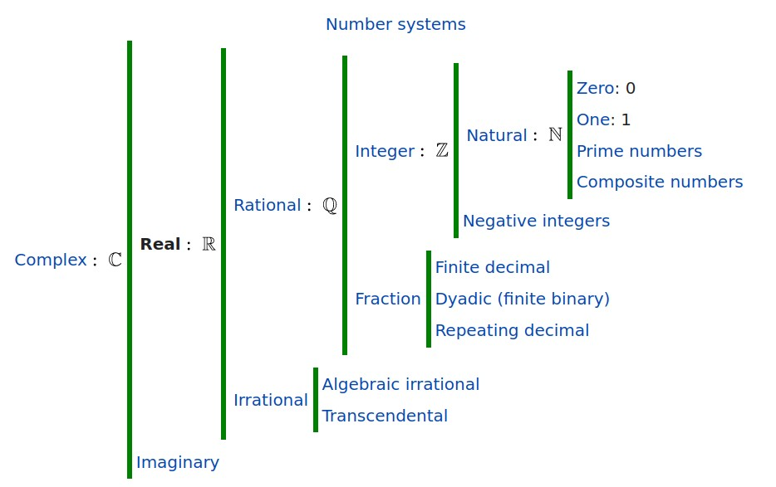
Real Numbers
Image from https://en.wikipedia.org/wiki/Real_number
Floating-point is a way of representing real numbers as approximate values
Some examples of reals:
3.14159265 · · · (pi)
2.71828 · · · (e)
0.000000001 or 1.0 × 10⁻⁹
`
2
3
The last number is called scientific notation, with a single digit to the left of the decimal point.
We will say a number is normalized if there are no leading zeros

Slide 3
How to store floating-point data?
Why can’t just write them as real numbers like middle school?
If you had to build it yourself, what would you do?
What goals should we have for floating-point representation?
Examine https://baseconvert.com/ieee-754-floating-point
Values to try:
0.5, 1.0, 400.0
-0.5, -1.0, -400.0
0.1, 0.099999999999999
0.0, -0.0, infinity, NaN
1e8, 1e30, 1e50, 1e38
1e-30, then find smallest number you can represent in 32 bits
What did you learn from these?
Notes:
Goals: precise, compact, and fast computation

Slide 4
Floating-point standard we will use
Defined by IEEE Std 754
Developed in response to divergence of representations
Portability issues for scientific code
Now almost universally adopted
Two representations
Single precision (32-bit)
Double precision (64-bit)

Slide 5
Floating Point Representation
(−1)^{s} × F × B^{E}
s- Sign part of the number
F– Fractional Part of the number. Also called as The Mantissa, The Significand
E– Exponential Part of the number
B is the base of the number. 2 for binary numbers, 10 for decimals
1
2
3
4
In the IEEE 754-2008 standard, all floating-point numbers - including zeros and infinities - are signed. https://ieeexplore.ieee.org/document/4610935

Slide 6
IEEE Std 754 Floating point
Single and Double Precision Floating points
Precision
Single Precision Largest: 1.111 · · · × 2¹²⁷ ≈ 10⁺³⁸
Double Precision Largest = 1.111 · · · × 2⁺¹⁰²⁴ ≈ 10⁺³⁰⁸
Smallest Single: 1.000 · · · × 2⁻¹²⁷ ≈ 10⁻³⁸
Smallest Double: 1.000 · · · ×2⁻¹⁰²² ≈10⁻³⁰⁸

Slide 7
IEEE 754 treats 00000000 as the most negative exponent and 11111111 as the most positive. This amounts to using a bias of 127 for single precision and 1023 for double precision.
Biased Representation
1
2
Overflow - When a positive exponent becomes too large to fit in the exponent field
Underflow - When a negative exponent becomes too large to fit in the exponent field
The fraction field will contain the value being multiplied by the exponent, a 1 to
the left of the binary point is added.
So, value is
(−1)^{s} × (1 + significand) × 2^{(exponent−bias)}

Slide 8
Converting Binary Float to Decimal
A fractional decimal number can be expressed as
a_{n} × 2^{n} + a_{n−1} × 2^{n−1} + · · · + a₂ × 2² + a₁ × 2¹ + a₀
+ a₋₁ × 2⁻¹ + a₋₂ ×2⁻² + · · · + a_{−m} × 2_{−m}
General method: apply the formula
(−1)^{s} × (1 + significand) × 2^{(exponent−bias)}
Examples:
0 10100000 11111010101000111011010:
Exponent: 32+128 – 127 = 33
Fraction: 1 + ½ + ¼ + 1/8 + 1/16 + 1/32 + 1/128 + 1/512 + 1/2024 + 1/32768 + 1/65536, about 1.97906
2**33 * 1.97906 = about 16999990000, or (when rounded) 1.7e10
0 01111010 10011001100110011001101
Notes:
0 01111010 10011001100110011001101 is 0.05:
10+16+32+64 – 127 = -5
1 + ½ + 1/16 + 1/32 + 1/256 + 1/512 + 1/4048 + 1/8096 = 1.599980 (about)
2**-5 * 1.599980 = 0.049999375 or, rounding to 6 digits, 0.05

Slide 9
Special values

Slide 10
Decimal to Binary Floating-Point Conversion
1
Determine the sign bit
Convert magnitude to unsigned binary
2
Convert the whole number value using division algorithm
1 Just use the whole number portion (separate the whole number from the fraction value)
2 Divide by 2
3 Place remainder as MSB
4 Repeat until quotient is zero
2 Convert fractional value using multiplication algorithm
1 Use only the fractional value
2 Multiply by 2
3 Store the whole number part of the result of the product as the LSB
4 Repeat until the fractional value of the product is 0
1
Now have sign, exponent, fractional portions…

Slide 11
Decimal to Binary Floating-Point Conversion
The following assumes 32 bits; 64 bits are similar:
Compute the sign, exponent, and mantissa as described above
Add the bias to the exponent (for single precision, 127)
Normalize the mantissa by shifting it until there is a single 1 bit to the left of the decimal point
On each left shift, decrement the biased exponent
On each right shift, increment the biased exponent
If exponent overflows, underflows: replace all bits by appropriate pattern
Concatenate the result into the sequence of bits:
Sign bit + Exponent (8 bits) + Mantissa

Slide 12
Example 1
Convert 9.125 into single precision floating point
9 = 1001
0.125 × 2 = 0.25
0.25 × 2 = 0.5
0.5 × 2 = 1
9.125 = 1001.001 × 2⁰
Normalize = 1.001001 × 2³
signed bit s=0
Bias =3
Exponent = 127+3 = 130
8-bit binary =10000010
Significand = 001001 00000000000000000
0 10000010 00100100000000000000000

Slide 13
Example 2
Convert -35.75 to IEEE floating point format and Hexadecimal format
Magnitude of 35.75
35 = 100011
0.752 = 1.5 → 1
0.52 = 1.0 → 1
100011.11
Normalized form = 1.0001111 × 2⁵
signed bit: 1 (negative) Bias = 5
Exponent = 127+5= 132
8 bit binary = 1000 0100
Significand = 0001111 0000000000000000
1 10000100 00011110000000000000000
Convert the binary into a group of 4 to a hex digit: 1100 0010 0000 1111 0000 0000 0000 0000
0xC20F0000

Slide 14
Example 3
Convert the hexadecimal IEEE format floating point number 0x40200000 to
decimal:
First, convert the hex to binary:
0100 0000 0010 0000 0000 0000 0000 0000
Then pull out each of the 3 pieces: S: 0 (positive)
E: 1000 0000 = 128.
Taking 128 - 127 = 1
M: 01 000000000000000000000
So we have 1.01 × 2¹ = 10.1
Then convert that to decimal to get the answer: 2.5

Slide 15
Convert -1313.3125 to IEEE 32-bit floating point format.
Example 4

Slide 16
The binary number 1313 = 10100100001. The fractional:
0.3125 × 2 = 0.625 0
0.625 × 2 = 1.25 1
0.25 × 2 = 0.5 0
0.5 × 2 = 1.0 1
So 1313.3125 = 10100100001.0101
Normalize: 10100100001.0101 = 1.01001000010101 ×2¹⁰.
Mantissa is 01001000010101000000000,
exponent is 10 + 127 = 137 = 10001001, sign bit is 1.
So -1313.3125 is 1 1000100 101001000010101000000000 = c4a42a0016

Slide 17
Example 5
Convert 0.1015625 to IEEE 32-bit floating point format. Converting: 0.1015625 ×2 = 0.203125 0
0.203125 ×2 = 0.40625 0
0.40625 ×2 = 0.8125 0
0.8125 ×2 = 1.625 1
0.625 ×2 = 1.25 1
0.25 ×2 = 0.5 0
0.5 ×2 = 1.0 1
So 0.1015625 = 0.0001101
Normalize: 0.0001101 = 1.101 ×2⁻⁴.
Mantissa is 101 00000000000000000000,
exponent is -4 + 127 = 123 = 01111011, sign bit is 0.
So 0.1015625 is 00111101110100000000000000000000 = 3dd0000016

Slide 18
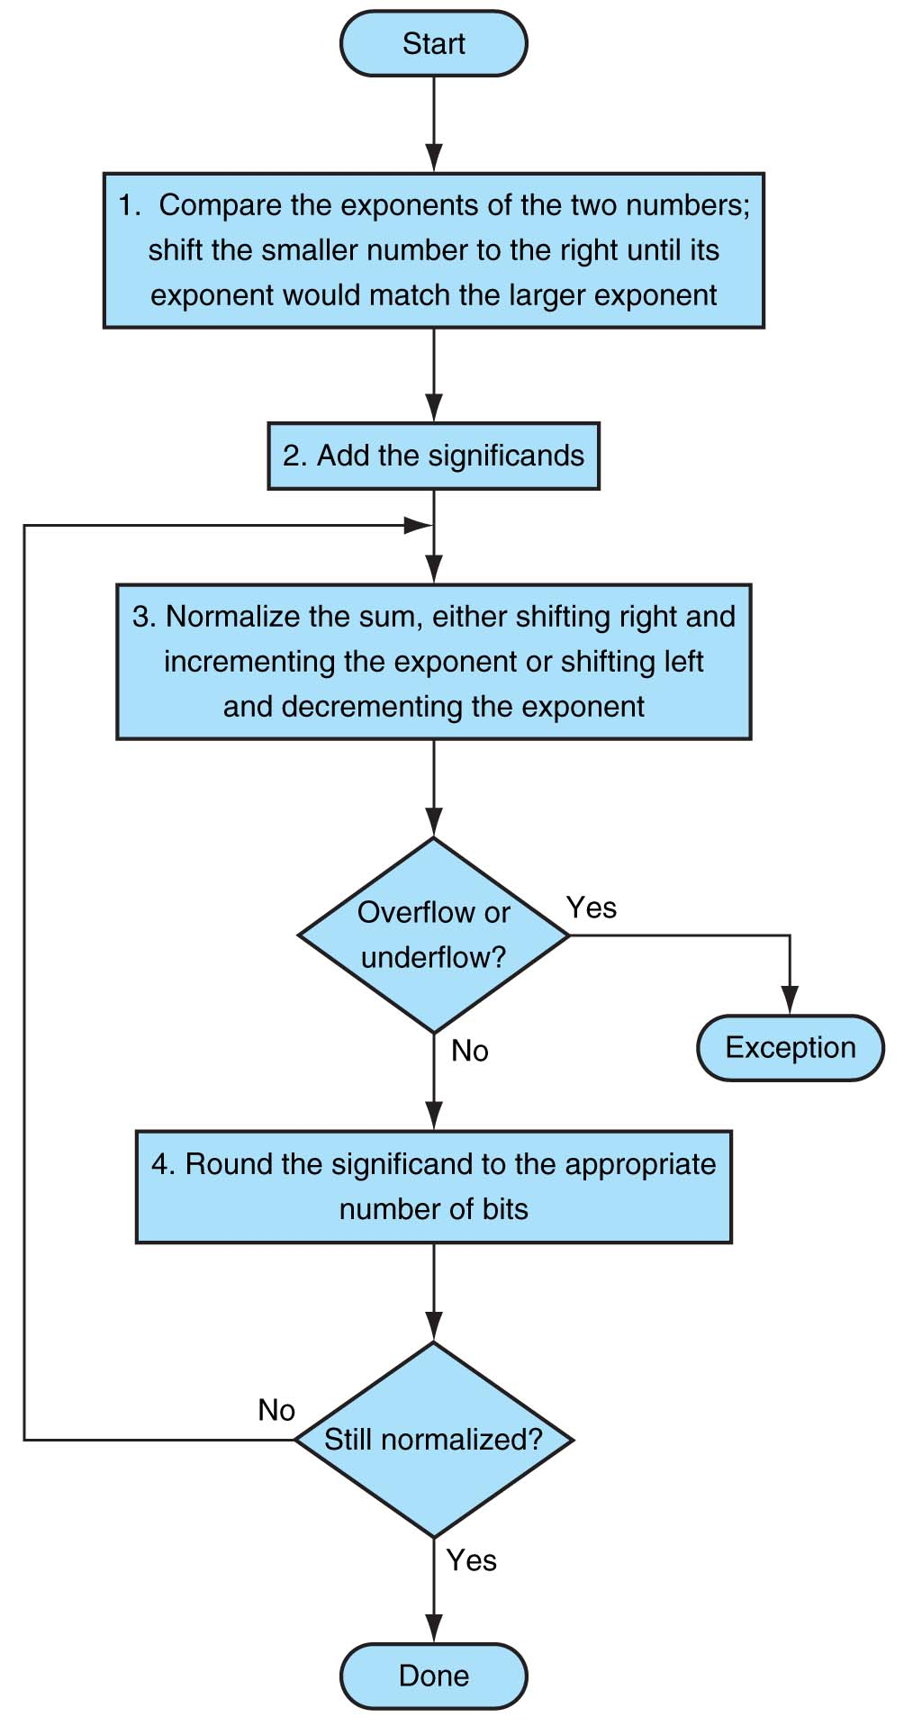
Floating- point addition

Slide 19
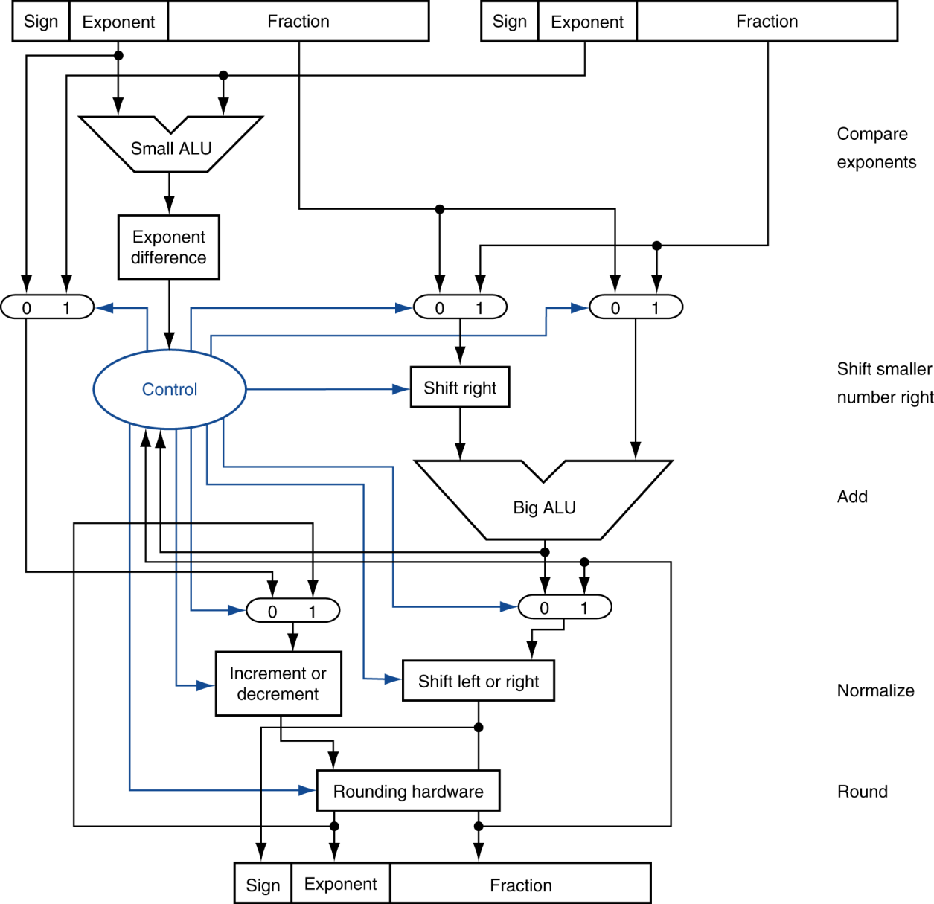
FP Adder Hardware
Step 1
Step 2
Step 3
Step 4

Slide 20
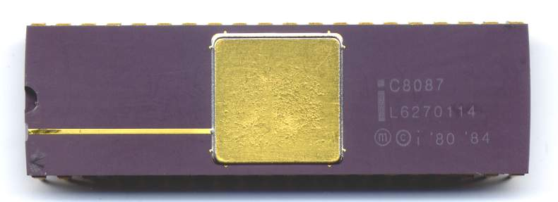
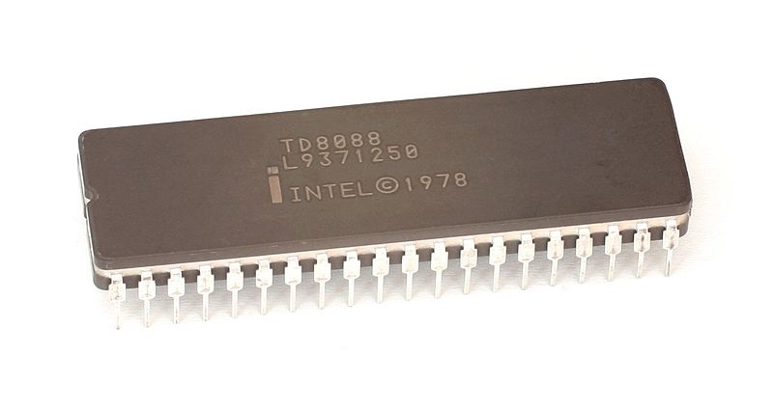
Floating Point Hardware
… companion to 8086:
Notes:
8087 math coprocessor
What if have no coprocessor – then floating point arithmetic done by libraries

Slide 21
Single vs. Double Precision
Why have double precision?
Typical precision on Windows: 15-16 digits
If double precision is more accurate, why have single?
Typical precision: 7 digits
Default: compute with doubles since space doesn’t often matter
Note get double precision unless all values are single
Constants default to double; use 3.5f to get single precision
Some systems: long double gives more precision
Many simulations:
Compute using double to avoid being overwhelmed by roundoff error
Save final result as single precision
Experience with machine learning:
Models are rarely sensitive to single vs. double
Typically store final model as 16-bit floats to save space, transmission costs
Notes:
Reasons for single: faster computation, half the storage requirements (significant when storing billions of values!)

Slide 22
Floating Money
What’s the common way to store dollar amounts?
What is the impact?
Issue: is (a + b) + c always the same as a + (b + c) for floats?
Why does this matter?
Consider 1e6 + 1.0 + … + 1.0, 1000 times vs. 1000.0 + 1e6
How should monetary amounts be stored?
Simple solution: int – count pennies
Write a class to convert from strings to money
Don’t look silly!

Slide 23
Review
Don’t compare floats for equality (except for 0.0)
Eg: use something like abs(x – 0.5) < 1e-6, not x == 0.5
Dominant format for floats: IEEE 754
Format of 32-bit float: sign + exponent + mantissa
Exponent is biased by adding 127 (avoids negative exponents)
Mantissa is fractional part, normalized, with no leading 1
Formula: (−1)^{s} × (1 + significand) × 2^{(exponent−bias)}
Expense of computing
Must normalize numbers, add bits, normalize back
Essentially requires loops!
Floating point multiply can be orders of magnitude slower than integer multiply
So, what’s in a type??

Slide 24
3 ways to understand types in Programs
View #1, the version you learned in your introductory courses:
A type is a set of values
Example: int is an Integer, floating-point is a Real
Operations: +, -, *, /, but / fails if dividing by 0
In code, val1 / val2 is an int if both numbers are ints, floating-point otherwise
Really have ranges of values and approximations, but not important in most cases
This is the mathematical view
View #2:
A type captures how the data is represented, a format
Examples: 2s-complement, 32-bit or 64-bit IEEE Std 754 floating point
The machine view: a type as a format for a series of bits
View #3: abstract data types
A type captures the information stored and operations on that information
Classes, float, double, int: all provide an abstract data type
Programmers regularly must switch between these views
Mathematical: logic
Machine: debugging
ADT: capture what we know about the domain of the problem
Learn to see your code from each viewpoint!

