Slide 1
Note 16 How Computers Work
CSC 2210 Procedural and Object-Oriented C++
Copyright © 2023-24 Robert W. Hasker

Slide 2
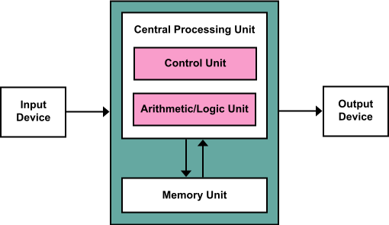
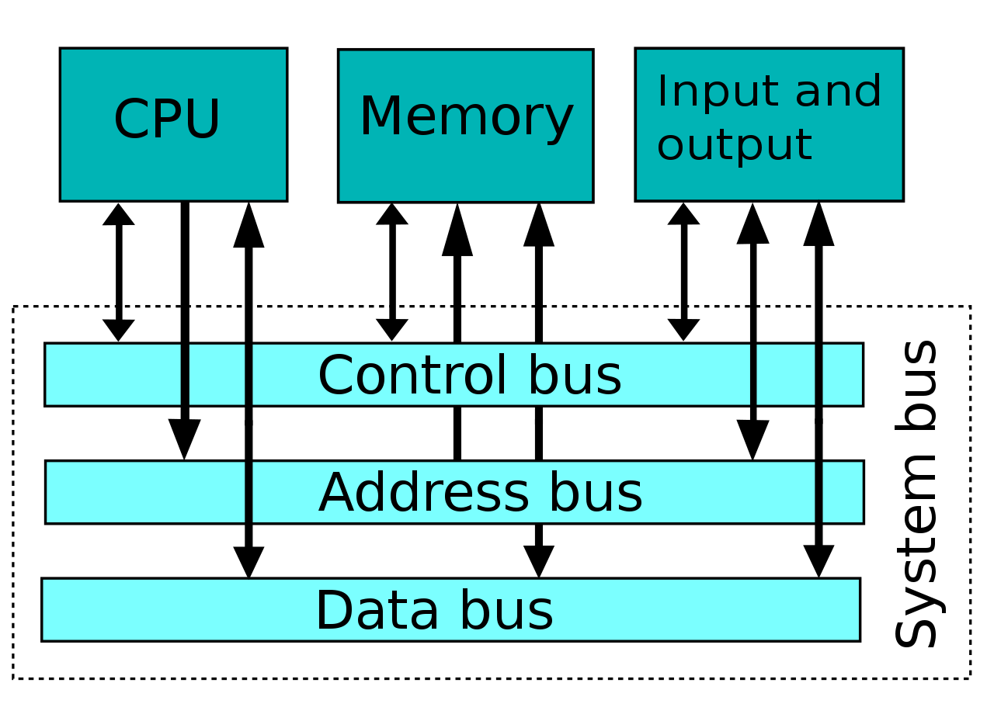
Basic Structure
This is from note 3
CPU reads instructions from memory
CPU executes the instruction
Reads data from memory (RAM)
Use the ALU to compute a result
Writes result to memory
System bus
Communicate between RAM, CPU, other devices
Essentially parallel lines of wires, each wire holding a single bit
Data, address bus: word width
Control: a few wires determining read/write, source/destination
How does the CPU work?
Notes:
Image from https://en.wikipedia.org/wiki/System_bus

Slide 3
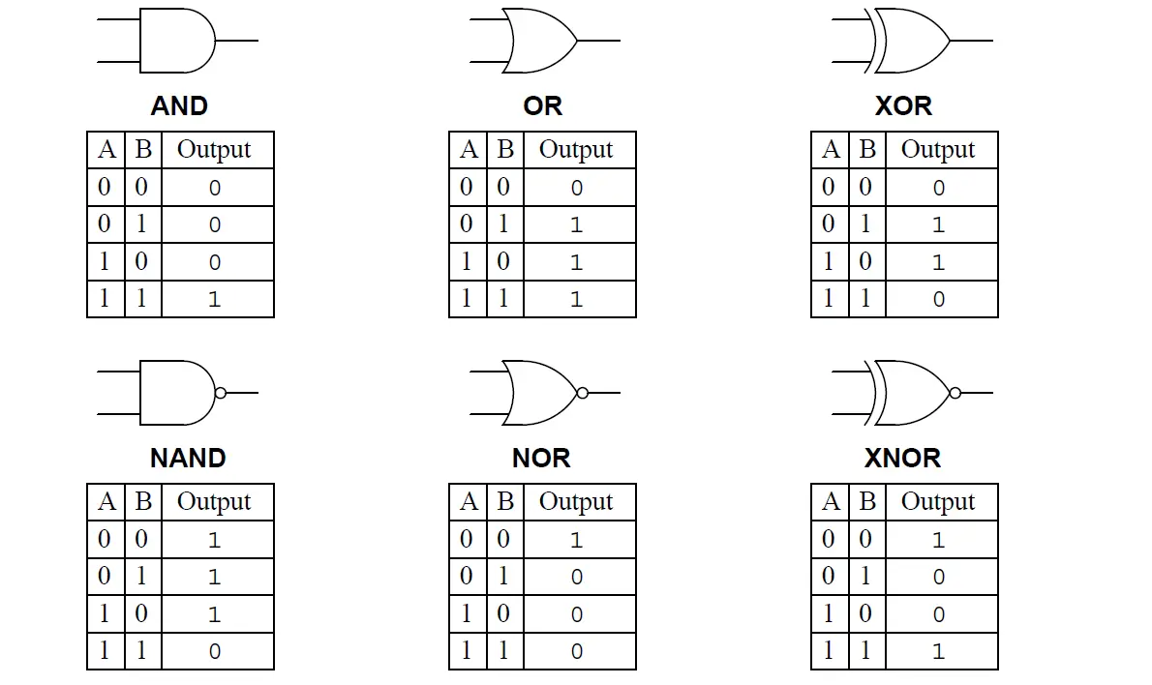
Logic Gates
Core element: logic gates
Each can be implemented with a small number of transistors, resistors, diodes
Implemented on chip using “doped” bits of silicon
https://instrumentationtools.com/logic-gates/
Notes:
Logic gates from https://instrumentationtools.com/logic-gates/

Slide 4
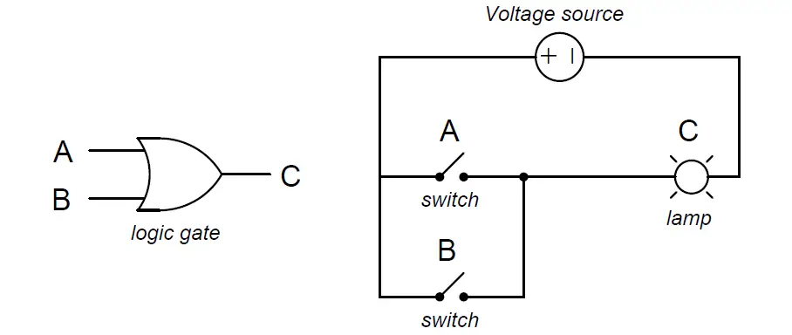
Logic Gates
Core circuit element
Top to bottom:
AND
OR
NOT
Careful “doping” of silicon can build each
Can also implement each with transistors, resistors, diodes
https://instrumentationtools.com/logic-gates/
Notes:
Images from https://instrumentationtools.com/logic-gates/

Slide 5
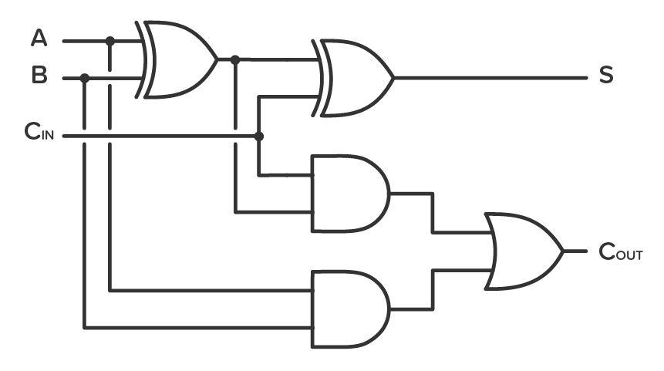
1-bit full adder
A, B: input bits
C_{in}: carry from previous addition
S: result (sum)
C_{out}: Carry out
String multiples together for a full adder
Notes:
Try cases: A = 0, B = 1, Cin = 1; etc
Diagram available many places, but this one from https://www.build-electronic-circuits.com/4000-series-integrated-circuits/ic-4008/

Slide 6
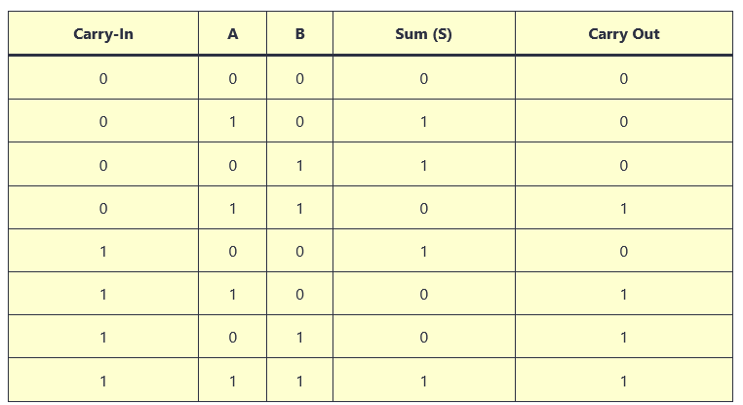
Using the full adder
Notes:
From same site as previous

Slide 7
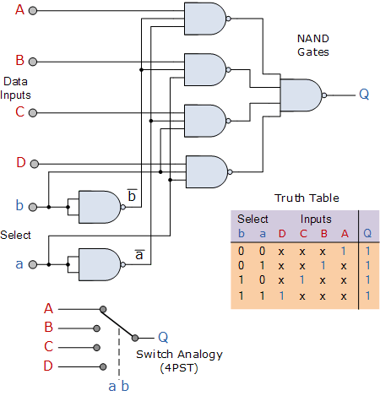
Multiplexor Circuit
NAND
gates
Data Inputs
Add: ALU
Key issue in CPU: how to route data
Solution: MUX (multiplexor)
Select from alternative inputs
And gate with circle: NAND
Convenient shorthand
a, b: select between A/B/C/D
This scales to any power of 2
Mirror image: 1 to many
Demultiplexor (DEMUX)
Truth table
Select
Switch Analogy
(4 positions)
Notes:
Image from https://www.electronics-tutorials.ws/combination/comb_2.html
See https://en.wikipedia.org/wiki/Multiplexer for additional discussion

Slide 8
Constructing a processor
Elements
Circuits to store data
For registers, these are typically feedback circuits that refresh on each cycle
ALU: essentially add/subtract with loops for multiplication
Optimized to reduce gate delay between input and output
Selectors: route data in CPU as required by instruction
Additional element: clock line so circuits can “settle” to get predictable output
Selectors controlled by instruction decoder
This can be a table of settings for each instruction
It can even be programmable: “microcode”

Slide 9
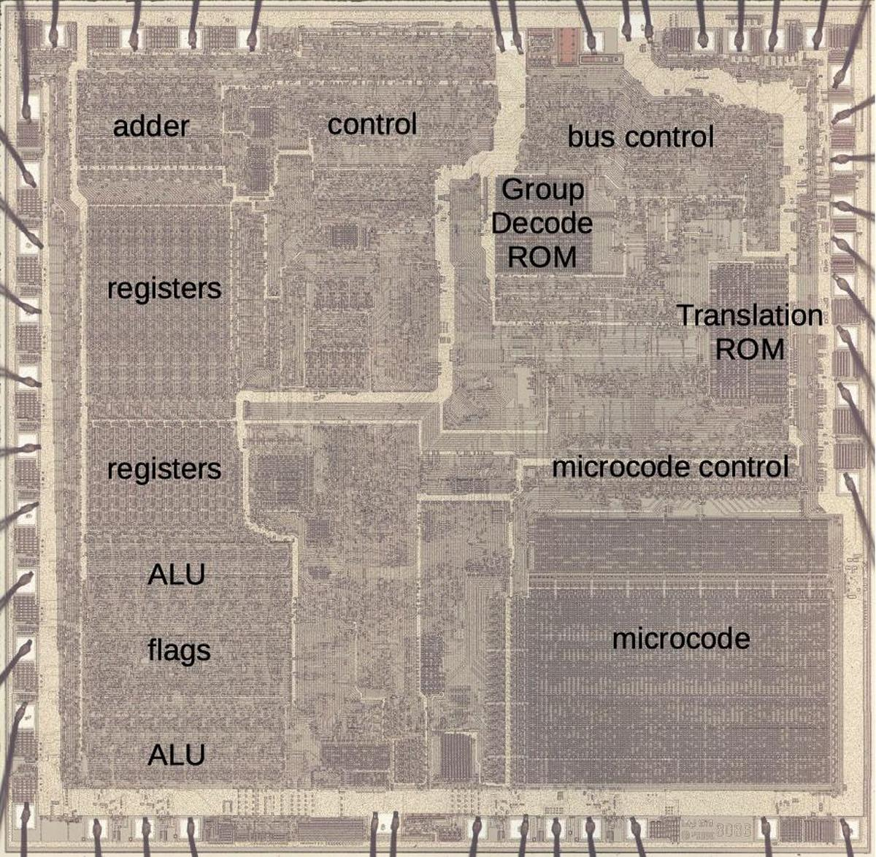
8086 Layout
Note registers, adder
Control: generally MUX/DEMUX circuits
Also contains clock
ALU: logic circuits
Flags: neg, overflow, etc.
Microcode: decode instructions to set MUX/DEMUX circuits

Slide 10
Review
Basic gates: AND/OR/NOT
Also have NAND, NOR
Interesting result: can create other gates from NAND, NOR
Theoretical result: all computers can be built from a single type of gate!
MUX: select between different inputs
DEMUX: chose output
Microcode: control selectors for instructions
Processor design as registers + ALU + control + instruction decoder
Question: how is this relevant to programmers?

