Slide 1
4. Object-Oriented Design (OOD)
SWE 2410 Design and Cloud Patterns
Drs. Hasker, Yoder
Notes:
Acknowledgement: Slides originally by Dr. Hasker

Slide 2
How to design object-oriented systems?
Null Object Pattern, Adapter Pattern: solving problems in existing systems
Open question: how to write systems in the first place?
What were the steps in SE 2030?
More questions to consider:
What makes a system object-oriented (OO)?
Why are object-oriented designs preferred?
What is the alternative to OO?
Are some OO systems better than others?
Starting point: defining what it means to be “object-oriented”
Notes:
Steps in SE 2030: write use cases & scenarios, develop classes from those – some students will know about noun identification

Slide 3
How to identify classes?
A user interaction with system written in the form
As a [type of user] I want to [do something] in order to [achieve a goal].
Meal Wheel user stories
As a hungry student, I want my phone to randomly select from different restaurants so I know where to eat.
As a picky student, I want my phone to suggest close restaurants that serve sashimi so I can choose a place to eat within 10 minutes walk.
As a restaurant owner, I want to distribute menus to potential customers so customers can be attracted by my food selections.
As a restaurant owner, I want potential customers to know of dietary restrictions that I support so I can attract customers who do not eat particular foods.

Slide 4
How to identify classes?
Some options – things in the system
Student, food order, menu
Diet, walking, 10 minutes
Orders
Database of restaurants
Lookup table of restaurant locations
javafx classes
Scene, Stage, Pane, MouseEvent
String, Date
Meal Wheel user stories
As a hungry student, I want my phone to randomly select from different restaurants so I know where to eat.
As a picky student, I want my phone to suggest close restaurants that serve sashimi so I can choose a place to eat within 10 minutes walk.
As a restaurant owner, I want to distribute menus to potential customers so customers can be attracted by my food selections.
As a restaurant owner, I want potential customers to know of dietary restrictions that I support so I can attract customers who do not eat particular foods.
What classes should be in this system?
Classes abstract things, so we’re really asking what things do we need?
Issues that might help us decide which things need to be classes:
What will be maintainable?
What if we switch to (say) iPhone & iOS/Swift rather than Android/Java?
What if we decide the data should be stored in text files?

Slide 5
Domain classes
Implementations: solution space
Classes that are in a particular solution
Possible classes: table of restaurants to GPS coordinates, table of restaurants to menus, table of dietary restrictions to menu items
Problems: domain classes
Classes that are part of the problem space
Start with these classes, add solution classes only as needed
Why prefer domain classes?
Solution independent – less likely to change to support new features
How would each solution change if we track popularity and wait times?
Natural: these are the entities that form the problem to solve
Design: adding solution space classes to meet goals
Notes:
Goals: performance, portability, safety, reliability

Slide 6
How to identify domain classes?
Solution 1: just sit there and think them up
Solution 2: mine the stories/scenarios/requirements
Nouns: classes – things
Verbs: actions/methods
Simple values: attributes

Slide 7
Finding classes:
Noun identification method
Nouns – things: classes, attributes
Verbs – actions: methods
Meal Wheel user stories
As a hungry student, I want my phone to randomly select from different restaurants so I know where to eat.
As a picky student, I want my phone to suggest close restaurants that serve sashimi so I can choose a place to eat within 10 minutes walk.
As a restaurant owner, I want to distribute menus to potential customers so customers can be attracted by my food selections.
As a restaurant owner, I want potential customers to know of dietary restrictions that I support so I can attract customers who do not eat particular foods.
Notes:
Activity: identify nouns, verbs of interest

Slide 8
Finding classes:
Noun identification method
Nouns – things: classes, attributes
Verbs – actions: methods
Meal Wheel user stories
As a hungry student, I want my phone to randomly select from different restaurants so I know where to eat.
As a picky student, I want my phone to suggest close restaurants that serve sashimi so I can choose a place to eat within a 10-minute walk.
As a restaurant owner, I want to distribute menus to potential customers so customers can be attracted by my food selections.
As a restaurant owner, I want potential customers to know of dietary restrictions that I support so I can attract customers who do not eat particular foods.
Notes:
Note: duplicate nouns are omitted here, though it can be better to identify all nouns on a first pass and go back and eliminate duplicates.
We are also ignoring very non-specific verbs such as want

Slide 9
Nouns & verbs
Nouns:
Student
Phone
Restaurant
Where to eat
Sashimi
Place
10-minute walk
Owner
Menu
Food selection
Customer
Dietary Restriction
Verbs
Select [restaurant]
Eat [at restaurant]
Suggest [close restaurants]
Serve [sashimi]
Choose [a place to eat]
Distribute [menus]
Know [of dietary restrictions]
Support [dietary restrictions]
Attract [customers]
What are the responsibilities of each?
Phone: whole system
Sashimi: something to eat – an example
Walk: a measure of distance
Notes:
Other objects: clear responsibilities – have students pick those out

Slide 10
Nouns & verbs
Nouns:
Student
Phone
Restaurant
Where to eat
Sashimi Menu Item
Place Location
10-minute walk Distance
Owner
Menu
Food selection Menu Item
Customer
Dietary Restriction
Verbs
Select [restaurant]
Eat [at restaurant]
Suggest [close restaurants]
Serve [sashimi]
Choose [a place to eat]
Distribute [menus]
Know [of dietary restrictions]
Support [dietary restrictions]
Attract [customers]
What are the responsibilities of each?
Phone: whole system
Sashimi: something to eat – an example
Walk: a measure of distance
Notes:
Student: redundant with Customer (and Customer is more specific);
Restaurant: capture name, location
Place: ultimately, the location of the restaurant
Owner: sets menu

Slide 11
Nouns & verbs
Nouns:
Student
Phone
Restaurant
Where to eat
Sashimi Menu Item
Place Location
10-minute walk Distance
Owner
Menu
Food selection Menu Item
Customer
Dietary Restriction
Verbs
Select [restaurant]
Eat [at restaurant]
Suggest [close restaurants]
Serve [sashimi]
Choose [a place to eat]
Distribute [menus]
Know [of dietary restrictions]
Support [dietary restrictions]
Attract [customers]
Next: associate actions with objects

Slide 12
Nouns & verbs
Nouns:
Student
Phone
Restaurant
Where to eat
Sashimi Menu Item
Place Location
10-minute walk Distance
Owner
Menu
Food selection Menu Item
Customer
Dietary Restriction
Verbs
Select [restaurant]
Eat [at restaurant]
Suggest [close restaurants]
Serve [sashimi]
Choose [a place to eat]
Distribute [menus]
Know [of dietary restrictions]
Support [dietary restrictions]
Attract [customers]
Next: construct a (domain level) class diagram
No types, no getters/setters,
Minimal attributes
All in the language of the client

Slide 13
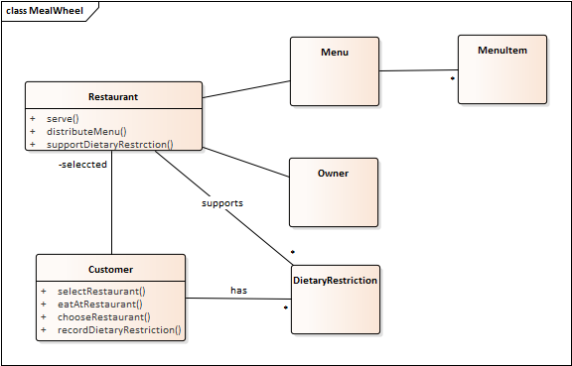
Nouns & verbs
Nouns:
Student
Phone
Restaurant
Where to eat
Sashimi Menu Item
Place Location
10-minute walk Distance
Owner
Menu
Food selection Menu Item
Customer
Dietary Restriction
Verbs
Select [restaurant]
Eat [at restaurant]
Suggest [close restaurants]
Serve [sashimi]
Choose [a place to eat]
Distribute [menus]
Know [of dietary restrictions]
Support [dietary restrictions]
Attract [customers]
Next: construct a (domain level) class diagram
No types, no getters/setters,
Minimal attributes
All in the language of the client

Slide 14
A more detailed design process…
Start with domain classes
These persist across problem changes
Capture things clients, users will recognize
Capture requirements that go with those items
Explore interactions through sequence and state diagrams
Add containers, architectural elements
Decisions about time/space/complexity tradeoffs
Databases, network communications, GUI elements
Introduce design patterns, refine
These generally reduce coupling, increase flexibility
May REMOVE classes from previous steps
Be careful about removing domain classes!
Notes:
Might remove a domain class, but document why, especially where it’s responsibilities have moved

Slide 15
How to define a class?
One solution: responsibilities
What the class provides to the rest of the system
What are the responsibilities of…
A house?
A roof? door? window?
Bank account?
Student record in registration system?
How many responsibilities should a class have?
Could say “just one,” but what would happen if Student had just 1?
Responsibilities: clear, limited, but complete!
At least one, usually not more than three
Notes:
What are some other ways to define objects?

Slide 16
Common issues
“doit” class: does everything
Generally surrounded by lots of passive objects
Often has one or two large, impossible-to-reuse methods
System class – little need to document (the Java-specific) main()!
Often becomes a doit class
High level design diagrams should be language-independent
Focus on domain, not solutions
Classes for actions
“parser”, “artificial intelligence”, “list maintainer”
Roll these into domain objects!
Patterns excepted!

Slide 17
Common issues
Software Design Principles, Ch. 3:
Favor (object) composition over (class) inheritance
Example:
class StrictStringStack {
private List<String> items = new LinkedList<String>();
public void push(String x) { items.add(x); }
public String pop() { return items.pop(); }
}
Avoid abbreviations unless very common
Abbreviations mean having to remember yet another thing
Correct spelling matters!
Follow standards
Typically capitalize class names, lower case methods/attributes
Plural names – objects are instances
A group of students: a roster
Poor inheritance
If A extends B, then anywhere a B can appear, so can an A
Liskov Substitution Principle – see Ch. 5 of Software Design Principles
Never violate contracts
Example: deriving Stack from List
Can sort a list
Eg: put items in alphabetical order
Should we be able to sort a stack?
If class Stack extends List …
Then following is legal:
Stack todo = new Stack(); …
sort(todo);
Notes:
Plural names: Menu, not Menus (even though will have multiple menus in system – that’s what * is for)
“Favor composition over inheritance” is another way to think of LSP

Slide 18
Example #1: domain model for…
As a student, I would like to take a quiz so I have an opportunity to learn the material through studying.
As an instructor, I would like to create quizzes with multiple choice and short answer questions so I can check students’ knowledge.
As an instructor, I would like to grade answers to questions so I can find out how much each student knew about the material in the question.
As an instructor, I would like the system to suggest possible scores for questions so I can grade quizzes more quickly.
As a student, I would like to see the total score and the response feedback so I can evaluate how well I studied.
As an instructor, I would like to allow multiple answers to short answer questions so I can avoid checking each manually.

Slide 19
Example #2: domain model for…
As a student with limited vision, I would like to be able to navigate around MSOE without having to be lead by another student or service animal.
As a student with limited vision, I would like to receive directions on my smart watch while following a route so I know when to turn left or right in a building.
As a student, I would like to be able to enter my class schedule into my calendar with room numbers so I know where to be at the right time.
As a student, I would like to have my smart watch plan a route to the next class so I know how to get to that class at the start of the term.
As a student, I would like routes to follow hallways so I am not walking through other classrooms, especially if classes are in session.
Notes:
First story: an “epic” – it’s really a full system, not a piece of one

Slide 20
A more systematic definition
Domain objects: problem space objects
Is there a way to identify these more systematically?
Starting point: objects are things
This includes physical things – building, street
Also some concepts: account, payment transaction, committee meeting
Notes:
Objects are things: they abstract physical objects (a city) as well as concepts (an account, a committee meeting)

Slide 21
A more systematic definition
Things exist, can change, provide utility:
Each object has a state
Captures information, provide it on request, record events
Student: name, id, classes taken or are taking, GPA
Sometimes implied by behavior: light bulbs can be turned on & off
Each object has behavior
Operations that do things; sometimes implied by state
Student: compute GPA for term, add a class to schedule
Sometimes implied by state: a roster can be listed
Each object has responsibilities
What the object provides to the rest of the system
Student: record classes taken, track status of accounts, track overall status

Slide 22
A more systematic definition
Often confused: responsibilities and behaviors
Responsibility: duty to the rest of the application
Behavior: the action
That is: behavior is what an object does, responsibility is what it is expected to take care of
Example: what are the responsibilities of the fielder at first base in baseball?
Would you expect the first base player to field left field flies?
What are that player’s behaviors?
Things exist, can change, provide utility:
Each object has a state
Captures information, provide it on request, record events
Student: name, id, classes taken or are taking, GPA
Sometimes implied by behavior: light bulbs can be turned on & off
Each object has behavior
Operations that do things; sometimes implied by state
Student: compute GPA for term, add a class to schedule
Sometimes implied by state: a roster can be listed
Each object has responsibilities
What the object provides to the rest of the system
Student: record classes taken, track status of accounts, track overall status

Slide 23
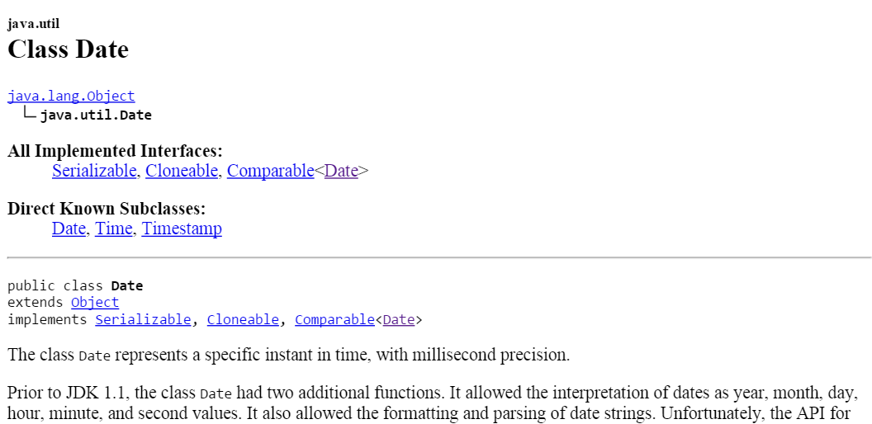
Responsibilities are the key to understanding classes, but…
What is the responsibility of java.util.Date?
See first line of Java API
Milliseconds from when?
If time is a construct, this represents a concept, not a thing
Date objects have state, behavior, and responsibilities, but…
They are concepts, not ”real” objects
Likewise for the Java class Math…
We need another condition
Notes:
With my Unix mindset, I might count milliseconds since Jan. 1, 1970. You might count milliseconds since (or before) your birth.

Slide 24
What’s a domain object, continued…
An object has identity
Something you can point at
A street address: text
A building: a specific building at a specific location
Helps distinguish between pieces of information about something (color, name, identification number, temperature) and the things that have that information (people, hurricanes, cars, Campus Center)
Objects without identity: attributes
Examples: colors, names, addresses, numbers – all are concepts
“Red” can appear in multiple places
Contrast to Student: just one instance of each student in a system

Slide 25
MealWheel example
Nouns:
Student
Phone
Restaurant
Where to eat
Sashimi Menu Item
Place Location
10-minute walk Distance
Owner
Menu
Food selection Menu Item
Customer
Dietary Restriction
Verbs
Select [restaurant]
Eat [at restaurant]
Suggest [close restaurants]
Serve [sashimi]
Choose [a place to eat]
Distribute [menus]
Know [of dietary restrictions]
Support [dietary restrictions]
Attract [customers]
Another example: a “Distance” object in MealWheel makes no sense because it does not have identity – it’s an attribute

Slide 26
What characterizes a domain object
An object is something with
Responsibility
Identity
Behavior
State

Slide 27
What characterizes a domain object
An object is something with
Responsibility
Identity
Behavior
State
Objects not meeting RIBS: attributes or otherwise non-domain objects
System, colors: no identity
Dates: no changeable state: March 3 and March 4 are completely different dates
Classes: a template for new objects
Allows creating many objects with very similar behavior, responsibilities
Abstractions of particular objects: a general car, bus, vehicle
Domain classes: abstractions of domain objects

Slide 28
Sound designs
Start with domain classes (satisfying RIBS)
These persist across problem changes
Capture things clients, users will recognize
Capture requirements that go with those items
Explore interactions through sequence and state diagrams
Add containers, architectural elements
Decisions about time/space/complexity tradeoffs
Databases, network communications, GUI elements
Introduce design patterns, refine
These generally reduce coupling, increase flexibility
May REMOVE classes from previous steps
Be careful about removing domain classes!
Notes:
Might remove a domain class, but document why, especially where its responsibilities have moved

Slide 29
Review
Preference for domain classes over solution-space (implementation-specific) classes
Noun identification method
Doit, passive classes and their dangers
Liskov Substitution Principle
RIBS: responsibility, identity, behavior, state
A tool for identifying domain objects, classes

Slide 30
Working in teams
(Assumption: have a partner-based assignment due soon…)
Basic rules:
No, you don’t have to implement everything yourself
If necessary, you will be graded separately
Make sure what you submit does run and has (documented!) behavior
Help your instructor: document what the system does not do
If partner fails to complete something on time
Don’t panic, they may well get to later; just ensure your part is gradable
They often do, and late penalties can be applied to just one team member (tell us!)
Key: over-communicate
Send multiple messages describing progress as time gets short
Tell your partner about changes in plans
Respond to messages right away so your partner knows you know what they said!

