Slide 1
Note 1 CSC 2210: Why?
CSC 2210 Procedural and Object-Oriented C++
Copyright © 2016, 2023, 2025 Robert W. Hasker

Slide 2
Java is the best language
What are good things about Java?
Key goal: “write once, run anywhere”
Highly portable
Another win: checks for common errors like array indices
Improves portability; errors would lead to results depending on the machine
How do we handle some computers having more memory?
Solution: automated garbage collection
If run out of memory, automatically reclaim parts no longer in use
So why not use Java for all projects?
Notes:
Things students might mention:
Runs anywhere
Runtime checks make it easier to learn programming
Simple model: all data stored as objects or as simple values

Slide 3


Java is the best language?
Issue: automated garbage collection takes time
Must search memory to find parts not in use
Worse: it can happen at any moment
What are some applications where this would be a problem?
Video Games?
Imagine a freeze half-way through dealing with hundreds of opponents
Aircraft
Would you want garbage collection to start while landing?
Nuclear reactor control?
Running Java? How is the JVM implemented?
Other overhead
Run-time checks: useful, but take time
Do you want these checks for Rosie matrix operations?
Note: Python has the same issues
But it is usually interpreted, so even slower
Notes:
JVM is typically written in C or C++; RWH’s research as of Sept 2024:
Based on the article and a check of OpenJ9:
HotSpot, supported by Oracle: C++ and assembly
OpenJ9: C, C++, asssembly
JRockit: C + Java
Squawk: C++
Harmony: C++ and Java
Image of plane from https://i0.wp.com/mechstuff.com/wp-content/uploads/2015/09/FA-18_going_transonic-e1441897209245.jpg?fit=1236,900&ssl=1
Explain the memory management issue – running out of memory, needing to collect unused bits

Slide 4
Why can’t Java and Python do it all?
Another issue: programming languages must reflect how programmers think!
This is the motivation for OO: the real world has objects, let’s reflect them in code
Business systems: need to reflect accounting procedures – e.g. Cobol
Very high performance: multiple processors, new models
Converting to/from objects is unnecessary overhead
Apply operations to large amounts of data, even infinite streams
Functional programming: ideal for this model
Note: Python supports functional programming as does Java, but there are too many non-functional components to fully optimize
Key issue for software developers: learning new languages/platforms

Slide 5
... and there are LOTS of languages!
What languages have you used on internships?
Languages your faculty have used with (paying) clients:
How many languages do you think there are?
Ada | C# | Pascal | D
MIPS assembly | Cobol | Python | x86 assembly
C | Fortran | Ruby | Erlang
C++ | Lisp | SQL | Scala
See this page from a history of programming languages

Slide 6

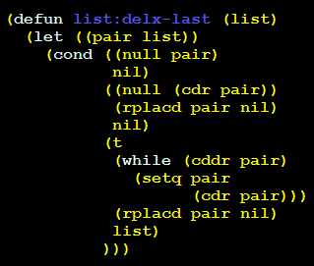
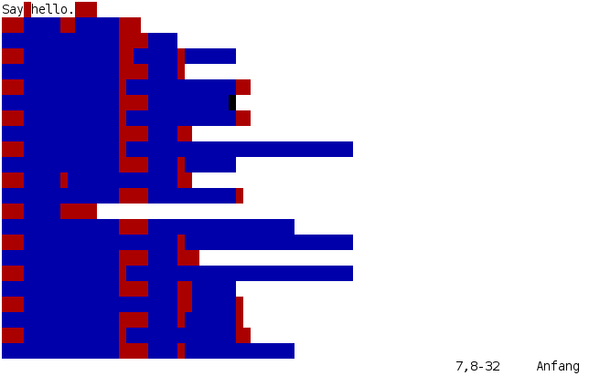
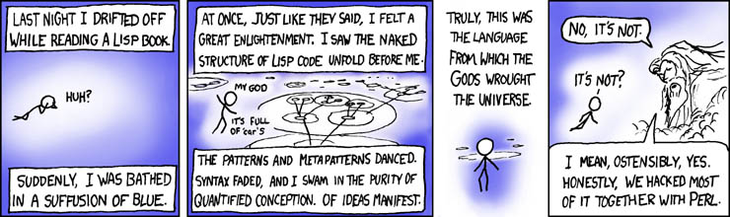
More Esoteric languages
Piet
APL:
Whitespace
xkcd.com/224/

Slide 7

Odd languages
Shakespeare
The Infamous Hello World Program.
Romeo, a young man with a remarkable patience.
Juliet, a likewise young woman of remarkable grace.
Ophelia, a remarkable woman much in dispute with Hamlet.
Hamlet, the flatterer of Andersen Insulting A/S.
Act I: Hamlet's insults and flattery.
Scene I: The insulting of Romeo.
[Enter Hamlet and Romeo]
Hamlet:
You lying stupid fatherless big smelly half-witted coward!
You are as stupid as the difference between a handsome rich brave
hero and thyself! Speak your mind!
You are as brave as the sum of your fat little stuffed misused dusty
old rotten codpiece and a beautiful fair warm peaceful sunny summer's
day. You are as healthy as the difference between the sum of the
sweetest reddest rose and my father and yourself! Speak your mind!
You are as cowardly as the sum of yourself and the difference
between a big mighty proud kingdom and a horse. Speak your mind.
Speak your mind!
[Exit Romeo]
Piet
Notes:
Shakespear: hello world written as a play with scenes.

Slide 8
Informal goals for this course
Discuss other ways to think about programming
In particular, how high-level, abstract concepts are implemented
We cannot program at the lower levels, that leads to content coupling/unexpected results
Understanding the low level helps debugging, predict performance, better understanding of high-level concepts
Cover two new languages, C and C++
Learn something about learning new languages
Starting point: procedural C++

Slide 9
Course Structure
See syllabus
4 lectures per week, but writing code a key part of the course
SPA: Structured Programming Assignment
Detailed requirements, strong testing, meet coding standard
Plan: approximately 1 class each week for work on SPAs, etc.
Textbook: reading exercises to reinforce material
Some readings will be assigned before class so class can focus more on problem solving
These will be linked from Canvas

Slide 10
Review
Motivations for new languages
High performance
Control of hardware
Strong abstraction
Capturing how programmers think to solve various problems
Structure of the course
Next: C++ 101 – procedural programming in C++

