Slide 1
Note 3
Computers 101
CSC 2210 Procedural and Object-Oriented C++
Copyright © 2023 Robert W. Hasker

Slide 2
What do you know?
How is information stored on a computer?
What are the major components of a computer?
What are the primary types of storage on a computer?
How are programs stored?
How is a program executed?
Give examples of individual instructions

Slide 3

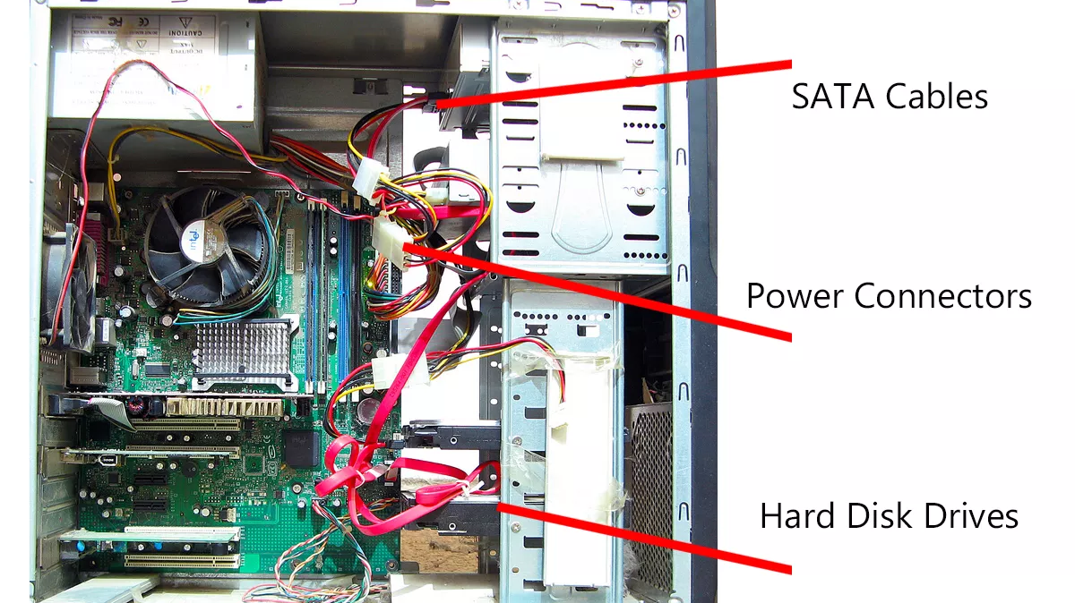
Textbook: great overview of how computers work,
but what’s inside the box?
Power supply
Motherboard
Notes:
Images captured from https://www.lifewire.com/tour-inside-a-desktop-pc-2624588
This page: photo by Asim Bijarani / Flickr / CC-BY-2.0

Slide 4
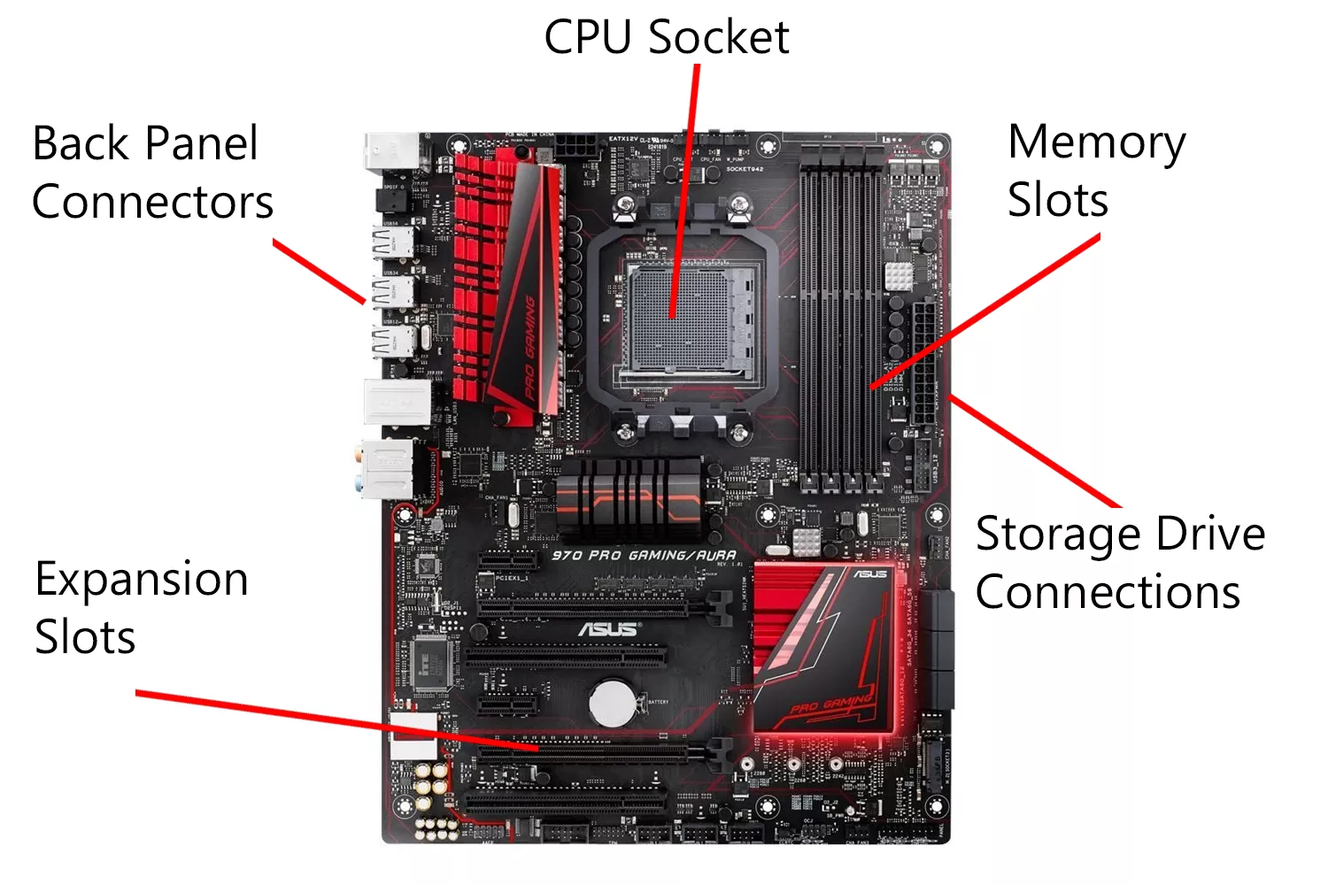
(Central Processing Unit)
Notes:
Photo from Amazon

Slide 5
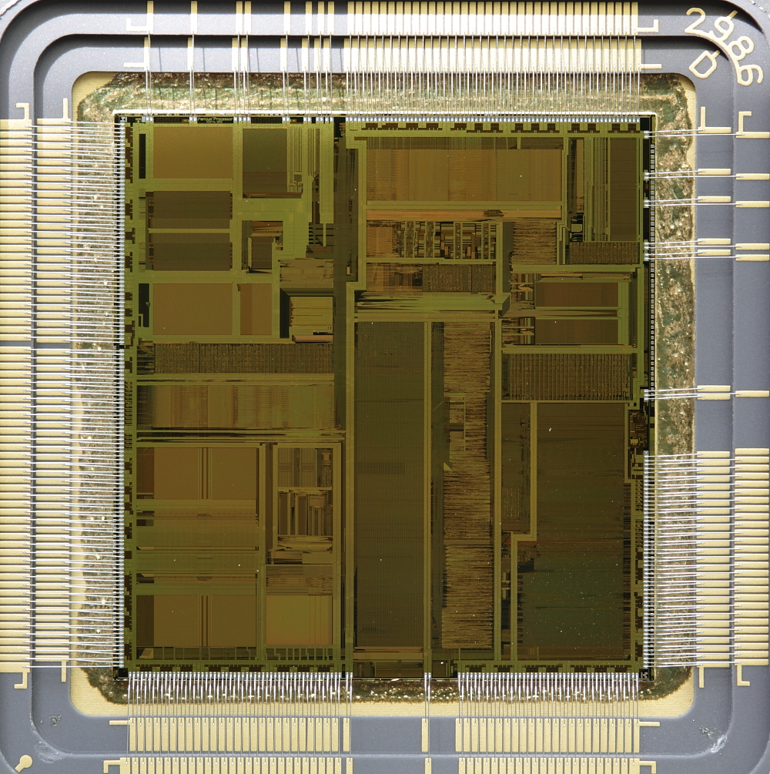
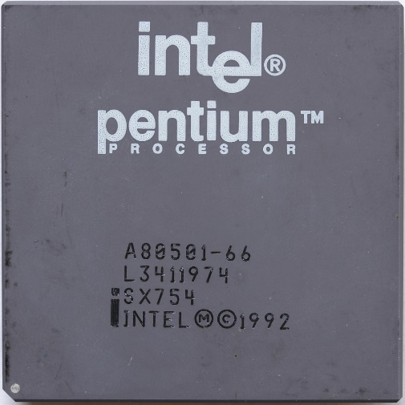
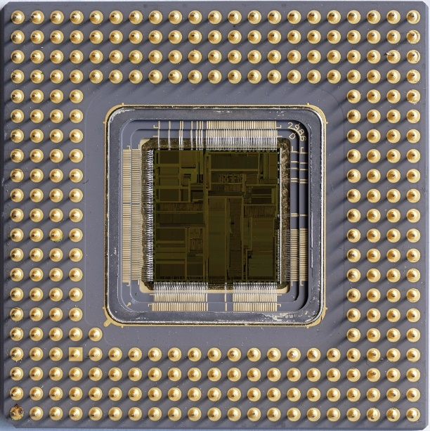
CPU – package, internals
Notes:
Images from https://notabs.org/pictures/intel-pentium-p5/
For more images, see https://en.wikipedia.org/wiki/Central_processing_unit

Slide 6
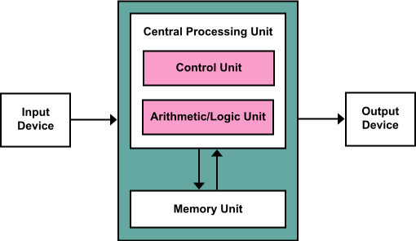
Schematic view
Memory: data store
Input: long term storage (eg, SSDs), network ports, mouse, keyboard
Output: long term storage, display, various lights
Control: what happens when
ALU: basic math
Often known as the Von Neumann architecture – first described by his group in 1945
  Sometimes also known as the “common architecture”
  Dominates computing even today
Notes:
Image from https://en.wikipedia.org/wiki/Von_Neumann_architecture; see https://en.wikipedia.org/wiki/First_Draft_of_a_Report_on_the_EDVAC for link to where von Neumann architecture described (though note other people also contributed to this!! – von Neumann tried to give them credit, but the publisher failed to include all of the appropriate names)

Slide 7
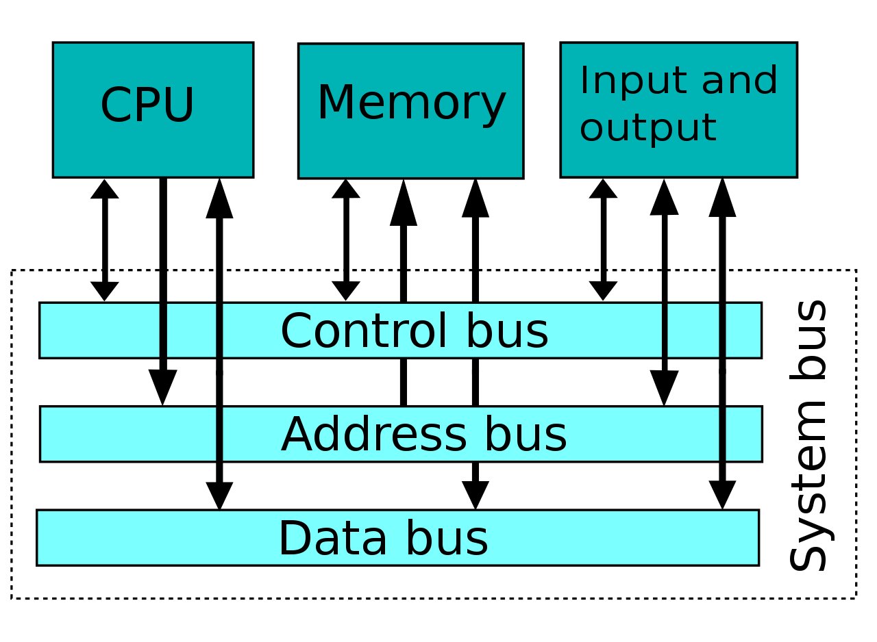
Basic mechanism for transferring data
More precisely, the system bus
General model: to transfer data from (say) CPU to RAM:
  put the address on the address bus,
  value on the data bus,
  set control line to indicate cpu->memory
Bus width: generally, one bit (0 or 1) per line
Each line costs, but more information at a time gives faster performance
Word size: typically matches the size of address and data bus
Notes:
Image from https://en.wikipedia.org/wiki/System_bus

Slide 8
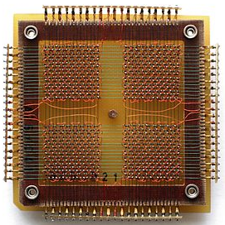
Magnetic-Core Memory
In use from about 1955 to 1975
  Magnetic ring at each intersection
  Write: send power on one X and one Y wire to flip one magnet’s field
  Read: use induction to determine direction of field
Manufactured by hand!
Keeps values even if lose power
  Can run code on powerup – no boot
This is why we often refer to memory (RAM, ROM) as “core”
This core: 32 by 32 magnets
32 * 32 / 8 = 4 * 32 = 128 bytes!
https://en.wikipedia.org/wiki/Magnetic-core_memory
Notes:
Image on white from Wikipedia Commons, https://commons.wikimedia.org/wiki/File:KL_CoreMemory.jpg
Interesting discussion (and where the picture is apparently from: https://www.amusingplanet.com/2020/02/that-time-when-computer-memory-was.html )

Slide 9
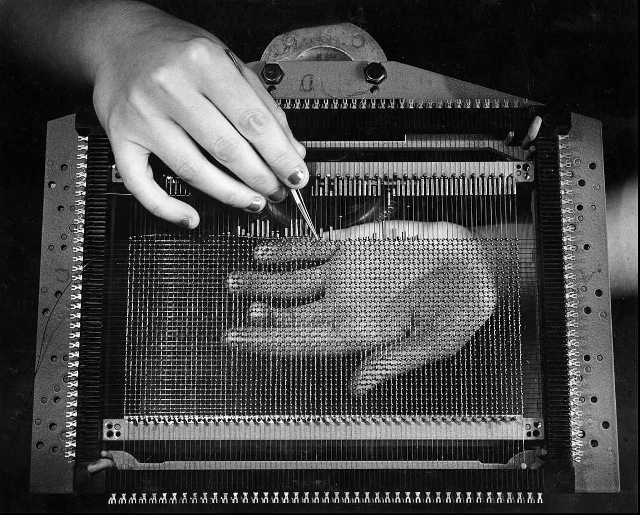
Magnetic-Core Memory
In use from about 1955 to 1975
  Magnetic ring at each intersection
  Write: send power on one X and one Y wire to flip one magnet’s field
  Read: use induction to determine direction of field
Manufactured by hand!
Keeps values even if lose power
  Can run code on powerup – no boot
This is why we often refer to memory (RAM, ROM) as “core”
Ansel Adams
Notes:
Image from https://www.facebook.com/anseladamstrust/photos/hands-weaving-magnetic-core-memory-ibm-poughkeepsie-new-york-1956-photograph-by-/1071657868112786/
An IBM promotional picture taken on assignment by Ansel Adams
The facebook thread pointed out the women were from the Phillipines and IBM had to build a dormitory to house them.

Slide 10
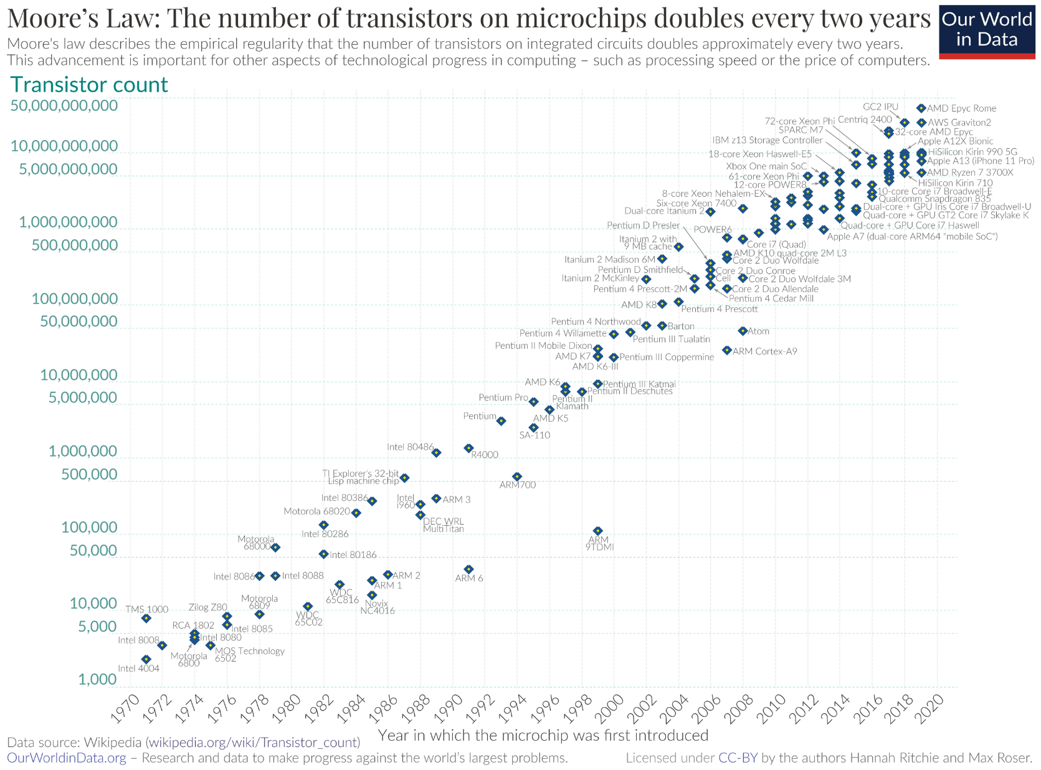
Issue: Speed of light
About 3e8 meters per second in vacuum
  97% fewer meters pre second in copper
In a billionth of a second (a nanosecond), light travels 11.8 inches
  Fast, but not instantaneous!
Clearly a problem with old magnetic cores!
  But even a problem with very short (nanometer-scale) wires!
Question: how much work can we get done in (say) 11.5 inches?
  Compare to a processor that might be ¼ inch on a side…
  More detail: work done by series of gates built from transistors, etc
Notes:
Grace Hopper explains a nanosecond: https://kottke.org/19/05/grace-hopper-explains-a-nanosecond
Yes, it’s 299792458m/s in vacuum, but engineers often use 3e8 for computations
Image of Moore’s law from https://en.wikipedia.org/wiki/Moore's_law – ackmowledge that this is slowing quickly 2 decades later
uploaded from Max Roser, Hannah Ritchie from https://ourworldindata.org/uploads/2020/11/Transistor-Count-over-time.png with UploadWizard

Slide 11
Issue: Speed of light
About 3e8 meters per second in vacuum
  97% fewer meters pre second in copper
In a billionth of a second (a nanosecond), light travels 11.8 inches
  Fast, but not instantaneous!
Question: how much work can we get done in (say) 11.5 inches?
  Compare to a processor that might be ¼ inch on a side…
  More detail: work done by series of gates built from transistors, etc
Impact: transferring data from/to processors is relatively slow
Key point: where data is stored is critical to computations!
  Minimize transfer from/to RAM
Notes:
Grace Hopper explains a nanosecond: https://kottke.org/19/05/grace-hopper-explains-a-nanosecond
Yes, it’s 299792458m/s in vacuum, but engineers often use 3e8 for computations

Slide 12
Solution: on-CPU (“on-chip”) memory
Register
  Very high speed – feeds directly to arithmetic logic
  Typically: all computations involve registers, though sometimes hidden
  Limited number: 8, 12, 16, 32, 64, etc.
On-CPU Cache: copies of recent values in memory
  Managed by CPU, avoids unnecessary reads/writes on bus
Our focus: registers
  Cache is important to optimization, but not programmers
  Basic way code is executed: load values into registers, compute result, store register to memory

Slide 13
Register sizes
Typically: register size is the machine’s word size
  Eg: 32-bit, 16-bit, 64-bit, but there are 8-bit, 24-bit processors
  Can have register = half-word – early 16-bit processors did this, but not common
A bit: 0 or 1
  Represented by high/low voltages in a circuit
  For example,
    logical zero: up to 0.8 volts
    logical one: might be 2 volts or more
  Circuit design: ensuring correct logical values – programmer can ignore these
What is a byte, nibble?
How to represent an integer as a sequence of bits?
Notes:
END OF LECTURE 1 (on this topic)

Slide 14
Review
Name 4 classes of memory on personal computers and compare the performance of each
What controls the word size on a machine?
What is a bit?
Why is computer logic hardware bit-centric?
Today: how to represent numbers as “bit strings” (that is, sequences of bits)

Slide 15
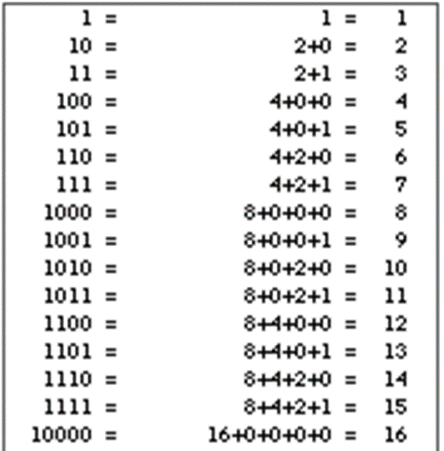
Binary ↔ Decimal
How do we count in binary? - Count 0-10
  How does this relate to decimal?
  What does 3284₁₀ “mean”?
What is the decimal value of 1011₂?
  What is the algorithm to convert from binary to decimal?
How to convert from decimal to binary?
  Assume need “most significant” bit first – bit for highest power
  Solution 1: compute remainders of dividing by two until reach 0, read bits backwards
  Solution 2: find largest power of two that fits, subtract, repeat
Notes:
Binary to decimal: one’s place, two’s place, four’s place, eight’s place, etc.
Decimal to binary: divide by 2, read bits backwards

Slide 16
Binary ↔ Decimal
Example: binary value for 43₁₀:
  Powers of two: 32 (remainder 11), 8 (remainder 3), 2 (remainder 1), 1
  = 101011
  Remainder method:
    43 / 2 = 21 r 1
    21 / 2 = 10 r 1
    10 / 2 = 5 r 0
    5 / 2 = 2 r 1
    2 / 2 = 1 r 0
    1 / 2 = 0 r 1
Why does the remainder method work?
If we have N, what is the rightmost digit in base ten? N % 10
What is the next digit? (N / 10) % 10
Next? (N / 10 / 10) % 10
The remainder method for binary is doing the same thing…
Notes:
See https://math.stackexchange.com/questions/2463620/why-does-the-method-of-converting-from-decimal-binary-by-taking-remainder-work for a discussion of why the remainder method works

Slide 17
Binary ↔ Decimal
Related issue: how to represent the data in memory
  Is the first bit the one’s place or the highest power of two? – almost always have one’s place to the right
  But how to order bytes in a word? Left to right, right to left?
Big-endian vs. little-endian representation of data
  Big-endian: left-to-right order of bits
    This course typically just uses left-to-right; it’s simpler to remember
  Reference to Gulliver’s Travels, whether people break an egg shell starting at large end or small end (big-end vs. little-end)
  A similar issue is relevant for the order of bytes within a word
  Important to circuit designers, data transmission, but not general computing!
Know: how to convert with MSB to far left!
Notes:
Binary to decimal: one’s place, two’s place, four’s place, eight’s place, etc.
Decimal to binary: divide by 2, read bits backwards
Big vs little endian: important terms for computer engineers, but not so useful for more abstract computing!

Slide 18
Examples
Binary of 1178 (compute by long hand, dividing by 2’s)
Compute binary of 35, 81
Add them
How many bits in the result?
What if the word size is just large enough for 42, 35?
What do we get if we multiply the values?
Processors: carry bit, overflow bit (flags)
Notes:
END OF LECTURE 2

Slide 19
Question, how to represent negatives?
Simple model: sign bit followed by number
  Problems: two representations for zero, lots of cases for addition/multiplication
1’s Complement: negatives = the complement of positive values
  “Complement”: flip all bits
  Eg: 1’s complement of 01101₂ (13) is 10010, so this represents -13
  Challenge: still have multiple cases for addition
2’s Complement: complement and add one
  Eg: -01101₂ (for -13) would give 10010 + 1 = 10011
  MSB = 0: positive; 1: negative
Write table for -8 to 7
Notes:
Table:
7: 0111
6: 0110
5: 0101
4: 0100
3: 0011
2: 0010
1: 0001
0: 0000
-1: 1111
-2: 1110
-3: 1101
-4: 1100
-5: 1011
-6: 1010
-7: 1001
-8: 1000

Slide 20
2’s complement math
13 + -12:
  -12: inv(1100₂) + 1 = 0011 + 1 = 0100
  13: 1101
  Add: 0001 (with 1 carry) – positive result = 1
12 + -13:
  12: 1100₂
  13: inv(1101) + 1 = 0010 + 1 = 0011
  Add: 1111 = -1
Negating 0: inv(0000) + 1 = 0000
  Advantage: 0 and -0 have same representation
Notes:
Image from http://www.mathmaniacs.org/lessons/01-binary/Magic_Trick/

Slide 21
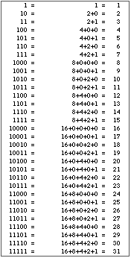
2’s complement math
13 + -12:
  -12: inv(1100₂) + 1 = 0011 + 1 = 0100
  13: 1101
  Add: 0001 (with 1 carry) – positive result = 1
12 + -13:
  12: 1100₂
  13: inv(1101) + 1 = 0010 + 1 = 0011
  Add: 1111 = -1
Negating 0: inv(0000) + 1 = 0000
  Advantage: 0 and -0 have same representation
Notes:
Image from http://www.mathmaniacs.org/lessons/01-binary/Magic_Trick/

Slide 22
More examples
See https://sandbox.mc.edu/~bennet/cs110/tc/index.html

Slide 23
Range of values
The range of 4-bit values: -8 to 7
  Largest positive 4-bit value: 0111 = 7
  Largest negative 4-bit value: 1000 = -8
The range of 16-bit values: -32768 to 32767
  Why? (review the bit patterns)
General formulas: 2^{n-1} – 1 down to -2^{n-1}
  Always one more value in negative space vs. positive space
  Oddity of 2’s complement: unequal ranges
  What is the range for 32-bit registers?
Summary:
  Computer (logical) circuits: low/high voltage for zero, one
  Represent numbers in binary
  Most common binary representation: 2’s complement

Slide 24
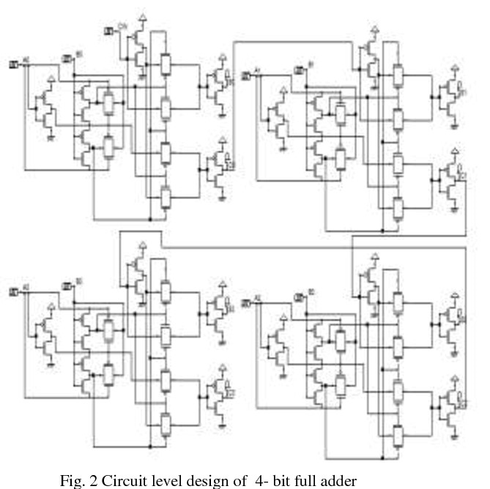
4-bit full adder
Adds two four-bit numbers
Not all that many components to build!
Full adder with both carry-in, carry-out
Later, we will discuss a solution based on logic gates
Notes:
Full adder: handles carry bits; don’t memorize the diagram (this is just one example), but observe how it does not take a lot of components (typically, transistors, resistors, & diodes) to construct such a circuit.
From https://www.semanticscholar.org/paper/Efficient-Layout-Design-of-4-Bit-Full-Adder-using-Yadav-Mehra/c0772414c13a27b564b6074cb1a9100df5a214bb/figure/3
Efficient Layout Design of 4-Bit Full Adder using Transmission Gate
Anurag Yadav, R. Mehra, M. Scholar
Published 2015
DOI:10.14445/22312803/ijctt-v23p125

Slide 25
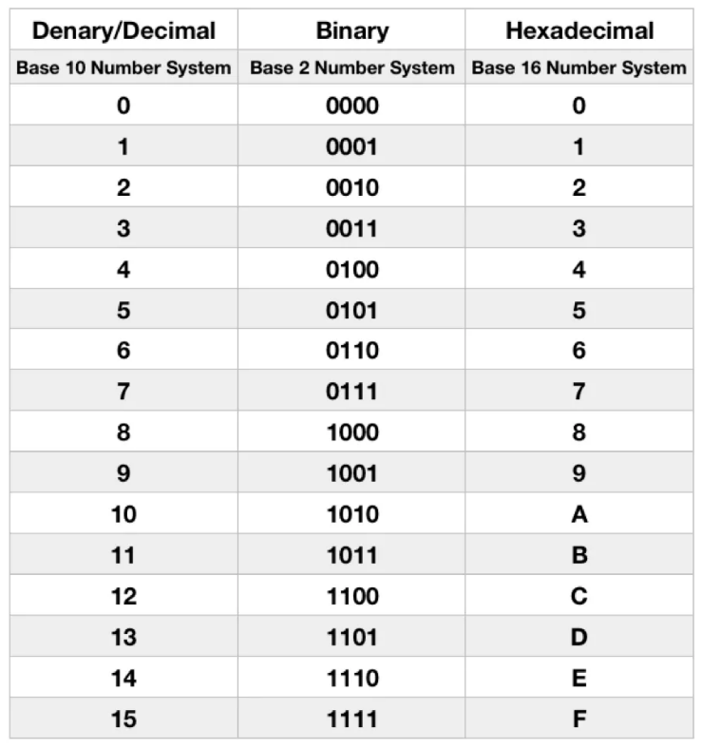
Hexing our data
How to represent binary values in code?
In C, C++ (and many others): put 0b at the front:
  0b11111100111
But what is this number?
  Compute!
  But often we don’t need the decimal value!
  Example: bits 0, 3, 5 control whether three LEDs are lit
Solution: Hexadecimal – base 16
  Why base 16? Why not 12? 48?
  This number in hex (as written in C, C++): 0x7E7
You will sometimes see octal values (written with leading 0): 03747
  Can also use \ in characters: ‘\007’ (BEL), ‘\177’ for DEL
ASCII charts: typically decimal, hexadecimal: see https://ss64.com/ascii.html
  Note the patterns between within the table: ^A to A is +0x40, A to a is +0x20, ^[ to [, etc.
Note: we often show data in hex, but the computer does all computations in binary!
Notes:
… it’s the 1st year this course was offered: 2023

Slide 26
Hex away
What is 0x29 in decimal?
  2 * 16 + 9 = 41
  In binary: 0b00101001
What is 0x38a in decimal?
  3 * 16² + 8 * 16 + 10 = 3 * 256 + 8 * 16 + 10 = 906
Suppose we have 8-bit, 2s-complement values; what is 0xA5?
  In bits: 10100101
  High order bit is set, so have a negative value
  Convert to positive: 01011010 + 1 = 01011011, or 0x5B, or 5 * 16 + 11 = 91
  0xA5, interpreted as 2s-complement, is -91
Compute 8-bit hex value for -50, assuming 2s-complement:
0xCE

Slide 27
Review
Examine internals of computer, particularly basic system structure
Bit: smallest unit of value in logical circuits: either on or off
Byte, word: collections of bits
  Word: typically size of bus, registers in computer, size of address
Binary to decimal, decimal to binary
1’s complement: multiple values for zero, many cases to add/subtract
2’s complement: efficient to implement, single zero, no cases
Different ways to represent binary data in code

